Slide 1
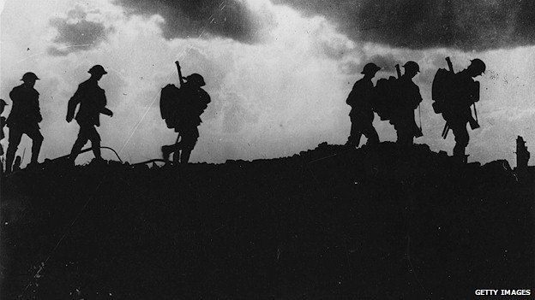
Subtitle
WWI: Home Front and Outcomes

Slide 2
The Home Fronts in Europe
Soldiers received little sympathy from civilians
Governments grew and took power of elected parliaments
Newspapers and media were censored
Suppression of criticism
Propaganda was widely used
Labor groups voice dissatisfaction
Weakens Germany
Russia falls

Slide 3
Women in the War
Women emerge in the workforce during war
Defy gender roles
Give women more liberation
Many women were forced back into the homes after the war ends
Women in Britain, Germany, and the US gained the right to vote by 1918

Slide 5
The War outside Europe
1915- war spread to the Middle East, west & east Africa, China, India
1917- the US enters the war
Unrestricted Submarine Warfare
Zimmerman Telegram
Britain’s participation contributed the most to the globalization of the war
British navy was able to blockade the Central Power’s supplies
Imperial resources
Colonial manpower

Slide 6
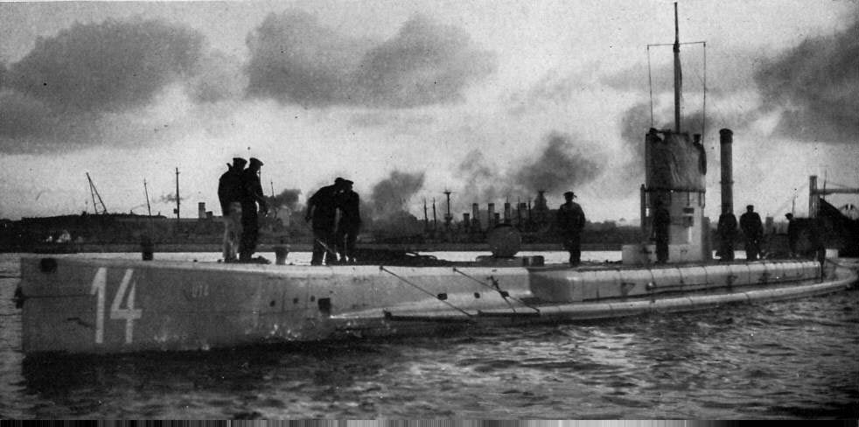

Slide 7
French- use support in Africa, India, and southeast Asia
Relied heavily on non-European soldiers from Africa
Ottoman Empire
Young Turk leaders
Blame Christian Armenians for reverses on the Russian front
Armenian Genocide occurs in 1915
Japan joins the British and fights the Germans in China and the Pacific
US business profits by selling goods to the Entente

Slide 8
The End Game
November 11, 1918 Germany agrees to an Armistice
Many Germans believed that they had been betrayed by socialists and Jewish politicians
“Stab in the back” will be the rallying cry for Adolf Hitler and the Nazis’ drive to power in the 1920’s
The cost of war was widespread
Farmlands and cities were reduced to ruins
The devastation and postwar economic downturn led to an economic depression in Europe in the 1920s

Slide 9
The Major Players
Georges Clemenceau
French Prime Minister
Wanted Germans to pay reparations
reduce size of German nation and spread its resources
David Lloyd George
British Prime Minister
Feared reducing Germany would lead to the spread of Communism
Woodrow Wilson
American President
Self-determination of colonized peoples

Slide 10
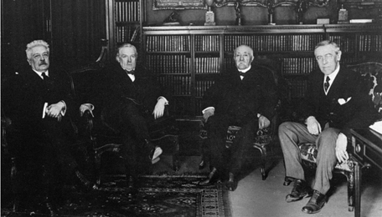

Slide 11
Failed Peace
Peace of Paris aka Treaty of Versailles (1919)
Big Four
Wilson, George, Orlando, & Clemenceau
Dictated peace without negotiations
German war guilt clause
Reparations
Loss of territory
Dismemberment of Austria-Hungary
Creation of Czechoslovakia, Hungary, & Yugoslavia
Poland becomes independent

Slide 12
