Slide 1
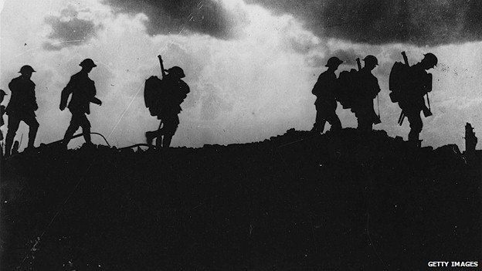
Subtitle
World War I: Causes

Slide 2
Background
From 1914 to 1918 World War I raged in Europe
This “Great War” was the largest, most destructive war the world had yet seen
WWI was a global war that altered the course of the 20th century

Slide 3
M.A.I.N Causes for WWI
From 1870 -1914 a number of developments gradually increased tensions in Europe
These would lead to the outbreak of the war
M- militarism
A- alliances
I- imperialism
N- nationalism

Slide 4
Militarism
The Industrial Revolution=arms race among European powers.
Particularly Germany and Great Britain
Dreadnoughts (naval ships)
Nations glorified military power and kept an army prepared for war.
Leads to strong patriotic feelings

Slide 6
Imperialism and Nationalism
European powers divided the world amongst themselves.
Wanted resources for growing industries and wealth
This leads to conflicts at home and abroad
Nationalism increased due to imperial ambitions and militaristic ideology
Leads to a change in the balance of power.

Slide 8
The Powder Keg
The greatest tension in Europe was in the Balkans
Greece, Serbia, Bulgaria, Albania, and Romania all broke away from the Ottoman Empire
Pan-Slavism- Slavic peoples wanted to unit and create an independent nation
1908- The Austro-Hungarian empire annexed Bosnia and other predominantly Slavic nations
This leads to tensions in the Region

Slide 9
The Spark
June 1914- Austro-Hungarian Archduke Franz Ferdinand and his wife visited Sarajevo, Bosnia.
Assassination
Seven individuals attempt to assassinate the Archduke
Gravillo Princip-
Bosnian Serb
Shoots Ferdinand and is captured

Slide 10
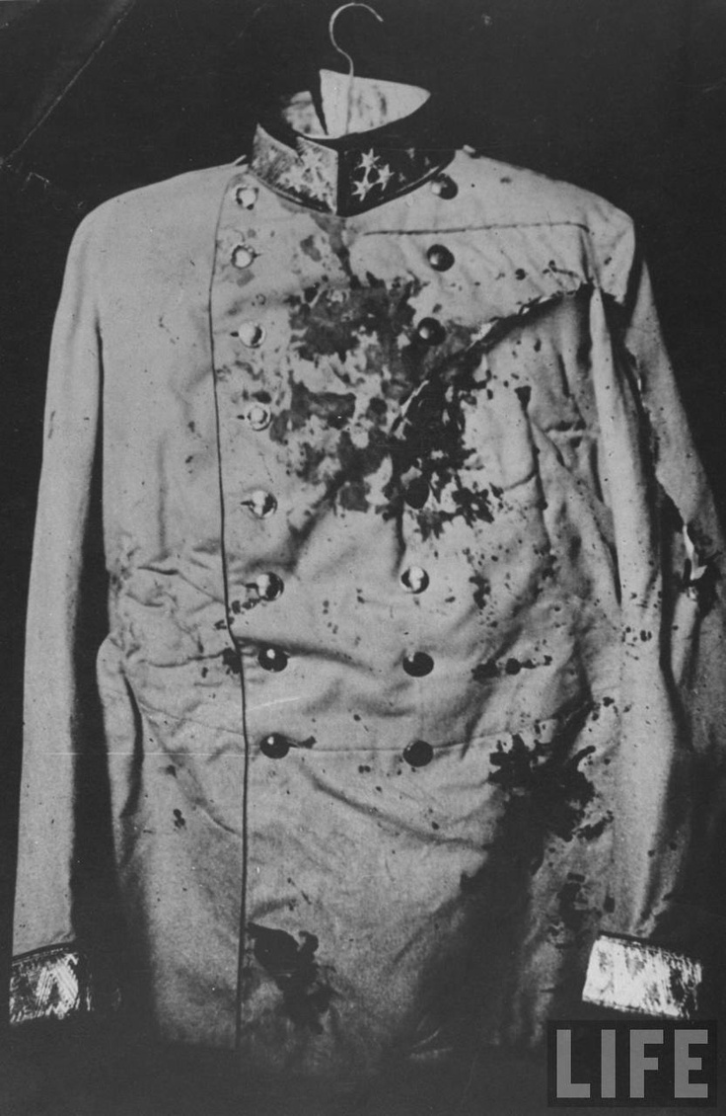
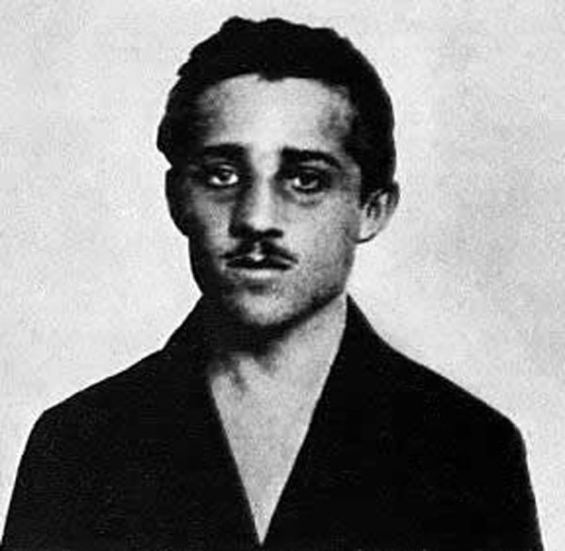
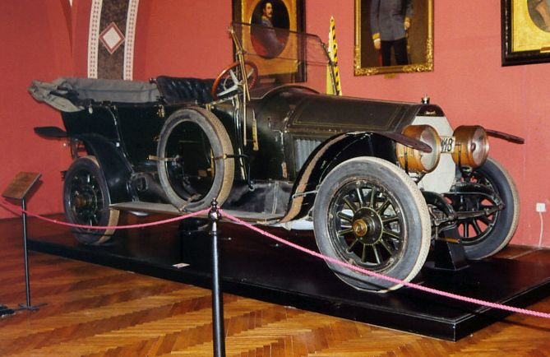
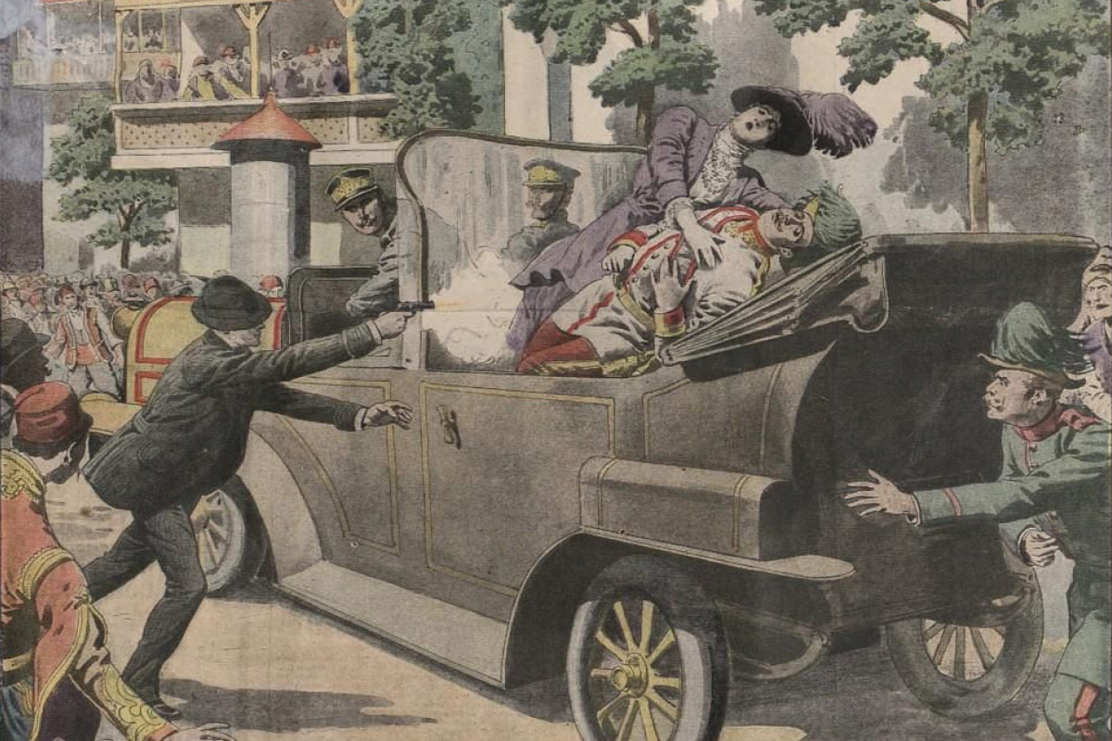
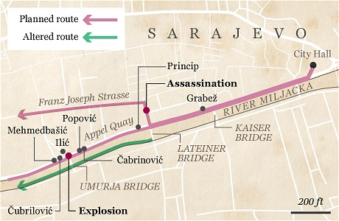
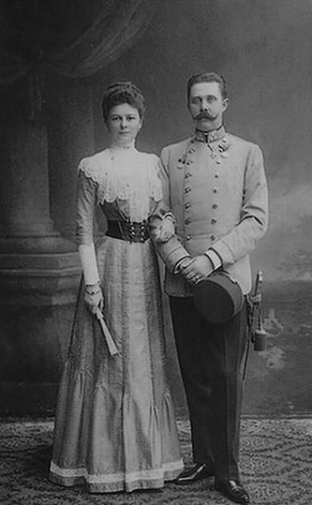

Slide 11
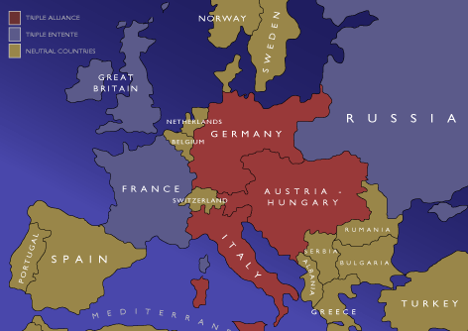
Austria-Hungary declared war on Serbia & its ally Russia
On August 4, 1914, England declared war on Germany & Austria-Hungary
On August 1, 1914, Germany declared war on Russia
On August 3, 1914, Germany declared war on France
Russia mobilized for war to protect Serbia
Italy backed out of its agreement with Germany & Austria-Hungary…
…and joined the Allies
On July 28,1914, Serbia declined the ultimatum
World War I had begun

Slide 12
Chain Reaction
1. Austria-Hungary blames Serbia and sends an ultimatum to Serbia.
2. Russia (protector of the Slavs) begins its “pre-mobilization”
3. Serbia refused to comply with the demands.
4. Austria-Hungary declared war on Serbia on July 28.
5. Russia mobilized its troops for war.

Slide 13
6. Germany, an ally of Austria-Hungary, declared war on Russia.
7. Germany declared war on France, an ally of Russia.
8. Germany invaded Belgium on August 3, 1914, so that German forces could enter France more easily.
9. Britain declares war on Germany.

Slide 14
Alliances
Triple Entente
Russia
France
Great Britain
Central Powers
Germany
Austria-Hungary
Ottoman Empire

Slide 15
