Slide 1
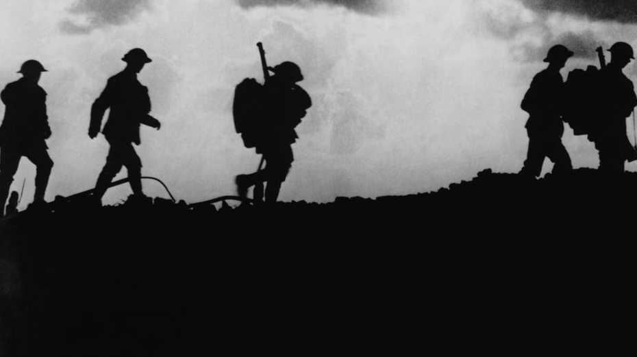
The First World War
1914-1918

Slide 2
Long-term Causes: Alliances
Rival alliances: Triple Alliance vs. Triple Entente
1871: The balance of power of Europe was upset by the decisive Prussian victory in the Franco-Prussian War and the creation of the German Empire.
Bismarck thereafter feared French revenge and negotiated treaties to isolate France.
Bismarck also feared Russia, especially after the Congress of Berlin in 1878 when Russia blamed Germany for not gaining territory in the Balkans.
In 1879, the Dual Alliance emerged: Germany and Austria
This became a major feature of European diplomacy until the end of World War I.
Triple Alliance, 1881: Italy joined Germany and Austria

Slide 3
Russian-German Reinsurance Treaty, 1887
It promised the neutrality of both Germany and Russia if either country went to war with another country.
Kaiser Wilhelm II refused to renew the reinsurance treaty after removing Bismarck in 1890.
"Splendid Isolation" for Britain: After 1891, Britain was the only non-aligned power
Anglo-Japanese Alliance (1902): Britain sought a Japanese agreement to "benevolent neutrality" to counter the possible Russian threat in India.
Entente Cordiale (1904): Due to the Anglo-German naval arms race, Britain and France settled all outstanding colonial disputes in Africa.
Triple Entente, 1907: Britain, France and Russia

Slide 4
Long-term Causes: Anglo-German Arms Race
Militarism led to a belief in the inevitability of a general European war.
Germany overtook Britain industrially in the 1890s.
Bertha von Suttner (Austrian)
She was the first woman to win the Nobel Peace Prize; she opposed the arms race.
Lay Down Your Arms (1889) contributed to the founding of Peace Societies in Austria and Germany.
British policy was to have its fleet larger than the combined fleets of any two rival nations.
In 1898, Kaiser Wilhelm II began the expansion of the German navy
By World War I, both Britain and Germany possessed Dreadnoughts—new super battleships with awesome firing range and power

Slide 6
Long-term Causes: Imperialism
Imperialism led to increased tensions between the Great Powers over Africa
In 1906, the Algeciras Conference settled the First Moroccan Crisis
Kaiser Wilhelm had urged Moroccan independence despite its being a French colony.
Britain and Italy supported French dominance in Morocco and Tunisia.
Britain, France, Russia, and the U.S. saw Germany as potential threat to dominate all of Europe.
Germany became further isolated (except for Austria's support).
Germany decried "encirclement" by other powers to block Germany's emergence as a world power.
The Triple Entente was created in response.

Slide 7
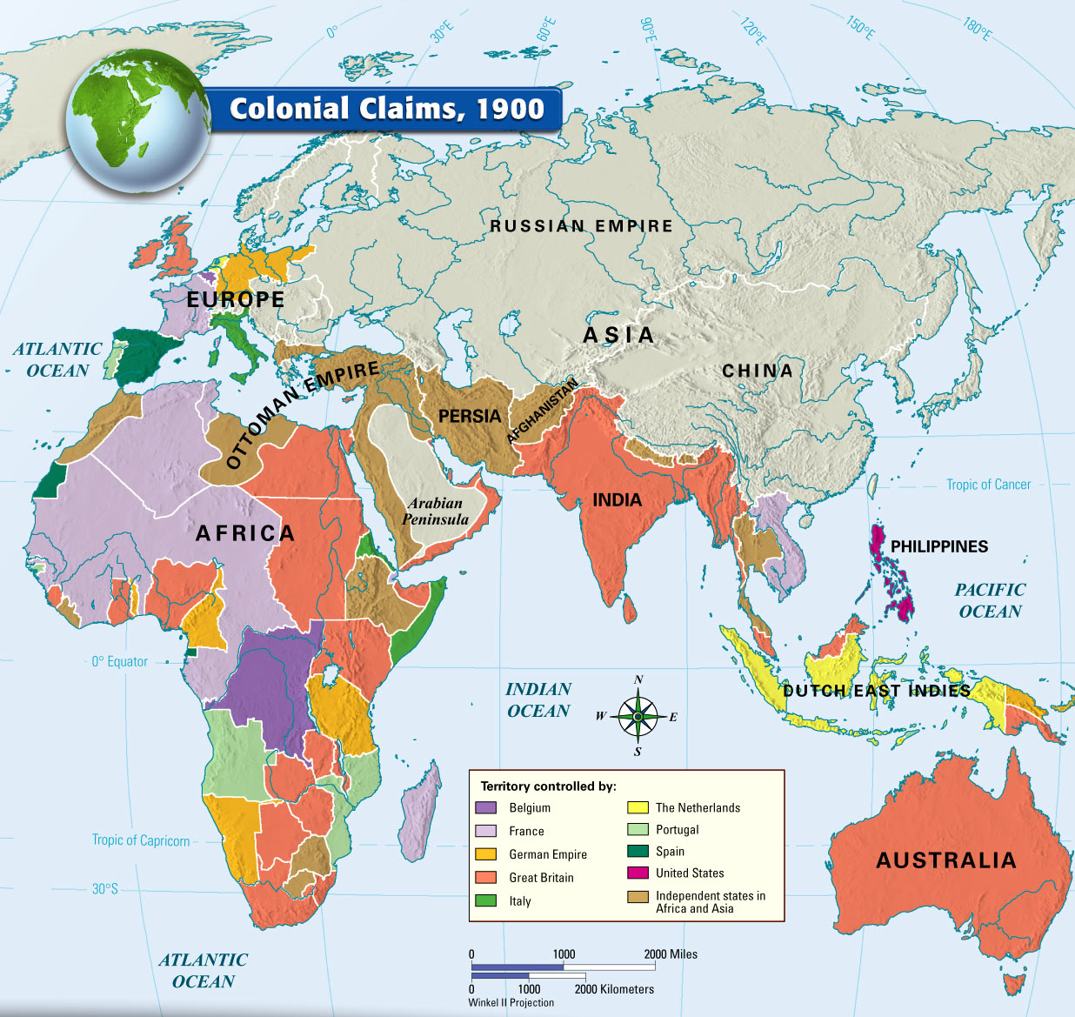

Slide 8
Long-term Causes: Nationalism
Nationalism created a "powder keg" in the Balkans.
The Ottoman Empire (“the sick man of Europe”) receded from the Balkans leaving a power vacuum.
This was the so-called Eastern Question.
Pan-Slavism, a nationalist movement to unite all Slavic peoples
First Balkan War (1912)
Serbia, Greece, and Bulgaria allied to successfully drive the Turks out of the Balkans.
The fighting lasted less than one month.
Most of the formerly-Ottoman Balkan territories were now divided up among the Balkan states.
Serbia sought port access to the Adriatic Sea but was rebuffed when Austria created the state of Albania to block Serbia

Slide 9
Second Balkan War (1913)
Bulgaria was angered that Serbia and Greece had acquired significant territory in Macedonia and thus attacked both countries.
Serbia defeated Bulgaria in its quest for Macedonia and temporarily gained Albania as a result.
Russia backed its Slavic neighbor, Serbia.
Austria, with German support against Russia, prevented Serbia from holding onto Albania.
Serbia was frustrated as it still had no access to the Adriatic Sea; Albania gained independence.
Russia was humiliated as it could not help Serbia acquire Albania.

Slide 11
Immediate Cause for WWI
June 28, 1914:
Archduke Franz Ferdinand, the Austrian heir to the throne, was assassinated by Serbian nationalist Gravilo Princip (member of the ultra-nationalist Serbian "Black Hand") while visiting Bosnia-Herzegovina
Kaiser Wilhelm II (of Germany) pledged unwavering support to Austria to punish Serbia:
This is known as "the blank check” agreement.
On July 28, Austria declared war on Serbia
In response, Russia mobilized its armies against Austria and Germany.
France, in response, mobilized on Germany's western border.
On August 1, Germany declared war on France.
On August 3, Germany invaded Belgium (on its way through to France).
This violated Belgiums neutrality (this is known as the rap of Belgium due to the German brutality)
In effect, Germany turned the little localized war in the Balkans into a world war by attacking Belgium and France.
On August 4, Britain declared war on Germany. All the major powers in Europe were now at war.

Slide 12
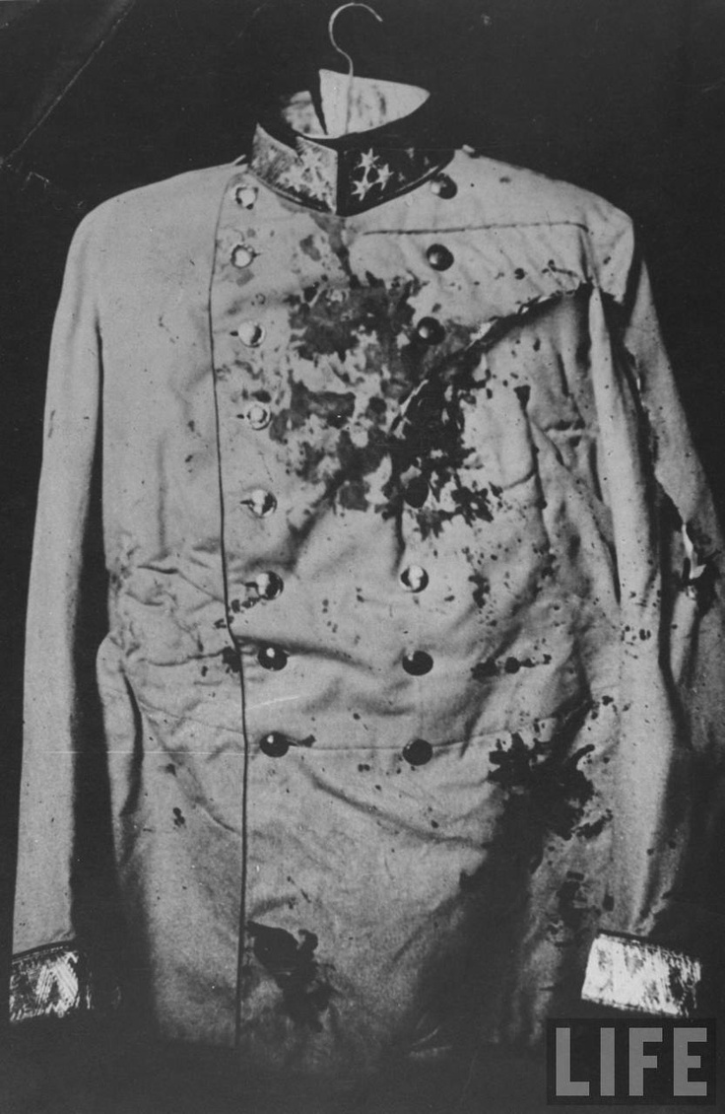
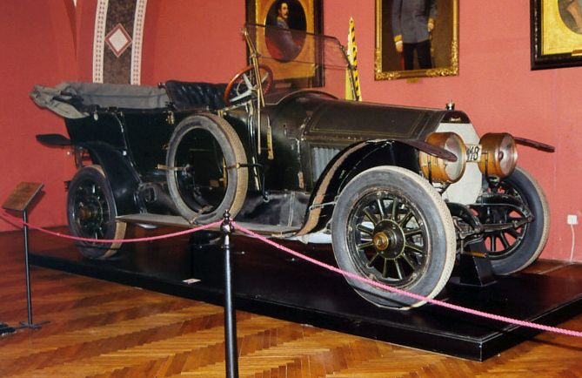
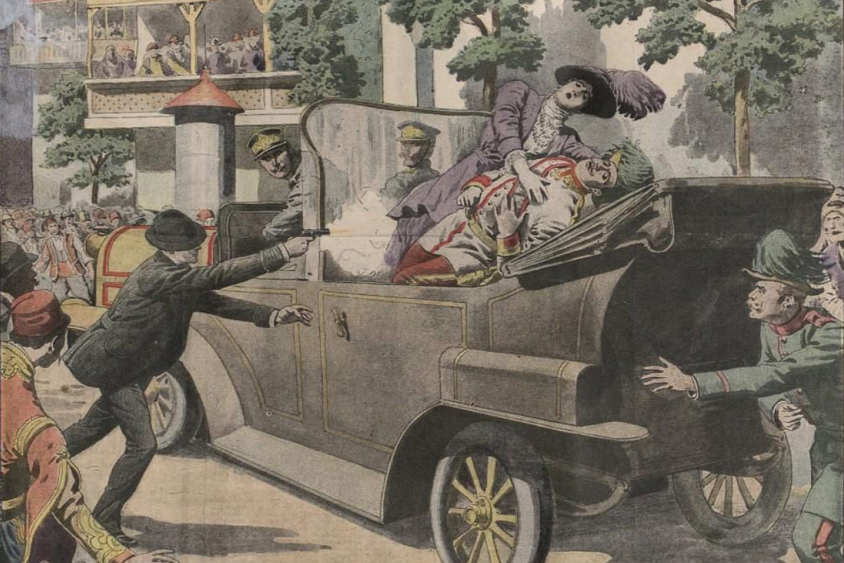
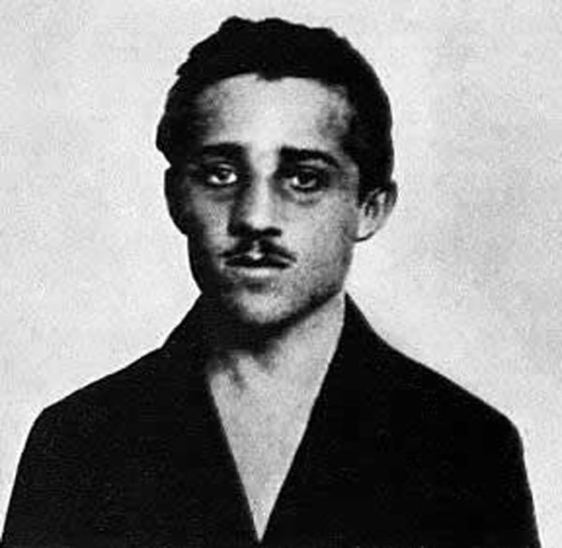
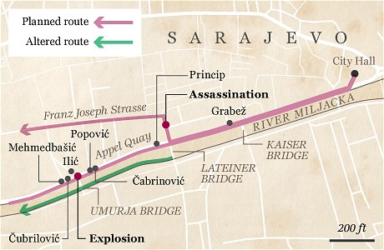
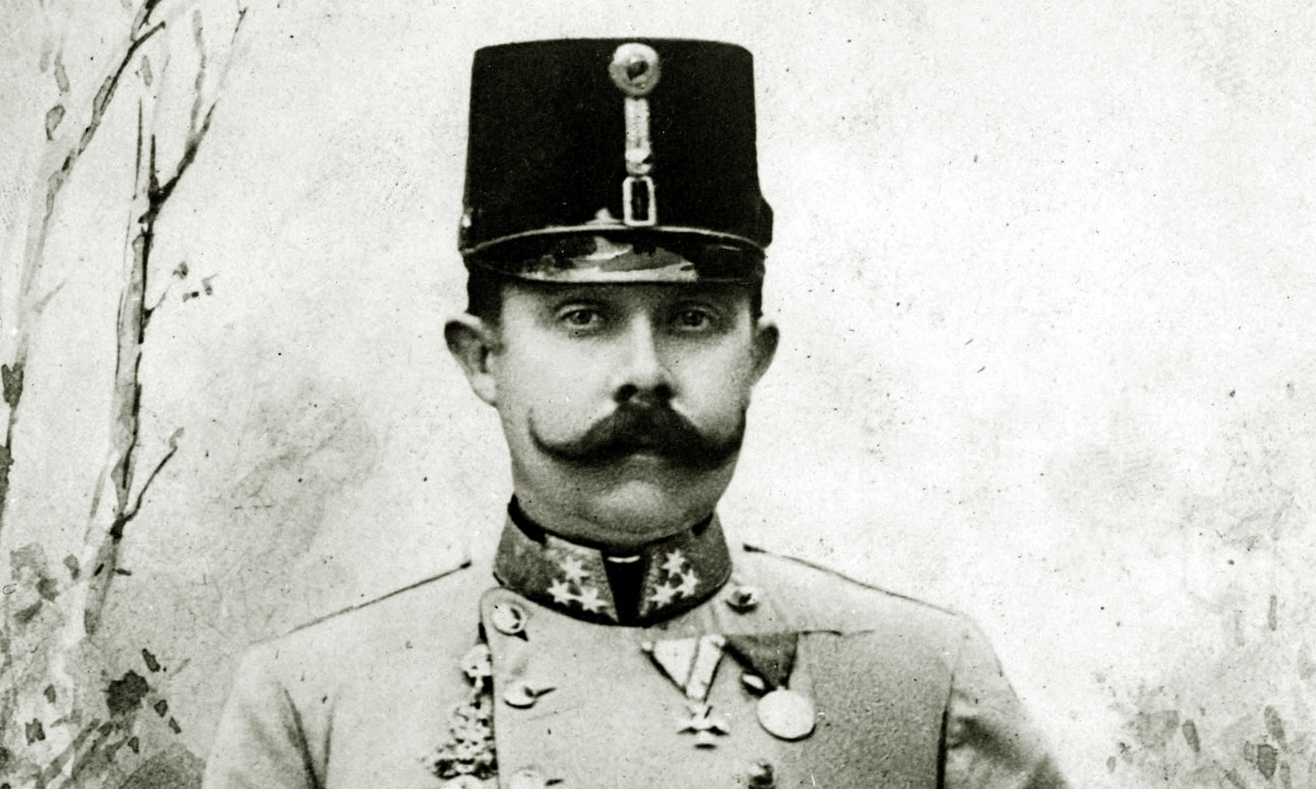
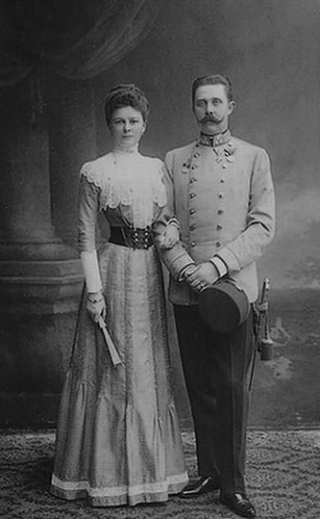

Slide 13
Two Opposing Alliances
Central Powers (Triple Alliance): Germany, Austria-Hungary, Ottoman Empire, (also Bulgaria)
Allies (Triple Entente): Britain, France, and Russia (later, Japan, Italy, Romania, and the U.S.)

Slide 14
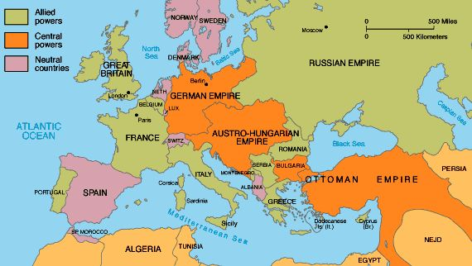

Slide 15
The Western Front
The Schlieffen Plan
German 42-day military plan to invade France through Belgium, defeat France quickly by sweeping around Paris, and then redeploy to the east to defeat Russia before she fully mobilized
Battle of the Marne (September 1914)
After the Germans came within sight of Paris, French and British forces pushed the German forces back.
The French army was led by General Joseph Joffre.
The battle represented the end of mobility on the Western Front.

Slide 17
Failure of the Schlieffen Plan
Belgium’s surprising resistance to Germany’s invasion slowed down the German offensive into France.
The left of the German line failed to lure the French army into Alsace and Lorraine (boarder regions between France and Germany) and destroy it.
Russia mobilized quickly in the east requiring German divisions to be sent there instead.
The French and British counterattack at the Battle of the Marne was decisive in halting the German invasion.

Slide 18
Trench Warfare
The halt of the German advance resulted in a stalemate and lasted for four bloody years.
A long line of trenches stretched from the North Sea to the Swiss border in the south (about 440 miles—25,000 miles of trenches were built overall).
Despite massive casualties on both sides, few gains were made in terms of gaining ground.
1916: Massive casualties mount but neither side could break through
Erich Remarque’s book All Quiet on the Western Front (1929) later illustrated the horrors trench warfare.

Slide 19
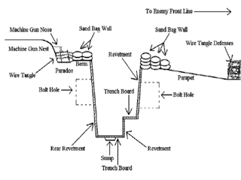
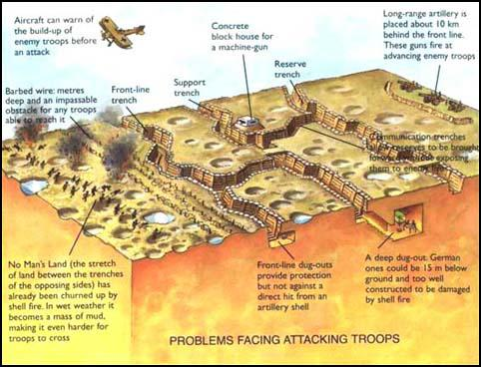
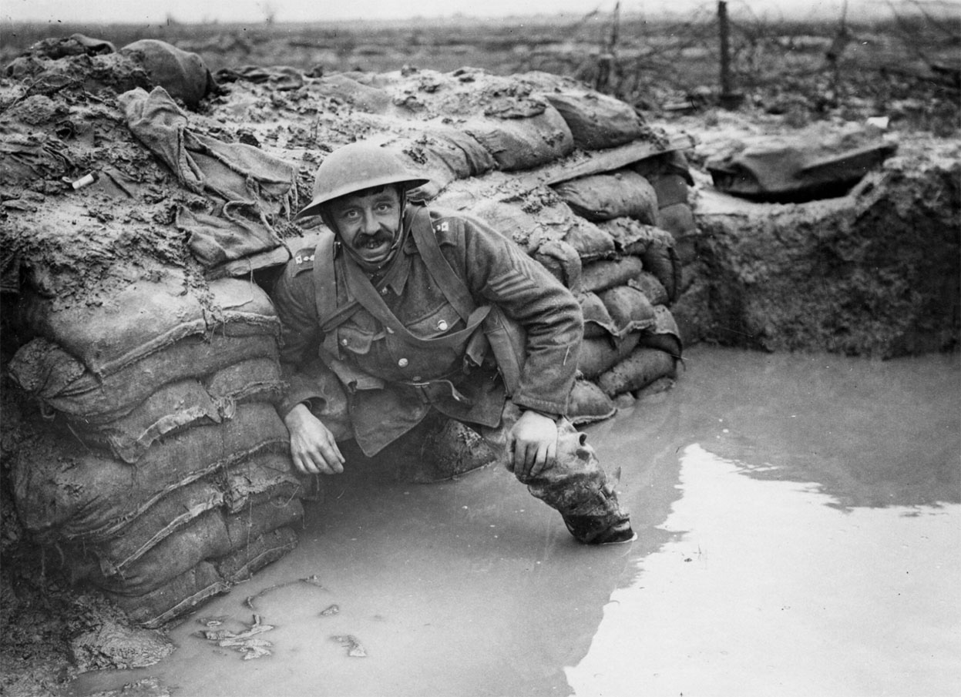
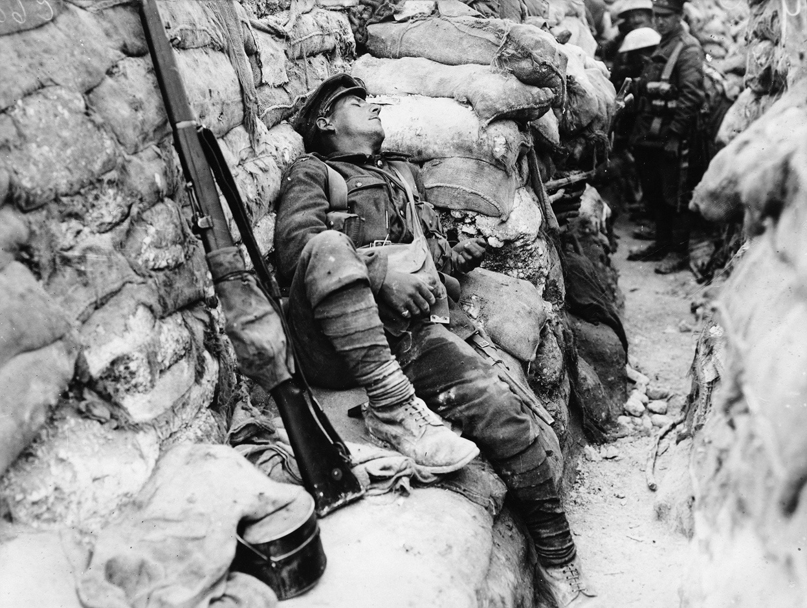
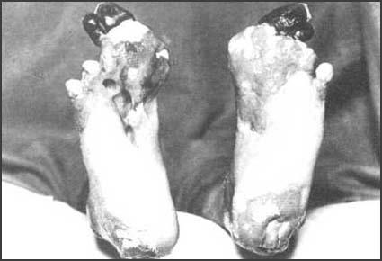
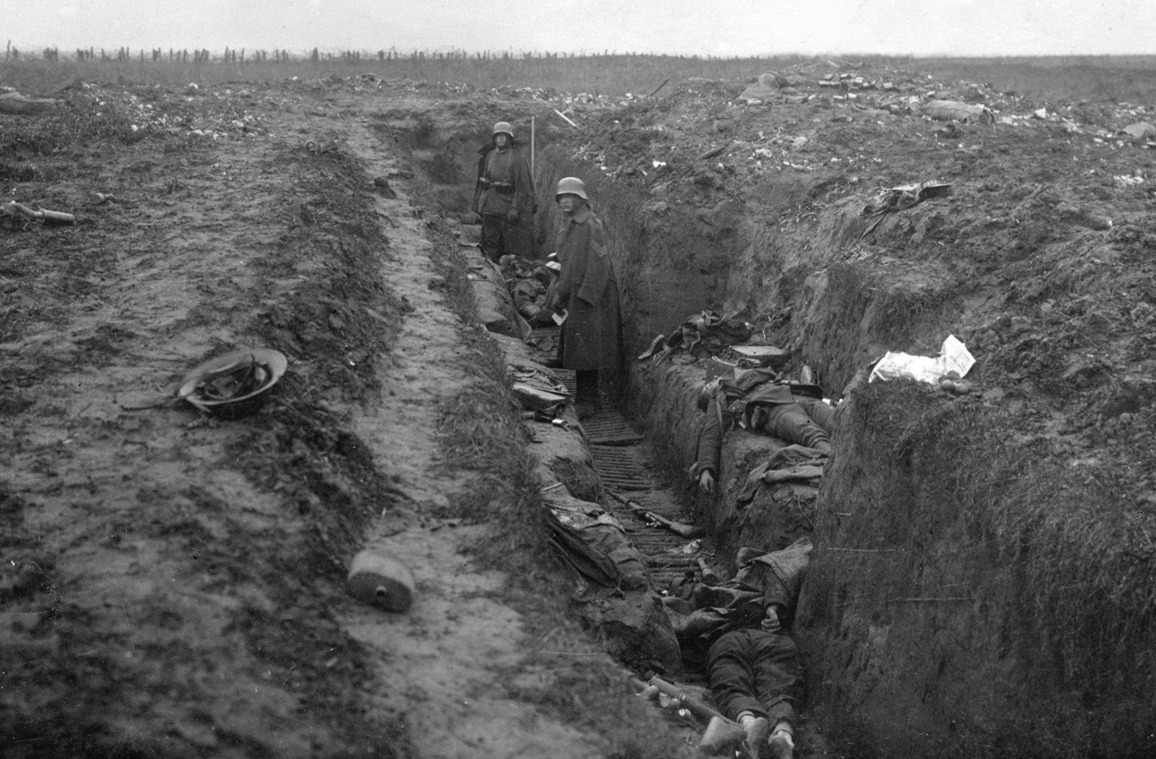

Slide 20
Two Major Battles on the Western Front
Battle of Verdun (February-December)
Germany sought a battle of attrition that would “bleed France white” and force it to sue for peace.
France lost 540,000 men; Germany lost 430,000; it was the war’s second bloodiest battle.
General Philippe Pétain’s leadership of French forces made him a national hero.
Battle of the Somme (July-November)
British and French offensive aimed to break through the German lines.
Bloodiest battle of the war
Losses of men: Britain 420,000; France 200,000; Germany 650,000

Slide 21
Technological Advancements
Technological advancements in war increased casualties.
World War I represented the industrial revolution applied to warfare.
New Tech:
Machine Guns
Tanks
Airplane
Poison Gas
Submarines (U-boats)
Zeppelins (blimps)
Radio

Slide 22
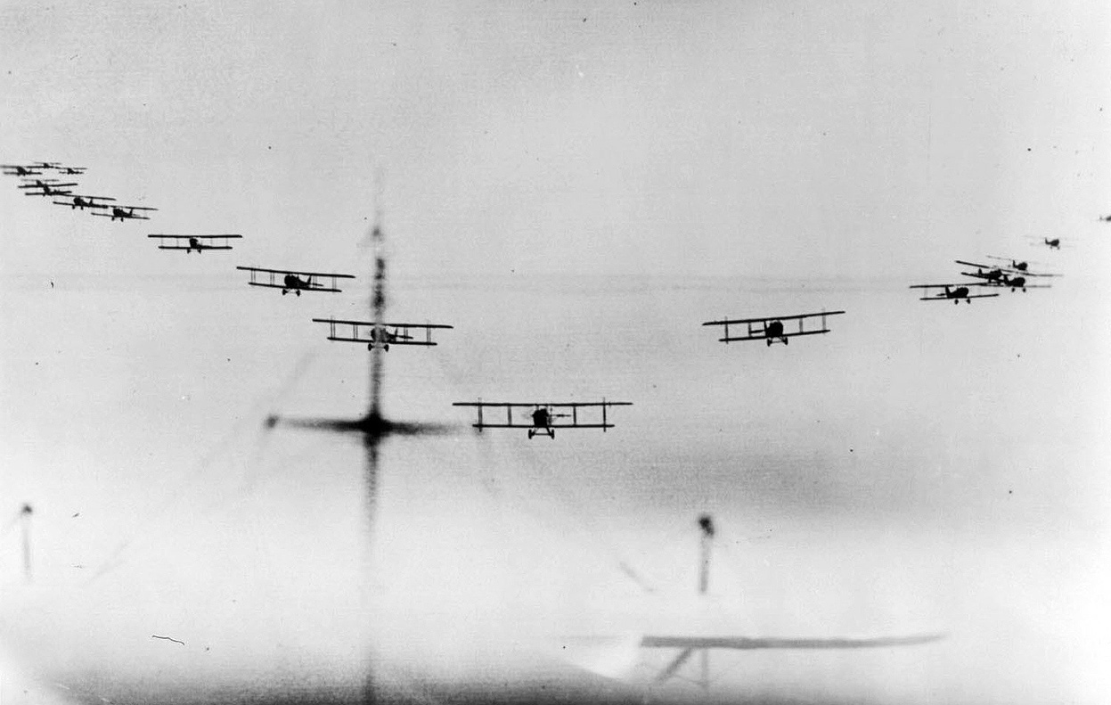
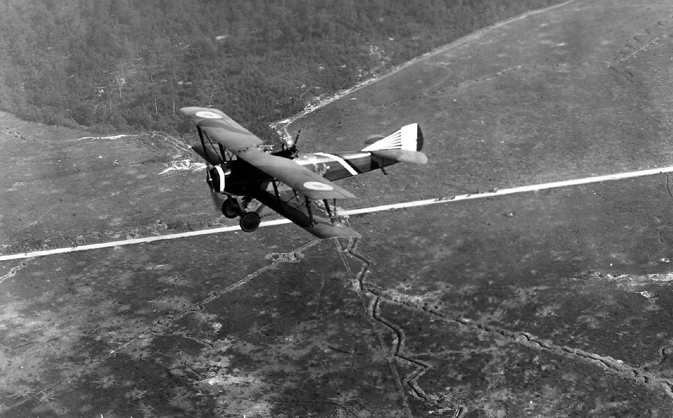
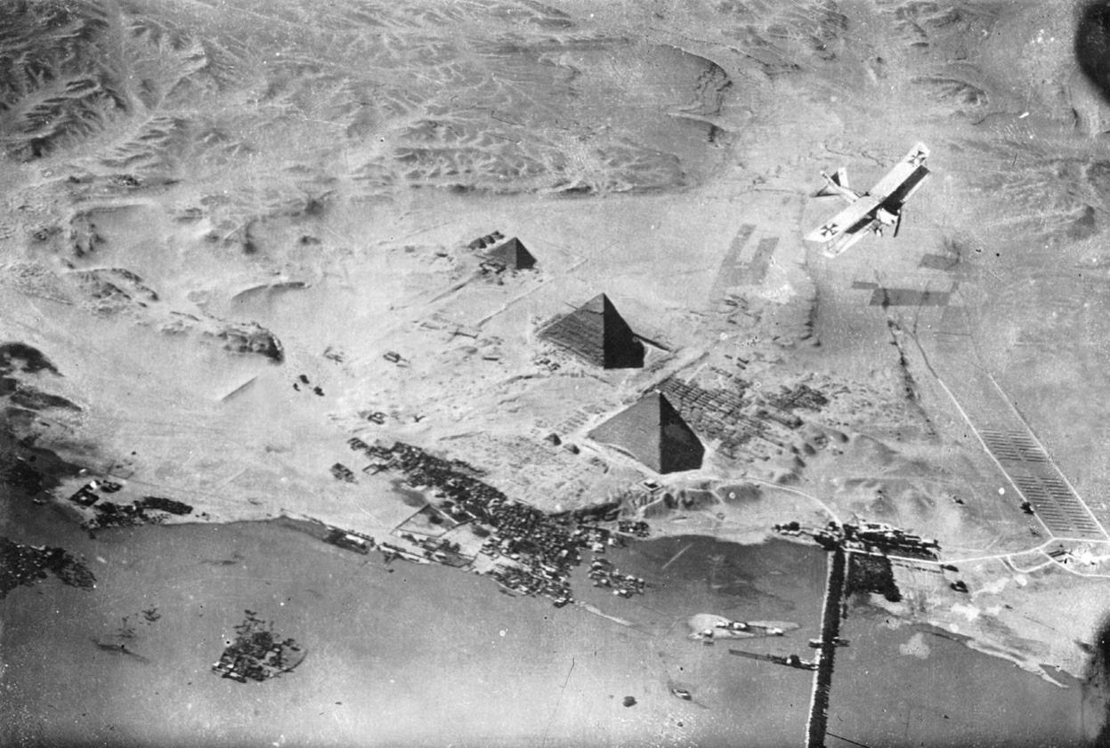

Slide 23
Eastern Front
The war was more mobile in eastern Europe.
General von Hindenburg and General von Ludendorff defeated invading Russian armies at Tannenburg in 1914.
Turned the tide of the war in the east
Though numerically superior, the Russians were poorly organized and suffered horrific casualties at the hands of the Germans.
Treaty of Brest-Litovsk (Dec. 1917):
Vladimir Lenin, after the Bolshevik Revolution, took Russia out of the war but was forced to give Germans 1/4 of Russia’s European territory

Slide 24
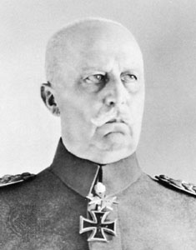

Slide 25
Gallipoli Campaign (1915)
British, Australian, and New Zealand forces failed to take the Dardanelles (strategic water way between the Black Seas and the Mediterranean Sea) as a step toward taking Constantinople and defeating the Ottoman Turks.
Taking control of the Dardanelles would have allowed Russia to receive increased supplies from the Allies and play a larger naval role in the war against the Ottoman Empire.
200,000 British troops were killed or wounded
Gallipoli represents one of the great Ottoman victories of the war and a huge defeat for the Allies.

Slide 26
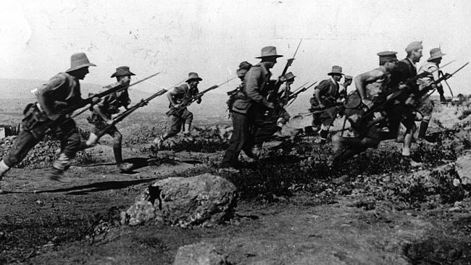
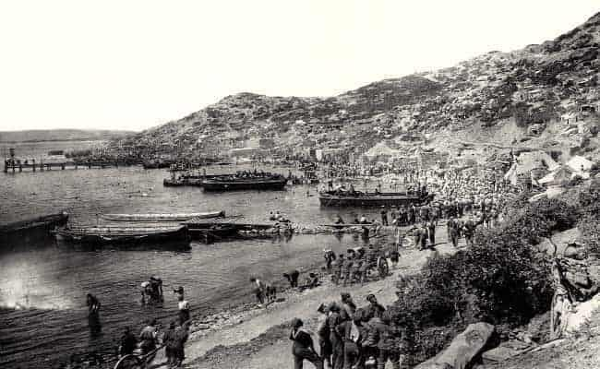
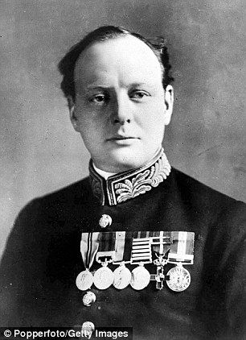

Slide 27
Middle East
Britain took great steps to protect the Suez Canal in Egypt.
The British gained support from Arab tribes who resented Ottoman domination of the region.
Arab revolts against the Turks throughout the war ended the Ottoman Empire’s grip on the Middle East.
The Arabs received military assistance from such figures as Lawrence of Arabia.
The Armenian genocide by the Turks resulted from Ottoman claims that Armenians were cooperating with the Allies.
Perhaps a million Armenians died in what became the first of several genocides in the 20th century.

Slide 28
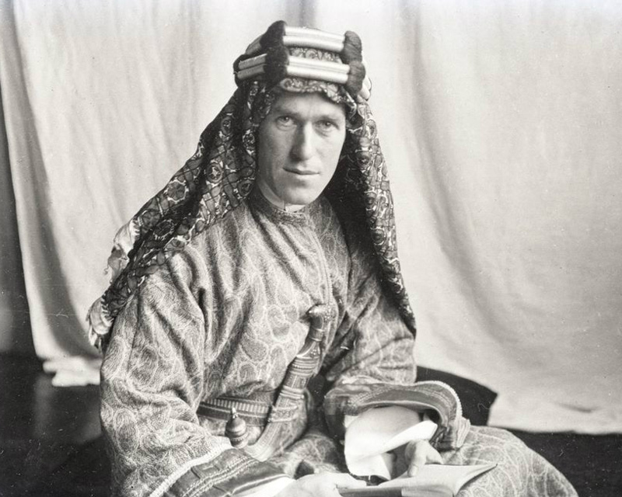

Slide 29
British and Allied Naval Blockade
Britain’s goal was to strangle the Central Powers.
Starting in 1914, the Allies used its superior fleet and sea mines to cut the Central Powers off from overseas trade and caused Germany to lose control of its colonial empire.
Germany responded by sinking Allied vessels with U-boats.
Lusitania, 1915: U-boats sank a British passenger liner killing 1,200 (including 128 Americans)
This turned American public opinion squarely against Germany.
After initially stopping Germany in 1917 began unrestricted submarine warfare agian, sinking allied ships (both military and civilan) with its U-boats.
This was the most important reason for U.S. entry into the war in 1917.
By war’s end, the blockade succeeded in strangling Germany, resulting in thousands of German deaths due to starvation.

Slide 30
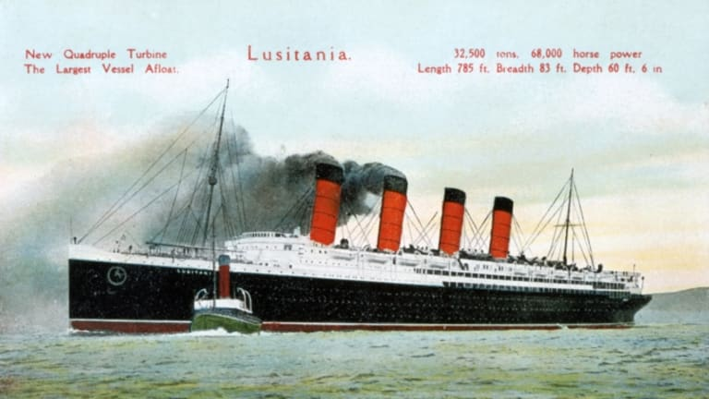
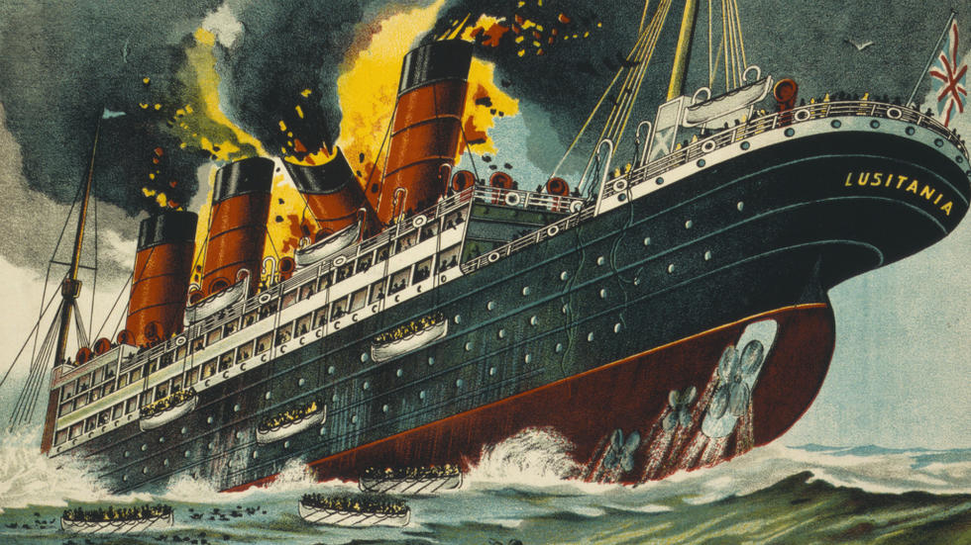

Slide 31
Total War
Massive conscription drafted most able-bodied men in their youth.
In some cases, civilian populations became targets.
Early in the war, Germany used Zeppelins to bomb London.
The British blockade resulted in significant starvation in Germany.
News was censored; propaganda lionized men at the front and dehumanized the enemy.
Intense nationalism demanded support from the entire population.
Some historians contend that Germany increased its belligerency in the 1890s in order to rally the masses behind the government and slow down the growth of the SPD.
British propaganda effectively demonized Germany as the “Hun.”

Slide 32
Economic production focused on the war effort.
Free-market capitalism was abandoned in favor of strong central planning of the economy.
Women replaced male factory workers who were now fighting the war.
Women accounted for 43% of the labor force in Russia
Increased rights form women came as a result of the war in Britain, Germany, Austria, and the US)
Labor unions supported the war effort and saw increased influence and prestige due to increased demand for labor.
The rationing of food and scarce commodities was instituted.
Civilians financed the war by buying war bonds.
Each side aimed at “starving out” the enemy by cutting off vital supplies to the civilian population.
Increase in centralized control by warring regimes
Ex. Georges Clemenceau created a dictatorship in France during the war

Slide 33
Diplomacy during the War
1915: neutral Italy entered the war against the Central Powers (its former allies) with the promise of some Austrian and Balkan territory—Italia Irredenta (“unredeemed Italy”)—and some German colonies and Turkish territories.
Zimmerman Note: Germany proposed an alliance with Mexico against the U.S.
Mexico would receive much of the southwestern U.S. (Texas, Arizona, New Mexico) if the Central Powers won.
The letter was intercepted by the British
US will enter the war in 1917 on the allied powers side.

Slide 34
Balfour Declaration (1917): Arabs and Jews in Palestine were promised autonomy if they joined the Allies.
Britain declared sympathy for Zionism—the idea of a Jewish homeland in Palestine.
The new policy seemed to contradict British support for Arab nationalism as a new Jewish state would require Arab lands to be given up in Palestine.

Slide 35
Wilsonian Idealism: 14 Points (January 1918)
U.S. planed to end the war along liberal, democratic lines
Provisions
Abolish secret treaties
Freedom of the seas
Remove economic barriers (e.g. tariffs)
Reduce armament burdens
“Self-determination”
Adjustment of colonial claims in interests of both native peoples and colonizers
German evacuation of Russia; restoration of Belgium; return of Alsace-Lorraine to France; evacuation and restoration of the Balkans; return of Schleswig to Denmark
Adjustment of Italy’s borders along ethnic lines
Autonomy for non-Turkish parts of the Turkish Empire
14th point: creation of an international organization to provide collective security

Slide 36
End of the War
Meuse-Argonne offensive (spring 1918)
Germany transferred divisions from the east (after defeating Russia and the subsequent Brest-Litovsk Treaty) to the Western Front and mounted a massive offensive.
The U.S. entered the war in time to assist Britain and France in stopping the German offensive
The Central Powers sought peace based on the Fourteen Points (believing they would get fair treatment).
Germany and Austria-Hungary were wracked with revolution.
Austria-Hungary surrendered on November 3, 1918.
Germany agreed to an armistice which began on November 11.
Wilhelm II was forced to abdicate and fled to Holland.

Slide 37
Paris Peace Conference (1919)
Big Four: David Lloyd George (Br.), Georges Clemenceau (Fr.), Woodrow Wilson (U.S.), Vittorio Orlando (It.)
The Central Powers were excluded from negotiations as France was concerned with its future security.
Italy left the conference, angry it would not get some Austrian and Balkans territories it had been promised in 1915.

Slide 38
Versailles Treaty (1919)
Mandates were created for former colonies and territories of the defeated Central Powers.
Much of the Middle East was now controlled by Britain and France.
Article 231 placed sole blame for the war on Germany that resulted in its severe punishment.
Had to pay reparations
Army and navy were reduced
The Rhineland was demilitarized
Loss of all colonies
German territory was given to Poland, Denmark, and France

Slide 39
League of Nations
Germany and Russia were not included which weakened the League from the outset.
The U.S. Senate failed to ratify the Versailles Treaty resulting in U.S. isolationism for two decades.
The League thus was born as a mere shadow of what it had originally been intended to achieve

Slide 40
Impact of WWI on European Society
Massive casualties: 10 million soldiers dead; 10 million civilians dead, many also died from the 1918 influenza epidemic; perhaps 15 million died in the Russian Revolution and subsequent Russian Civil War.
Thus, the birthrate fell significantly after the war (although illegitimate births increased).
The war promoted greater social equality, thus blurring class distinctions and lessening the gap between rich and poor.
The nobility in Germany, Austria and Russia lost much of its influence and prestige.
Dissent increased as the war continued.
Tsar Nicholas II was overthrown by the Provisional gov’t in February 1917,
Irish Republicans staged an insurrection—the Easter Rebellion—in England in 1916.

Slide 41
End to long-standing royal dynasties
Habsburg dynasty removed in Austria (had lasted 500 years)
Romanov dynasty removed in Russia (had lasted 300 years)
Hohenzollern dynasty removed in Germany (had lasted 300 years)
Ottoman Empire destroyed (had lasted 500 years)
The political map of Europe was redrawn.
Creation of the new states of Poland, Czechoslovakia, Hungary, Finland, Estonia, Latvia, Lithuania, and Yugoslavia
The Russian Revolution resulted in the creation of the world's first communist country.
John Maynard Keynes, The Economic Consequences of the Peace (1919): Predicted the harsh terms of the treaty would hurt Germany’s economy, and thus the economy of the rest of Europe, and lead to significant future political unrest.

