Slide 1
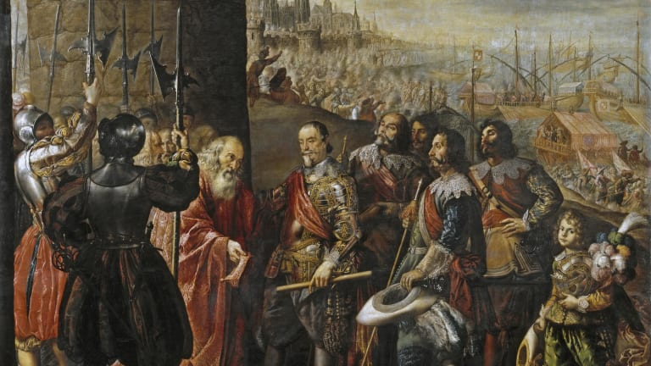
Wars of Religion

Slide 2
Background
From 1560 to 1648 wars would be fought largely over religious issues.
Spain sought to squash Protestantism in Western Europe and the spread of Islam in the Mediterranean.
French Catholics sought to squash the Huguenots.
The Holy Roman Empire sought to re-impose Catholicism in Germany.
The Calvinist Netherlands sought to break away from Spanish rule.
A civil war occurred in England between Puritans and Anglicans

Slide 3
Spain's Catholic Crusade
Philip II (r. 1556-98): A Habsburg ruler like his father, Charles V, he fanatically sought to re-impose Catholicism in Europe.
Under Philip, Spain became the dominant country in Europe: the “Golden Age” of Spain.
Escorial: new royal palace (and monastery) was built in Madrid in the shape of a grill to commemorate the martyrdom of St. Lawrence
It symbolized the power of Philip and his commitment to his Catholic crusade.

Slide 4
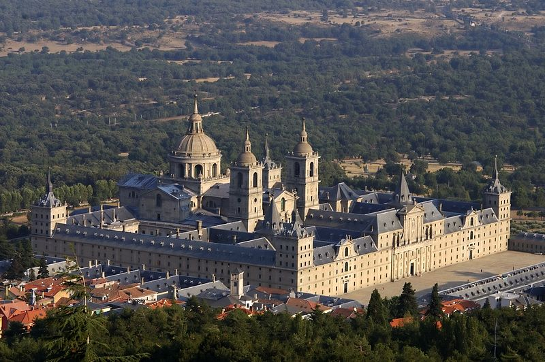
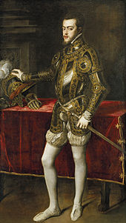

Slide 5
Spain waged a war against the Turks in the Mediterranean to secure the region for Christian merchants.
Battle of Lepanto (1571): Spain defeated the Turkish navy off the coast of Greece.
Spain’s religious fervor in its battle with the Turks was reminiscent of the earlier Christian Crusades.
Spain’s victory ended the Ottoman threat in the Mediterranean.

Slide 6
Catholic Spain V. Protestant England
Queen Mary Tudor had sought to re-impose Catholicism in England.
She had married Philip before he became king of Spain.
When she died, Queen Elizabeth I reversed Mary’s course via the “Elizabethan Settlement.”
Elizabeth later refused Philip’s request for marriage.
Elizabeth subsequently helped the Protestant Netherlands in their revolt for independence from Spain.
In 1587, she ordered the beheading of Catholic Mary, Queen of Scots
Philip sought revenge for England’s support for the Dutch; he also sought to make England Catholic again.
He thus planned a monumental invasion of England in 1588.

Slide 7
Spanish Armada-1588
Spain’s attempt to invade England ended in disaster.
Much of Spain’s navy lay in ruins due to a raging storm in the English Channel as well as the effectiveness of England’s smaller but better-armed navy.
This signaled the rise of England as a world naval power.

Slide 8
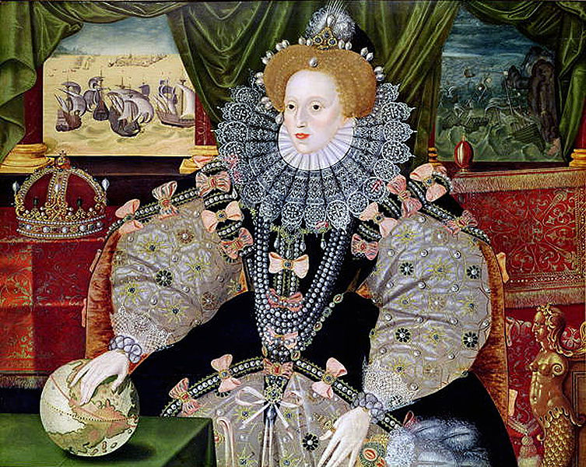
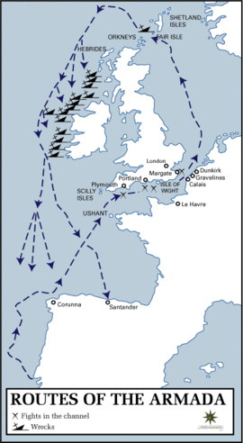

Slide 9
The Dutch Revolt (1568-1648)
William of Orange (1533-84) led 17 provinces in the Netherlands and Flanders against the Spanish Inquisition of Philip II.
Philip sought to crush the rise of Calvinism in the Netherlands.
United Provinces of the Netherlands formed in 1581 (Dutch Republic)
Received aid from England under Elizabeth I
Major blow to Philip’s goal of maintaining Catholicism throughout his empire
The Spanish Netherlands (modern-day Belgium): the 10 southern provinces remained under Spain’s control
The Dutch closing of the Scheldt River resulted in the demise of Antwerp as Europe’s commercial center and the rise of Amsterdam..

Slide 10
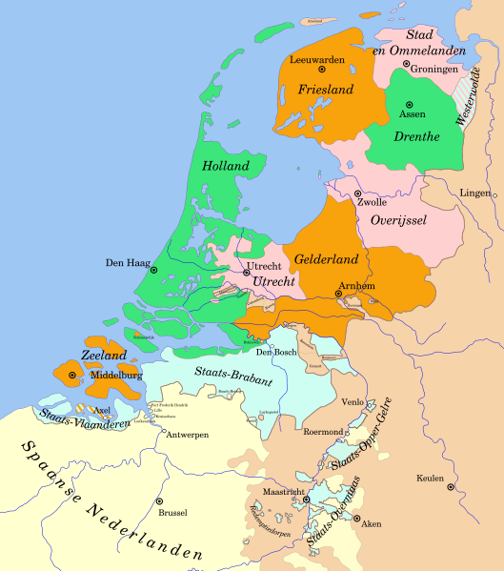
The Dutch Republic

Slide 11
French Wars of Religion (1562-1589)
9 separate conflicts collectively called the French Wars of Religion
After the death of Henry II in 1559 a power struggle between three noble families for the Crown ensued.
The throne remained in the fragile control of the Catholic Valois dynasty.
Three French kings from 1559 to 1589 were dominated by their mother, Catherine de Médicis, who as regent fought hard to maintain Catholic control in France.

Slide 12
Between 40-50% of nobles became Calvinists (Huguenots)—many were Bourbons
Many nobles ostensibly converted for religious reasons but sought independence from the crown.
A resurgence of feudal disorder in France resulted
The Bourbons were next in line to inherit the throne if the Valois did not produce a male heir.
The ultra-Catholic Guise family also competed for the throne; strongly anti-Bourbon.
Fighting began in 1562 between Catholics and Calvinists.
• Atrocities against rival congregations occurred.

Slide 13
St. Bartholomew’s Day Massacre (August 24, 1572)
The marriage of Margaret of Valois to the Bourbon Huguenot Henry of Navarre was intended to reconcile Catholics and Huguenots.
Rioting occurred when the leader of the Catholic aristocracy, Henry of Guise, had a leader of the Huguenot party murdered the night before the wedding.
Catherine de Médicis ordered the massacre of Calvinists in response.
20,000 Huguenots were killed by early October.
The massacre initiated the War of the Three Henrys: civil wars between the Valois, Guise, and Bourbons

Slide 14
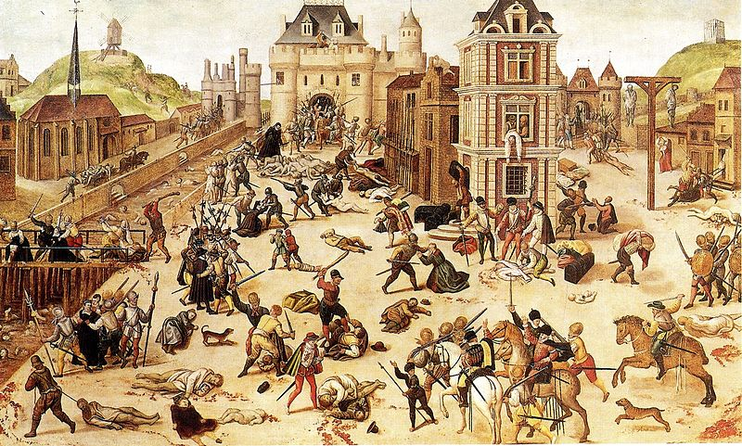

Slide 15
Henry IV (r. 1589-1610)
The First Bourbon King of France
One of most important kings in French history
His rise to power ended the French civil wars and placed France on a gradual course towards absolutism.
Henry was a politique (like Elizabeth I)
He sought practical political solutions (rather than ideological ones like Philip II); he was somewhat Machiavellian in nature.
He converted to Catholicism to gain the loyalty of Paris. (He allegedly stated: “Paris is worth a mass”)
Privately he remained a Calvinist for the rest of his life.

Slide 17
Edict of Nantes- 1598
Henry granted a degree of religious toleration to Huguenots and ushered in an era or religious pluralism.
It permitted Huguenots the right to worship privately.
Public worship was not allowed.
Huguenots were not allowed to worship at all in Paris and other staunchly Catholic cities.
It gave Huguenots access to universities, to public office, and the right to maintain some 200 fortified towns in western and southwestern France for self-protection.
In reality, the Edict was more like a truce in the religious wars rather than a recognition of religious toleration.
Nevertheless, the Edict gave Huguenots more religious protection than perhaps any other religious minority in Europe.

Slide 18
Thirty Years War (1618-1648)
Failure of Peace of Augsburg (1555)
Agreement had given Germany princes the right to choose either Catholicism or Lutheranism as the official religion in their states within the HRE
The truce in Germany lasted for 60 years until factionalism in the Holy Roman Empire precipitated a cataclysmic war.
The war was split into 4 phases

Slide 19
Bohemian Phase (1618-1625)
Defenestration of Prague” (1618) triggered the war in Bohemia
The Holy Roman Emperor placed severe restrictions on Protestantism in its empire.
Two HRE officials were thrown out a window and fell 70 feet (they did not die because they were allegedly saved by a large pile of manure).
The emperor then sought to annihilate the Calvinist nobility in Bohemia.
Protestant forces were eventually defeated and Protestantism was eliminated in Bohemia

Slide 20
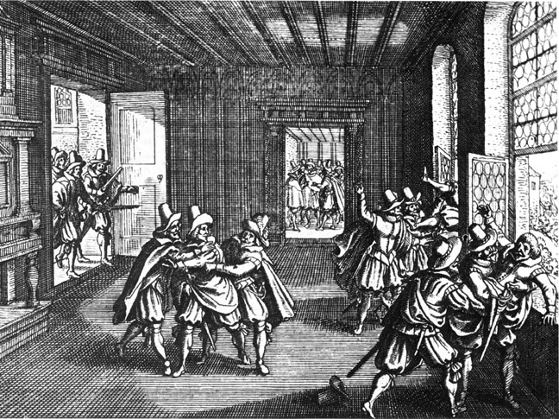
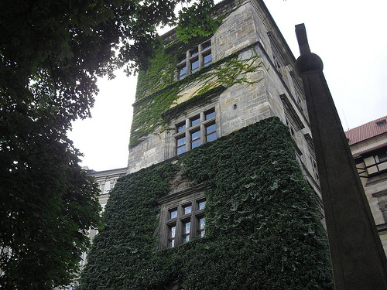

Slide 21
Danish Phase (1625-1629)
Represented the height of Catholic power during the war
Albrecht von Wallenstein (1583-1634): mercenary general paid by the emperor to fight for the HRE
He invaded northern Germany and won a number of important battles against Protestant armies.
Edict of Restitution (1629): the emperor declared all church territories secularized since 1552 to be restored to the Catholic church

Slide 22
Swedish Phase (1629-35)
Swedish Phase (1629-35): Protestants liberated territory lost during the Danish Phase
Gustavus Adolphus, king of Sweden, (r. 1611-1632): led an army that pushed Catholic forces all the way back to Bohemia
Ended Habsburg hopes of reuniting the HRE
Gustavus was later killed in battle
In response, the emperor reluctantly annulled the Edict of Restitution.
The Swedish army was defeated by the HRE in 1634; France now feared a resurgence of Catholicism in the HRE.

Slide 23
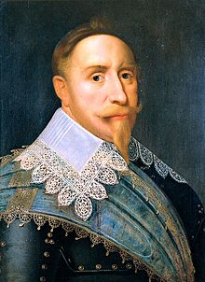

Slide 24
French Phase (1635-1648)
Cardinal Richelieu (of France)(1585-1642) allied with Protestant forces to defeat the HRE.
Allied with Holland, Sweden, Finland, & German mercenaries
Richelieu’s policies reflected Catholic France’s paramount diplomatic concerns as political, not religious; thus he can be seen as a politique.
Had the Habsburgs won in Germany, France would have been confronted with a more powerful German state on its eastern border.

Slide 25
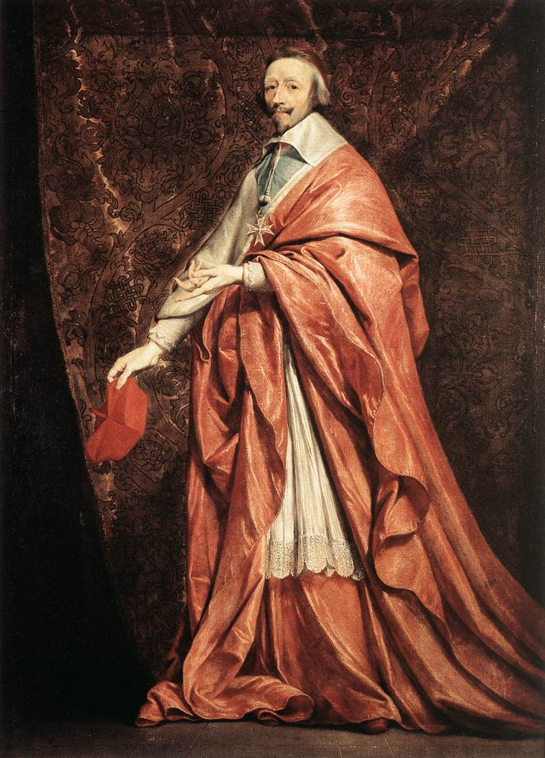

Slide 26
Treaty of Westphalia (1648)
It renewed the Peace of Augsburg but added Calvinism as a politically accepted faith.
In effect, it ended the Catholic Reformation in Germany.
It guaranteed that Germany would remain divided politically and religiously for centuries.
The dissolution of Holy Roman Empire was now confirmed.
The Netherlands and Switzerland gained their independence from Spanish rule.
300+ German states became sovereign.
The pope was denied the right to intervene in HRE affairs.

Slide 27
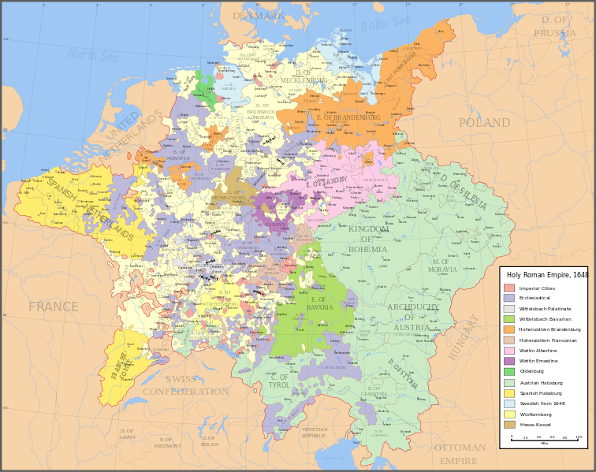
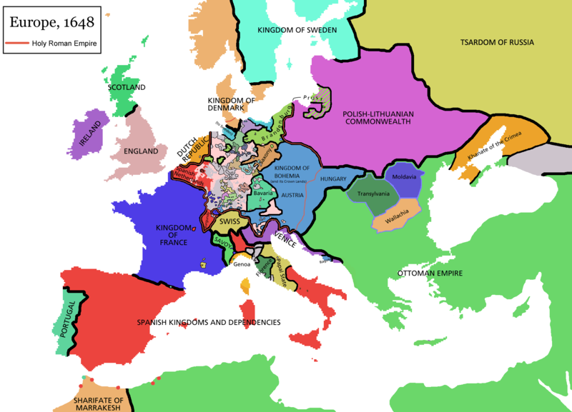

Slide 28
France, Sweden, and Brandenburg (future Prussia) received various territories and gained international stature.
The two Habsburg branches were weakened:
The Spanish Hapsburgs saw their empire decline dramatically thereafter.
The Austrian Hapsburgs lost much influence in Germany.

Slide 29
Results of the Thirty Years War
Germany was physically devastated (about 1/3 of the population perished; as high as 50% in certain areas).
Germany was further divided by the decline of the Holy Roman Empire.
It ended the wars of religion.
It marked the beginning of the rise of France as the dominant European power; it also accelerated the continued rise of England, the Netherlands, and Prussia.
Balance of power diplomacy emerged in Europe.

