Slide 1
Transformation of the West: The Renaissance

Slide 2
A New Spirit and the Italian Renaissance
Francesco Petrarch (1304-1374)
Secular writing
Italian Renaissance
Artistic movement that challenged medieval intellectual values & styles
Italy was urbanized, commercial, & had city-state politics
War common among city-states
Petrarch & Boccacio
Promote literary canons

Slide 3
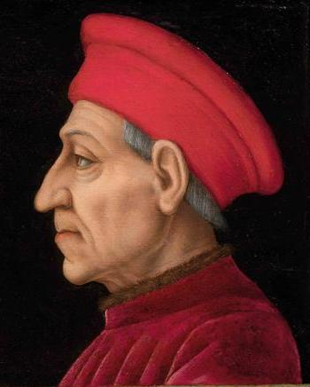
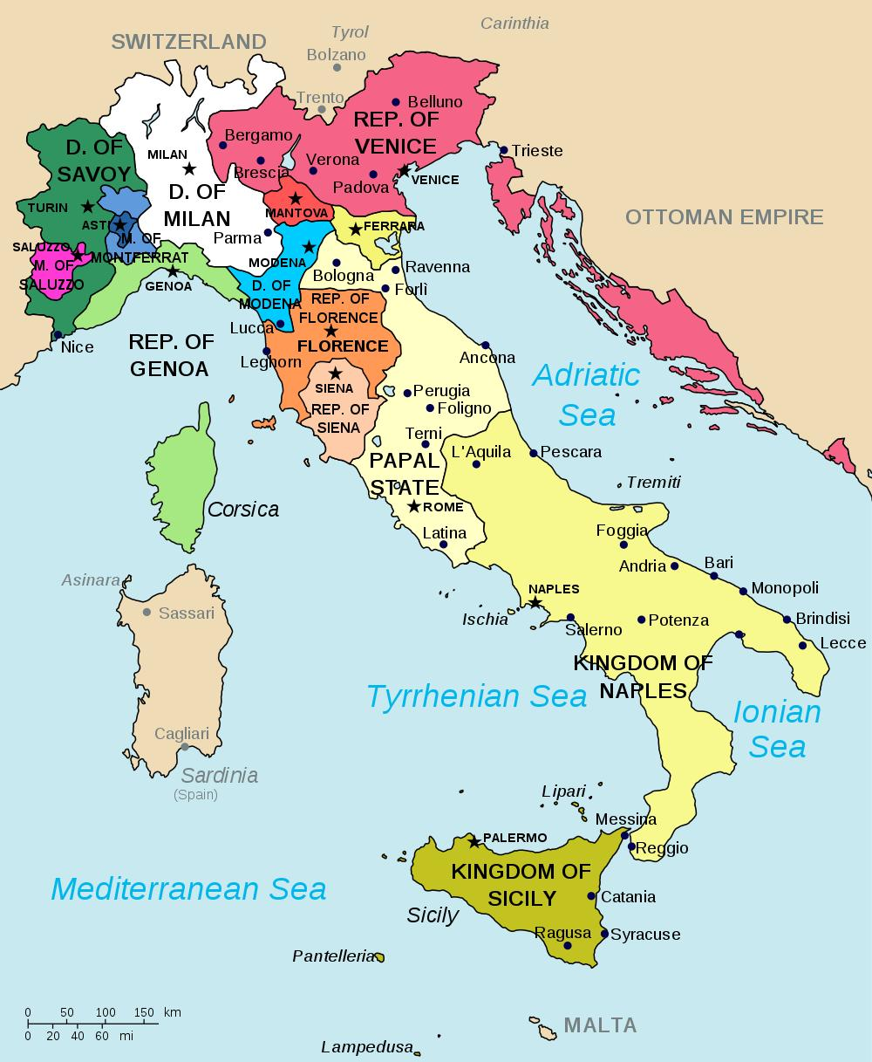
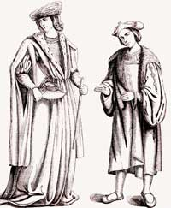

Slide 4
The First Big Changes: Culture & Commerce 1450-1650
Western art focused on realism
Leonardo da Vinci (painter & inventor)
Michelangelo (painter & sculpture)
Machiavelli (political theorist)
Humanism
Focus on human kind as the center of intellect & art
reintroduce the subjects of history, literature, and philosophy.
These are known as the humanities.

Slide 5
Italian Renaissance Art
New techniques
Perspective
Realism
Artist
Michelangelo and Donatello both utilized realism to portray the human body.
Leonardo da Vinci was a painter and inventor
Mona Lisa and Last Supper and sketched drawings of machines hundreds of years before their time.

Slide 6
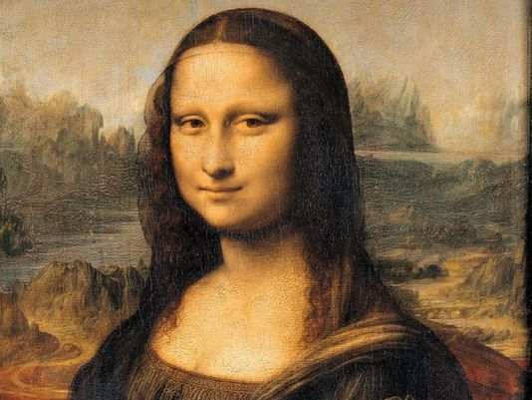
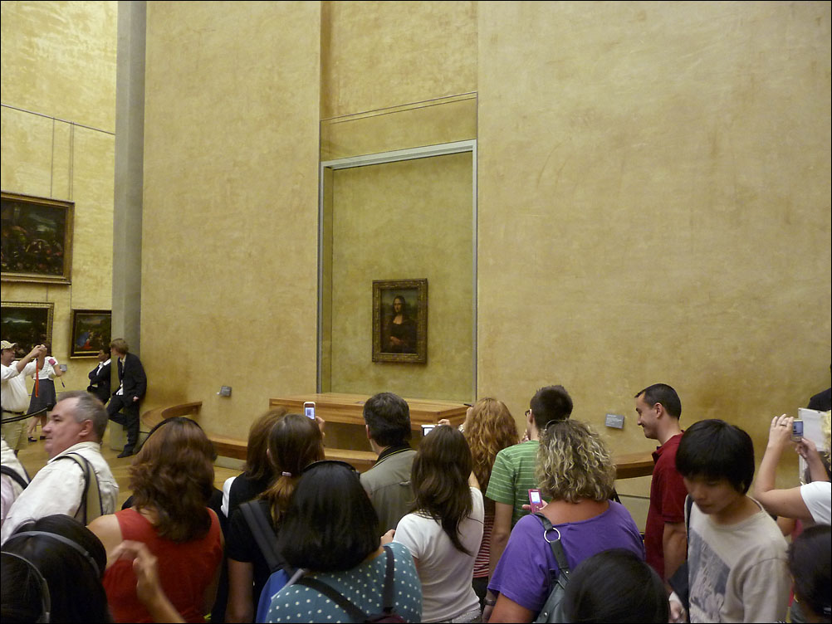
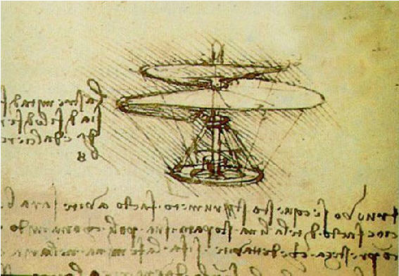
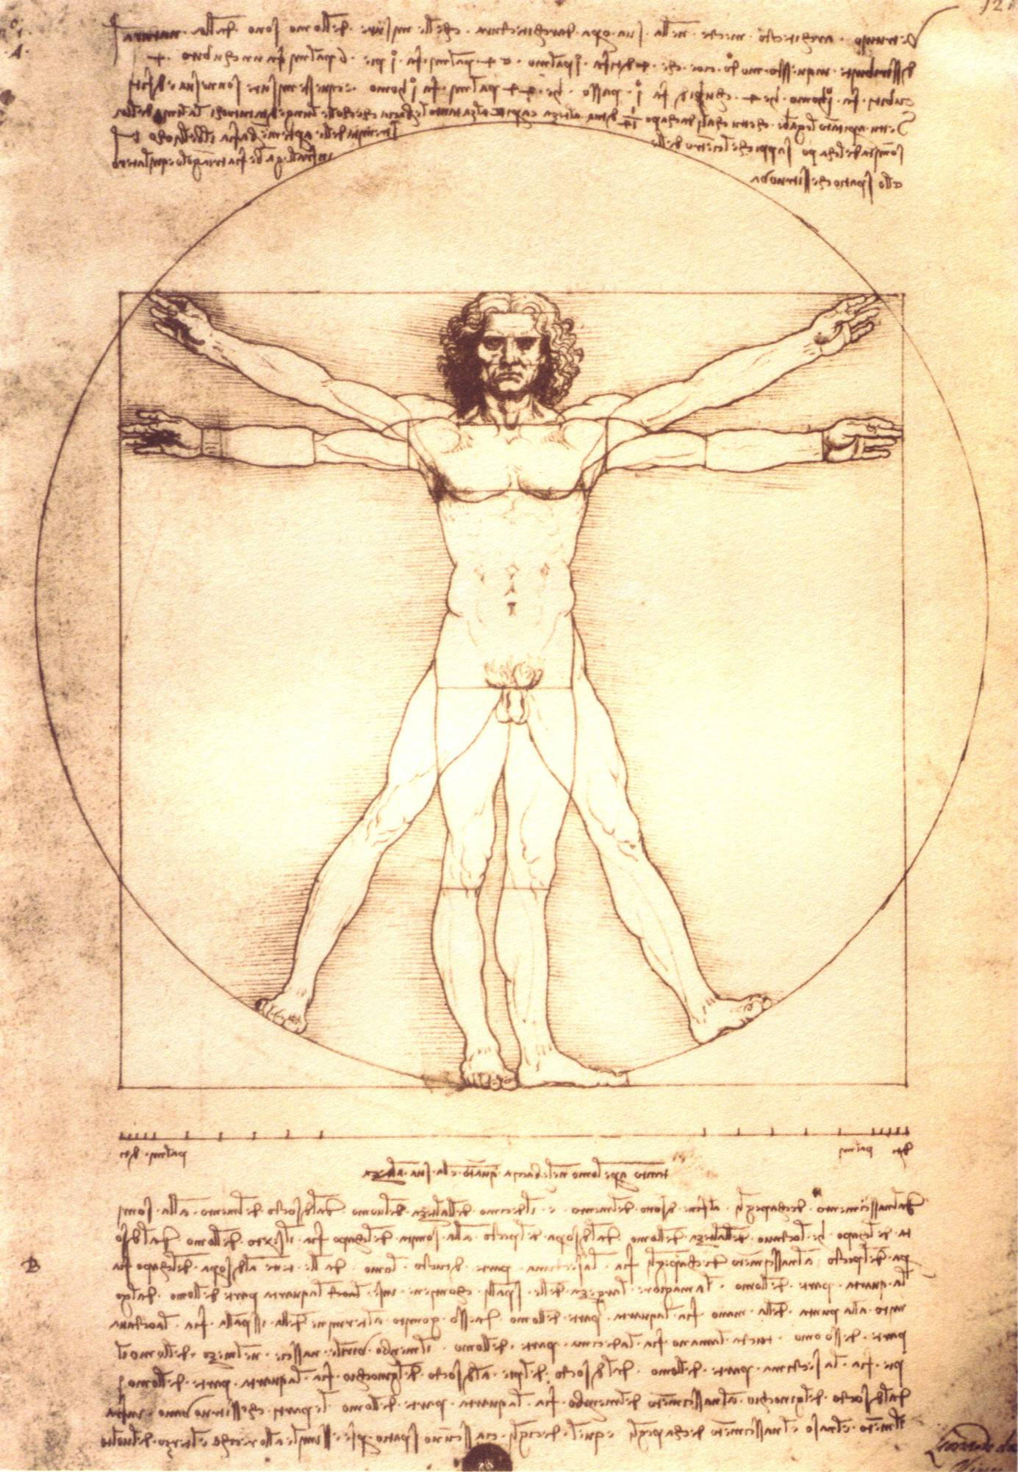

Slide 7
Renaissance Literature and Machiavelli
Writers wrote for self-expression and to portray the individual
This becomes the foundation for modern writers
They wrote to advise others
Niccolo Machiavelli
Was a political theorist
Wrote the The Prince
Advises Rulers on how to gain and keep power
He says that a ruler must be willing to trick his enemies and his own people for the good of the state.

Slide 8
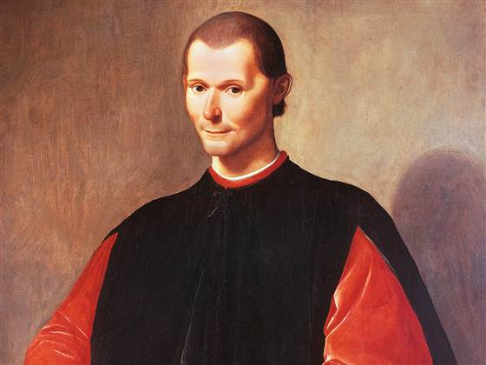

Slide 9
The Renaissance Moves Westward
By 1500, impetus moves north
“Northern Renaissance”
France, Low Countries, Germany, & England
More concerned with religion than secularism
Writers:
Shakespeare
Rabelais
Cervantes

Slide 10
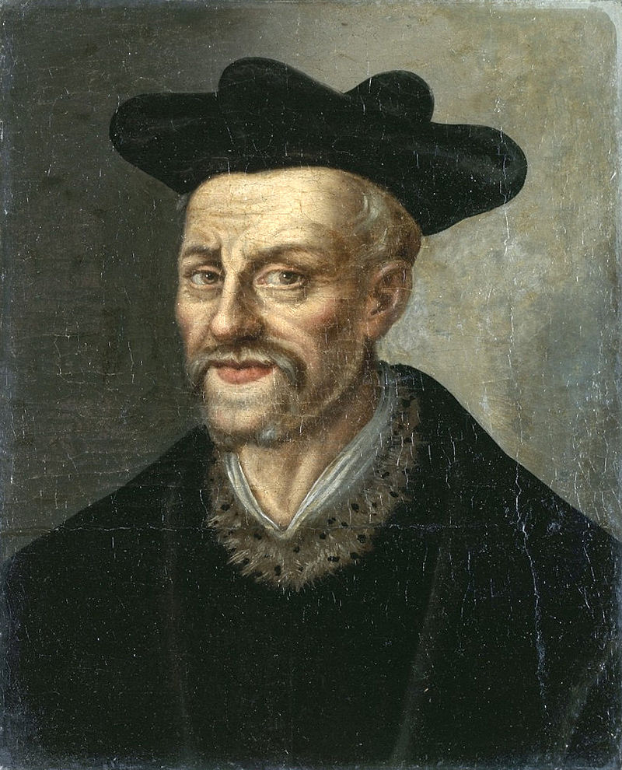
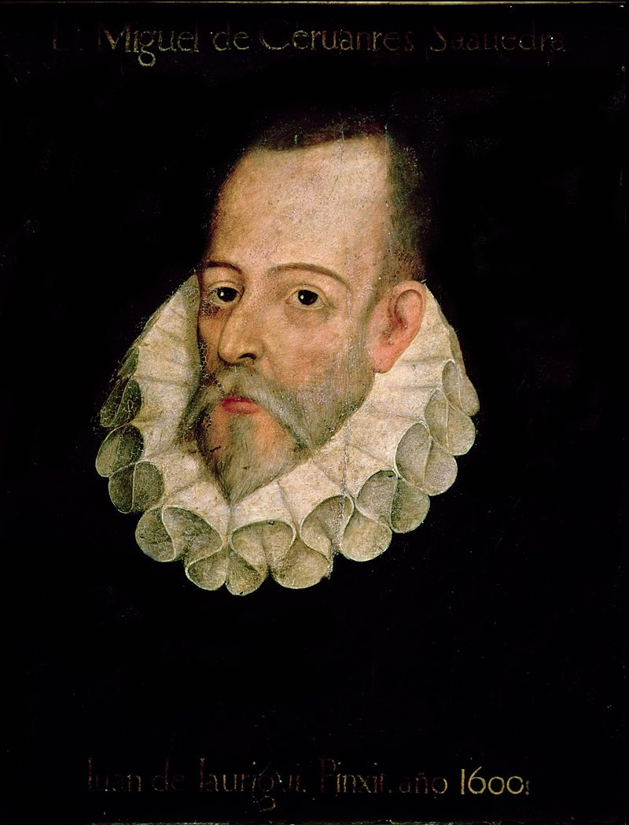

Slide 11
Political Changes of the Renaissance
greater state powers
Kings use increased revenues to increase pomp & ceremony
Francis I
Feudalism still popular

Slide 12
Changes in Technology & Family
Johannes Gutenberg
Movable type = printing
Expands literacy & ideas
European Style Family
Marry later
Emphasis on nuclear family
Limit birth rates
Property

Slide 13
