Slide 1
Things Outside the Ancient Civilizations

Slide 2
The Americas: Olmec People (1200-400 BCE)
Built the first large settlements
Found along the coast of the Gulf of Mexico
Were able to grow two maize crops a year
Created water drainage systems for urban areas
Best know for their ability to sculpt
Large basalt rocks
Culturally influenced the Mayan and Aztecs

Slide 3
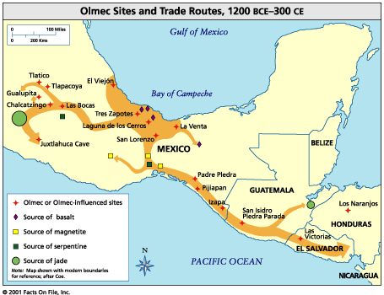
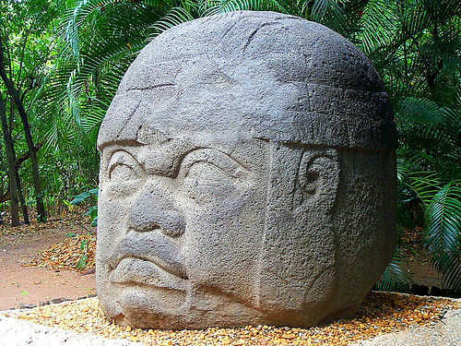
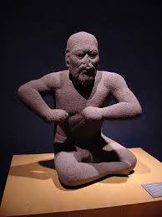

Slide 4
Pacific
Early Civilizations begin to appear in the Pacific sometime before 1500 BCE in the Philippines and New Guinea
They slowly spread from island to island
They had reached Tonga and Samoa by 1000 BCE
Polynesians would not reach Hawaii until 300 CE, Easter Island 400 CE, and New Zealand 1350.

Slide 5
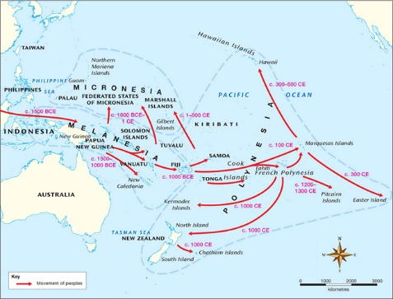

Slide 6
Judaism
Found by Abraham
Judaism is a monotheistic religion (belief in one god)
The holy text of Judaism is the Torah
The Ten Commandments act as a covenant, or agreement, between the Jews an God.
It provides right from wrong

Slide 7
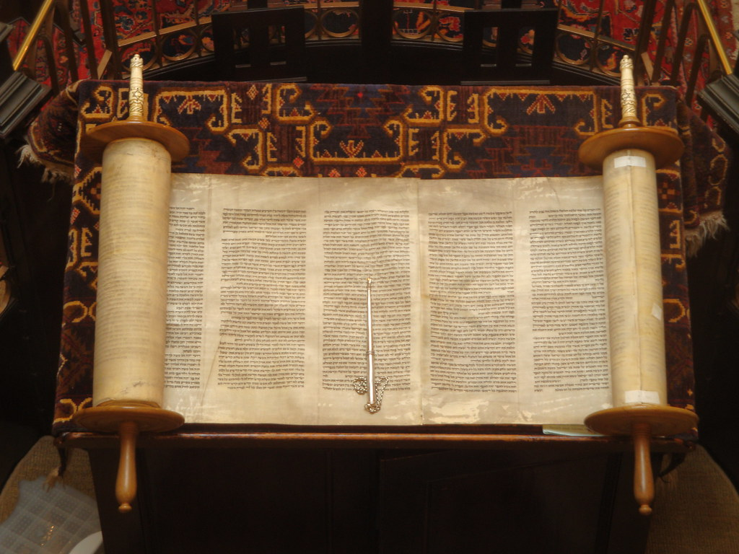

Slide 8
Confucianism
Founded by Kung Fuzi during he late Zhou Dynasty
Confucianism taught:
Five Key Relationships
respect for superiors (fathers and husbands)- Filial Piety
Obedience
leaders must show moderation in spending & lifestyle
rank in society/politics based on intelligence, merit
Dominate values were secular rather than religious
Analects - book of Confucian doctrine (teachings)

Slide 9
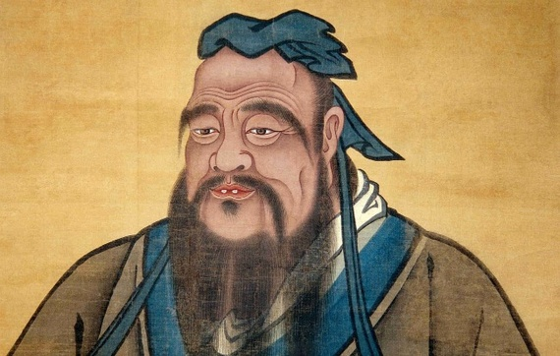

Slide 10
Silk Road Trade
The Silk Road was a trade network that connects east Asia to the Mediterranean in Europe.
The trade network provided wealth for the empires at either end.
It also introduced new cultural ideas
Items traded include:
Silk
Fruits
Gold
Luxury items

Slide 11
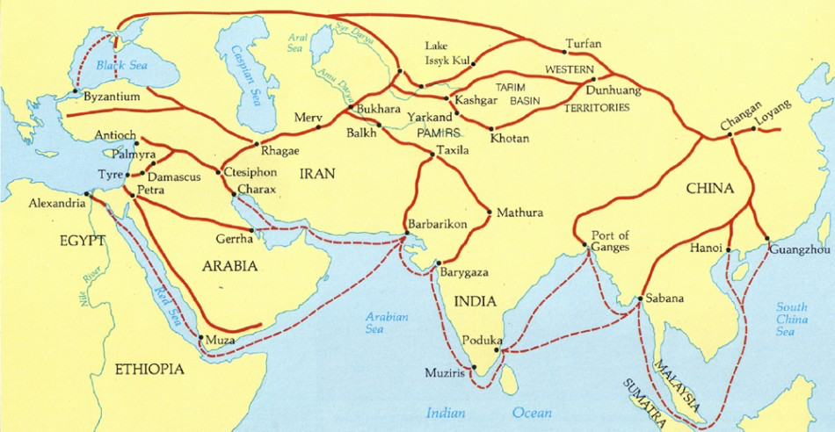

Slide 12
Indian Ocean Trade Network
A trade network that connected east Asia to south Asia via the sea and connected south Asia to east Africa.
Trade in the Indian ocean was entirely dependent on the seasonal monsoon winds.
Items traded include:
Spices
Religion
Pottery
Bananas
Coconuts

Slide 13
Phoenicians
Centered in modern day Lebanon
Around 900 BCE they began to move westward across the Med.
Greeks called them “red men”
Known for creating a red-purple dye from glands of a snail
Major trade networks
Established colonies throughout the Med.
Ex. Carthage
Legacy:
Alphabet:
Consisted on 22 consonants
No pictorial symbols
Depicted only sounds
Ancestor of the Roman alphabet

Slide 14
