Slide 1
The World Since 1945
Outside of the Cold War and in additional to Nationalism and Decolonization.

Slide 2
Egypt
Gamal Abdul Nasser – Radical leader Egypt
Took power via coup in 1952 to end rule of the corrupt khedival regime
Allied with the Muslim Brotherhood
Founded by Hasan al-Banna
Revivalists of Islam
Social reform

Slide 3
Nasser
Dictator
Land redistribution
State-financed education
Food staples regulated
Massive population growth
Industrial growth based on Stalin’s 5 Year Plans
Forced British out of the Suez Canal
Aswan Dam Project
Six Day War
Israel

Slide 4
Anwar Sadat
Negotiated with Israel
Opened Egypt to aid and investment from the US and the West
Honsi Mubarak
Continued Sadat’s move to capitalism & pro-Westernization

Slide 5
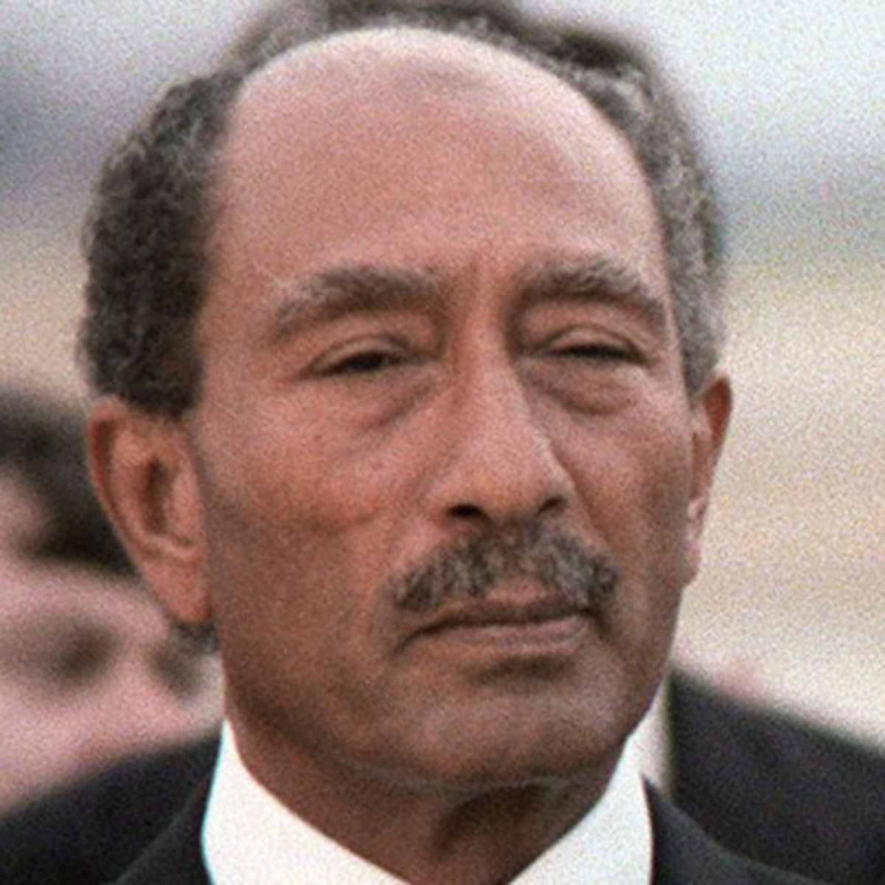
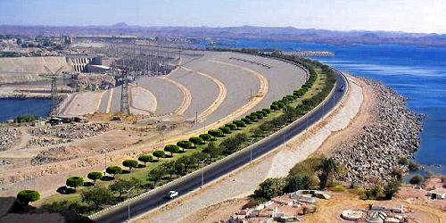
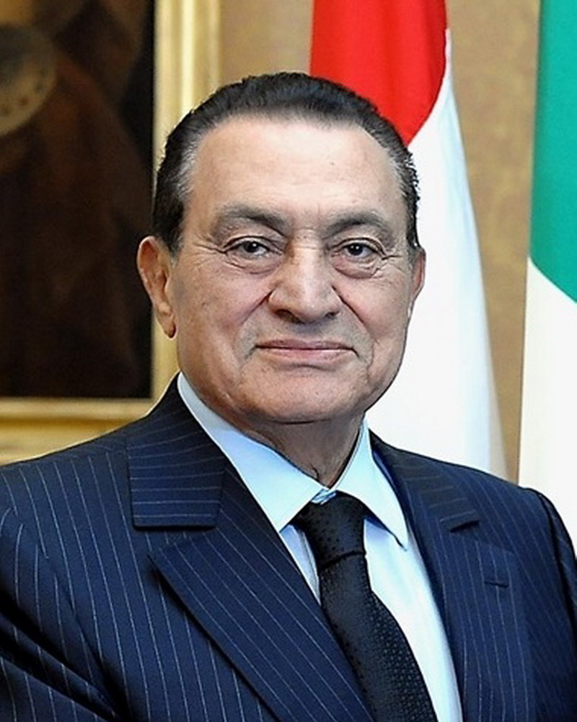

Slide 6
Iran
Religious Revivalism and the Reaction of the West
Pahlavi Shahs
Wanted to modernize Iran
Wanted economic development and social change
Alienated religious leaders and the mass population
Overthrown by Khomeini
Ayatollah Ruhollah Khomeini
Wants to return to the “Golden Age” of Muhammad
Wanted to spread the revolution to surrounding areas

Slide 7
Radical Reforms
Sharia law
Opposition repressed
Purging of western influence
Women become more restricted
Veiling & limitation of careers
War with Iraq
Saddam Hussein
Supported by Western Powers
Iran suffers great losses
Armistice in 1988

Slide 8
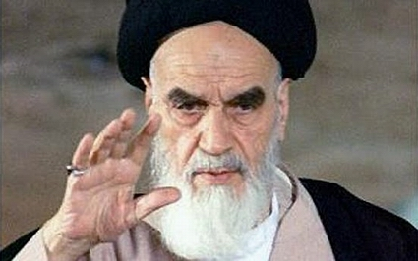
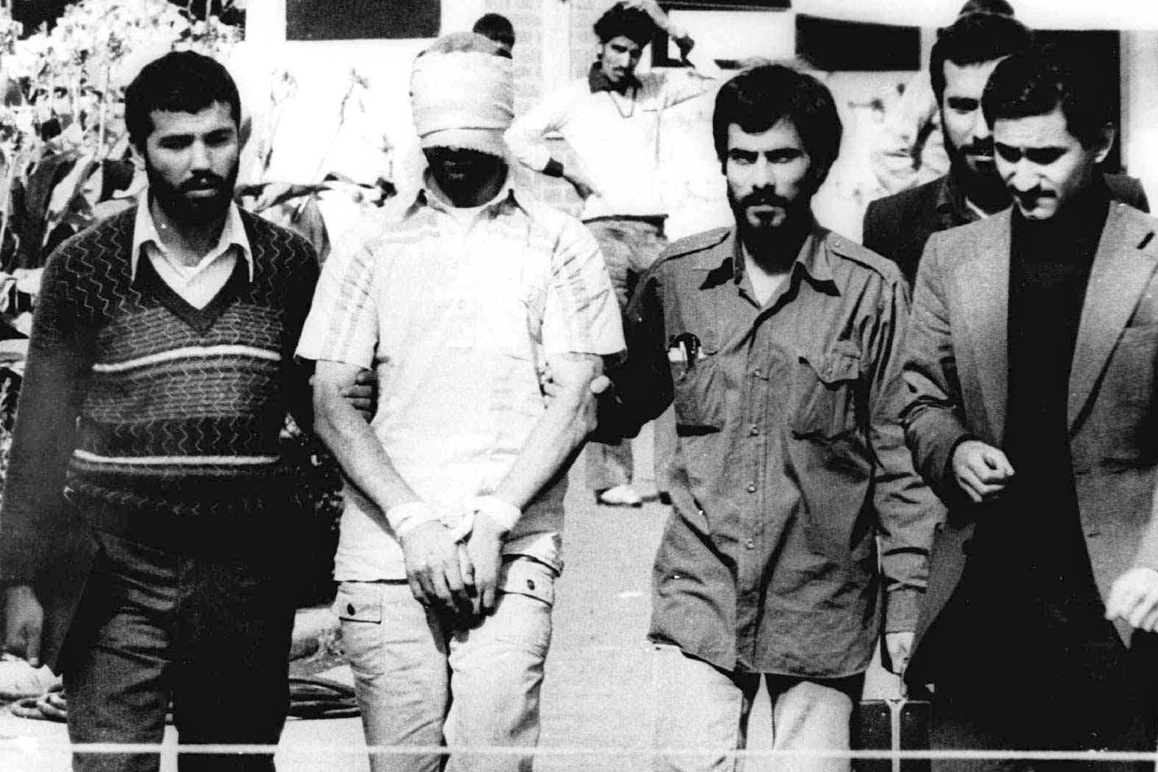
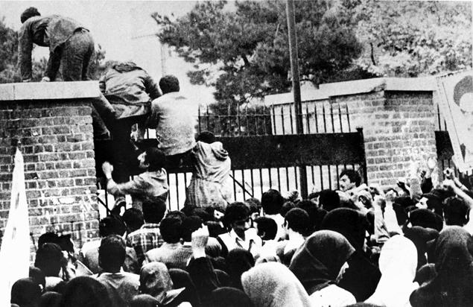
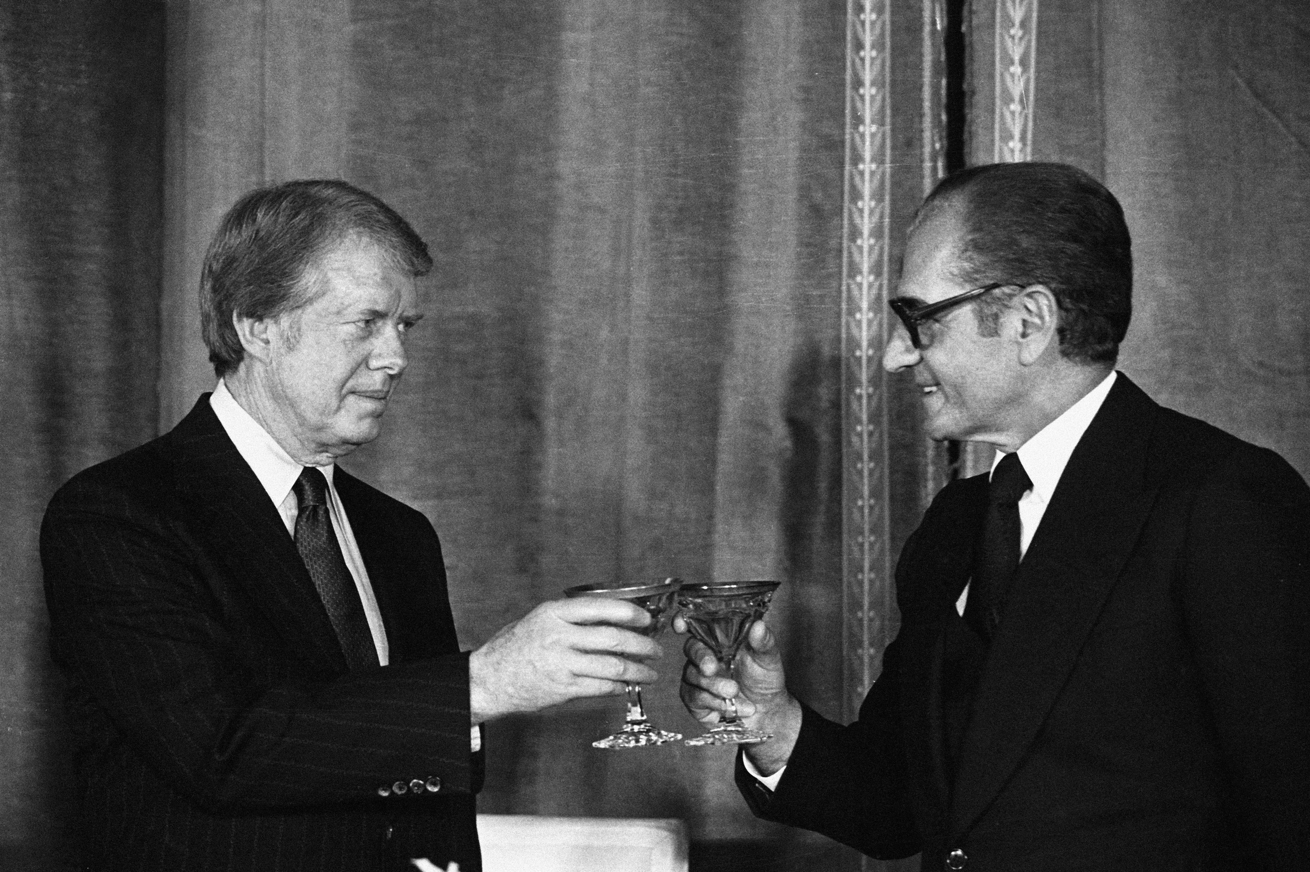

Slide 9
Israeli Palestinian Conflict
Post WWII the pan-Arabism movement began.
called for all Arabs to unit as one
one major obstacle in their way, the new nation of Israel.
1948- Israel is created out of the state of Palestine
Response- creation of the PLO (Palestine Liberation Organization)
Palestinian people led by Yasir Arafat
US and other nations have pressured Israel to give some of the land back
Regions of issue today include: The West Bank, Gaza Strip, and areas around Jerusalem

Slide 11
Persistence of White Supremacy In South Africa
Afrikaner National Party
Apartheid
Between 1990-1993 negotiations took place to end apartheid
In 1994 Nelson Mandela becomes the President of South Africa

Slide 12
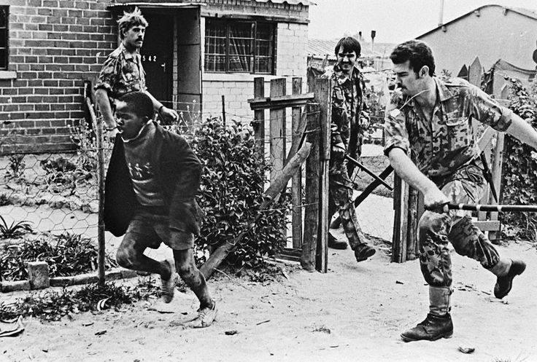
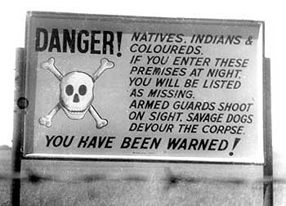
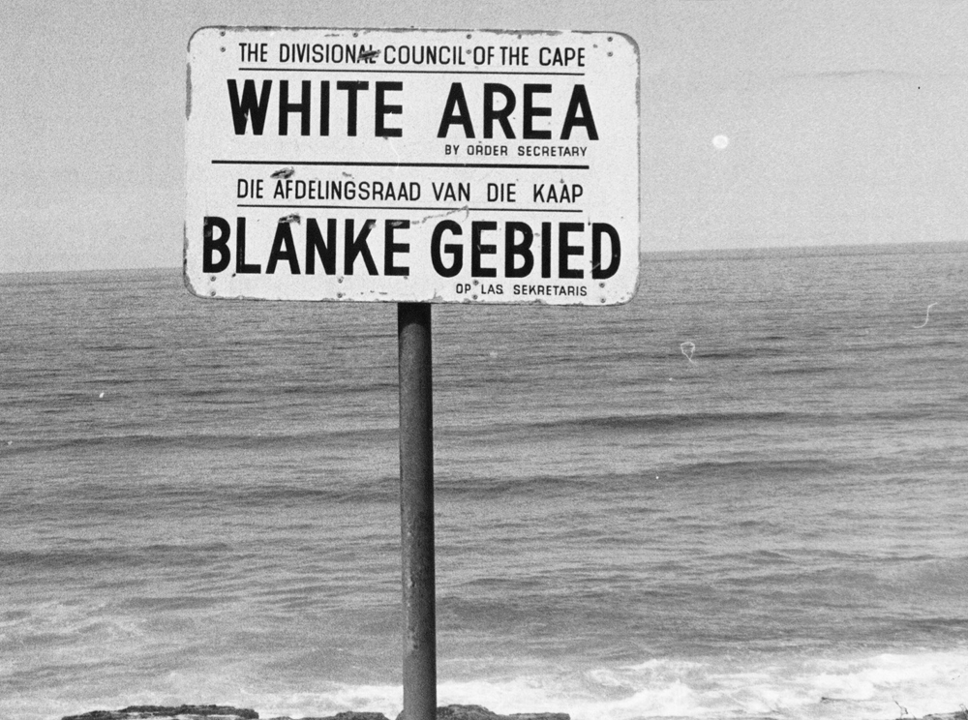
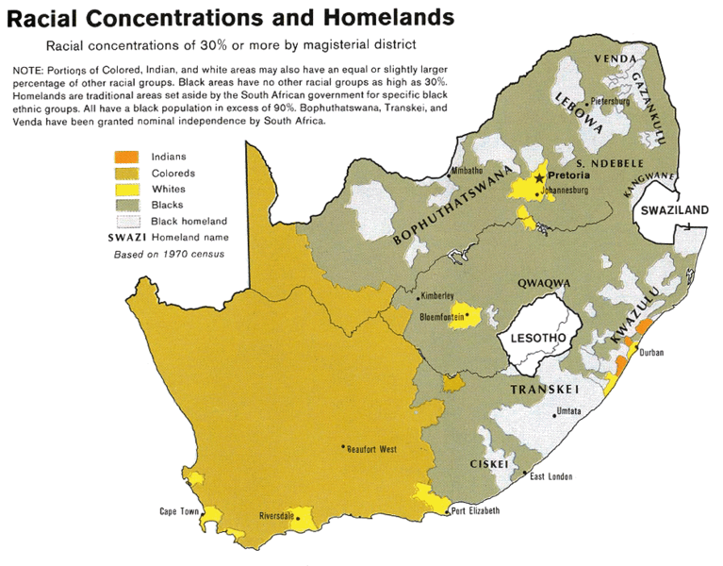

Slide 13
Rwandan Genocide
Lasted from April- July 1994
Population was made up of two ethnic groups
Hutu and the Tutsi (they don’t get along)
Hutu’s control the government
April 1994- a plan carrying the Rwandan President was shot down.
The next day the killings began (100 days of killing)
Hutu Military personnel, police, and ordinary citizens began to kill Tutsi individuals.
July- killing stops
estimated 500,000–1,000,000 Rwandans were killed, as much as 20% of the country's total population
70% of the Tutsi then living in Rwanda.

Slide 14
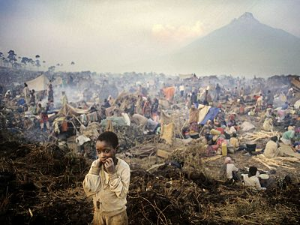
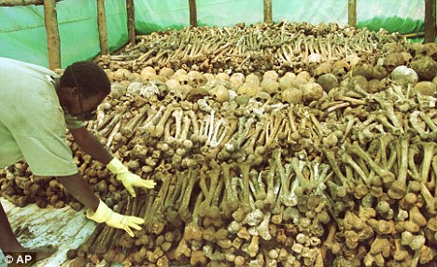
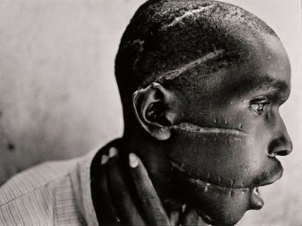

Slide 15
Globalization
Since 1945 the world has become increasingly globalized
Increasing the interconnectedness of all parts of the world
result of political, demographic, cultural, and technological changes
Examples of causes
China opening up to international economic exchange
Soviet Union’s glasnost
Latin America and Asia adopting free market policies
Spread of English
Decline in Nationalism

Slide 16
Technological Globalization:
Cellular phones, Computers, Email, Internet, Satellites
Cultural Globalization:
Music, Fashion, Academics, Olympic Games, World Cup Soccer, Food, Media, Holidays, Consumerism, Obesity, Adaption of foreign models
Institutions of Globalization:
UN, World Health Organization (WHO) , International Nongovernmental Organizations (INGOs), International Monetary Fund (IMF), World Bank

