Slide 1
The World Between the Wars

Slide 2
Revolution and Post War Boom
Prior to the end of WWI Russia underwent a social and political Revolution
Economic boom in the west centered around consumerism.
The US and Japan have economic gains
New Authoritarian movements surface in Eastern Europe and Italy

Slide 3
Cultural and Scientific Changes
Cubist movement (Artistic movement)
Picasso
Renders familiar objects geometrically
Scientific advancement
Einstein’s theories of relativity
Genetics
Atomic structure is mapped

Slide 5
Mexican Revolution
Mexican Revolution
10 year civil war
Eventually influenced by WWI
Affects exports
Reliance on outside supplies
Foreign control – US businesses own 20% of national territory in Mexico
Porfirio Diaz
In power since 1876
Rules as a dictator
Corrupt political system benefits political elites
Hacienda system continues under Diaz
Strict censorship of complaints

Slide 6
Francisco Madero
Ran against Diaz in 1910 elections
Arrested & Diaz stays in control
Madero Calls for revolt upon his release from prison
Rebellion
Pancho Villa, Madero, Emiliano Zapata
Leaders of the rebellion against Diaz
Diaz removed from power
Madero assassinated in 1913 by a military coup

Slide 7
Victoriano Huerta comes to power
Supported by landowners, the army, and foreign companies
Villa & Zapata rise against Huerta- Huerata forced out in 1914
Villa and Zapata fight over leadership and how to run the new regime
General Alvaro Obregon
Becomes first elected President of Mexico when civil war ends in 1920
Mexican Constitution of 1917
Promises land reform
Limited foreign ownership of resources
Gives workers rights
Restricts church power
Educational reforms

Slide 8
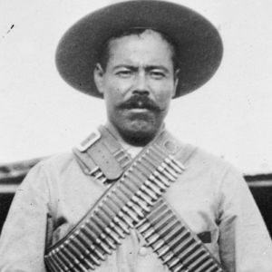
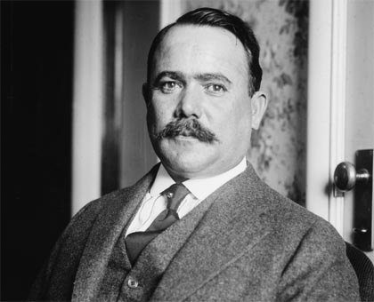

Slide 9
Revolution in Russia: Liberalism to Communism
Revolution breaks out in St. Petersburg in 1917
Food riots
Strikes
Wanted a new political regime
Many were tired of the Tsar and his policies
Two failed wars (Russo-Japanese War of 1905 and the WWI)
The soviet (a council of workers) take over the city
Tsar abdicates (gives up) the throne

Slide 10
Alexander Kerensky
Liberal Russian Revolutionary leader
November 1917 (Bolshevik Revolution)
Bolsheviks (Communists) take over
Led by Lenin
Close Parliament
Forms a Congress of Soviets
Stayed in control until 1989
1918-1921- Civil War
The Western World reacts to Russia’s civil war
Anti-Communism known as the Whites (supported by western powers) fight against the Bolsheviks (communist) known as the Reds.
Reds win the civil war
During the civil war the Tsar and his family are held as prisoners and eventually murdered by the Bolshevik forces

Slide 11
Stabilization of Russia’s Communist Regime
Red Army
Led by Leon Trotsky
Used able generals and loyal masses
Lenin’s New Economic Policy
1921
State set basic economic policies
Union of Soviet Socialist Republics (USSR) formed in 1923
Bolshevik revolution a success
Moscow becomes the new capital
New constitution

Slide 12
The Supreme Soviet
Parliament
Elections held
Competition in elections prohibited
Communists have a monopoly over power
Communists reestablish an authoritarian system

Slide 13
Soviet Experimentation
Gains for workers & women
Education focus on communism and science
Lenin dies in 1924
St. Petersburg renamed Leningrad
Succeeded by Joseph Stalin

Slide 14
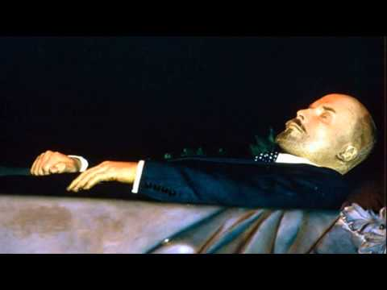
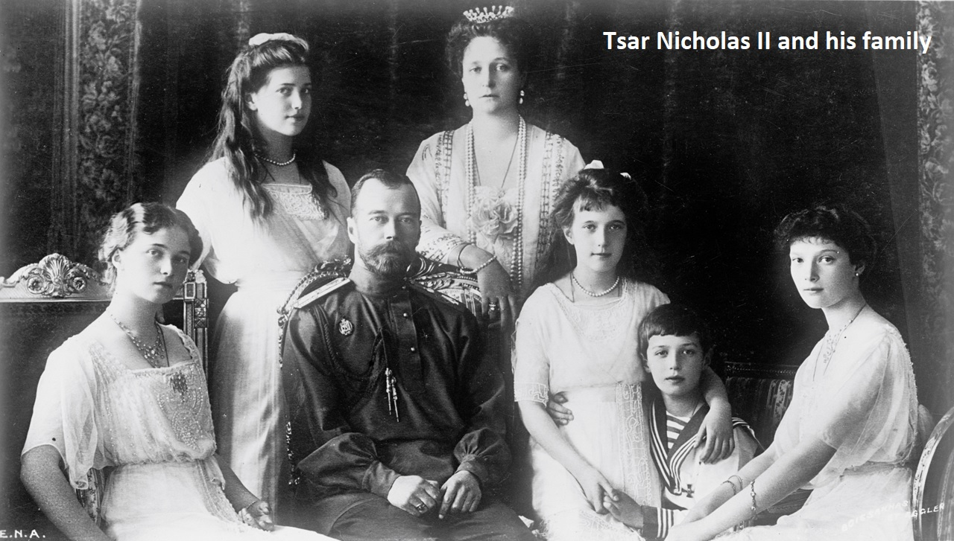
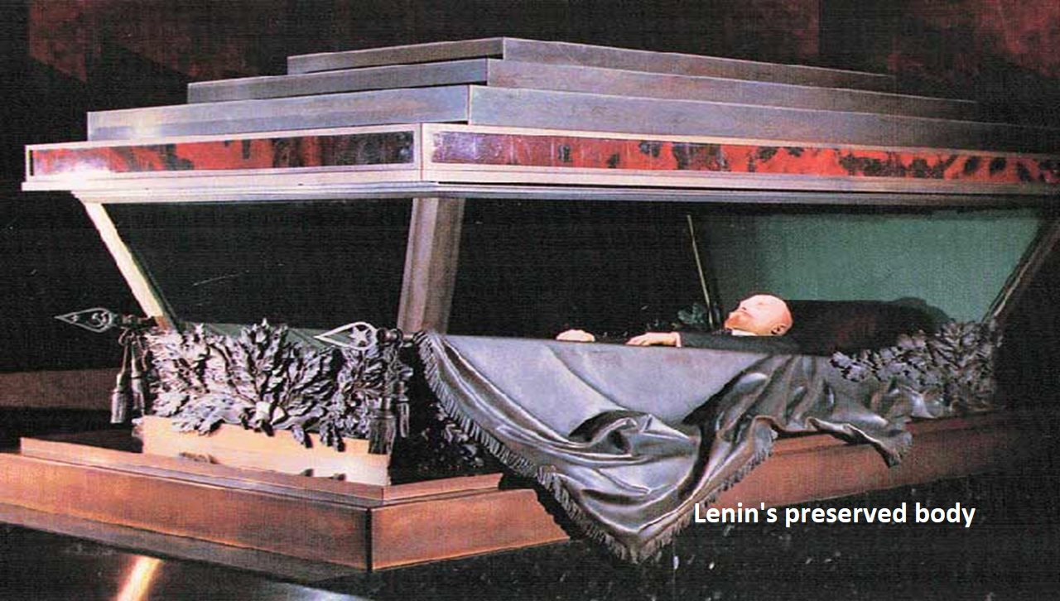
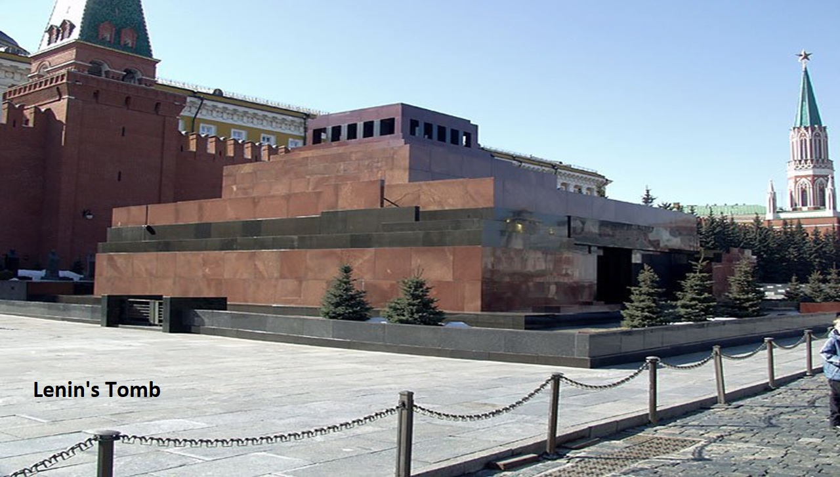
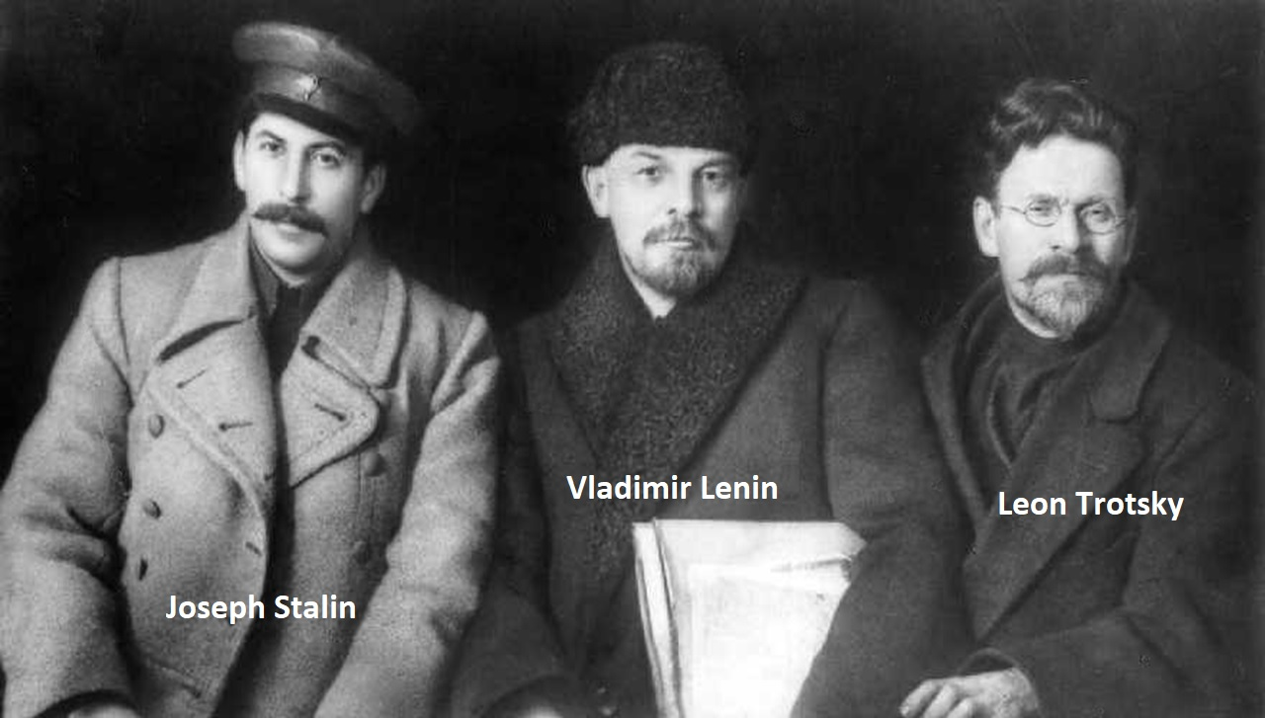

Slide 15
Weimar Republic
Germany
Becomes a democratic republic
Hapsburg & German Empire end
Still paying reparations
Economy is in shambles
German Mark (currency) is worthless
The German Mark goes through hyper inflation
Kellogg-Briand Pact
Countries agree to never to war again

Slide 16
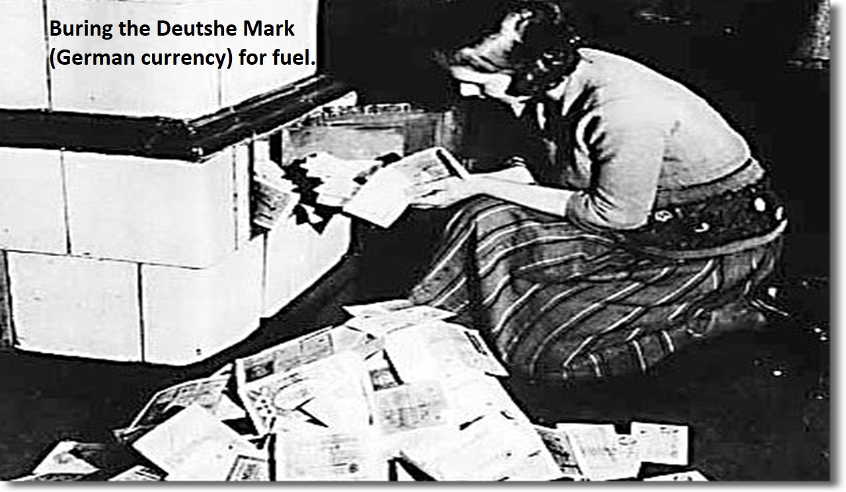

Slide 17
The United States
The United States
Economic boom
Ford introduces the assembly line in 1913
Cultural exports
Jazz spreads in African American centers
Hollywood becomes global
The US Senate
Rejects the Versailles treaty
Refuses to enter the League of Nations
Isolationism
“Red Scare”
Fear of communism

Slide 19
Rise of Fascism in Italy
Benito Mussolini
Forms fascio di comattimento or “union for struggle”
Replaces socialism and capitalism
Fascism
Authoritarian leadership devoted to nationalists values
Conditions Post WWI in Italy
Nationalists resent little gains received after the war
Veterans felt abandoned by civilian society
Labor unrest increased
Inept parliament
In 1922 the Italian king calls on Mussolini to form a new government
Elections suspended in 1926

Slide 20
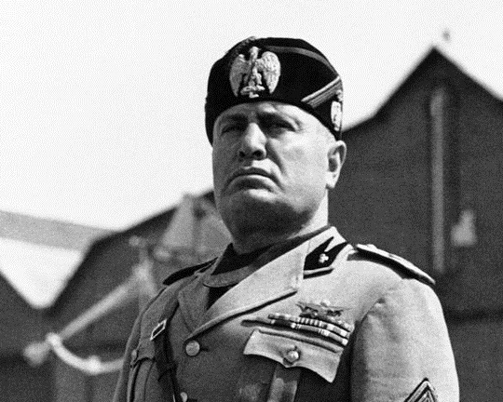

Slide 21
China
Sun Yat-sen
Heads the Revolutionary Alliance
Leads revolt
Elected President in 1911
Establishes a western-like Parliament
Resigns in 1912
Yuan Shikai becomes president
Yuan Shikai
Used military power to put down opposition
Schemes to become next emperor foiled by:
Rival warlords
Republican nationalists
Japan

Slide 22
May Fourth movement (1919)
Aimed at forming China into a liberal democracy
Western Reform
Mass demonstrations protesting against Japan
The Bolshevik victory leads to Chinese intellectuals to consider the works of socialist thinkers
Marx, Lenin, Engels, Trotsky
Li Dazhao
Marxism adapted to fit China
Saw peasant, rather than urban workers, as the vanguard of revolutionary change
Influences Mao Zedong

Slide 23
Mao Zedong
Leads the Communist Party of China in 1921
Attacks imperialist powers
Wanted a government committed to social reform and social welfare
Similar to Confucianism

Slide 24
The Seizure of Power By China’s Guomindang
Guomindang – Nationalist Party
Put together by Sun Yat-sen 1919
Allies with Communists
Supported by the Soviet Union
Wampoa Military Academy
Chiang Kai-shek – head of academy
Political tensions distract Nationalist leaders from the economic downfall
Famine and disease prevalent

Slide 25
Chaing Kai-shek
Seizes power after Yat-sen dies
Attacks Communists
Massacre in Shanghai 1927
Workers killed
Mao Zedong
Long March of 1934-1935
Solidifies Mao’s leadership of the Communist Party

