Slide 1
The Spread of Islam and Cultural Interactions

Slide 2
Islam In South Asia
Islam transmitted via invaders, traders, & migrants to Asia
Political Division & the First Muslim Invasion
First Muslims were traders
Muhammad ibn Qasim declared Sind & Indus Valley as part of Islamic Empire after dhows were attacked by pirates
Hindus and Buddhists treated as Dhimmi
Hindus and buddhist were allowed to keep their religion and practices. Essentially they had a protected status

Slide 3
From Booty to Empire: 2nd wave of Muslim Invasion
Turkish dynasty established in Afghanistan
Mahmud of Ghazni
Led Muslim raids & conquest of N. India
Muhammad of Ghur
Conquest of Gangetic Plain
Assassinated

Slide 4
The Delhi Sultanate 13th-16th Centuries
Lasted for 300 years
Never developed a highly centralized bureaucracy similar to the Chinese
Political decentralization continues in India
Local kingdoms continued
The Sultanate was never able to effectively impose it’s polices
Wanted to extend its control a territory to the south but had to fend of the Mongols from the northwest
Successfully prevented the Mongols from conquering South Asia but eventually fell to another Islamic empire, the Mughals

Slide 5
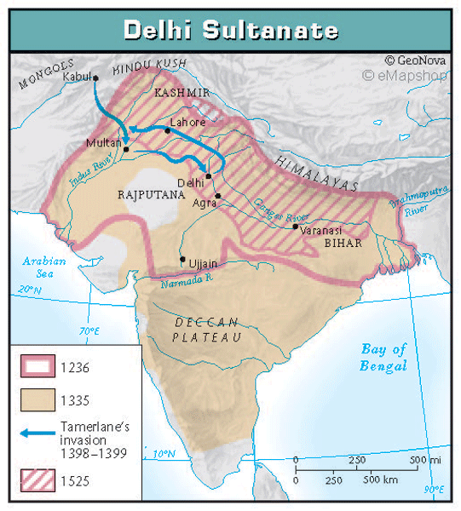
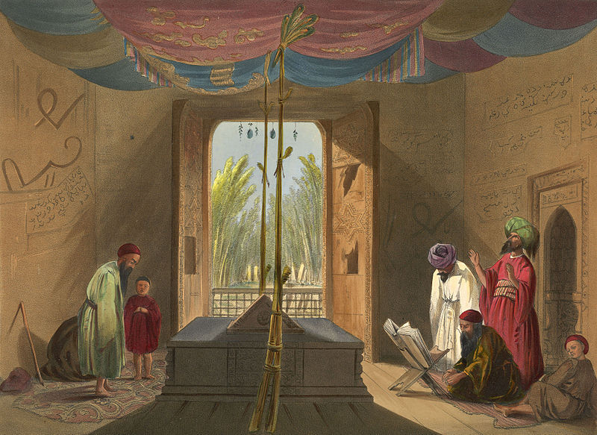

Slide 6
Patterns of Conversion
Low-caste & outcast Hindus
Buddhists
Some converted to escape Jizya (tax)
Patterns of Accommodation
Islam made little impression on Hindus as a whole
Hindus and Muslims do not like each other.
Muslims failed to integrate into Hindu society
Often seen as foreigners
Muslims & high-cast Hindus contact was rare
Some Muslims adopt sati

Slide 8
Islamic Challenge & Hindu Revival
Bhaktic cults (Hindu)
religious groups who stressed the importance of strong emotional bonds between devotees and the gods or goddesses
Open to women and untouchables
Mira Bai – female religious writer and poet
Kabir – Muslim mystic
Tried to minimize differences between Hindus and Muslims

Slide 9
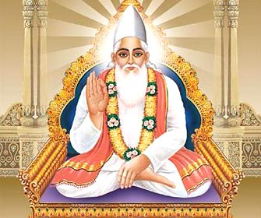

Slide 10
Srivijaya Empire
Was a large trading empire in SE Asia
Controlled much of modern-day Indonesia and the Malay archipelago
Traded extensively in India and China
Leads to the incorporation of Buddhist and Chinese political practices
leads to the Introduction Islam
The empire acted as a vassal state to China
Official language was Old Malay- incorporated aspects of Sanskrit, Persian, and Arabic
Lost its influence when the Chola empire gained dominance in the waters around SE Asia

Slide 11
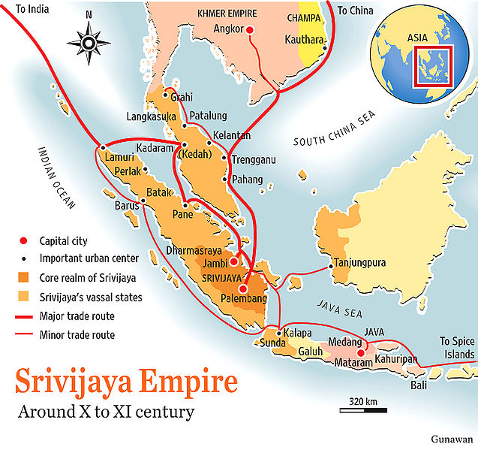

Slide 12
Trading Contacts and Conversions in SE Asia
Trading leads to peaceful conversions
Sufis played an important role
Sufiism- Islamic mysticism that emphasizes introspection and spiritual closeness with God
Important trading cities
Malacca
Demak
Elites practiced Buddhism, but most of population converted to Islam
Islam was infused with Mystical strains from Sufis
Women had a strong position
Matrilineal

Slide 14
The Arrival of Islam in N. Africa
As part of the Roman & Greek Empires Christianity was main religion
Muhammad’s followers swept across N. Africa spreading Islam
Arab & Berber armies
Spread stopped by Martel & the Franks at the battle of tours in 732
Almoravids & Almohadis– puritanical reformist
Launched jihad
Islam promoted equality of believers
Social stratification continued
Uniting of powers of the state & religion appealed to African kings

