Slide 1
The Spread of Chinese Culture
Japan: Era of Warrior Dominance

Slide 2
Early Middle Ages in Japan
Chinese influence on Japan peaked in the 7th and 8th centuries
Rulers sought to build a Chinese-style bureaucracy & society
Shintoism remained central to Japanese culture
Periods
Taika (645 – 710)
Nara (710 – 784)
Heian (784 – 857)
Fujiwara (established in 668) – elite family dominating government
Married daughters to the emperors until their demise in the12th century

Slide 3
Start of the Feudal System
House governments ruled mini-states within Japan
Regional lords (bushi)
Administer law
Supervise public projects
Collect revenue

Slide 4
Bushi have private armies of samurai
Samurai also protect emperor & serve as body guards
Emergence of Warrior class
Warrior codes of honor & death over retreat/defeat
Seppuku – ritual honor suicide
Beginning of Japanese Feudalism
Peasants = serfs

Slide 5
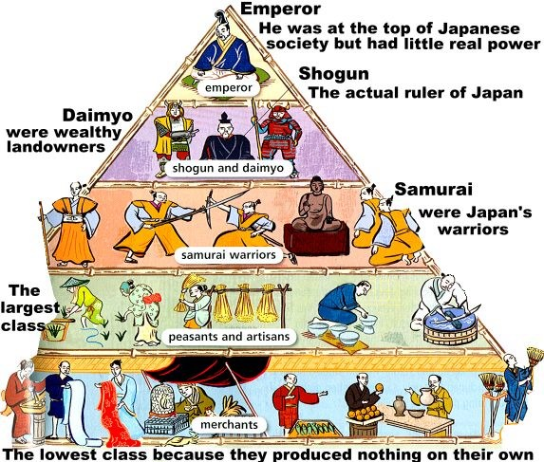

Slide 6
The Era of Warrior Dominance
Family rivalries dominate by the 11th & 12th centuries
Taira & Minamoto
Form alliances with provincial lords (bushi)

Slide 7
The Declining Influence of China
Scholarly gentry declines and aristocratic power reasserted
838 Japanese embassies to China stop
Trade with China continues
Gempi Wars
Fighting between Taira & Minamoto (winner)
Bakufu established– military government

Slide 8
The Breakdown of Bakufu Dominance & the Age of the Warlords
Yoritomo – Minamoto leader
Weakens Kamakura regime due to paranoia
Assassinates relatives
Shogun fearful of spies
Hojo family dominates Kamakura regime after Yoritomo’s death

Slide 9
Ashikaga Takuaji
Minamoto leads revolt against bushi
overthrows the Kamakura regime
Establishes Ashikaga Shogunate (1336 – 1573)
Emperor driven from Kyoto
Collapse of centralized authority leads to civil war among Ashikaga rival heirs (1467-1477)
Kingdom broken down to 300 little kingdoms ruled by Daimyos (warlords)

Slide 10
Military Division & Social Change
Patterns of warfare change
Less Samurai & more armed peasants
Size of army & effective leadership key components
Peasants looted & pillaged – Barbaric behavior
Economic & cultural growth supported by daimyos
Irrigation systems, regular tax collection, etc…

Slide 11
New tools, greater use of animals, and new crops
Merchant class emerges
Japanese women could be strong in commercial classes
Primogeniture arises among daimyo – major change for women of elite classes
Disinheritance forces women to marry to form alliances between households
Women taught to slay themselves over dishonor

Slide 12
Artistic Solace for a Troubled Age
Zen Buddhism appealed to warrior elite
Zen monasteries provided renewed diplomatic and trade contacts with China
Revival of Chinese influence – cultural

