Slide 1
The Scientific Revolution
16th -18th centuries

Slide 2
Introduction
The new wave of ideas of the Renaissance challenged medieval thinking and superstition.
The Renaissance was built upon the rediscovery of the ancient world.
Namely the Greeks and Romans
The ideas of the Scientific Revolution would challenge previously held ideas of the natural world and natural phenomenon that had been passed down from the Greeks and Romans
Aristotle and Ptolemy
This revolution set the foundation for modern sciences and scientific thought.

Slide 3
Challenging the Status Quo
The ideas of the Scientific Revolution were not met without opposition.
The new methods of viewing natural phenomena challenge the long held beliefs of the Catholic Church.
In the 16th century two major challenges to the Church’s authority began
Protestant Reformation and the Scientific Revolution
Note: Not all protestants agreed with the new scientific ideas nor did all Catholics challenge the ideas of the scientific revolution
Many of the scientific thinkers and late enlightenment thinkers will become deist
Don’t believe in a omnipresent god

Slide 4
The Beginning
Nicole Oresme began to challenge the long held beliefs about the structure of the universe as early as the 14th century.
His ideas however are largely forgotten because Oresme did not push them and neither did his contemporaries.
Nicolas Copernicus is usually credited with starting the Scientific Revolution.
He went to university sometime around 1500 to become a humanist
Copernicus argued that the earth was not center of the solar system. Instead he argued the planets revolved around the sun
Geocentrism v. Heliocentrism
Throughout much of his life Copernicus had trouble reconciling his beliefs and scientific ideas
It was not until his death in 1543 that he officially published his works

Slide 5
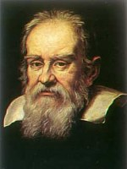
Galileo Galilee (1564-1642)
Developed the laws of motion using the experimental method
Used the experimental method (with controlled experiments)
Acceleration experiment: gravity was a universal force that produced uniform acceleration.
Law of inertia: an object that is in motion remains in motion until it is stopped by some external force.

Slide 6
Galileo and the Church
The Catholic Church in 1616 declared the Copernican theory to be heretical.
In 1632, Galileo published Dialogue Concerning the Two Chief World Systems in which he wrote about the Copernican system as a mathematical proposition.
In 1633, the inquisition of Pope Urban VII forced Galileo to retract his support of the Copernican theory.
He remained under house arrest for the rest of his life.

Slide 7
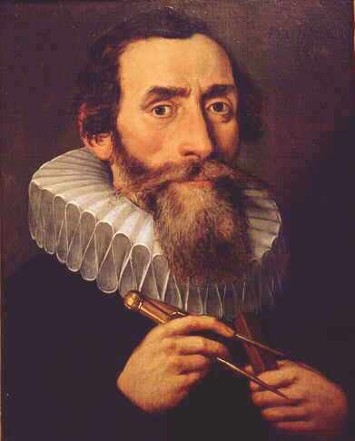
Other Revolutionaries
Johannes Kepler (1571-1630)
He was the first great Protestant scientist
Mathematically, he proved the Copernican theory
Developed the laws of planetary motion

Slide 8
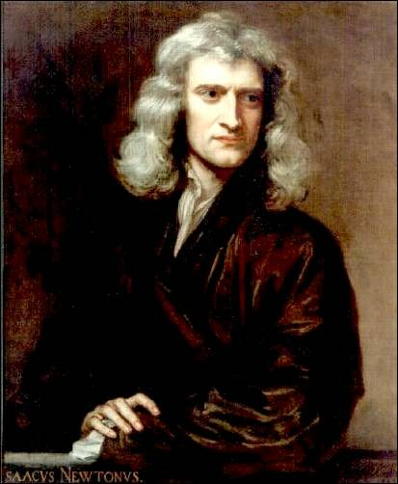
Isaac Newton (1642-1727)
Integrated the astronomy of Copernicus and Kepler with the physics of Galileo into an overarching theory on how the universe worked.
Principle of universal gravitation:
Detailed in Mathematical Principles of Natural Philosophy, (1687) (Known more popularly as Principia).
The natural laws of motion – gravitation – are evident in the movement of heavenly bodies and earthly objects.
He developed a set of mathematical principles to explain motion.

Slide 9
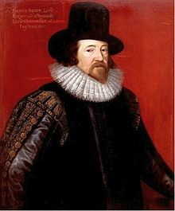
Francis Bacon (1561-1626)
He formalized the empirical method (or empiricism) that had already been used by Brahe and Galileo.
Inductive method for scientific experimentation:
Begin with inductive observation, then form a hypothesis, conduct experiments and then organize the data.
Bacon’s inductive method, coupled with Descartes deductive reason formed the backbone of the modern scientific method.

Slide 10
Legacy of the Scientific Revolution
It challenged the old medieval superstitions
Uncovered knowledge of the physical world
Increased people’s health and understanding of their environment
Laid the foundation for modern science
Helped paved the way for the political and social enlightenment of the 1700s

