Slide 1
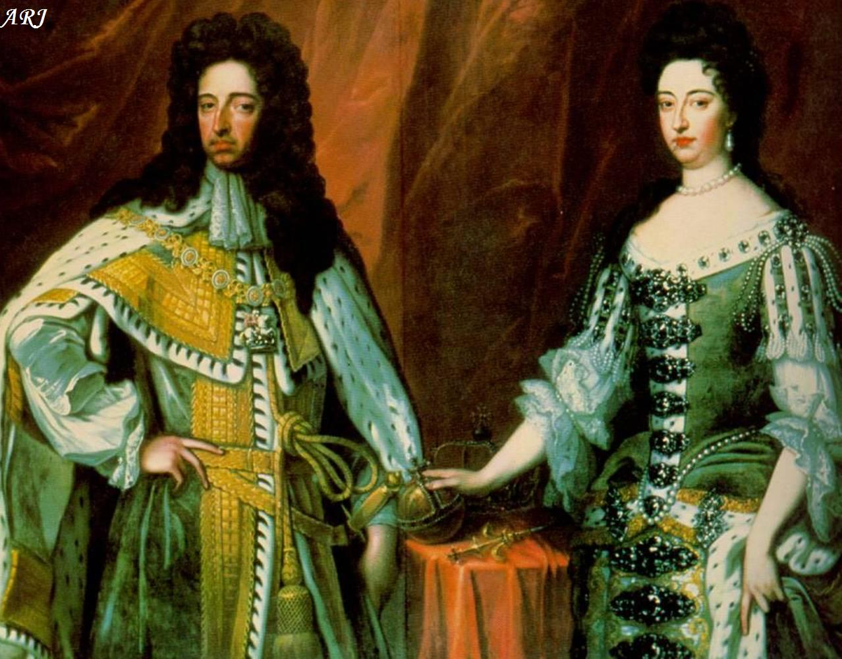
The Restoration and Glorious Revolution
England

Slide 2
The Restoration 1660
The Cavalier Parliament restored Charles II (1660-1685) in 1660
While in exile, he agreed to abide by Parliament’s decisions
Parliament was stronger in relation to the king than ever before in England
King’s power was not absolute
Granted religious toleration
He was known as the “Merry Monarch” for his affable personality.

Slide 4
Development of Two Political Parties
Whigs
Initially they were anti-Catholic (opposed James II)
Later, they were composed of the wealthy middle-class and Puritans who favored Parliament and religious toleration.
They were more liberal in the classical sense.
Tories
Initially, they supported James II as king.
They were composed of nobles, gentry, and Anglicans who supported the monarchy over Parliament.
Essentially conservative es

Slide 5
Habeas Corpus Act (1679)
Whig Parliament sought to limit Charles’ power
Provisions
Enabled judges to demand that prisoners be in court during their trials
Required just cause for continued imprisonment
Provided for speedy trials
Forbade double jeopardy

Slide 6
Charles II in Scotland
When Charles came to power (1660) he agreed to allow Presbyterianism (Calvinism) in Scotland
In 1661 he broke his promise and placed himself at the head of the Church of Scotland
Tried to impose and Anglican church hierarchy
This was met with resistance and thousands died in the struggle against Charles II
Last few years of Charles II reign are known as the “Killing Time”

Slide 7
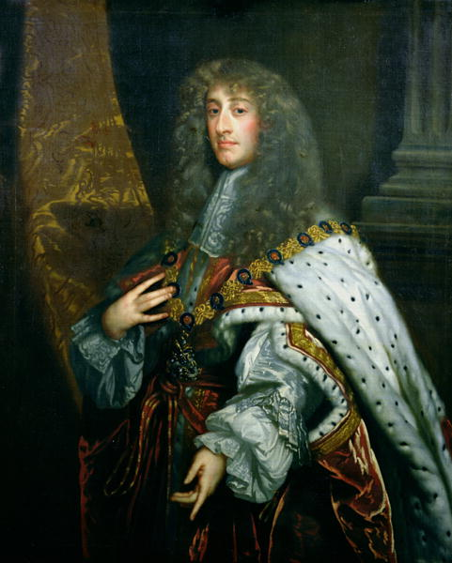
James II (1685-1688)
Inherited the throne from his brother, Charles II
Sought to return England to Catholicism
He appointed many Catholics to high positions in gov’t and in colleges.

Slide 8
“Glorious Revolution” of 1688
Final act in the struggle for political sovereignty in England
Parliament was not willing to sacrifice constitutional gains of the English Civil War and return to absolute monarchy.
Issues with James II
James’ reissue of the Declaration of Indulgence (granting freedom of worship to Catholics
Birth of a Catholic heir to the English throne in 1688

Slide 9
James II is forced to abdicate his throne
His daughters, Mary and Anne, were Protestants.
Parliament invited Mary’s husband, the Dutch stadholder William of Orange, to assume the throne.
In late 1688, James fled to France after his offers for concessions to Parliament were refused.
William III and Mary II were declared joint sovereigns by Parliament.

Slide 10
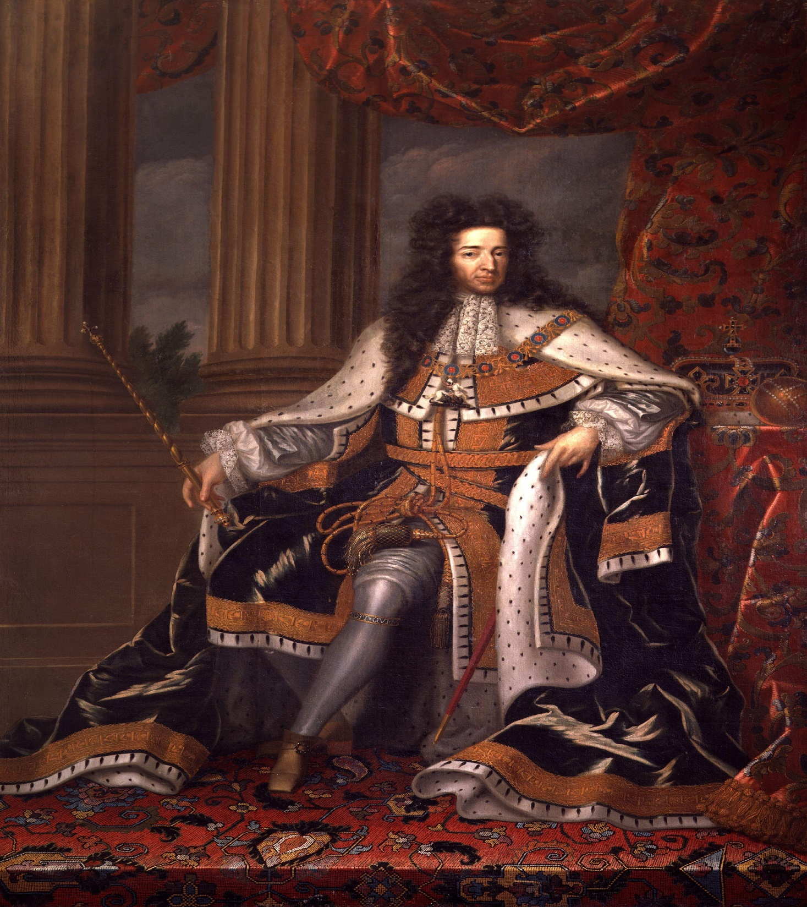
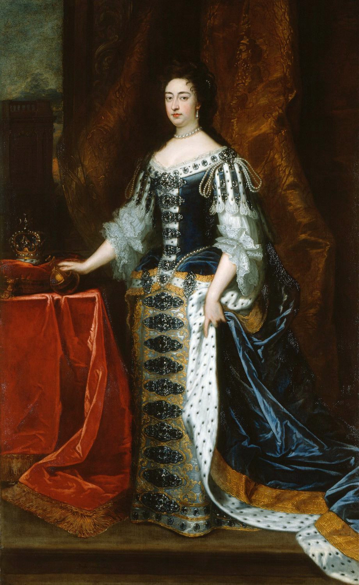

Slide 11
English Bill of Rights (1689)
William and Mary accepted what became known as the “Bill of Rights.”
England became a constitutional monarchy
The Bill of rights established parliamentary sovereignty
This became the hallmark for constitutionalism in Europe.
The Petition of Right (1628), Habeas Corpus Act (1679), and the Bill of Rights (1689) are all part of the English Constitution.

Slide 12
Summary
Glorious Revolution was NOT a democratic revolution
Power remained largely in the hands of the nobility and gentry until at least the mid-19th century.
Parliament essentially represented the upper classes.
The majority of English people did not have a say in political affairs.

Slide 13
Act of Settlement (1701)
Provided guidelines for succession once the Protestant Stuarts had passed on
If King William, or his sister-in-law, Anne, died without children, the Crown would pass to the granddaughter of James I, the Hanoverian electress dowager, or to her Protestant heirs.
The Stuarts were no longer in the line of succession.
When Anne died in 1714, her Hanoverian heir assumed the throne as George I.

Slide 14
Act of Union (1707)
It united England and Scotland into Great Britain
The Scots desperately desired access to England’s trade empire and believed that it would continue to fall behind if it did not enter into a union.
Scottish Presbyterians feared the Stuarts (who were now staunchly Catholic) might attempt to return to the throne in Scotland.
Within a few decades, Scotland transformed into a modern society with dynamic economic and intellectual growth.

