Slide 1
Cause for the Reformation

Slide 2
Overview of the Reformation
Beginning of modern Europe; profoundly influenced development of western civilization
Protestantism adopted by states in Northern Europe
Religious enthusiasm rekindled
Catholic Counter Reformation responded to Protestant challenge, with some success
Destroyed religious unity of Western Europe and initiated period of devastating religious wars in the 16th and 17th centuries

Slide 3
Causes of the Reformation
The crises of the 14th and 15th centuries hurt the prestige of the clergy.
Babylonian Captivity, 14th century
Great Schism: 1377-1417
Conciliar Movement to reform the church and give a church council more power than the pope was rejected by several popes in the 15th and 16th century

Slide 4
Corruption in the Catholic Church
simony: sale of church offices
For example, in 1487 the pope sold 24 offices.
Reformers were outraged that unqualified people would become bishops or cardinals.
pluralism: an official holding more than one office at a time
absenteeism: an official not participating in benefices but receiving payment and privileges

Slide 5
nepotism: favoring family members in the appointment of Church offices
Two popes (Leo X and Clement VII) were sons of Florentine Medici rulers
Pope Paul III made two of his grandsons cardinals

Slide 6
sale of indulgences: people paying money to the Church to absolve their sins or sins of their loved ones
nepotism: favoring family members in the appointment of Church offices
Two popes (Leo X and Clement VII) were sons of Florentine Medici rulers
Pope Paul III made two of his grandsons cardinals

Slide 7
Moral decline of the papacy
Pope Alexander VI (r. 1492-1503) had numerous affairs and children out of wedlock.
20% of all priests in the diocese of Trent kept concubines during the early 16th century.
Clerical ignorance: many priests were virtually illiterate
Some abused their power such as trading sexual favors for the absolution of sins during confession.

Slide 8
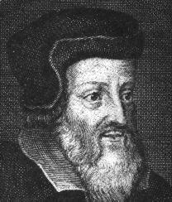
Critics of the Church
Critics of the Church: emphasized a personal relationship with God as primary
John Wyclif (1329-1384), England
Stated that the Bible was the sole authority
Foreshadowed Martin Luther’s views in the early 16th century

Slide 9
Stressed personal communion with God
Diminished the importance of sacraments
Translated the Bible into English
His followers—Lollards—continued his ideas into the 16th century.

Slide 10
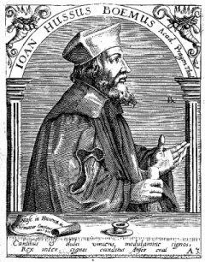
John Hus (1369-1415), Czech
Ideas were similar to Wyclif
Religious leader in Bohemia who led a nationalist movement there
Burned at the stake by the Church for his “heretical” views
Hussites were followers of Hus who staged large rebellions in the 14th century

