Slide 1
The Protestant Reformation

Slide 2
Background
Prior to the Protestant Reformation there was considered to be one church, the Catholic Church.
Many had called for reform of the church including
John Wyclif (1329-1384) and Erasmus (1466-1536)
Many argued against the church practices of
Simony, pluralism, absenteeism, and nepotism
1515- Pope Leo X gave indulgences to those that helped fund the renovation of St Peters Basilica.
Indulgences: payment (penance) for the forgiveness of the sin
Problem: only the rich could afford this

Slide 3
Martin Luther
German monk and professor
1517- nails his 95 Theses to the castle door in Wittenberg, Germany (then the Holy Roman Empire)
arguments for reform in the church.
#1 complaint-practice of indulgences
Ideas of Luther
Purgatory was a false doctrine
The Bible alone was the authority of truth
Baptism and Last Supper were the only valid sacraments
His ideas were published and spread with the help of the printing press
He also translated the Bible into the vernacular, or common language, of the people

Slide 4
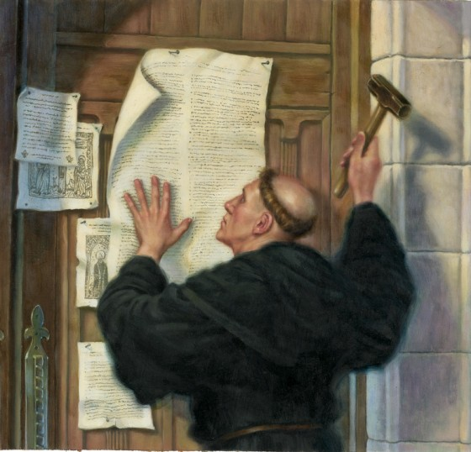
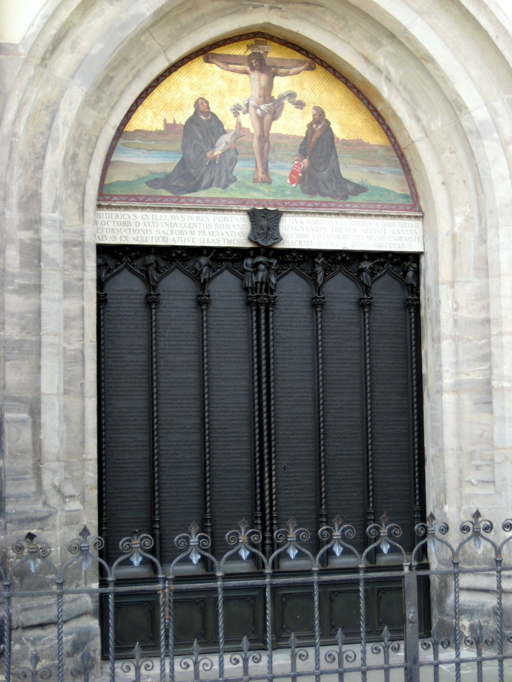

Slide 5
Diet of Worms (1521)
Council of clergy and loyal European leaders that were catholic.
Presided over by Charles V of the Holy Roman Empire.
Tried Luther for heresy
Luther is ordered to renounce his statements; he refuses.
He is excommunicated.
Luther is forced into hiding with the help of Fredrick the Wise

Slide 6
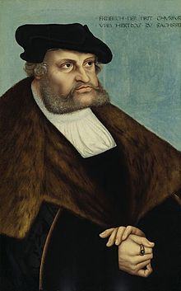
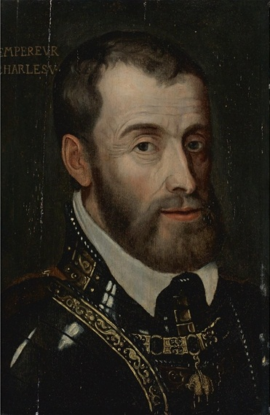

Slide 7
John Calvin
French theologian and pastor
He believed that purgatory was a lie
Created to spread fear
Proponent of the idea of predestination
Believed that only a reformed Christianity was the path to heaven
1533- forced to flee Paris due to this radical ideas

Slide 9
Reaction to Luther
Charles V:
Holy Roman Emperor that wanted to stop the spread of Protestantism.
Allied himself with the Pope
Preoccupied with the Turks and the French
German peasant Revolts
German peasants demanded an end of serfdom and tithes, and other practices of feudalism that oppressed the peasantry (e.g. hunting rights).
Many were inspired by Lutheranism
Luther took a conservative view of the revolts
As many as 100,000 peasants died during the uprisings

Slide 10
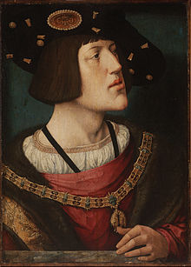

Slide 11
Peace of Augsburg 1555
Temporarily ends the struggle in the HRE over Protestantism
Provisions
Princes in Germany could choose either Protestantism or Catholicism.
It resulted in permanent religious division of Germany.
It essentially reaffirmed the independence of many German states.

Slide 12
St. Bartholomew’s Day Massacre
Royal wedding between Protestant (Henry IV Bourbon) and Catholic (Margaret of Valois)
Huguenot (Calvinist French men) attempt to assassinate the French King (Charles IX of Valois)
Three days later: French King attacks the Huguenots responsible for the attempt but killing spreads on, killing over 100,000 French men

Slide 14
Protestantism reaches England
Henry VIII
Born a Catholic in 1492
Asked for an annulment from the Pope because his wife (Catherine of Aragon) could not produce an heir
He had six wives trying to produce an heir
Pope denied the request
Henry breaks away from the Church and forms the Church of England (Anglican Church) with himself at its head

Slide 15
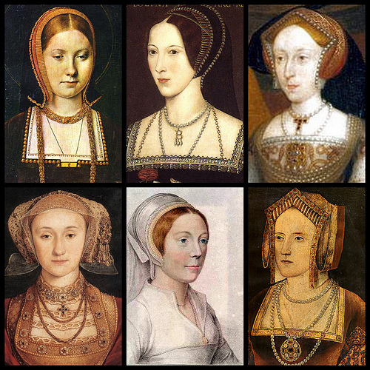

Slide 16
Edward VI: took over the throne after Henry VIII (Jayne Syemore)
extreme measures to keep Catholicism out of England
Banned Catholic practices and rituals
Priests were forced to hide out in Catholic homes in secret compartments
Mary I:
Returns England to Catholicism
Marries Philip II of Spain
She executed protestants which led her to gain the title “Bloody Mary”
Elizabeth I:
Returns England to Protestantism
Holds back the Catholic challenge led by King Philip II of Spain and Mary queen of Scotts

Slide 17
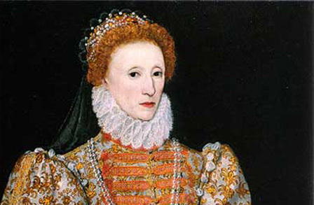
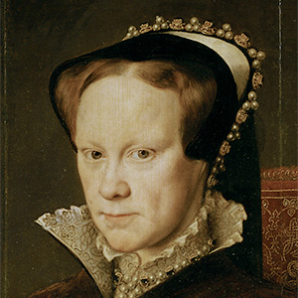

Slide 18
The Spanish Armada (1588)
Philip II of Spain
King of Spain and King of England when he was married to Queen Mary I
After Mary I death he sought to marry Elizabeth I
Elizabeth was a Protestant and did not wish to marry a catholic
Philip feared that Elizabeth would persecute Catholics
Events leading to the Armada
Elizabeth executes her cousin Marry Queen of Scotts (a Catholic) for treason (1587)
Philip II builds a large naval fleet in response
It purpose is to invade England and take the throne

Slide 19
Outcome
It fails and leaves Spain bankrupt
Spain's empire begins to crumble
England became the dominate naval power in Europe
England begins to build its overseas empire

Slide 20
Catholic (Counter) Reformation
Council of Trent (1545-63) – Council of Catholic clergy members
Revived Catholic doctrine
Refuted Protestantism
Jesuits
A catholic order of priests
Founded by Ignatius Loyola in 1534
active in politics, education, & missions (help spread Catholicism)

