Slide 1
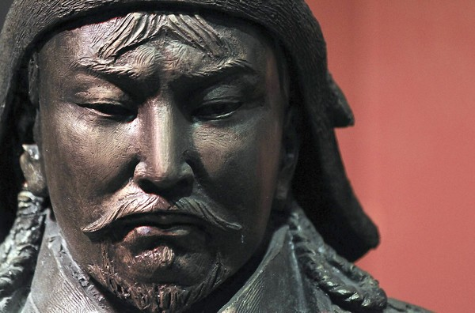
The Mongols
The Last Nomadic Challenge

Slide 2
Introduction to the Mongols
The Mongols were a pastoral nomadic people from central Asia
Smaller populations that relied heavily on animals for food, transportation, and warfare
Organized around families, clans, and/or tribes
Lived in small villages with kinfolk
Moved based on seasonal changes
Took their homes with them

Slide 3
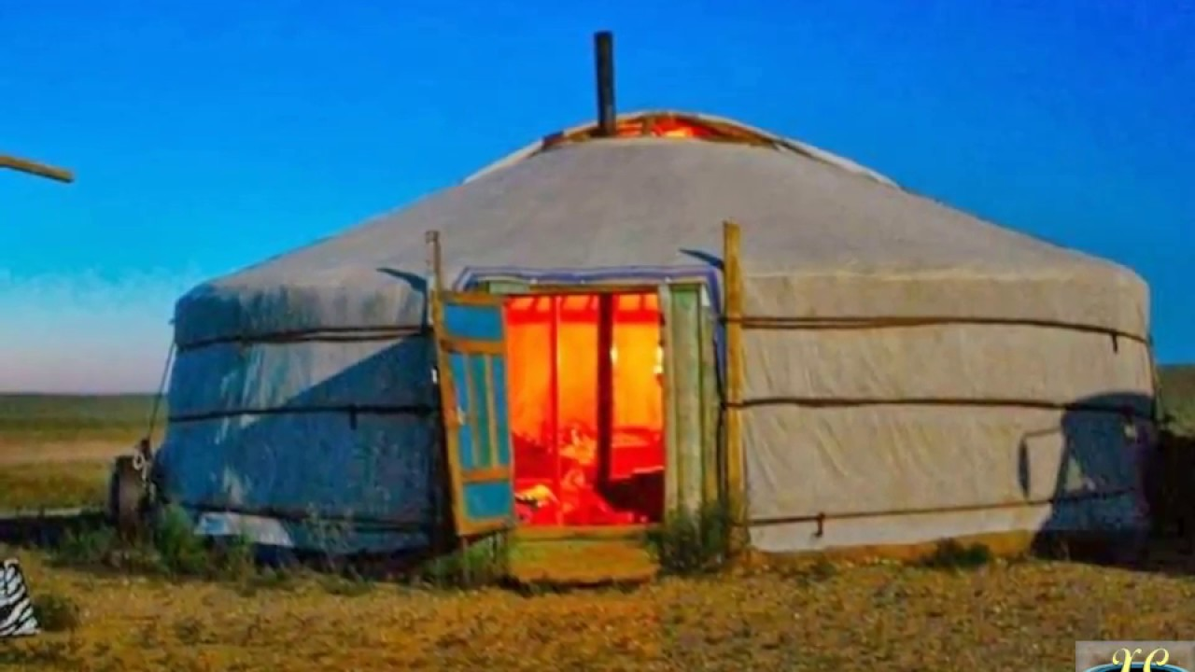
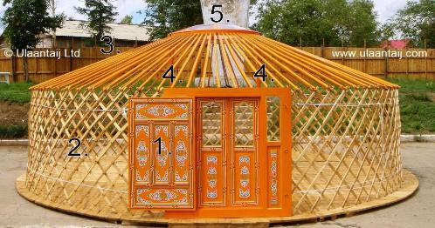

Slide 4
Mongol Women
Pastoralists offered women a higher status in society
Fewer restrictions
Greater role in public life
Involved in productive labor
Mongol women:
Could initiate divorce
Could remarry if widowed
Served as political advisors
active in the military

Slide 5
Pastoralists: Military Interactions
Nomadic states had military advantages
Horseback riding and hunting skills
Entire male population and many females trained in these skills
Used their militaries to extract wealth from larger civilizations → through raiding, trading, and extortion

Slide 6
The Mongol Empire
Largest land-based empire in world history
Stretched from the Pacific coast of Asia to Eastern Europe
Brought the major civilizations of Eurasia (Europe, China, and the Islamic world) into more direct contact
One major contribution = facilitated worldwide networks of exchange and communication
No real cultural impact
Did not spread any major religion
Did not spread their language or culture

Slide 7
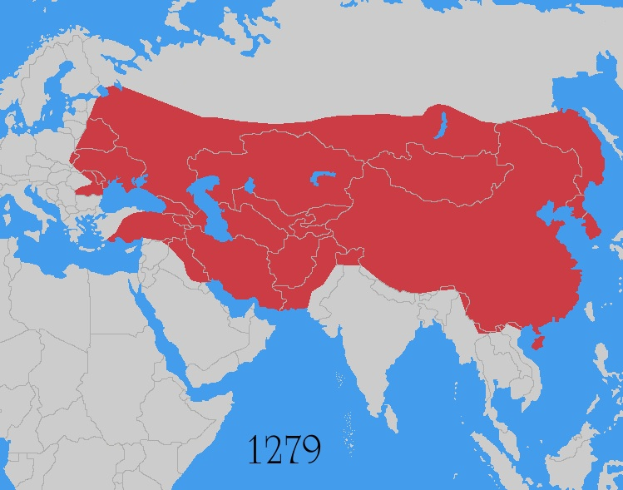

Slide 8
Temujin aka Genghis (1162-1227)
United and led the Mongols
Capitalized on shifting tribal alliances and betrayals
Mounting string of military victories
Enemies were indecisive
Used his reputation as a leader generous to friends and ruthless to enemies
Incorporated warriors from defeated tribes into his own forces
He will be responsible for expanding the control of the Mongols
1206 = a Mongol tribal assembly (kurlitai) recognized Temujin as Genghis Khan
Means “universal” or “supreme” ruler

Slide 9
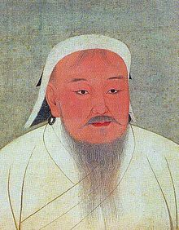

Slide 10
Mongol Expansion
Two major reasons for expansion
needed a common task or else they would fragment and fall apart
needed external resources with which to reward followers
Conquests continued for about 50 years under Genghis Khan
China was #1 goal
1207- Defeats the Xi Xia and Jurchens Kingdoms
1227- Genghis dies and his empire is split into 4 Khanates ruled by his 3 sons and grandson
Kurlitai convened and elected Ogedei (3rd son) as khan

Slide 11
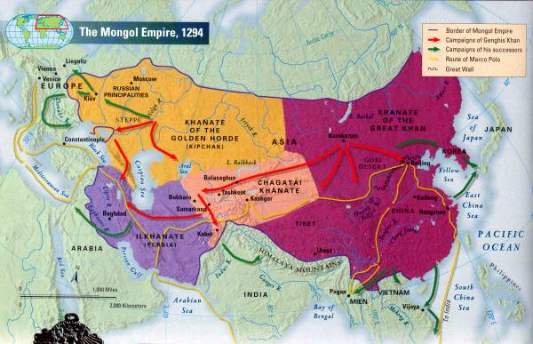

Slide 12
Continued Expansion to the West
Mongols wanted Russia & Europe
Golden Horde – subjugating these regions
Led by Batu (grandson of Chinngis)
Invaded most of Russia
tartars
Major cities destroyed
Saint Sophia Cathedral spared
Mesopotamia & North Africa
Destroys Baghdad in 1258
Murder the Caliph
1260 Mongols stopped by Baibars
Egyptian Mamluks
Christians cooperated to defeat Mongols

Slide 13
Renewed interest in China
Mongols wanted to conquer the Song dynasty in south China
Mongols led by Kublai Khan
Established Yuan dynasty & ruled most of China
Capital at Tatu (Beijing)
Yuan era showed bureaucracy at local & regional levels
No civil service exams
Social stratification

Slide 14
Marco Polo
Merchant from Venice, Italy
Extensive travel of Mongol empire 13th century
Served as an administrator to Kublai Khan for 17 years
Utilized Mongolian relay stations and road networks
Kept a diary of everything he encountered and experienced
Primary way in which Europeans learned about the east

Slide 15
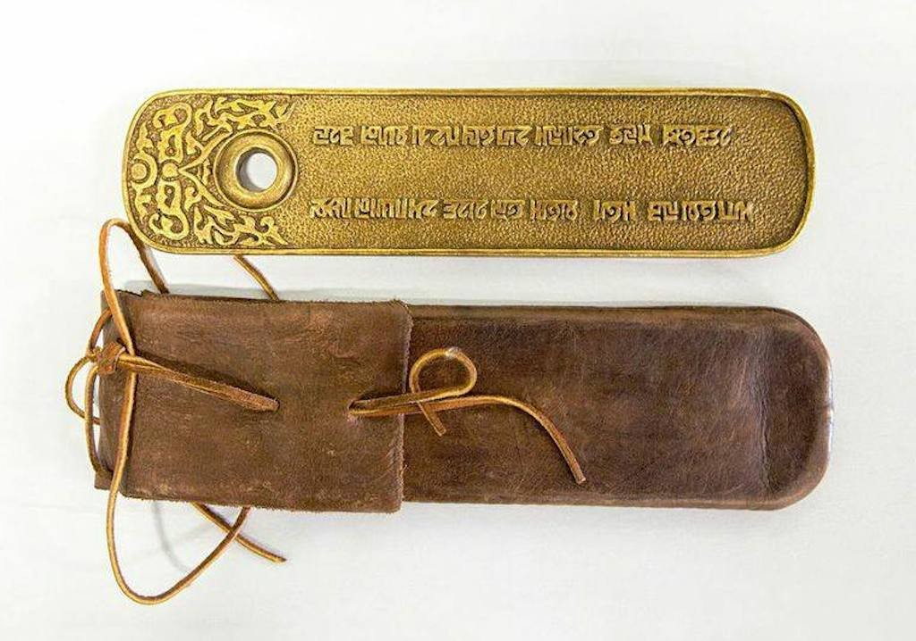
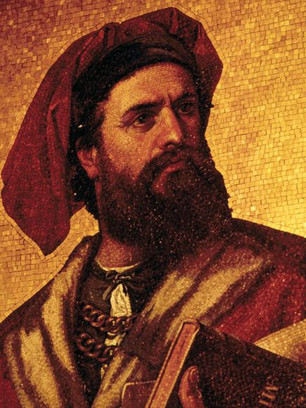
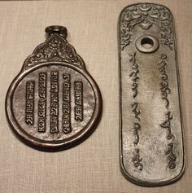

Slide 16
Major defeats
Mongol expansion put in check by a few setbacks, which marked the limits of the empire:
1242 = Withdrawal from Eastern Europe
1260 = Defeat by Egyptian forces in Palestine
1274 & 1281 = Two failed invasions of Japan
Difficulty of moving through the tropical jungles of Southeast Asia

Slide 17
Mongol Economic and Political Policy
Economy
Politics
Wanted to foster trade
Allowed merchants free use of their relay stations
Often offered merchants 10% more than their asking price
Mongols held the highest decision-making posts
Chinese and Muslim officials held many advisory and lower-level positions

Slide 18
Mongol Tolerance
Total religious toleration → as long as religion wasn’t the cause of political opposition
Major religions throughout the Mongol Empire = Buddhism, Christianity, Islam, and Daoism

Slide 19
The Brief Ride of Timur and the Decline of the Mongols
Turkish nomadic leader
Tamerlane
1360’s – conquests in Persia, Fertile Crescent, India, & southern Russia
Defeats the Golden Horde
Precipitates the decline of the Mongol Empire and Mongol rule
Barbaric, build pyramids out of the skulls of people they killed
1405 Timur dies and the empire ends
Also ends the last great steppe nomadic civilization

