Slide 1
The Italian Renaissance
City States, Politics, and Humanist

Slide 2
Back Ground
Renaissance is considered the beginning of modern European history.
Renaissance (c. 1300-1600)
Occurred first in Italy c. 1300 and lasted until 1527 when Rome was sacked by foreign armies.
The Renaissance spread to Northern Europe around 1450
In England, the Renaissance did not begin until the 16th century and lasted until the early 17th century (e.g. Shakespeare).

Slide 3
Origins of the concept of a “renaissance”: 19th-century Swiss historian Jacob Burckhardt claimed the Renaissance stood in stark contrast to the Middle Ages.
Renaissance culture applied almost exclusively to the upper classes.
1. The upper classes had the luxury of time to spend learning the classics.
2. The peasantry was largely illiterate and Renaissance ideas had little impact on common people.
3. The working classes and small merchants were far too preoccupied with the concerns of daily life.

Slide 4
Rise of Italian City States
Northern cities developed international trade
Venice, Genoa, and Milan
By 1300, signori (despots), or oligarchies (rule of merchant aristocracies) controlled all of the Italian peninsula.
Commenda: a contract between a merchant and “merchant-adventurer” who agreed to take goods to distant locations and return with the proceeds (for 1/3 of the profits)
Italy became more urban: it had more towns and cities with significant populations than anywhere else in Europe at this time.

Slide 5
Politics in the Italian City States
Competition meant that Italy did not unify politically.
In effect, an early balance of power emerged.
Political disunity eventually led to the downfall of the city-states in the late 1400s and early 1500s.

Slide 6
Major City States
Republic of Florence (included Genoa)
Center of the Renaissance during the 14th and 15th centurie
Dominated by the Medici family
Cosimo de Medici (1389-1464): allied with other powerful families in Florence and became the unofficial ruler of the republic
Most powerful of the Medici rulers
Lorenzo the Magnificent (1449-1492): perhaps the greatest patron of the arts

Slide 7
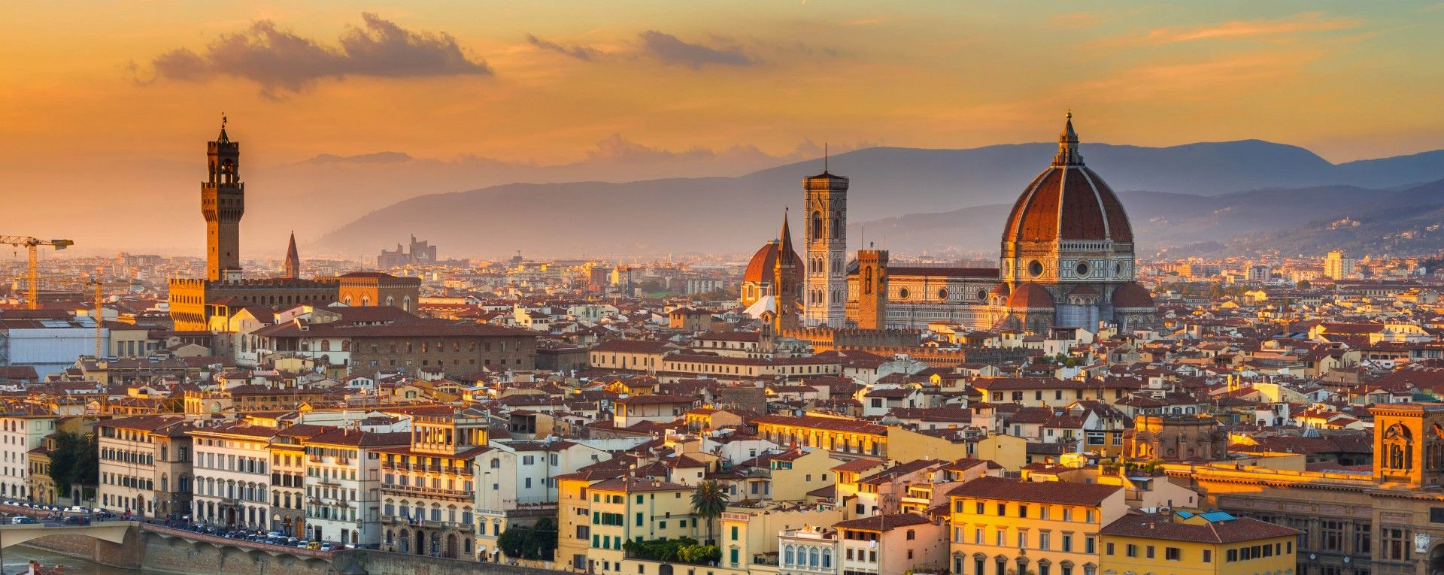
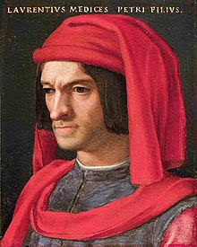

Slide 8
Duchy of Milan
Ruled by the Sforza family after 1450
Milan was a major enemy of Florence and Venice.
The Peace of Lodi (1454) created a 40-year period of relative peace in northern Italy
The peace was, in part, a response to concerns over the Ottoman conquest of Constantinople a year earlier.
It created a stable balance of power for a time.

Slide 10
Naples, Kingdom of the Two Sicilies:
Included southern Italian region of Naples and the island of Sicily
Only Italian city-state to officially have a “king”
Controlled by France between 1266-1435
Controlled by Spain after 1435
Rome, the Papal States:
Popes served as religious and political leaders; controlled much of central Italy
Venice, Venetian Republic:
Longest lasting of the Italian city-states
Greatest maritime power in Italy

Slide 13
Decline of the Italian City States
The French invasions of Italy began in 1494
Milan’s despot, Ludovico “the Moor” invited French King Charles VIII (1483-1498) to invade Naples, Milan’s traditional enemy.
This was the beginning of foreign invasions in Italy
Florence's attempt at appeasement ends in the overthrow of the Medici family
Spain feard an alliance between France and the Nothern Italian city states
Forms an alliance with Venice, the Papal States, and the Holy Roman Empire
1527- Sack of Rome by the armies of Charles V of the HRE (who was also king of Spain) symbolized the end of the Renaissance in Italy.

Slide 14
Humanism: Characteristics
Revival of philosophy, literature and art
Some sought to reconcile pagan writings with Christian thought
Strong belief in individualism and the potential/ capabilities of the individual
Virtu- idea of excelling in all pursuits
Believed the key to a good life was Reason and Nature
Secular in Nature
Shifted education focus away from theology to the classical text
Humanist still remain deeply Christian
Extensive study of Latin and Greek
Rejection of Aristotle in favor of Cicero, Virgil, and Plato
Civic Humanism- education should prepare good leaders

Slide 15
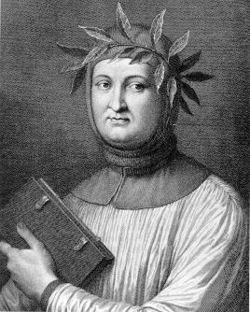
Italian Humanist
Petrarch (1304-1374): “father of humanism”
Considered the first modern writer
In his writings, literature was no longer subordinate to religion.
Considered the Middle Ages to be the “dark ages”
Perhaps the first to use critical textual analysis to ancient texts
Especially influenced by the Roman Cicero
Wrote his most well-known poetry in the Italian vernacular
Most texts in this era were written in Latin.

Slide 16
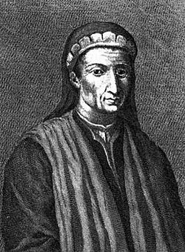
Leonardo Bruni (1370-1444)
First to use the term “humanism”
Among the most important of the civic humanists
He wrote a history of Florence, perhaps the first modern history, and wrote a narrative using primary source documents and the division of historical periods

Slide 17
Political Humanist: Niccolò Machiavelli
The Prince (1513)
It was the quintessential political treatise of the 16th century.
His views were decidedly secular and his emphasis on individualism reflected humanist philosophy.
He studied classical history thoroughly in order to get a more realistic portrait of politics.
For rulers, “it was better to be feared than to be loved.”
Rulers had to be practical and cunning, in addition to being aggressive and ruthless.
At times rulers should behave like a lion (aggressive and powerful) and at other times like a fox (cunning and practical).

Slide 19
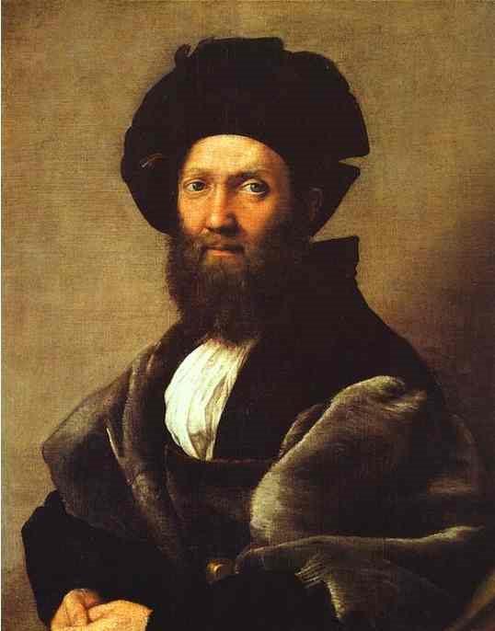
Humanist on Individual Behavior: Baldassare Castiglione
Book of the Courtier (1528)
most important Renaissance work on social etiquette
He specified qualities necessary to be a true gentleman including physical and intellectual abilities and leading an active life
described the ideal of a “Renaissance man” who was well-versed in the Greek and Roman classics, an accomplished warrior, could play music, dance, and had a modest but confident personal demeanor.

Slide 20
Printing Press
Johann Gutenburg (c. 1395-1468)
One of the most important inventions in human history
Development of moveable type made possible the spread of humanistic literature at an astonishing speed
No longer would copies of works need to be done individually by hand.
1457-58: published the first printed Bible in the city of Mainz
Encourages the use of vernacular (common language)
Facilitated the phenomenal spread of the Humanist ideas and the Reformation

Slide 21
