Slide 1
The Italian and Northern Renaissances
1300-1600

Slide 2
Renaissance Background
Renaissance (c. 1300-1600)
Occurred first in Italy c. 1300 and lasted until 1527 when Rome was sacked by foreign armies.
The Renaissance spread to Northern Europe around 1450
In England, the Renaissance did not begin until the 16th century and lasted until the early 17th century (e.g. Shakespeare).

Slide 3
Renaissance Culture
Renaissance culture applied almost exclusively to the upper classes.
1. The upper classes had the luxury of time to spend learning the classics.
2. The peasantry was largely illiterate and Renaissance ideas had little impact on common people.
3. The working classes and small merchants were far too preoccupied with the concerns of daily life.

Slide 4
Why Italy?
Northern cities developed international trade
Venice, Genoa, and Milan
By 1300, signori (despots), or oligarchies (rule of merchant aristocracies) controlled all of the Italian peninsula.
Italy became more urban: it had more towns and cities with significant populations than anywhere else in Europe at this time.
The Renaissance in Italy was far more religious in nature than that of the Northern Renaissance.
This can be seen in art and in literature

Slide 5
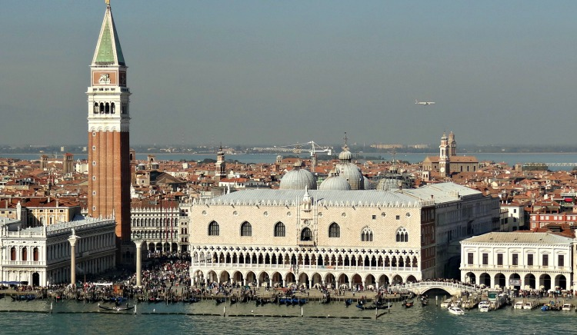
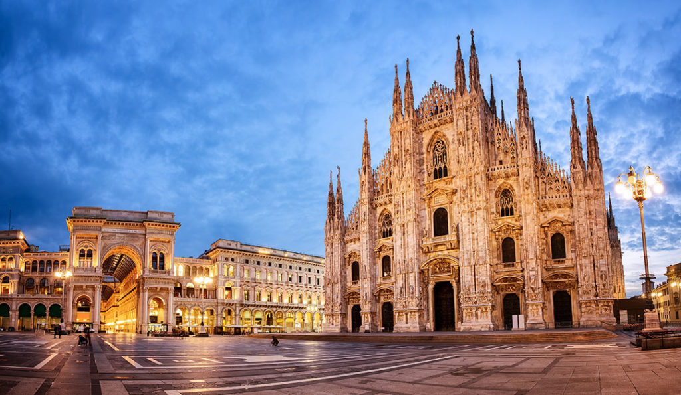
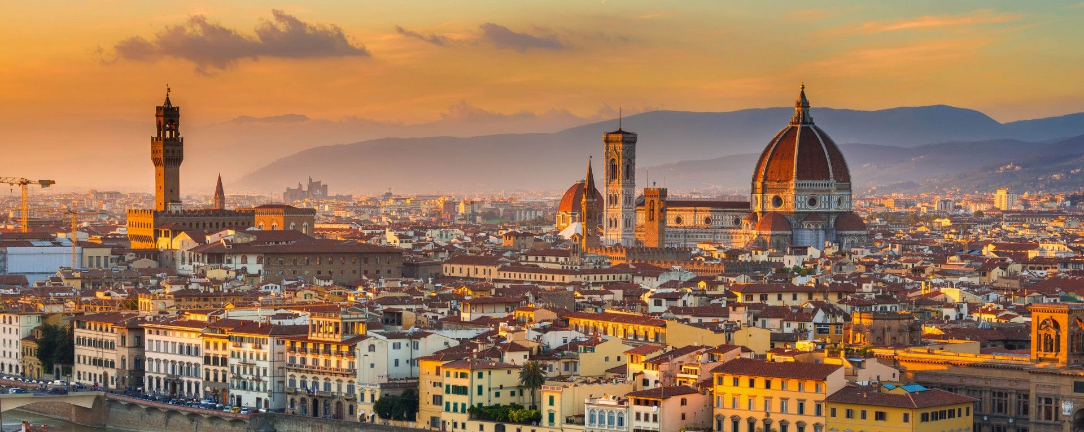
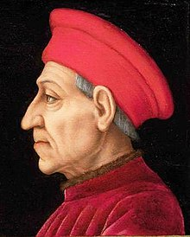
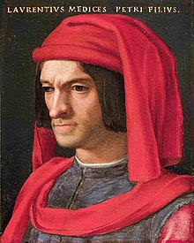

Slide 6
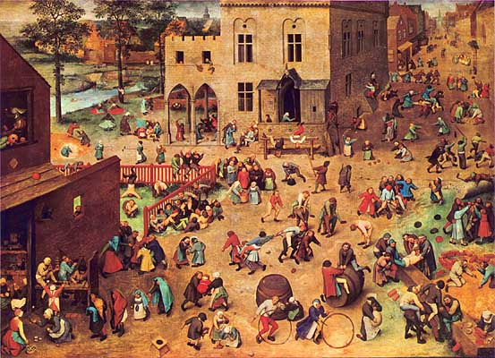
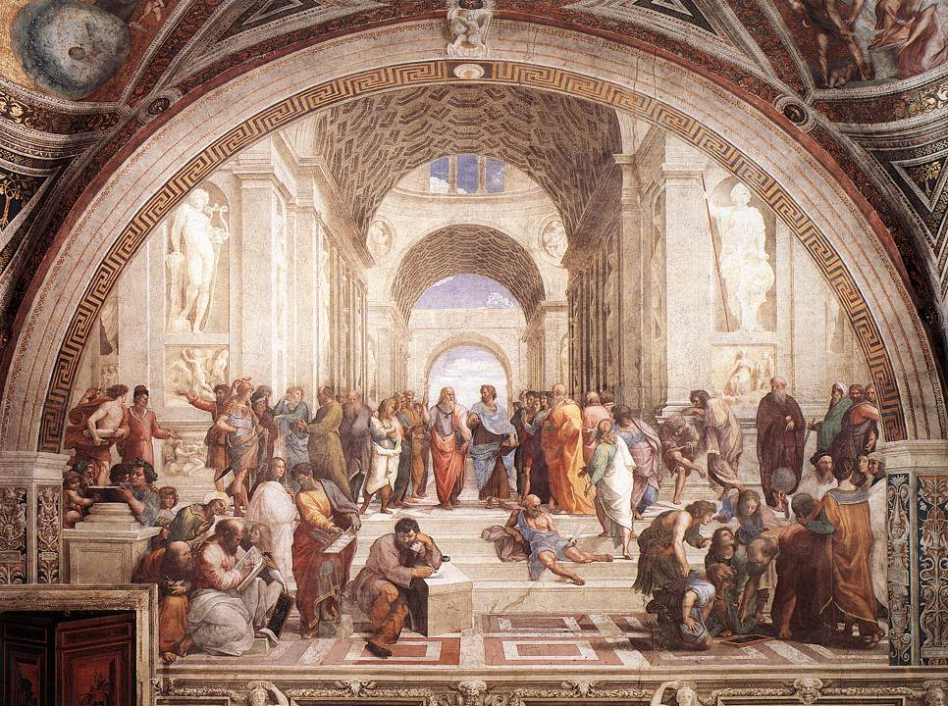
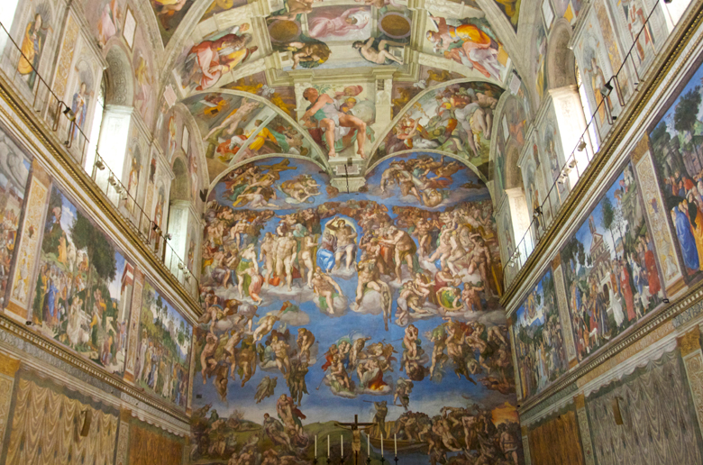
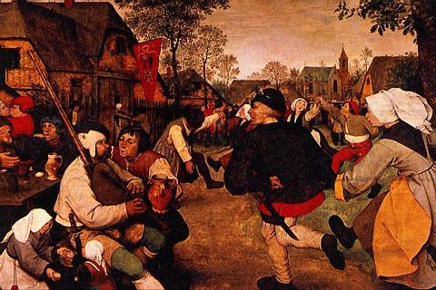
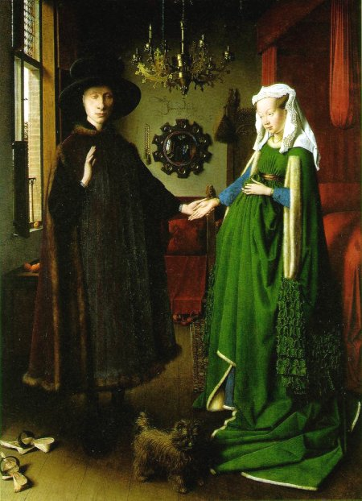
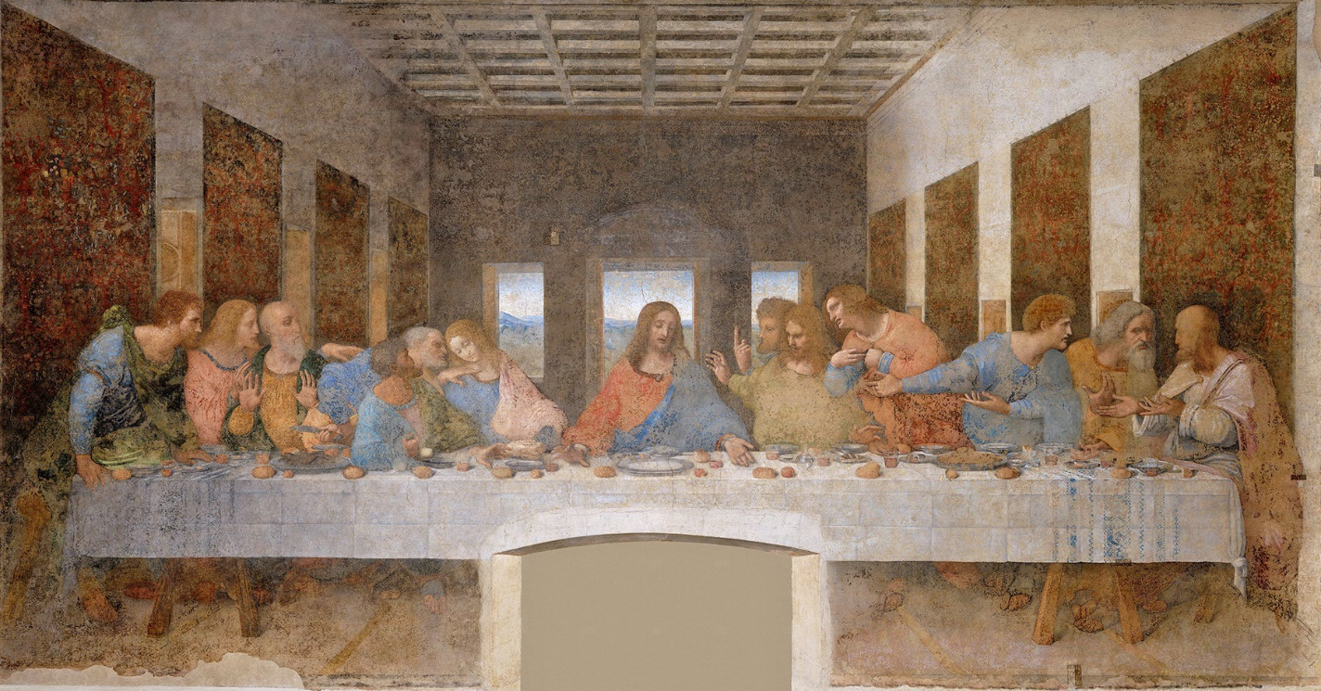

Slide 7
Humanism
Revival of philosophy, literature and art
Some sought to reconcile pagan writings with Christian thought
Strong belief in individualism and the potential/ capabilities of the individual
Virtu- idea of excelling in all pursuits
Believed the key to a good life was Reason and Nature
Secular in Nature
Shifted education focus away from theology to the classical text
Humanist still remain deeply Christian

Slide 8
Types of Humanist
Civic Humanist- believed that education should prepare leaders who would be active in civic affairs.
Niccolò Machiavelli
Write the Prince
Argues that at times rulers should behave like a lion (aggressive and powerful) and at other times like a fox (cunning and practical).
Thomas More (1478-1536)
He rose to the highest government position of any humanist
Lord Chancellor to King Henry VIII in England.
Wrote Utopia which seeks to describe a perfect society free of what More saw as society’s ills

Slide 9
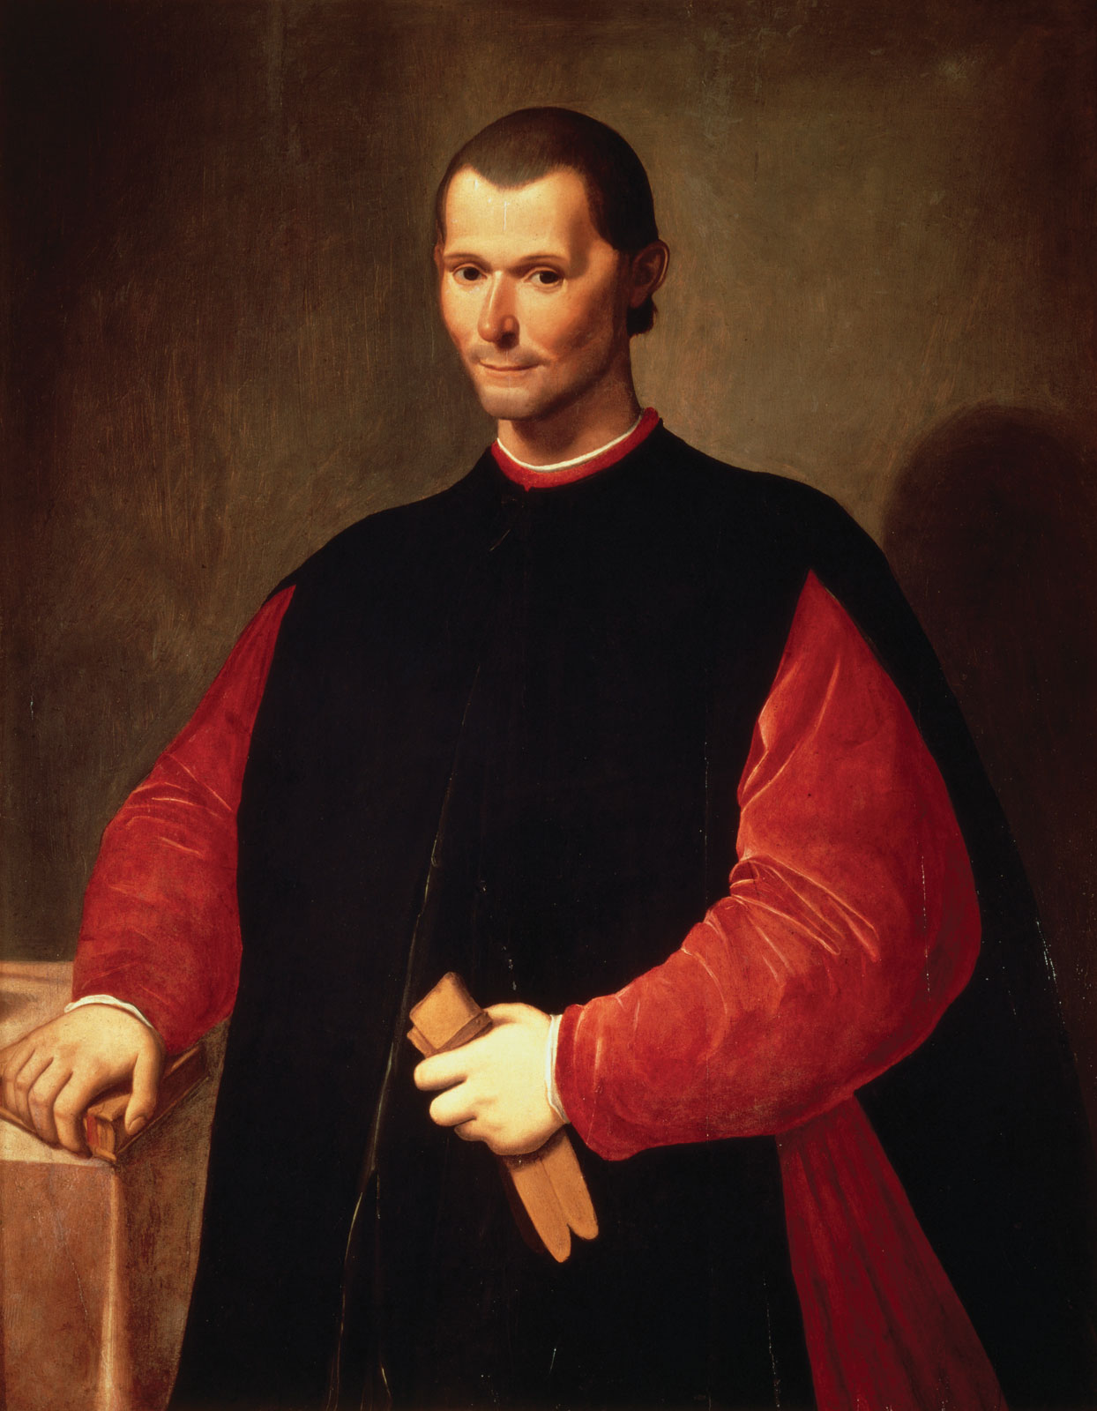
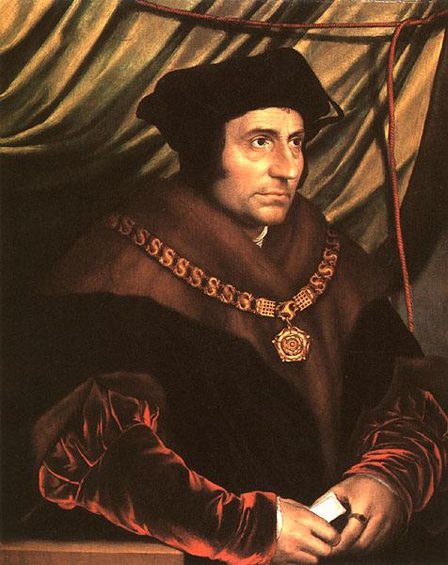

Slide 10
Christian Humanism: (mainly located in Northern Europe)
Emphasized early church writings that provided answers on how to improve society and reform the church.
Erasmus (1466-1536)
a devout Catholic who sought to reform the Church, not destroy it.
His works will inspire Martin Luther and the ideas of the Protestant Reformation
Humanist on Individual Behavior: sought to redefine social etiquette
Baldassare Castiglione
Book of the Courtier (1528)
He specified qualities necessary to be a true gentleman including physical and intellectual abilities and leading an active life

Slide 11
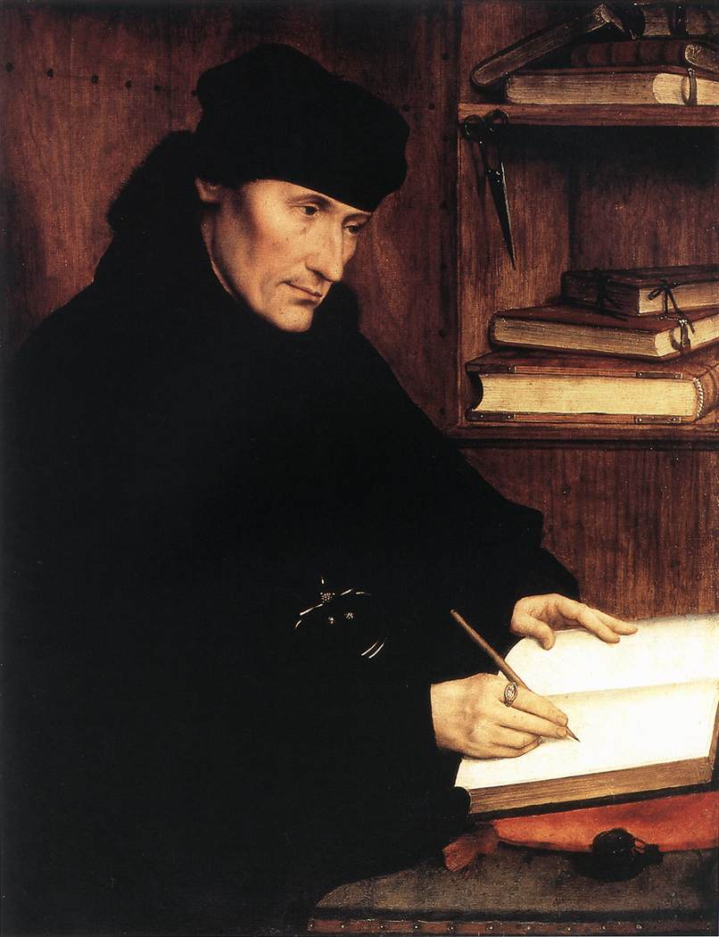
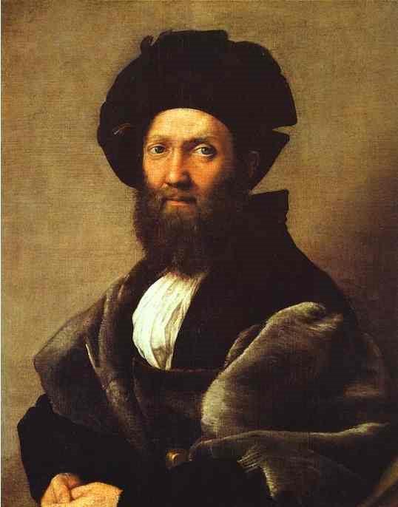

Slide 12
The Printing Press
Johann Gutenberg (c. 1395-1468)
One of the most important inventions in human history
Development of moveable type made possible the spread of humanistic literature at an astonishing speed
Encourages the use of vernacular (common language)
Facilitated the phenomenal spread of the Humanist ideas and the Reformation

Slide 13
