Slide 1
The Industrial Revolution
Causes and Outcomes

Slide 2
Industrial Revolution Overview
By the mid to late 1700s there was a shift towards manufactured good
The shift moved towards machines
Mass produced products
Lowered costs
Agricultural Revolution- new farming techniques led to higher yields
Crop rotation and seed drill
2 waves of industrialization
1st wave (late 1700s to mid 1800s)= textiles
2nd wave (late 1800s to early 1900s)= steel, petroleum, electricity production, and expansion of railroads
By 1900 the industrialization spread from Europe to the United States
Makes the west the dominate region of the world

Slide 3
Industrial Revolution: England
Industrial Revolution began in England
Reasons Why
Large deposits of natural resources
Coal and Iron
Overseas empire provided resources
Also acted as markets for finished goods
Banks invested in inventions and industry
From 1750 to 1850 Britain was the most industrialized nation

Slide 4
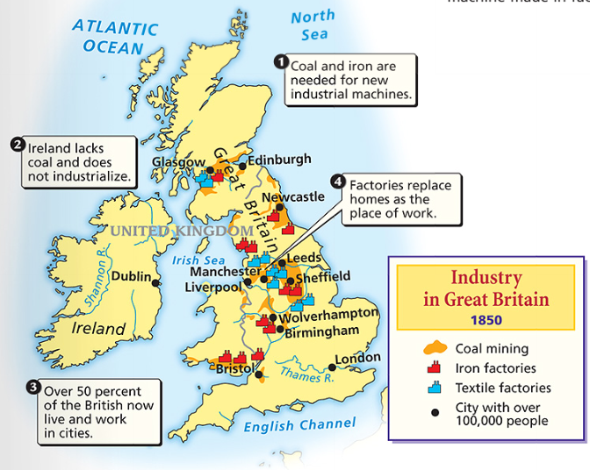
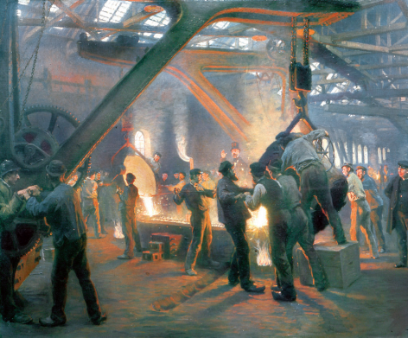

Slide 5
Textile Industry and the rise of the Factory System
Large boom in textile industry due to the demand for these products
Increases a demand for cotton
Affects slavery in the United States
Eli Whitney's cotton gin increases production
Textile industry leads to the factory system
Power driven machines
Factories located along rivers
1765- James Watt invented the steam engine
allowed factories to be built in cities near the populations

Slide 6
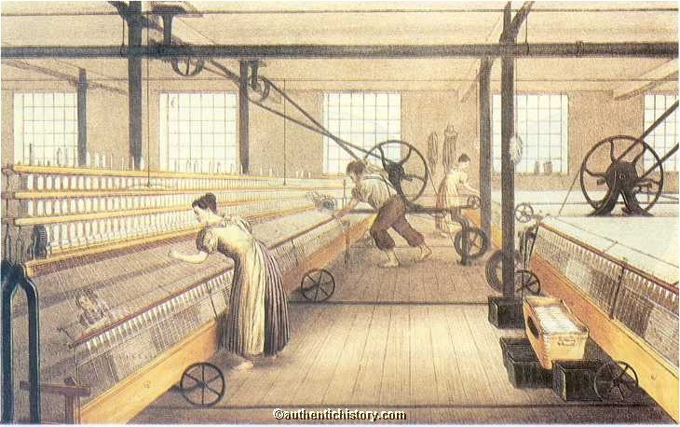
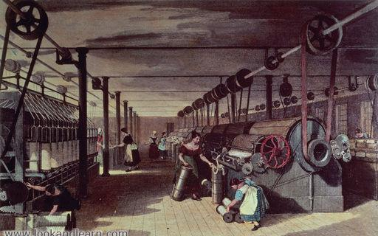
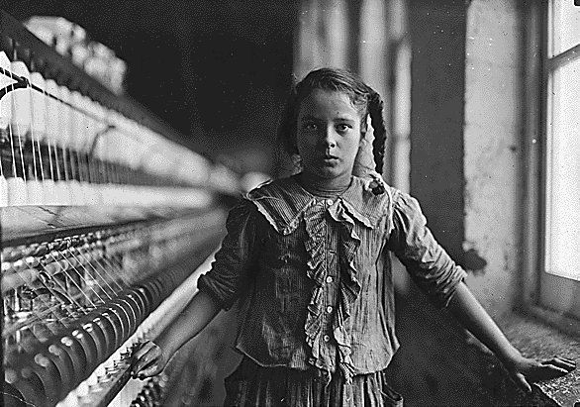

Slide 7
New Modes of Transportation
Robert Fulton- steam engine
Railroads
Gave manufactures a cheap way to transport goods
New jobs for miners
Coal used to power the steam engines
Helped increased agricultural and fishing industries
Spurred tourism and helped bring people to the cities

Slide 8
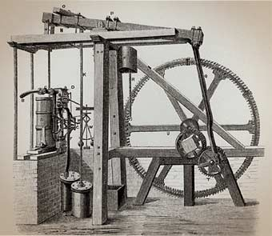
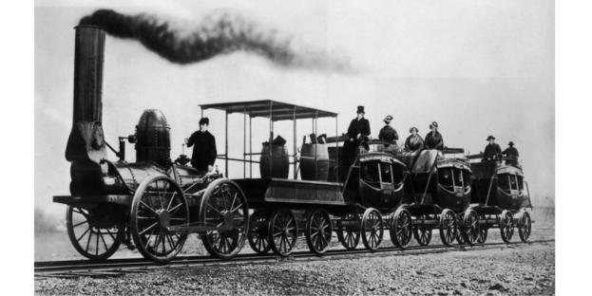
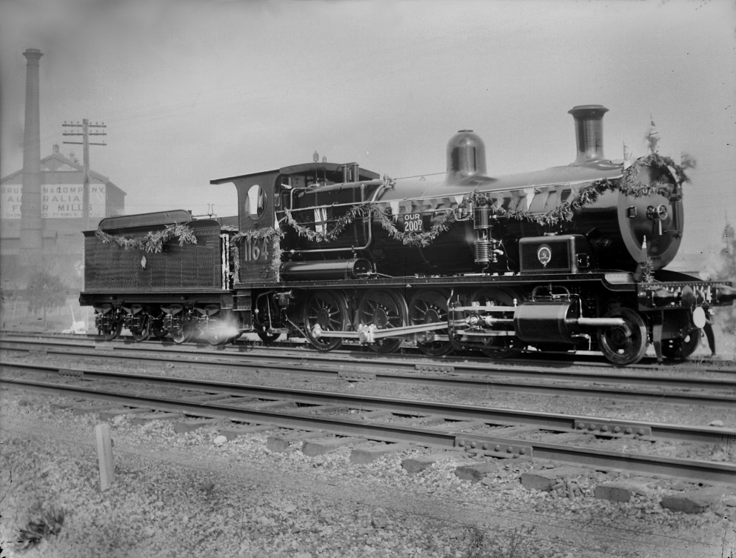
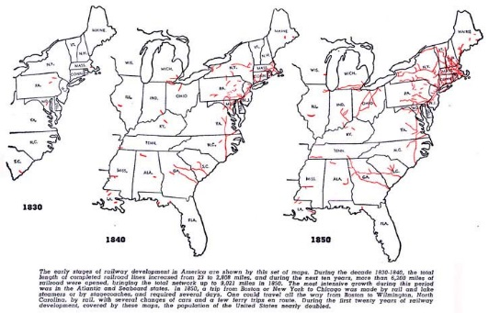
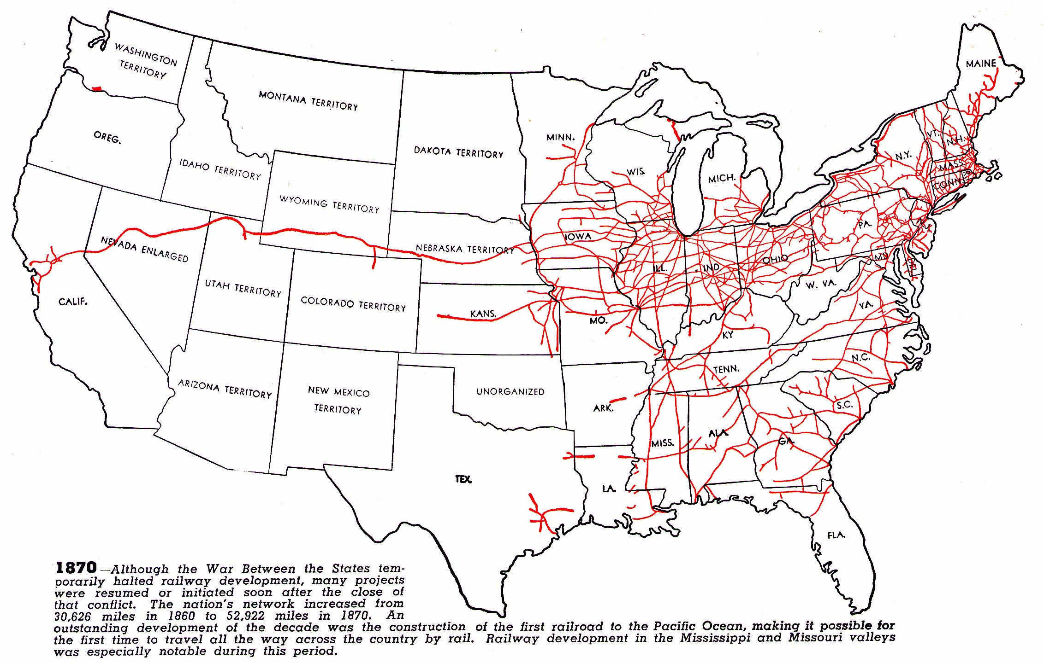
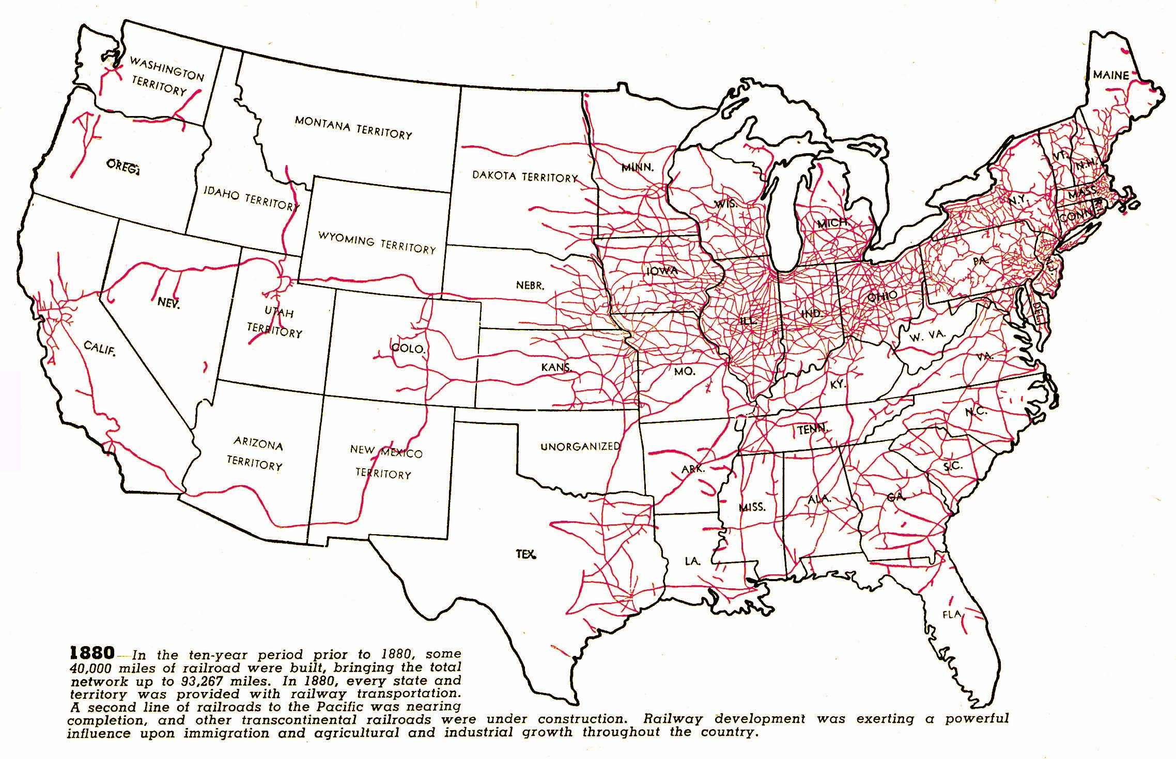
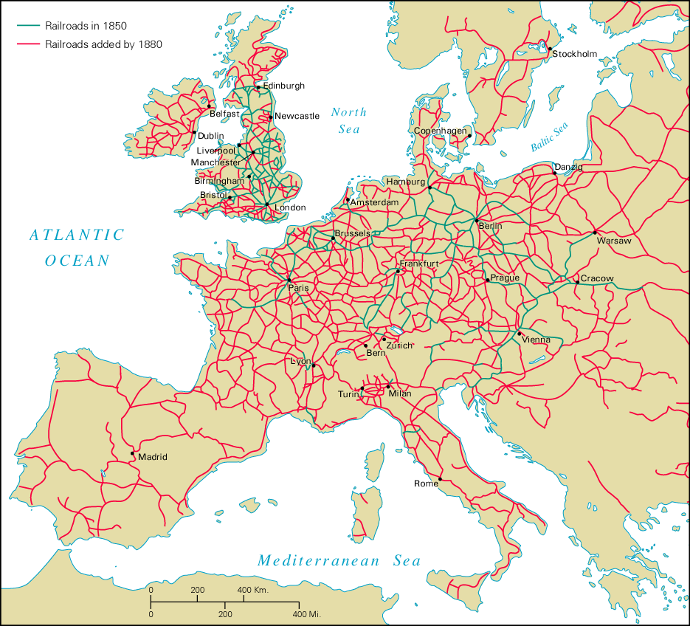
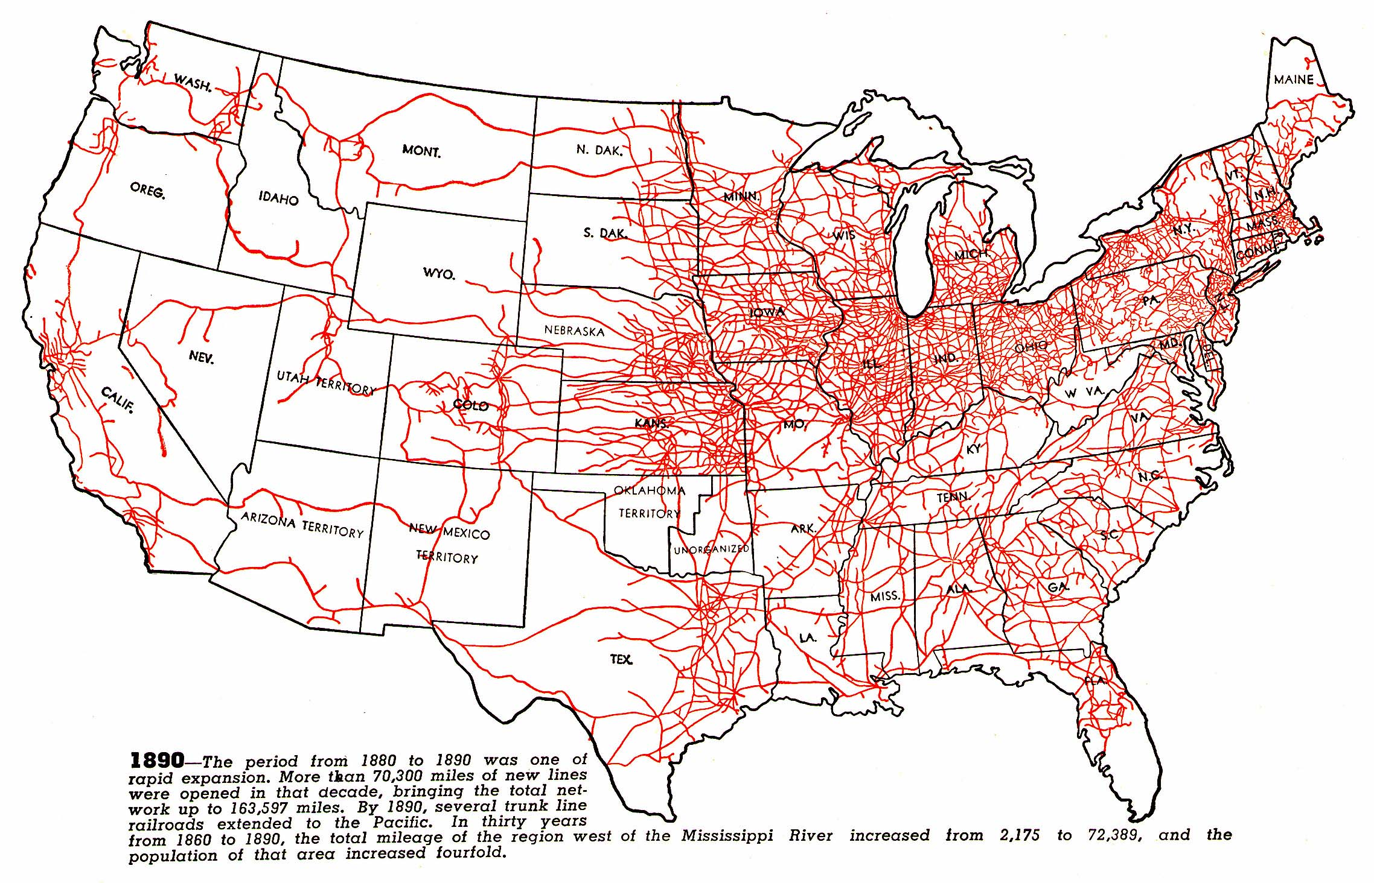
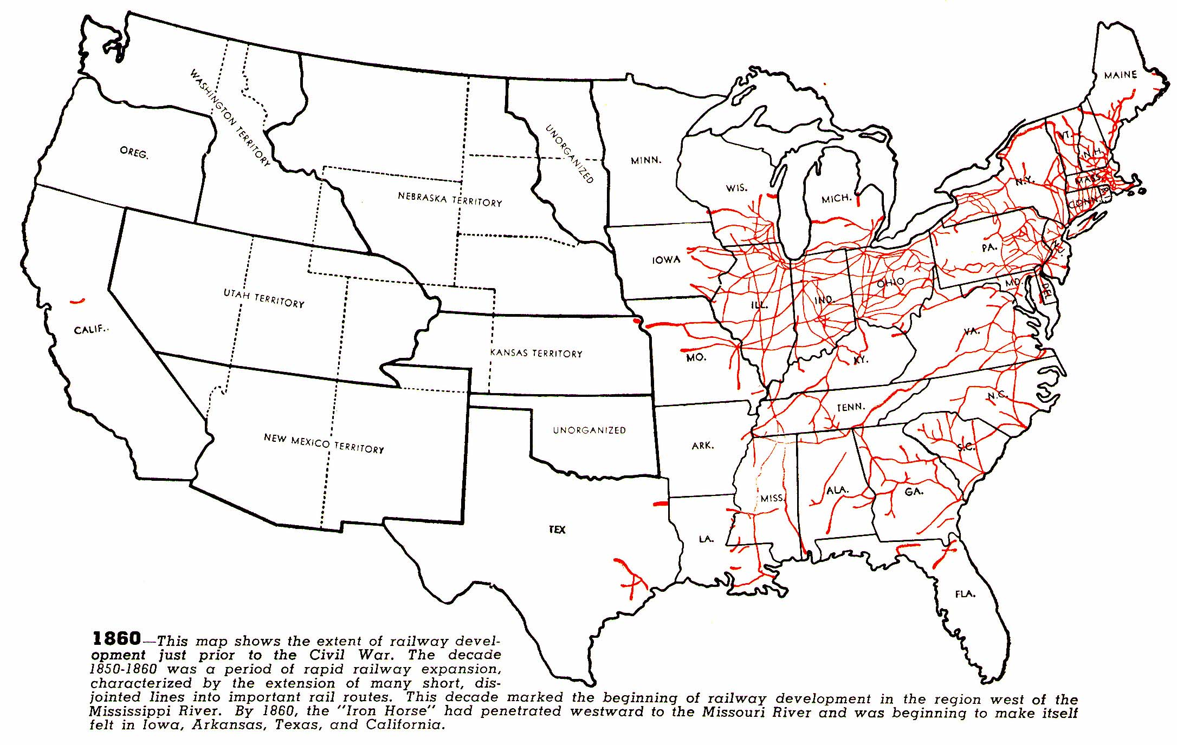

Slide 9
Industrialization Outside Britain
Germany
Germany was political divided into smaller principalities
Lead to pockets of industrialization
Large deposits of coal and iron ore
By the mid-1800s one of the worlds industrialized powers
United States
Cotton boom in the south lead to northern textile mills
Post Civil War- US becomes a leader in railroads, oil, steel, and electricity

Slide 10
Part 2: Outcomes

Slide 11
Dark side of Industrialization
A. Negatives of the factory system
Factory work became less skilled
Conditions were dirty, dangerous, and unhealthy
Long hours (12-16 hr day)
Workers were not paid well
Women & children were paid less than men
Owners required workers “clock in” & limited their breaks to increase production

Slide 12
B. Child Labor
worked in factories, brickyards, or mines
poor families needed their kids to work
worked long hours in dangerous conditions, were often beaten
Child workers earned 10% of an adult wage
C. Changing Role of Women
poor women in cities worked in factories
Some women worked as domestic servants
Factory jobs required long hours
could leave women crippled, sick, or deformed
Women were paid ½ or ⅓ of a man’s salary

Slide 13
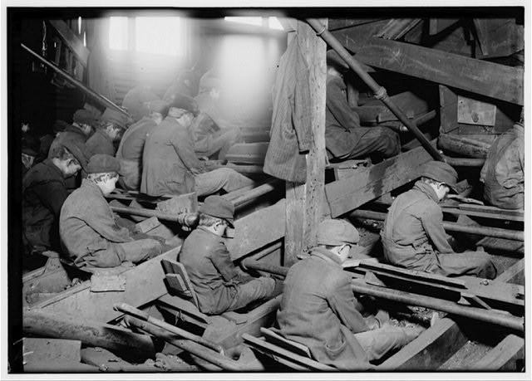

Slide 14
Response to the Industrialization
People wanted reforms
Reformers regulated water, food, sewage, and offered public education
By the mid to late 1800s Britain and the US had passed child and women labor laws
Regulated hours and wages
Workers organized in unions
Capitalism
Drove industrialization
Laissez-faire economics
Socialism
Argued for more government control and regulation
Communism
Introduced by Karl Marx and Friedrich Engels
Wrote the Communist Manifest
Argued that the workers should have the rights

