Slide 1
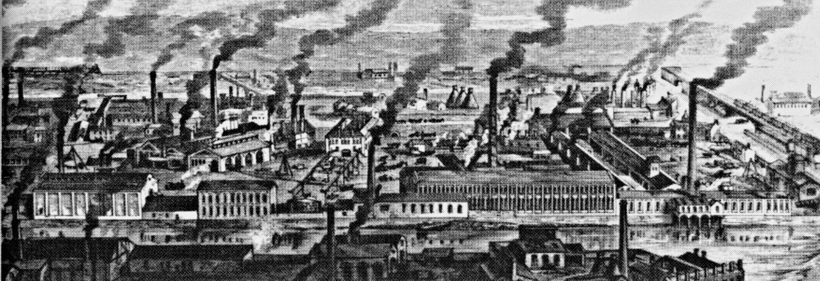
The Industrial Revolution

Slide 2
Roots of the Industrial Revolution
Commercial Revolution (1500-1700)
Spurred great economic growth of Europe and brought about the Age of Exploration
“Price Revolution” (inflation) stimulated production as producers could get more money for their goods.
Bourgeoisie acquired much of their wealth from trading and manufacturing
Rise of Capitalism
Increased use of surplus money for investment in ventures to make a profit.
The middle class came to provide the leadership for the economic revolution (e.g. chartered companies and joint-stock companies).
Scientific Revolution produced the first wave of mechanical inventions and technological advances.
Increase in Europe’s population provided larger markets

Slide 3
Proto-Industrialization: Cottage Industry
Rural industry was a major pillar of Europe’s growing economy in the 18th century
Rural population eager to supplement its income
Merchants in cities sought cheap rural labor rather than paying guild members in towns higher fees
Thus, early industrial production was “put out” into the countryside: the “putting-out system”
Manufacturing with hand tools in peasant cottages came to challenge the urban craft industry

Slide 4
Cottage Industry
Merchant-capitalist would provide raw materials (e.g. raw wool) to a rural family who produced a finished or semi-finished product and sent it back to the merchant for payment
Cottage workers were usually paid by the number of pieces they produced b
Merchants would sell the finished product for profit
Wool cloth was the most important product
The Cottage industry was essentially a family enterprise.
Work of four or five spinners needed to keep one weaver steadily employed.
Husband and wife constantly tried to find more thread and more spinners.
Sometimes, families subcontracted work to others

Slide 6
Problems with and results of the Cottage Industry
Problems:
Constant disputes between cottagers and merchants occurred over weights of materials and quality of cloth.
Rural labor was unorganized and difficult for merchants to control.
Merchant-capitalists thus searched for more efficient methods of production resulting in growth of factories and the industrial revolution.
Results:
Thousands of poor rural families were able to supplement their incomes
Unregulated production in the countryside resulted in experimentation and the diversification of goods
Goods included textiles, knives, forks, housewares, buttons, gloves, clocks and musical instruments

Slide 7
Proto-industrialism: Technology
1733- John Kay: flying shuttle enabled weaver to throw shuttle back and forth between threads with one hand.
Cut manpower needs on looms in half; only one person needed to operate a loom.
1764- James Hargreaves invented the spinning jenny which mechanized the spinning wheel.
Hand operated; simple and inexpensive
Usually worked by women who moved the carriage back and forth with one hand and turned a wheel to supply power with the other.
1769- Richard Arkwright invented the water frame, which improved thread spinning.
Several hundred spindles on a machine required water power.
Required large specialized factories that employed as many as 1,000 workers.
1779- Samuel Crompton invented the spinning mule which combined the best features of the spinning jenny and the water frame.

Slide 8
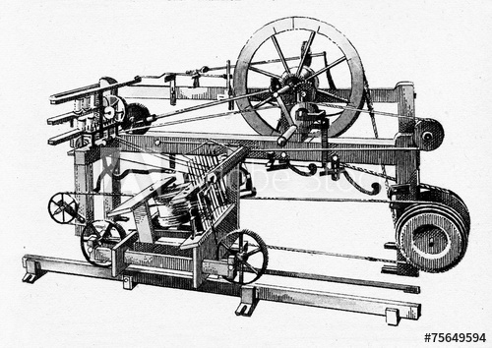
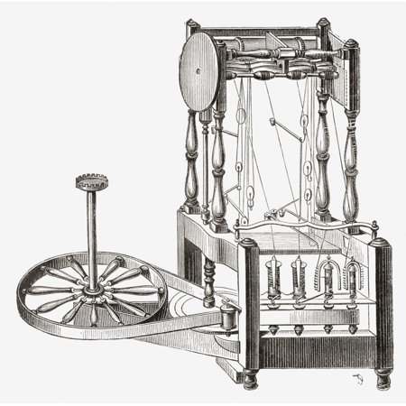
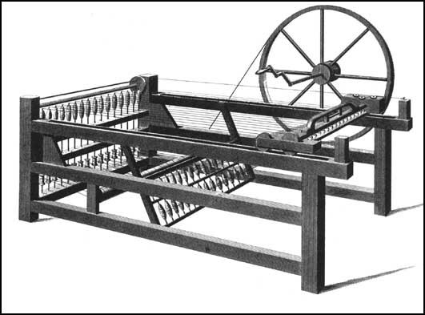
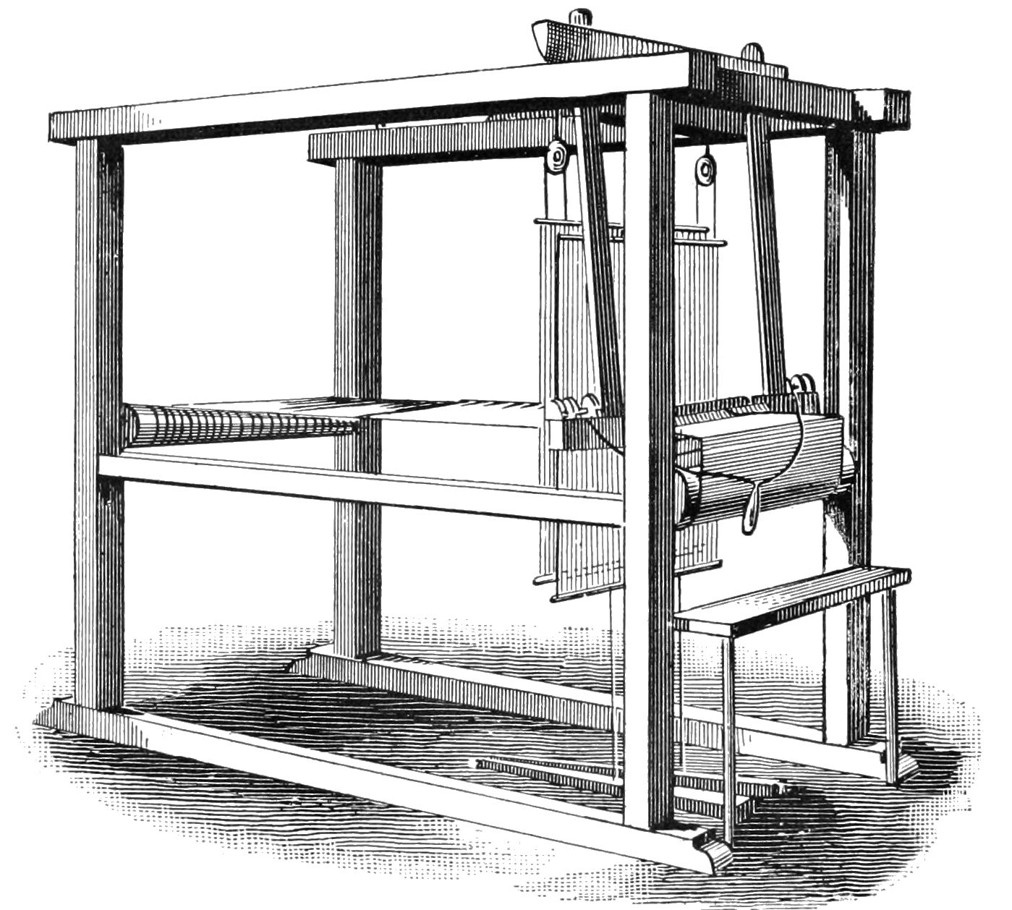

Slide 9
Great Britain First
Began in 1780s (not complete until 1830 at the earliest)
Had no impact on continental Europe until after the end of the Napoleonic Wars (1815)
Mainland Britain was untouched by the Napoleonic Wars
Economic and Social Factors
Land and geography
Geographic isolation from the Continent offered protection and separation from many of the continental wars b.
Good supply of coal and iron
Waterways offered a source of alternate power for factories and navigable transport for trade and communication. •
No part of England was more than 20 miles from navigable water.
Industrial Revolution grew out of England’s expanding role in the Atlantic economy of the 18th century. •
The growth of the Royal Navy and the development of ports provided protection from foreign invasion and later aided Britain’s commercial empire.
Large supplies of capital were available
Colonial Empire= access to raw materials

Slide 10
Agricultural Revolution
Agricultural Revolution was vital to the Industrial Revolution.
Supply of cheap and abundant labor emerged as the enclosure movement forced many landless farmers to move to towns and cities
The revolution in agriculture made it possible for fewer farmers to feed larger numbers of people.

Slide 11
Steam Engine and Coal
The use of coal to power steam engines was one of the hallmarks of the industrial revolution.
This revolution in energy involved a transition from wood-burning to coal-burning.
Prior to 1780, processed wood (charcoal) was the fuel mixed with iron ore in the blast furnace to produce pig iron.
Much of England as well as parts of Europe were experiencing deforestation.
Coal
Provided steam power used in many industries.
By 1850, England produced 2/3 of world's coal

Slide 12
The steam engine
Thomas Savory (1698) and Thomas Newcomen (1705) invented the steam pump to pump water out of mines.
Both engines were extremely inefficient.
James Watt in 1769 invented and patented the first efficient steam engine.
The steam engine was the most fundamental advance in technology.
Steam-power began to replace water power in cotton-spinning mills during the 1780s
Radical transformations occurred in manufacturing and transportation.

Slide 13
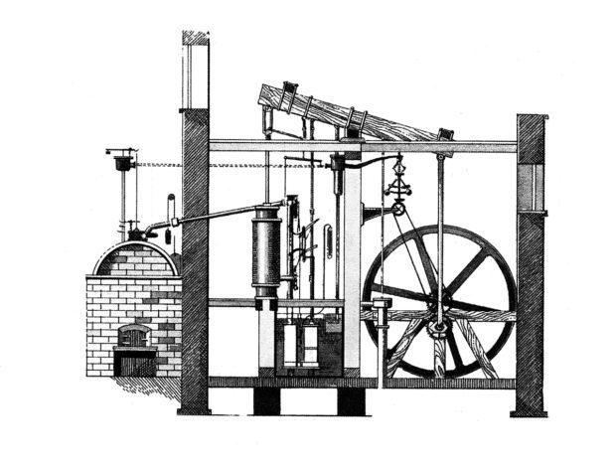

Slide 14
Iron Industry
radically transformed by steam power.
Rising supplies of coal boosted iron production and gave rise to heavy industry:
the manufacture of machinery and materials used in production
Iron makers switched over rapidly from charcoal to coke in smelting of pig iron.
Henry Cort, in 1780s, developed the puddling furnace, Which allowed pig iron to be refined in turn with coke.
Cort also developed heavy-duty steam powered rolling mills capable of shaping finished iron into any shape or form.
By 1850, England produced more than half of world’s iron.

Slide 15
Transportation Revolution
Made possible by steam power.
Necessary to distribute finished goods as well as deliver raw materials to factories.
New canal systems
Duke of Bridgewater important in development.
Canals important in completing basic needs of related interdependent industries: railroad, steel, coal industries
Construction of hard-surfaced roads pioneered by John McAdam (1756-1836) • Significantly improved land travel
1807- Robert Fulton’s steamboat, the Clermont, traveled up the Hudson River from New York City to Albany.
Used an imported Boulton and Watt steam engine.
Made 2-way river travel possible and travel on the high seas faster.
1838- first steamship crossed the Atlantic Ocean.

Slide 17
Railroads
1803-first steam wagon was used on streets of London
1812, steam wagon was adapted for use on rails.
1825, George Stephenson made railway locomotive commercially successful.
By 1829 the locomotive was widely used in England.
In 1830, his locomotive, the Rocket, traveled the Liverpool-Manchester Railway at 16mph.
World’s first important railroad as it was in heart of industrial England.
Many private companies were quickly organized to build more rail lines in the 1840s
Impact of the railroad:
Greatly reduced cost of shipping freight on land
Resulted in growing regional and national market spurring increased industrial productivity to meet larger demand. Facilitated the growth of urban working class who came from the countryside.
Many cottage workers, farm laborers, and small peasants worked building railroads.
After rail lines were built, many traveled on railroads to towns looking for work.

Slide 18
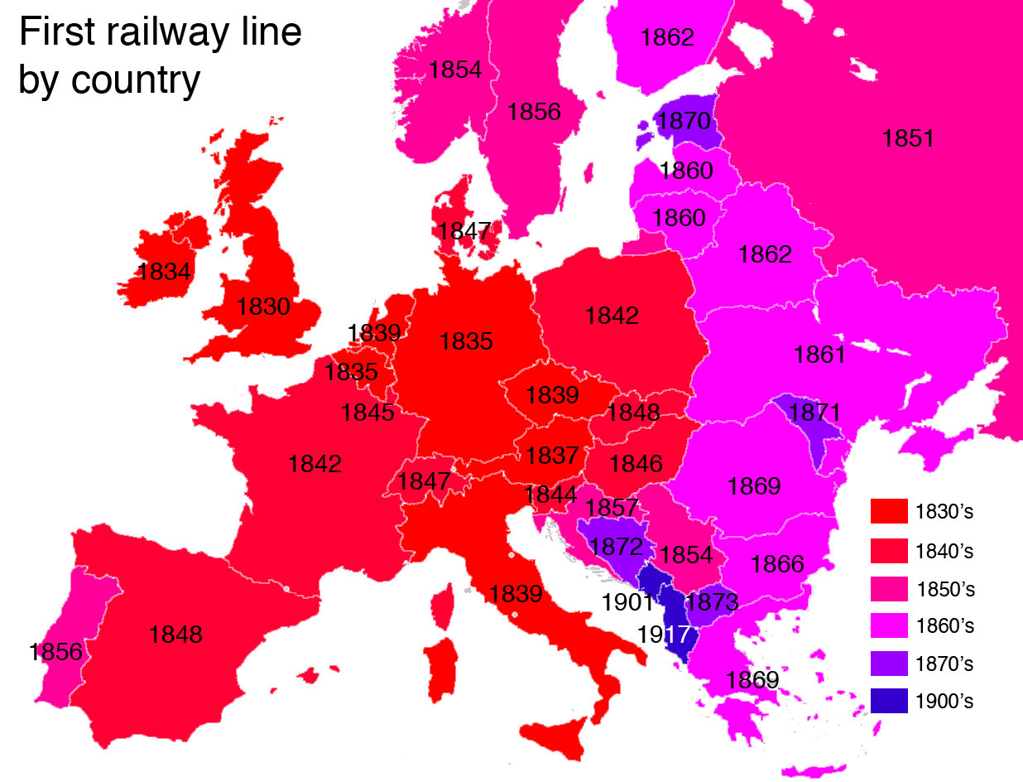

Slide 19
Great Britain in 1850
Produced 2/3 of world’s coal.
Produced more than ½ of world’s iron.
Produced more than ½ of world’s cotton cloth.
GNP rose between 1801 and 1850 350%
100% growth between 1780 and 1800.
Population increased from 9 million in 1780 to almost 21 million in 1851.
Per capita income increased almost 100% between 1801 and 1851.
Economy increased faster than population growth creating higher demand for labor.

Slide 20
Crystal Palace Exhibition Hall
The Crystal Palace was an exhibition hall built for the 1851 Great Exhibition
Originally located in Hyde Park London
It was made from cast-iron and plate glass
It is about 1/3 mile long, 128 feet tall, and about 990,00 square feet inside
More than 14,000 exhibitors gathered in the building during the Great Exhibition
It was intended to signify Britain’s industrial, economic and military power

Slide 21
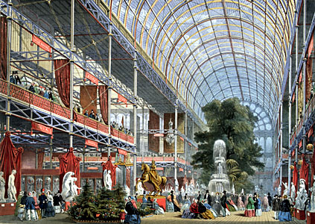
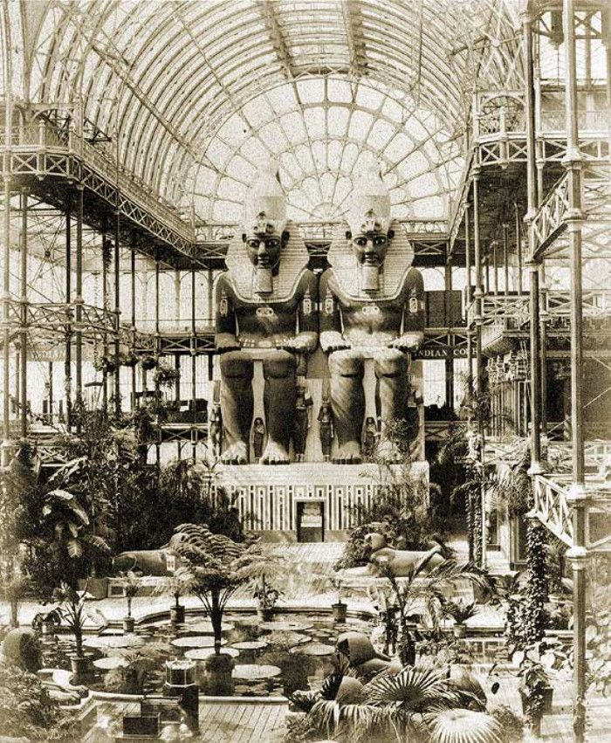

Slide 22
The Industrial Revolution Spreads
Parts of the Continent were not far behind Britain industrially in the 1780s.
Cottage industry thrived in certain regions
Some British manufacturing techniques were copied by certain Continental countries
The Napoleonic wars hindered the industrial growth of continental European nations.
Disrupted trade, created runaway inflation, and reduced consumer demand.
Continental access to British machinery and technology was reduced.
By 1815, the continental countries lagged much further behind industrially than in 1789.
Britain dominated world markets during the wars.
British technology too advanced for most continental engineers and skilled technicians to understand.
Technology of steam power was expensive and required large amounts of capital.
Continental entrepreneurs struggled to acquire large amounts of capital.
Shortage of factory workers. e. Landowners and gov’t officials did little to encourage industrial growth.

Slide 23
After the Napoleonic Wars
Industrialization differed in each country after 1815
Belgium, Holland, France, and U.S. began their industrial revolutions in the 2nd decade of the 19th century.
Germany, Austria, and Italy in mid-19th century.
By 1900, Germany was the most powerful industrial country in Europe
Eastern Europe and Russia industrialized near the end of the 19th century.
Borrowed British technology, hired British engineers, and gained British capital.
Used power of strong sovereign central governments and banking systems to promote native industry.
Belgium: in 1830s, pioneered the organization of big corporations with many stockholders.
Banks used money to develop industries and thus became industrial banks.
Banks in France and Germany became important in the 1850s in developing railroads and companies in heavy industries.

Slide 24
Britain Loses Ground
Britain was unsuccessful in maintaining a monopoly on technical advances.
Until 1825, it was illegal for artisans and skilled mechanics to leave Britain.
Until 1843, export of textile machinery and other equipment forbidden.
Yet, many emigrated illegally and introduced new methods abroad.
Tariff policies were used to protect native industries on the continent.
France responded by enacting high tariffs on many British imports.
France had been flooded by inexpensive and superior British goods
1834, the Zollverein was a German tariff on non German imports established to encourage capital investment in German industry
Established a free trade zone among member states and a single uniform tariff was levied against foreign countries.

