Slide 1
The Enlightenment

Slide 2
The Enlightenment
Secular world view emerged for the first time in human history
Belief that natural science and reason could explain all aspects of life
Belief in man’s intellect apart from God
Faith in reason, not revelation
Deism: the religious arm of the Enlightenment
The existence of God was a rational explanation of the universe and its form.
God was a deistic Creator—a cosmic clockmaker—who created the universe and then stepped back and left it running like a clock.

Slide 3
The universe was governed by “natural law”, not by a personal God.
Some called it the “ghost in the machine.”
The supernatural was not involved in human life.
Deism grew out of Newton’s theories regarding natural law.
Baruch Spinoza (1632-1677): philosopher during the Scientific Revolution whose worldview equated God and nature.

Slide 4
Principles of the Scientific Revolution
applied to human society and institutions.
Progress in society was possible if natural laws and how they applied to society could be understood.
Education was seen as a key towards helping society to progress.

Slide 5
Enlightenment Philosophers

Slide 6
John Locke (1632-1704)
Two Treatises on Civil Government (1690)
Philosophical defense for the “Glorious Revolution”
Humans in a state of nature: Locke believed humans are basically good but lack protection.
Contrasts Hobbes’ view of humans in a state of nature as “nasty and brutis

Slide 7
Governments provide rule of law but only through the consent of the governed.
The purpose of government is to protect the “natural rights” of the people: life, liberty and property.
Social contract: people agree to obey the government in return for protection of natural rights
Right to rebellion: People have a right to abolish a government that doesn’t protect natural rights.

Slide 8
Essay Concerning Human Understanding (1690)
One of the great works of the Enlightenment
Stressed the importance of environment on human development
tabula rasa: the human mind was born as a blank slate and registered input from the senses passively

Slide 9
Locke saw all human knowledge as the result of sensory experiences without any preconceived notions.
He rejected Descartes’ view that all people are born with certain basic ideas and ways of thinking.
For progress to occur in society, education was critical in determining human development.
This undermined the Christian view that humankind was essentially sinful.

Slide 10
Religious Toleration
The ideal of religious toleration was popularized by many scholars who made the Enlightenment accessible to the public.
Bernard de Fontenelle (1657-1757)
Made highly complicated scientific ideas accessible to a broad audience
Stressed the idea of progress
Skeptical of absolute truth and questioned claims of organized religion

Slide 11
The Philosophes
Notable 18th-century French philosophers that were committed to fundamental reform in society.
They were extremely successful in popularizing the Enlightenment, though they were not professional philosophers (like Descartes and Locke).
By 1775, much of western Europe’s educated elite had embraced the Enlightenment
They believed in progress through discovering the natural laws governing nature and human existence.
They were radically optimistic about how people should live and govern themselves.

Slide 12
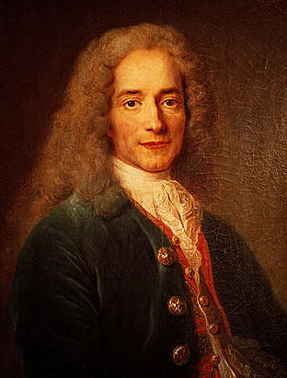
Voltaire (1694-1778)
Perhaps most influential of all the Enlightenment philosophers
He wrote his criticisms with a sharp sarcasm that ridiculed those with whom he disagreed.
He challenged traditional Catholic theology
Strong deist views
Believed prayer and miracles did not fit with natural law
Believed that human reason was the key to progress in society, not religious faith

Slide 13
His social criticism inspired a call for change, setting the stage for the French Revolution later in the century.
He hated bigotry and injustice and called for religious toleration.
His most famous quote against religious intolerance was “crush the infamous thing” (“Ecracsez l’infame”).
Although Voltaire was raised a Christian, he came to distrust organized religion as corrupt in its leadership and for having moved away from the central message of Jesus.

Slide 14
He advocated “enlightened despotism” (a more benevolent form of absolutism) believing people were incapable of governing themselves
These views were similar to Hobbes’ 17th-century views
influenced several “Enlightened Despots” including Frederick the Great of Prussia (who invited Voltaire to live in his court in Berlin), Catherine the Great of Russia, Joseph II of Austria and Napoleon of France.
Believed in equality before the law but not equality of classes.

Slide 15
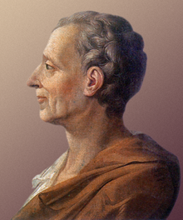
Baron de Montesqueiu (1689-1755)
He was a French noble who hated the absolutism of Louis XIV.
Spirit of the Laws (1748): He called for the separation of powers in government into three branches (monarchy, nobility, and the rest of the population).
His primary goal was to prevent tyranny and promote liberty.

Slide 16
The principle of checks and balances would ensure that no single branch of gov’t became too powerful as the other two branches could check excess power.
He favored the British system of a monarch, Parliament and independent courts.
He supported the 13 parlements in France (judicial tribunals of nobles) as a check against the tyrannical absolute rule by the monarch.
Montesquieu’s ideas had a significant impact on the creation of the U.S. Constitution and the French Revolution in the 1780s.

Slide 17
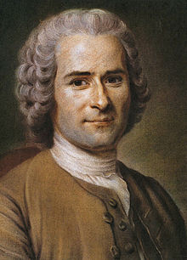
Jean-Jacques Rousseau (1712-1778)
Social Contract (1762)
He believed that too much of an emphasis on property, and not enough consideration of people, was a root cause of social injustice.

Slide 18
The general will, a consensus of the majority, should control a nation. This strongly implied democracy.
Downside: minority viewpoints were not recognized.
Though these ideas seem to support democracy, the ambiguous nature of “general will” was later manipulated by dictators to rationalize extreme nationalism and tyranny (e.g. Robespierre).

Slide 19
Though considered part of the Enlightenment, Rousseau is more accurately seen as a founder of the Romantic movement.
After the French Revolution, the Enlightenment’s emphasis on reason gave way to a glorification of emotion.
Rousseau believed that man in a simpler state of nature was good—a “noble savage”—and was corrupted by the materialism of civilization.

Slide 20
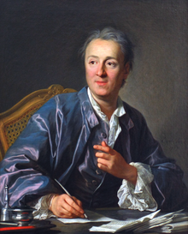
Denis Diderot (1713-1784)
The Encyclopedia (completed in 1765)
The multi-volume work was perhaps the greatest and most representative work of the philosophes.
It was a compendium of political and social critiques from various Enlightenment philosophers and authors.

Slide 21
It helped to popularize the views of the philosophes.
It emphasized science and reason while criticizing religion, intolerance, injustice and tyranny.
Sought to teach people to think critically and objectively
The Encyclopedia was banned in France; the pope placed it on the Index of Prohibited Books.

Slide 22
Marquis di Beccaria
On Crimes and Punishment (1764)
He sought to humanize criminal law based on Enlightenment concepts of reason and equality before the law.
Punishment for a crime should be based rationally on the damage done to society; it should not be linked to the religious concept of sin.
He opposed the death penalty except for serious threats against the state.

Slide 23
He opposed torture to extract confessions.
His views influenced the Enlightened Despots:
Frederick the Great of Prussia banned torture.
Catherine the Great restricted the use of torture.
Joseph II of Austria banned torture and the death penalty (but not other harsh punishments).

