Slide 1
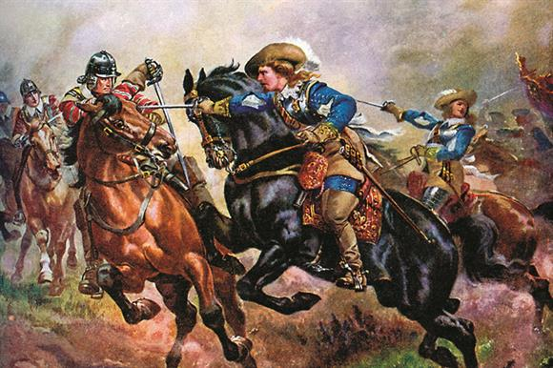
The English Civil War
1642-1651

Slide 2
End of Tudor Rule
In 1603 Elizabeth 1 dies
She died without an heir
This official ends the Tudor dynasty
Closet living heir was James VI of Scotland
  Mother was Mary Queen of Scots, cousin to Elizabeth I
He assumes the throne and becomes James I of England

Slide 4
James I (1603-1625)
First in Stuart Dynasty
Personal Union of Scotland and England: England and Scotland not one country, but both governed by same person
Justified his reign based on divine right
  believed he was God’s representative on Earth
  believed judges were agents of the king, not servants of the law
  Parliament rarely called when James I was in power
  True Law of Free Monarchies (1598) (argued monarchs are free from parliament control

Slide 5
Twice dissolved Parliament over taxations and demands for free speech
Flaunted his wealth and damaged the image/ prestige of the monarchy
  England was in debt due to a series of wars during Elizabeth's reign

Slide 6
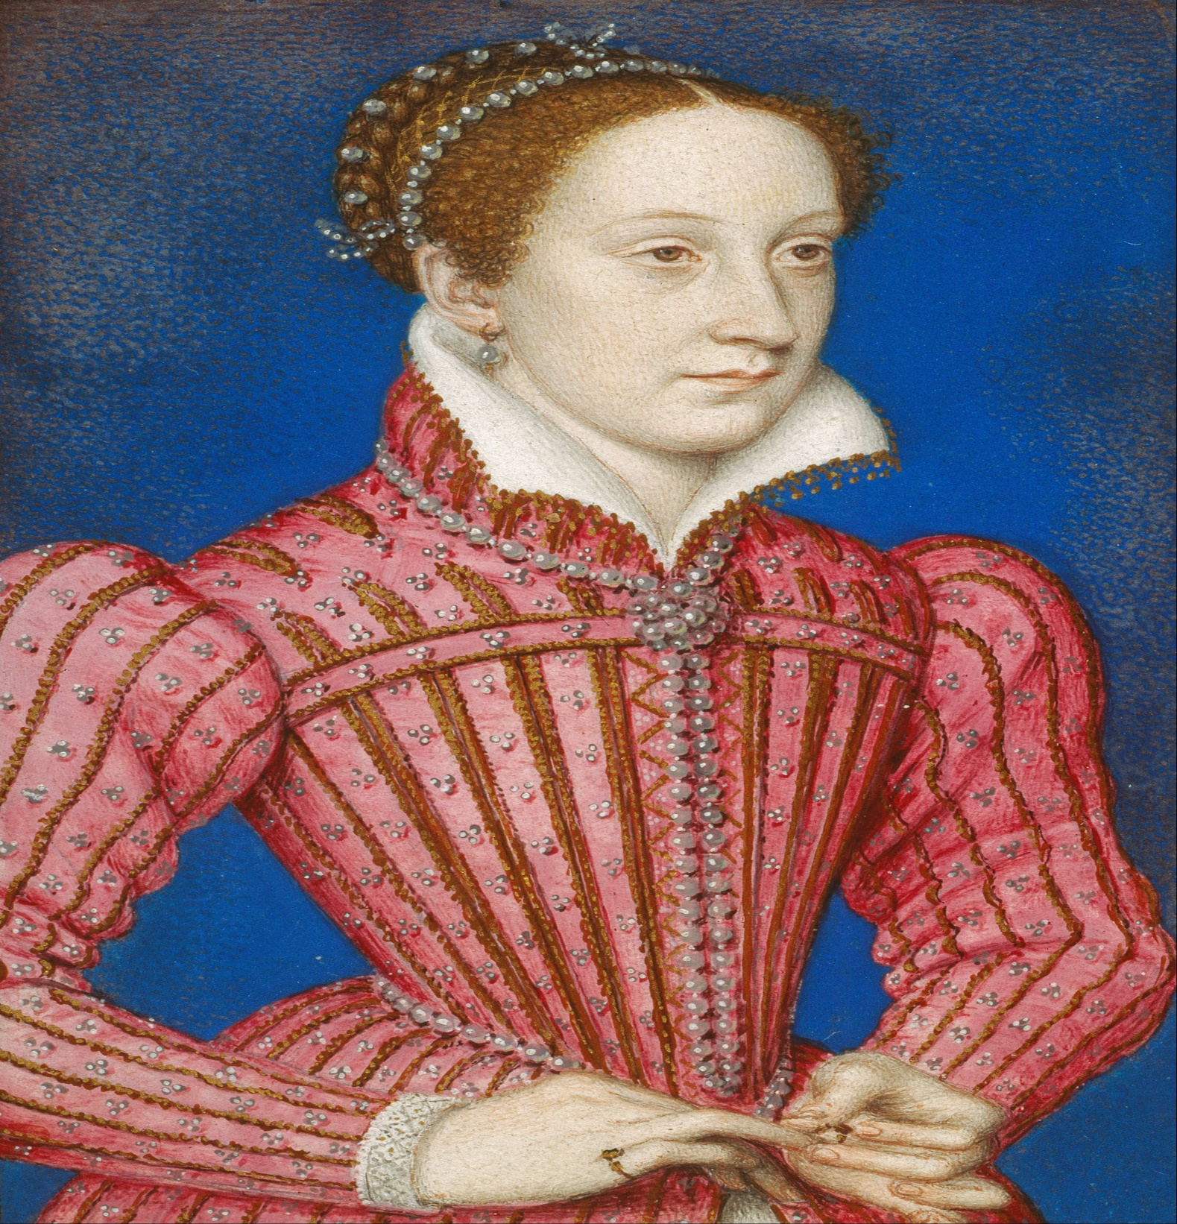
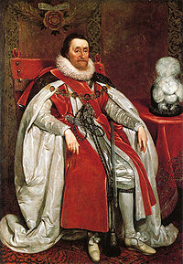

Slide 7
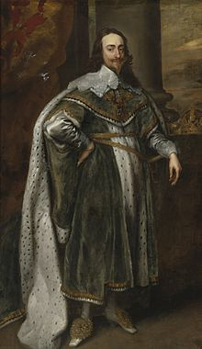
Charles I (1625-1642)
Personal:
  son of James I
  great supporter of the arts
  known to be vain
Politics
  believed in divine right monarchy
  attempted to rule as an absolute monarch

Slide 8
Charles I v. Parliament
Charles and Parliament argued over the issue of taxation
  Charles needed money for war.
To save money, soldiers were quartered in English homes during wartime (this was very unpopular).
Some English nobles were arrested for refusing to lend money to the government.
By 1628, both houses of Parliament were firmly opposed to the king.

Slide 9
Petition of Right (1628)
  Parliament attempted to encourage Charles to grant basic legal rights in return for granting tax increases.
  Provisions:
    Only Parliament had the right to levy taxes
    No one should be imprisoned without due process of law
    All had the right to habeas corpus
    No forced quartering of soldiers in homes of private citizens
    Martial law could not be declared in peacetime

Slide 10
In response Charles dissolved Parliament in 1629
  Parliament continued to refuse increased taxation without its consent.
  Parliament also had demanded that any movement of the gov’t toward Catholicism be treated as treason.

Slide 11
Charles Rule Without Parliament
Charles ruled as an absolute monarch during these 11 years.
Raised money using medieval forms of forced taxation (those with wealth had to pay)
“Ship money”: all counties now required to pay to outfit ships where before only coastal communities had paid
Religious persecution of Puritans became the biggest reason for the English Civil War

Slide 12
The “Short Parliament”1640
Scottish military revolt in response to Charles’ attempt to impose the English Common Book of Prayer on the Scottish Presbyterian church
Charles needed new taxes to fight the war against Scotland.
Parliament reconvened in 1640 but refused to grant Charles new taxes if he did not accept the Petition of Rights and church reforms.
Charles disbanded Parliament again (after only 1 month).

Slide 13
The “Long Parliament” (1640-1648)
Desperate for money after the Scottish invasion of northern England in 1640, Charles finally agreed to certain demands by Parliament.
Parliament’s demands:
  Parliament could not be dissolved without its consent.
  Parliament must meet at least once every three years
  Ship money was abolished

Slide 14
  Those who persecuted Puritans were to be tried and executed
  The Star Chamber was abolished.
  Common law courts were supreme to the king’s courts.
  Refused funds to raise an army to defeat the Irish revolt
Puritans became the majority in Parliament against the Kings Anglican supporters

Slide 15
The English Civil Wars (1642-1649)
Immediate Cause
  Charles tried to arrest several Puritan MPs but a crowd of 4,000 came to its defense.
    An Irish rebellion had broken out and Parliament was not willing to give the king an army.
March 1642, Charles declared war against his opponents in Parliament.
Civil war resulted

Slide 16
Cavaliers
supported the king
  Clergy and supporters of the Anglican Church
  Majority of the old gentry (nobility); north and west
  Eventually, Irish Catholics (who feared Puritanism more than Anglicanism

Slide 17
Roundheads
opposed the king
Consisted largely of Puritans (Congregationalists) and Presbyterians (who favored the Scottish church organization)
Allied with Scotland (in return for guarantees Presbyterianism would be imposed on England after the war)
Supported by a majority of businessmen
Included some nobles in the south and east
Had the support of the navy and the merchant marine

Slide 18
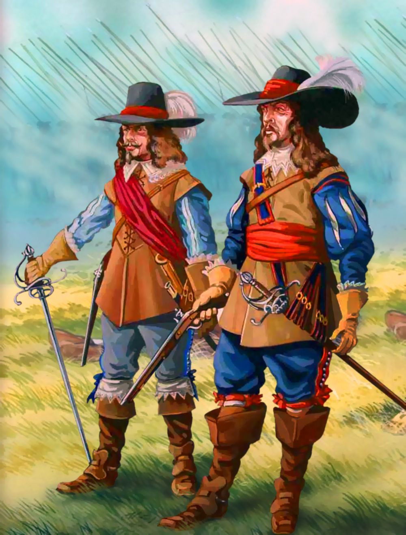
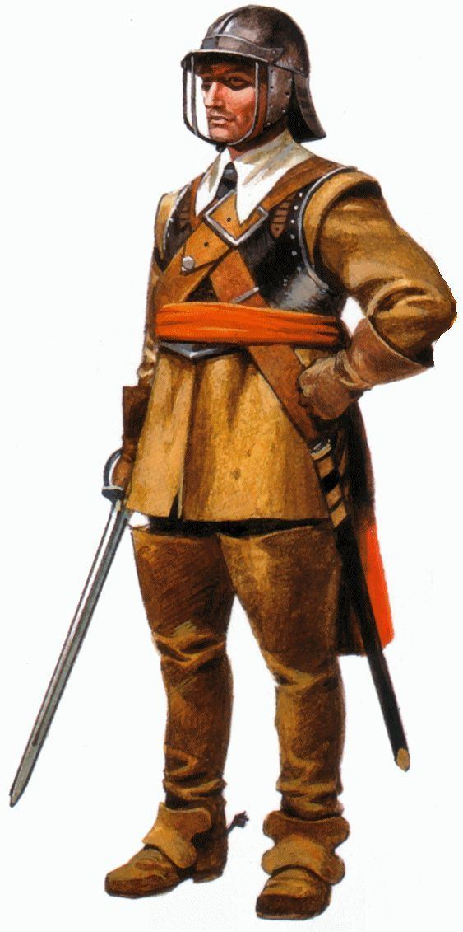

Slide 19
Oliver Cromwell and the New Model Army
Charles surrendered to the Scots in 1646 and convinced them to invade England to restore him to the throne.
A division between Puritans and Presbyterians (and non-Puritans) developed late in the war.
Cromwell refused Parliament’s call to disband the army.
Parliament ordered the army to disband; Cromwell refused.
  Cromwell successfully thwarted a Scottish invasion (Charles I had promised Scotland a Presbyterian system if they would help defeat Cromwell).

Slide 20
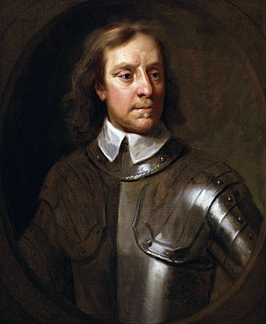

Slide 21
Pride’s Purge (1648)
Parliament debated restoring Charles I to the throne.
The New Model Army (without Cromwell’s knowledge) removed all non-Puritans from Parliament leaving a “Rump Parliament.”
The “Rump” put Charles I on trial for treason.
Charles I was beheaded in 1649.
  Effectively ended the English Civil War
  First European king to be executed by his own subjects

Slide 22
The Protectorate (1653-1659)
Cromwell became Lord Protector (in effect, a Puritan dictatorship)
  Dissolved the “Rump Parliament” in 1653 after a series of disputes
  England was divided into 12 districts, each under the control of a military general
  Denied religious freedom to Anglicans and Catholics
  Allowed Jews to return to England in 1655

Slide 23
End of the Commonwealth
Cromwell’s demise
  Cromwell’s policies grew increasingly unpopular and England faced mounting financial problems
  Cromwell died in 1658 (urinary infection)
Cromwell’s son Richard became “Lord Protector” from 1658-59
  Richard lacked credibility with the army
  Richard unable to deal with the Commonwealth’s financial problems •
Commonwealth collapsed in 1660
  Stuart dynasty restored by Parliament
  Charles I’s son Charles II returned from France to become king
    NOTE: after 1660, Commonwealth known as the “Interregnum”

