Slide 1
The Commercial Revolution
16th and 17th Centuries

Slide 2
Causes
Roots were in the Middle Ages
Population growth recovered to its pre-Plague level: 70 million in 1500; 90 million in 1600; thus, more consumers existed.
The “Price revolution”: long slow upward trend in prices
States and emerging empires sought to increase their economic power.
Rise in capitalism

Slide 4
Banking
The Fuggers in Germany and the Medicis in Italy were among the leading bankers in Europe
They funded countless economic activities.
Antwerp- in Flanders became the banking and commercial center of Europe in the 16th century.
Amsterdam- became the financial center in the 17th century after the successful Dutch Revolt against Spain.
Innovations in accounting, such as double-entry bookkeeping, made banking far more efficient

Slide 5
Hanseatic League
Evolved from within the German states in the Middle Ages
Was a commercial and defensive confederation
Located along the Northern German coast (North and Baltic Seas)
Controlled trade in much of northern Europe well into the 16th century.
The League was a mercantile association of numerous cities and towns.

Slide 6
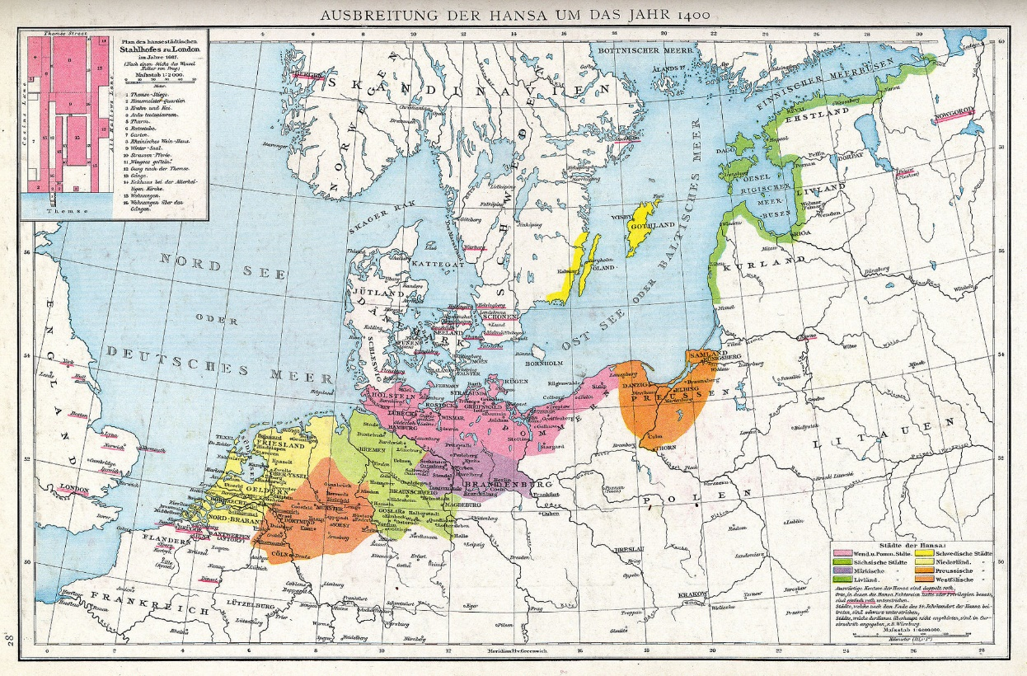

Slide 7
Chartered Companies and Joint-Stock Companies
Chartered Co.:
States provided monopolies in certain areas
These chartered companies became, in effect, a state within a state with large fleets of ships and military power
Example- Dutch East India Company, and the British East India Company
Joint-Stock Co.:
investors pooled resources for a common purpose
forerunner of the modern corporation
This was an early prime example of capitalism.

Slide 8
Stock Markets
Markets emerged in northern Europe
The Bourse in Antwerp
Investors financed a company by purchasing shares of stock;
As the value of the company grew so did the value of the stock, and thus the investors’ profit.

Slide 9
Mercantilism and “Bullionism”
Developed in the 17th Century
Goal of Mercantilist policy:
Nations sought a self-sufficient economy.
Strategy:
create a favorable balance of trade where one’s country exported far more than it imported
“Bullionism”: A country should acquire as much gold and silver as possible.
A favorable balance of trade was necessary to keep a country’s supply of gold from flowing to a competing country.

Slide 10
The Price Revolution
Prices during the 16th century rose gradually.
The rising population of Europe increased demand for goods, thereby increasing prices.
The influx of gold and silver from the New World was one of the factors (but not the major factor).
Accumulation of capital among large landowners who oversaw the commercialization of agriculture
Inflation stimulated production as producers could get more money for their goods.
The middle class acquired much of its wealth from trading and manufacturing; its social and political status increased.
Peasant farmers benefited, at times, when their surplus yields could be turned into cash crops.

Slide 11
Negative Effects of the Price Revolution
An uneven increase in prices meant that at times the price of goods grew sharply while wages did not. This results in lower standards of living.
The nobility, whose income was fixed (based on feudal rents and fees), suffered a diminished standard of living in the inflationary economy.
Attempts of landlords to increase their revenues by restricting the rights of peasants led to revolts

Slide 12
Other Effects of the Commercial Revolution
Slow transition from a European society that was almost completely rural and isolated, to a society that was more developed with the emergence of towns
Many serfs, mostly in western Europe but not in eastern Europe, improved their social position as a result.
Migration to towns and cities led to crime, poverty, unemployment, and sanitation problems.
Town elites such as bankers, merchants, and craft guilds struggled to govern effectively and experienced inadequate resources
The emergence of more powerful nation states occurred.
Wealth was increasingly taxed for state purposes.
The age of exploration emerged as competing nations sought to create new empires overseas

Slide 13
The bourgeoisie grew in political and economic significance.
First evident in the Italian city-states during the Renaissance.
Became the most powerful class in the Netherlands.
In France, it grew in political power at the expense of the nobility.
The gentry exerted increasing influence in English politics.
The standard of living increased (e.g. greater varieties of foods, spices, utensils), especially among the upper and middle classes.

