Slide 1
The Cold War
Part 1

Slide 2
Activator
From Stettin in the Balkans, to Trieste in the Adriatic, an iron curtain has descended across the Continent. Behind that line lies the ancient capitals of Central and Eastern Europe. -- Sir Winston Churchill, 1946

Slide 4
Yalta Conference
February 1945
FDR, Churchill, and Stalin meet to discuss postwar Europe
They agree to govern Germany jointly
Divided into occupation zones

Slide 6
Ideological Differences
Soviet and Eastern Bloc Nations
Goal- spread communism around the world
US and the Western Democracies
Goal- “Containment” of communism and the eventual collapse of the Communist world
George Kennan
Domino Theory
When one nation falls to communism the surrounding nations will too

Slide 7
United Nations
International peace keeping organization
Founded in 1945 in New York State.
Located today in New York City

Slide 9
Truman Doctrine
March 12, 1947
Greece and Turkey in danger of falling to communist insurgents
Truman requested $400 million from Congress in aid to both countries.
Successful effort
Implementation of the containment policy

Slide 10
Marshall Plan
U.S. Secretary of State George Marshall
proposes a massive aid program to rebuild Europe from the ravages of World War II.
Nearly $13 billion in U.S. aid was sent to Europe from 1948 to 1952.
The Soviet Union and communist Eastern Europe decline U.S. aid.

Slide 11
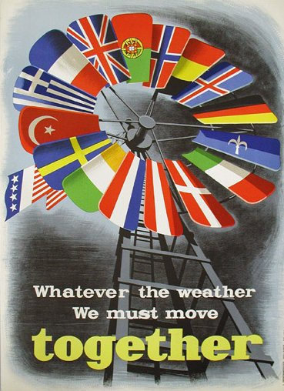

Slide 12
Communist Takeover in Czechoslovakia
Feb. 1948
Key members of Czech govt. die “mysteriously”
Pro-western President forced to resign, new constitution ratified
Complete takeover by Czech communists

Slide 13
Berlin Airlift
Soviets block supplies from reaching Berlin
began on June 24, 1948
June 1948 -May 1949: U.S. and British planes airlift over 2 million tons of supplies
After 200,000+ flights, the Soviet Union lifts the blockade.
Causes a rise in tensions between the West and the Soviets
Also helped heal divisions left by World War II.

Slide 14
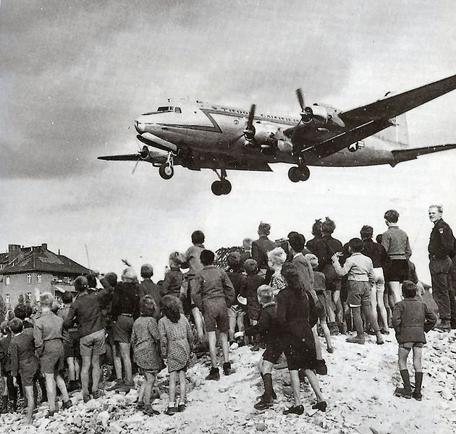
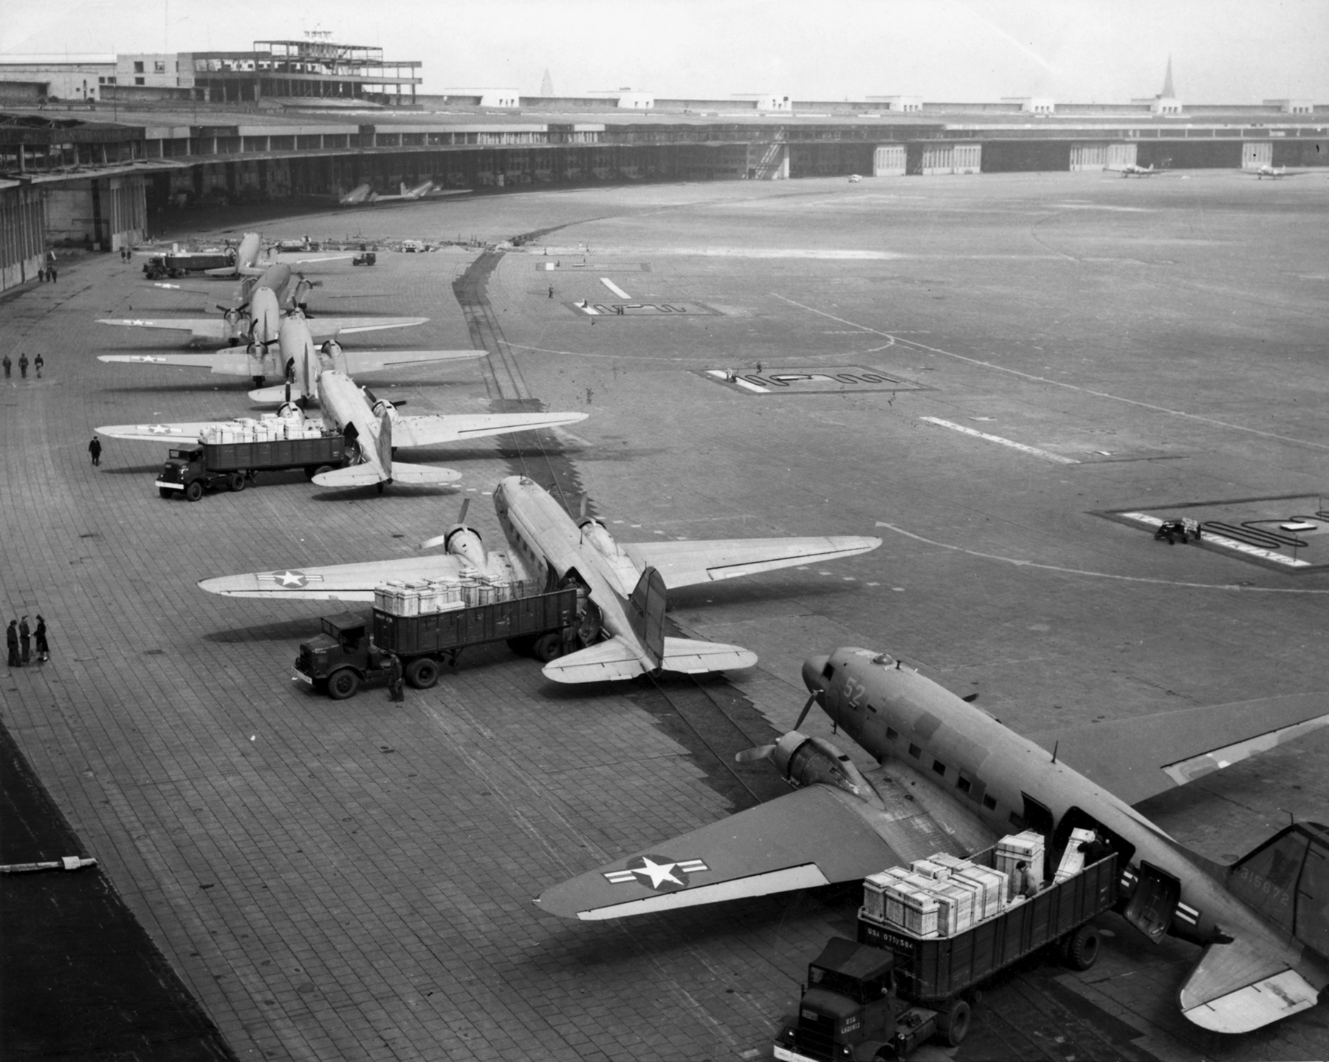
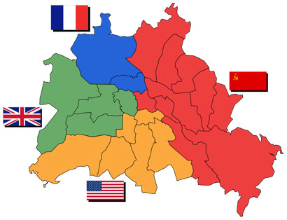

Slide 15
North Atlantic Treaty Organization
NATO was created in 1949
Military alliance between members
Created to safe guard western Europe from a Soviet invasion
Member nations
US, Belgium, Britain, Canada, Denmark, France, Iceland. Italy, Luxemburg, Netherlands, Norway, Portugal, Greece (1952), Turkey (1952), West Germany (19550, Spain (1983)

Slide 16
Warsaw Pact
Created in 1955
Military alliance that was created to challenge NATO
Member Nations
USSR, Albania, Bulgaria, Czechoslovakia, East Germany, Hungary, Poland, Rumania

Slide 17
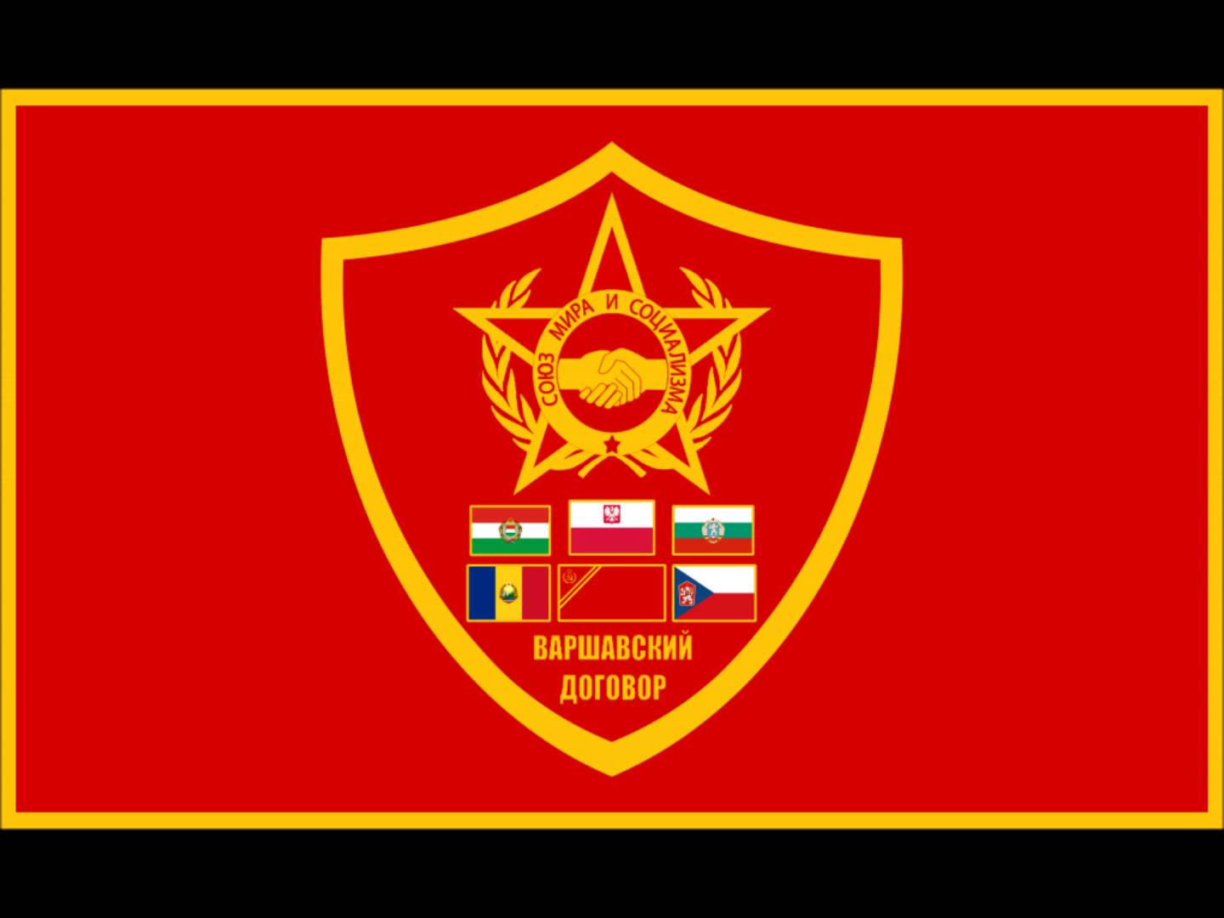
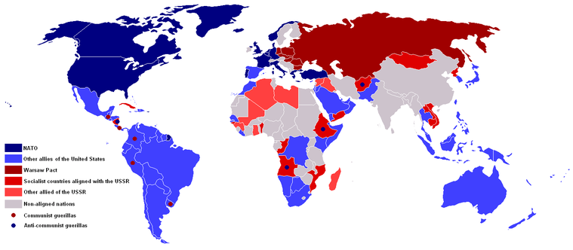

Slide 18
Fall of China- 1949
In June, Jiang Jieshi (Kai-Sheck) defeated by Mao Zedong
Flee to island of Taiwan
Oct 1-Mao proclaims People’s Republic of China (PRC)
Two months later, Mao travels to Moscow & negotiates a treaty with the Soviet Union

Slide 19
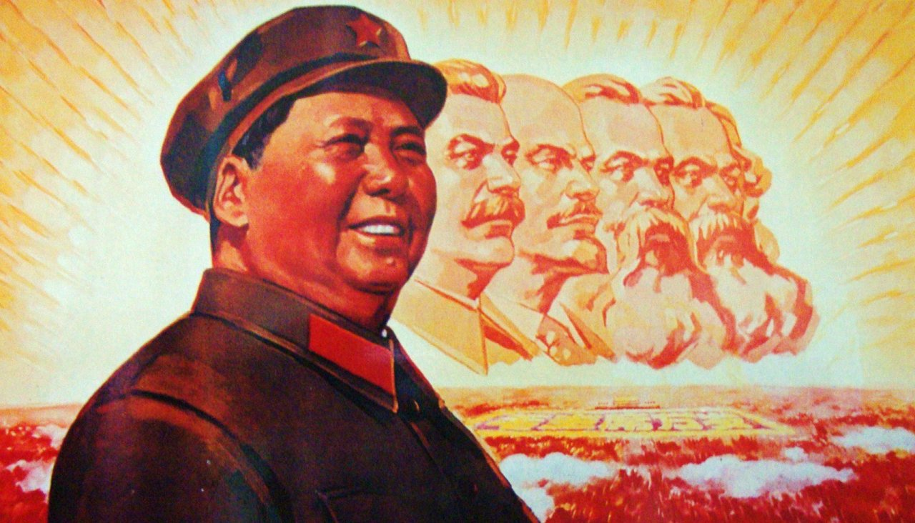

Slide 20
Korean War 1950-1953
June 25, North Korean communist forces cross the 38th parallel and invade South Korea.
June 27, Truman orders U.S. forces to assist the South Koreans
The United Nations (U.N.) Security Council condemns the invasion and establishes a 15-nation fighting force.
Chinese troops enter the conflict by end of 1950.
Cease fire eventually brings war to close by 1953

Slide 21
