Slide 1
The Atlantic Slave Trade

Slide 2
Triangular Trade
Triangular Trade (3 stages)
Slaves carried to the Americas
Sugar, tobacco, & other goods carried to Europe
European goods sent to Africa
Slave trade was essential to economic growth & emergence of capitalism

Slide 4
The Portuguese
“Factories” (forts)- along the West coast of Africa
Act as centers for trade and mission work
Benin, Kongo
El Mina- the most important due to its gold trade
Moves South in 16th century
Luanda in Angola
Establish ports on the Mozambique Coast
Access to gold

Slide 5
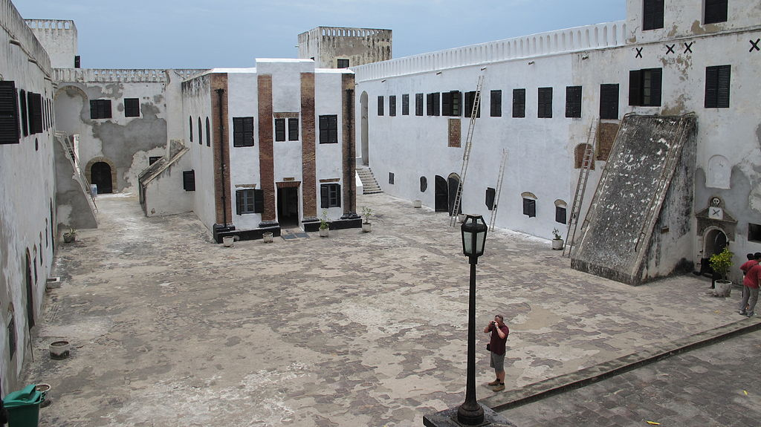
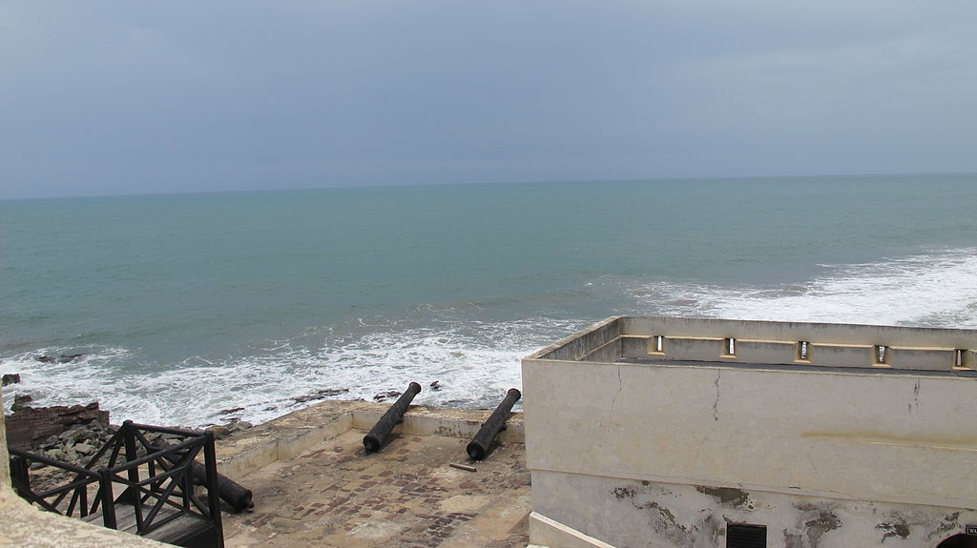
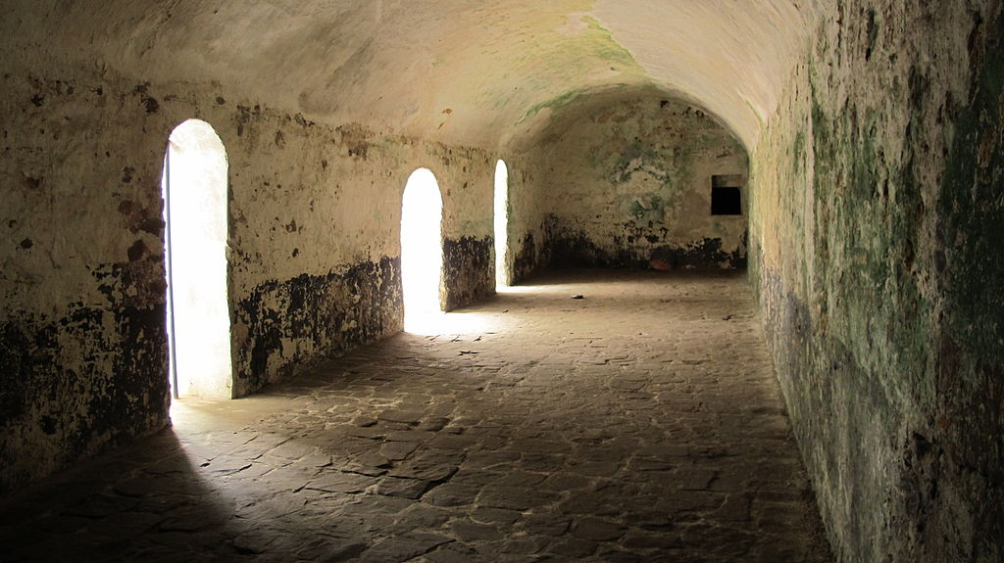
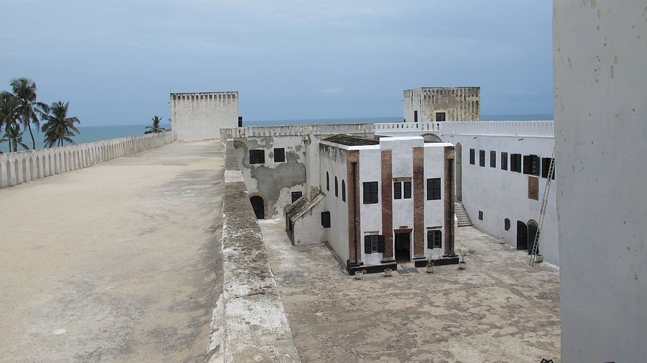

Slide 6
Dutch, English, and French
Dutch
Seize El Mina, 1630
Rival Portuguese
English
Slave trade from 1660s
French
18th century
Initially Europeans raided for slaves
more profitable to trade for human cargo
Slave trade grows due to American plantation colonies grew
Esp. Brazil
1450-1850 12 million Africans are sent to the New World
15-20% mortality rate

Slide 7
The Atlantic Slave Trade
Slaves needed most in Caribbean & Latin America due to high mortality & low fertility rates
Opposite in Southern US
Slave pop in British N. America = less ¼
Slave pop in British & French Caribbean = 80-90%
Slave trade was going on outside of the Atlantic by Muslim traders as well

Slide 8
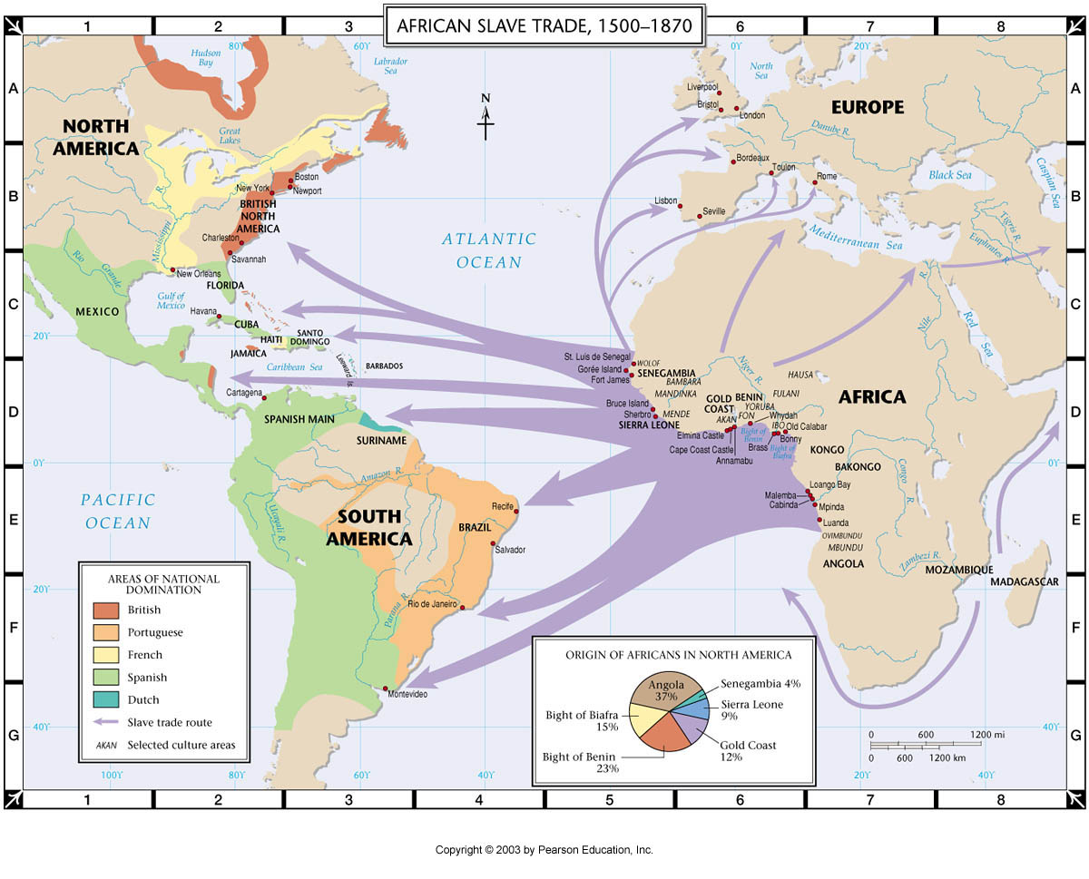

Slide 9
African Societies, Slavery, & the Slave Trade
Slave trade influenced forms of servitude and the social & political development of African states
African servitude varied from peasantry to chattel slavery
Slavery reinforced hierarchies of various African societies
Muslims believed slavery was legitimate for nonbelievers, but illegal for Muslims

Slide 10
Asante Empire
Asante located along the Gold Coast
Akan people
Kumasi, Hausa, & Mande – centers of trade
Matrilineal clans
Oyoko clan dominates in 1650 due to access to firearms
Leads to centralization & expansion

Slide 11
Osei Tutu
Asantehene (religious & civil leader)
Asante becomes dominate state of the Gold Coast
2/3 of trade made up of slavery
Dutch trade directly with Asante

Slide 12
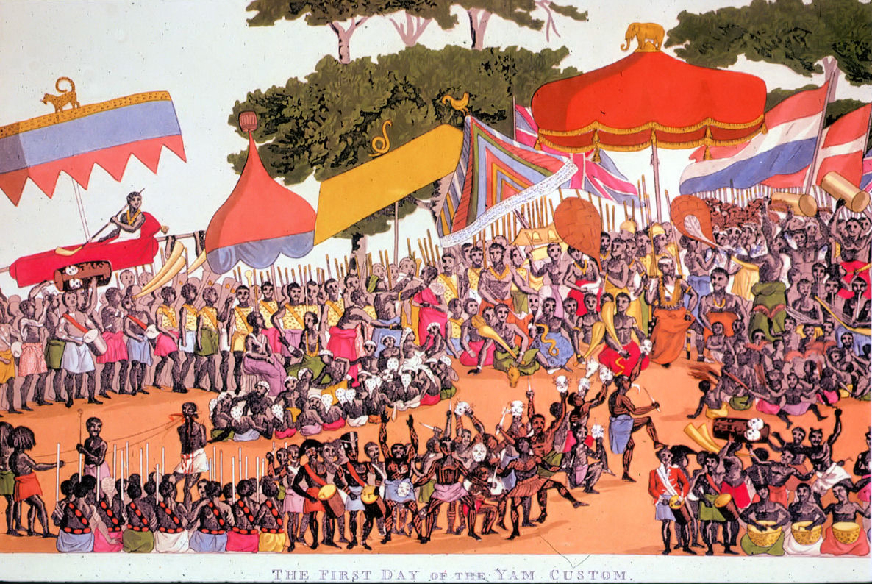
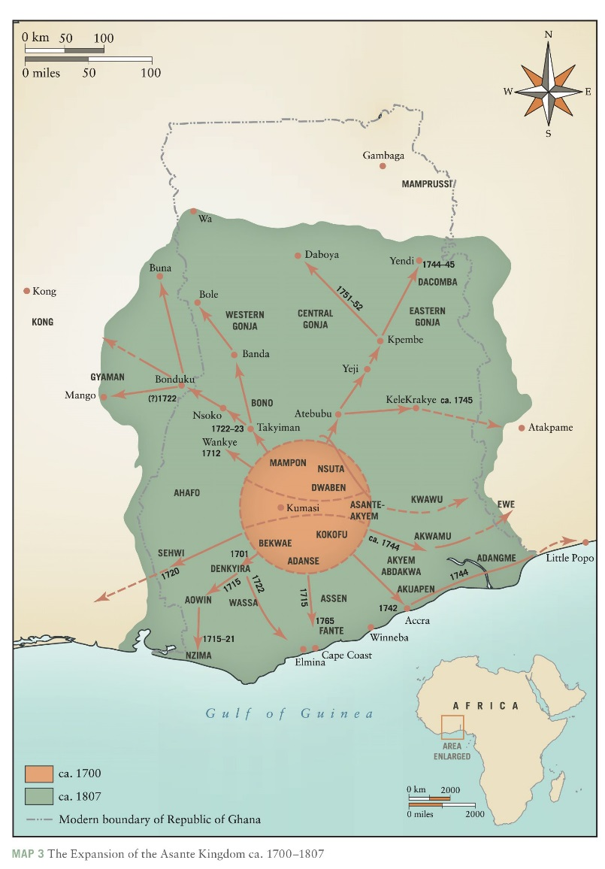

Slide 13
Benin (Slave Coast)
Oba limited slave trade
Slavery never primary source of revenue
Control trade with Europeans

Slide 14
Dahomey
Fon Peoples
King Agaja expands toward coast seizing port of Whyda
Major European attraction
Trade controlled by royal court
Slaving state

Slide 15
