Slide 1
The Age of Realpolitik
1848-1871

Slide 2
Failure of the Revolutions of 1848
Germany:
Nationalists and liberals of the Frankfurt Parliament failed to get the support of Prussian king Frederick William IV for a unified Germany.
Frederick William refused to “accept the crown from the gutter” and instead claimed Frederick “divine right.”
Italy:
The failure of Italian revolutionaries to work together effectively resulted in Austria and France forceful taking back control over Italy.
Austria (Hapsburg) Empire:
Minority groups failed to gain a foothold

Slide 3
France:
The February Revolution resulted in the overthrow of King Louis Philippe and established the Second French Republic led by Alphonse Lamartine.
The “June Days” Revolution pitted the bourgeoisie against the working class and conservatives (supported by the army) restored order.
Louis Napoleon (a conservative) was elected president overwhelmingly

Slide 4
Emergence of Realpolitik after 1848
For liberals and romantics strong idealism was not enough to accomplish revolutionary goals.
The “age of Realism” replaced Romanticism as the dominant philosophy after 1850.
A political outgrowth of realism was the notion of Realpolitik: the accomplishing of one’s political goals via practical means (rather than having idealism drive political decisions).
A new political era emerged where nationalist goals were achieved step-by-step in Machiavellian fashion (e.g. German unification, Italian unification, and Hungarian autonomy)/
In France, emperor Napoleon III (Louis Napoleon) would have to cater to liberals in order to maintain effective control.

Slide 5
Crimean War (1853-1856)
Symbol of the of the failure of the Concert of Europe
Between 1848 and 1878 peace in Europe would be interrupted by several wars
Major Cause:
dispute between two groups of Christians over privileges in the Holy Land (Palestine) (Roman Catholics v. Eastern Orthodox)
Russia occupied Turkish controlled land along the Danube River
The Ottoman Empire declared war on Russia in 1853 when Nicholas

Slide 6
In 1854, Britain and France declared war against Russia.
To some this was a major surprise as the Turks were not Christians, yet were supported by Britain and France who were Christian countries.
The “Four Points” included the following provisions:
Russia had to renounce claims to the occupied principalities on the Danube.
Navigation in the mouth of the Danube River (on the Black Sea) was internationalized.
Russia had to renounce its special role of protecting Greek Orthodox Christians within the Ottoman Empire.

Slide 7
Austria agreed to the “Four Points” and gave Russia an ultimatum to comply or Austria would join the war.
The new tsar, Alexander II, agreed to accept the Four Points and end the war.

Slide 8
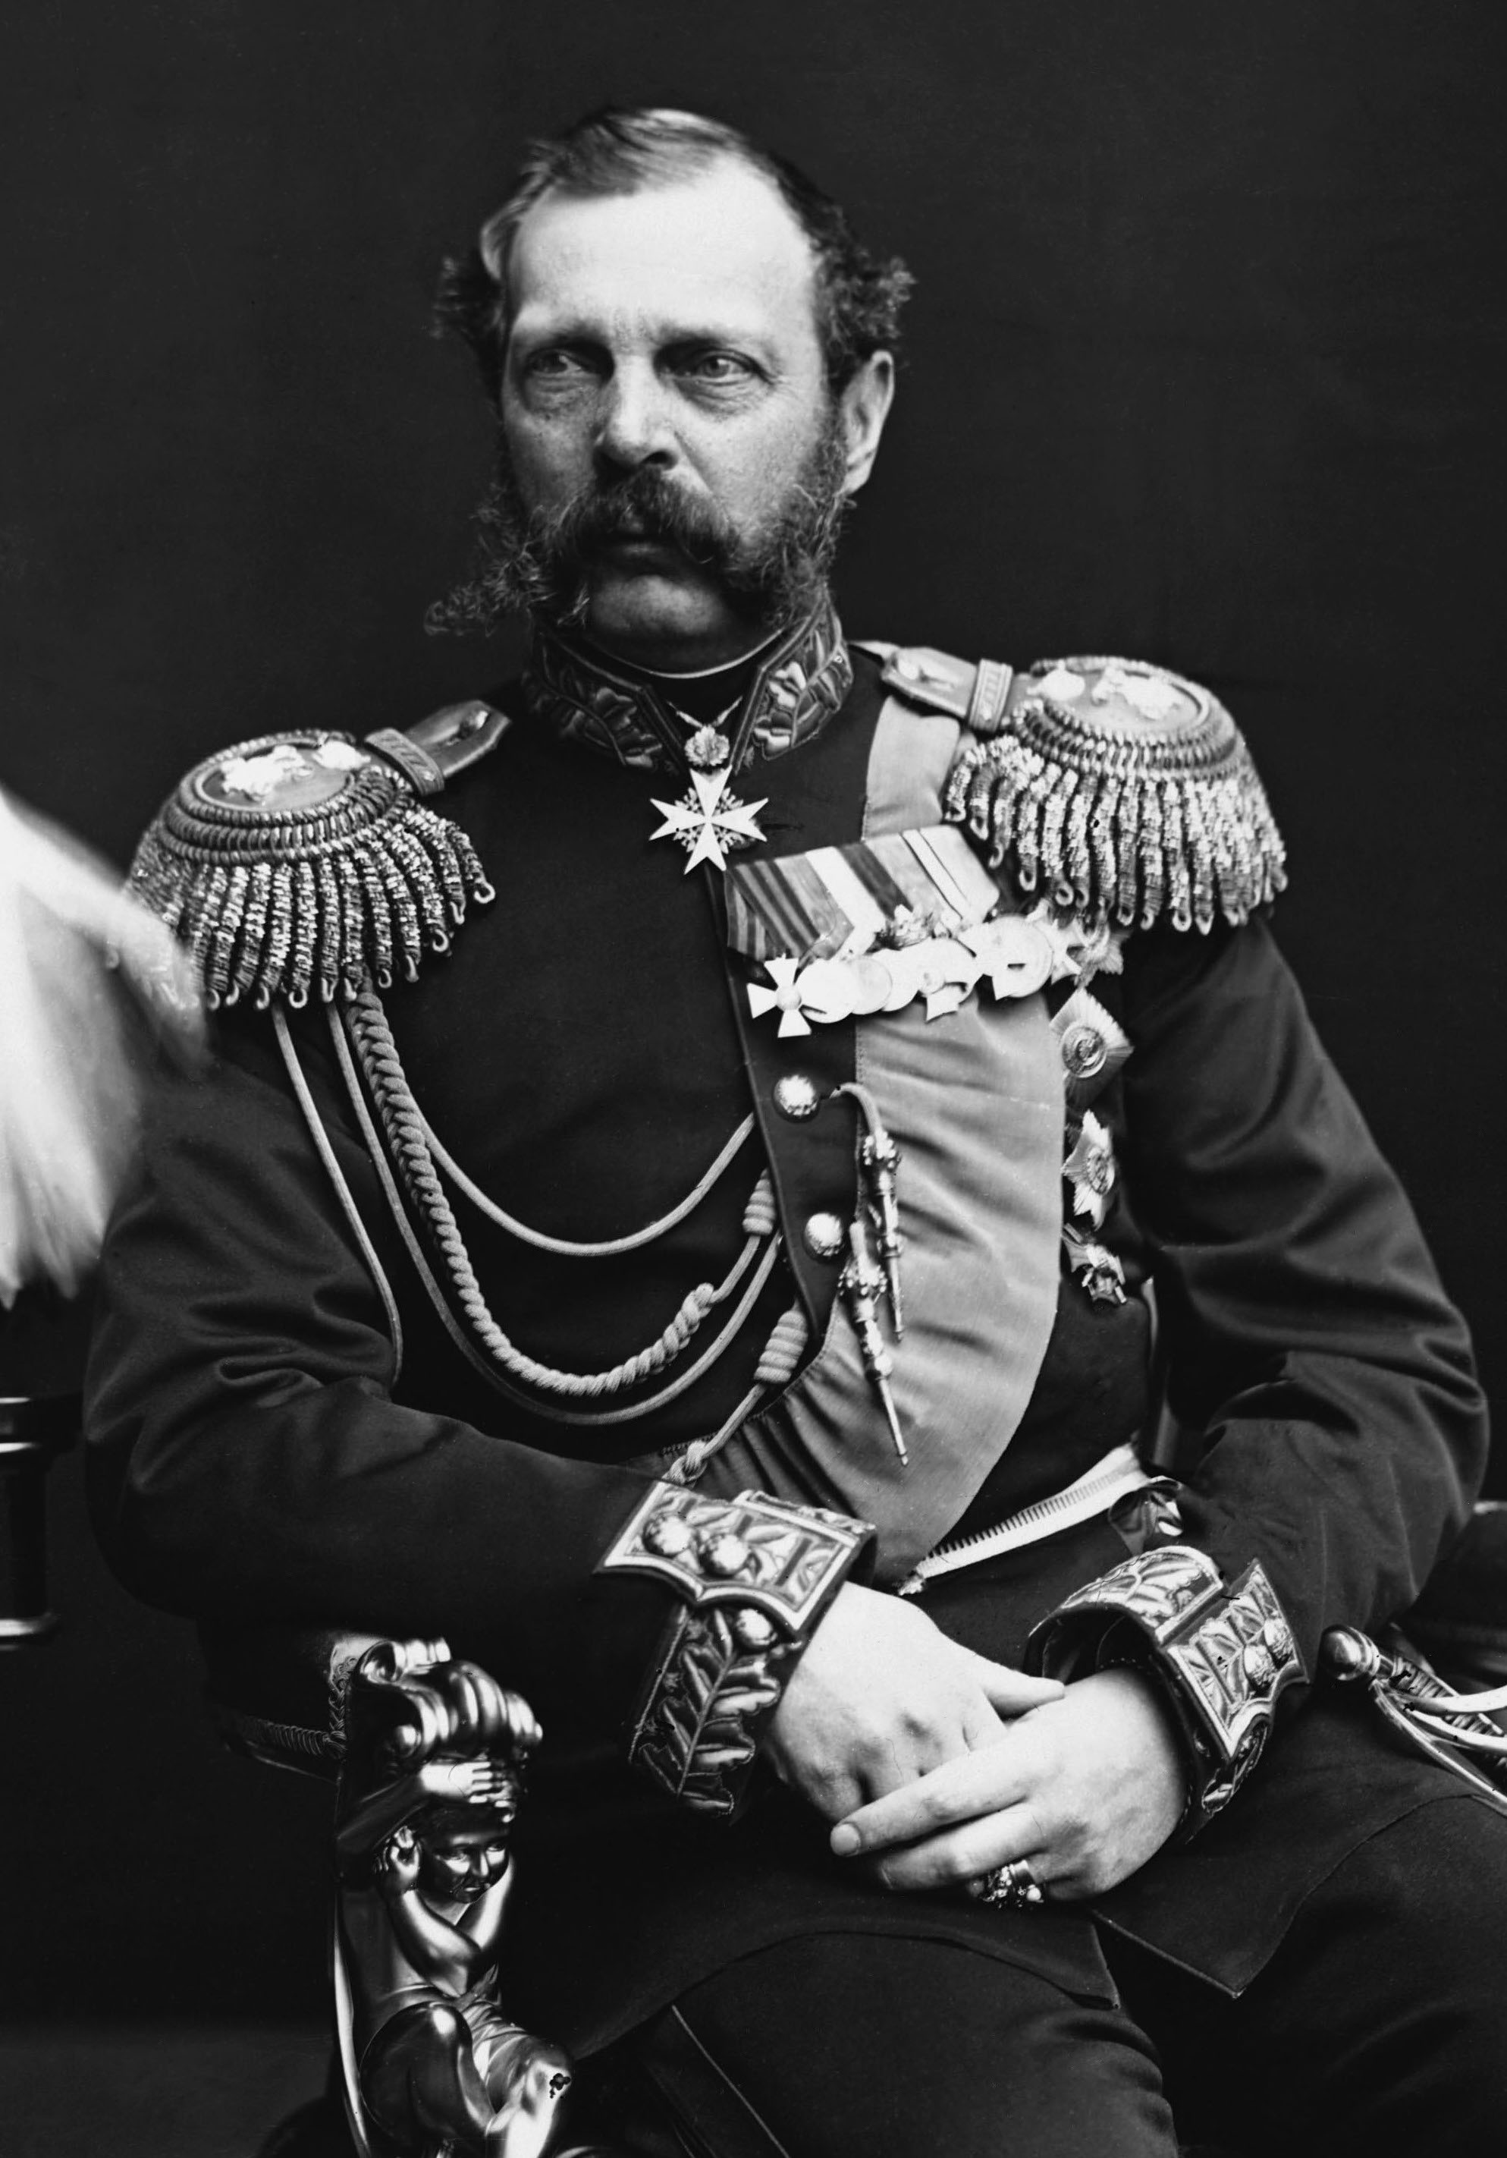

Slide 9
Fighting The War
Most of the war was fought on the Crimean peninsula in the Black Sea.
Over 50,000 British and French troops fought in the Crimea against Russian forces, seeking to take the Black Sea port city of Sebastopol.
Florence Nightingale (1820-1910)
British nurse who became a pioneer in modern nursing
During the Crimean War more men died of disease rather than by combat wounds.
Nightingale’s “Light Brigade” superbly tended to wounded men during the war, although fatalities due to disease remained high.

Slide 11
Peace of Paris
Russia emerged as the big loser in the conflict.
Russia no longer had control of maritime trade on the Danube
had to recognize Turkish control of the mouth of the Danube
renounced claims to Moldavia and Wallachia (which later became Romania).
Aftermath
Russia was shocked that it had fallen so far behind in military power.
Russia began its move toward industrialization and modernization of its army.

Slide 12
Second French Republic (1848-1852)
Constitution: unicameral legislature (National Assembly); strong executive power; popularly-elected president
Universal male suffrage
President Louis Napoleon
He was dedicated to law and order, opposed to socialism and radicalism, and favored the conservative classes—the Church, army, property-owners, and business.
In return for the support of conservatives, Louis Napoleon had to make concessions.

Slide 13
Concessions
Falloux Laws: Louis Napoleon returned control of education to the Church (in return for its support).
He minimized influence of the Legislative Assembly.
He supported policies favorable to the army.
He disenfranchised many poor people from voting.
He destroyed the democratic-socialist movement by jailing or exile its leaders and closing down labor unions.
The National Assembly did no grant Louis a second term
He decides to plot a coup and declare himself emperor

Slide 15
The Second French Empire (Liberal Empire )
Napoleon III took control of the gov’t in coup d’etat (December 1851) and became emperor the following year.
He restored universal suffrage in 1852 and 92% of the people voted to make him president for 10 years.
France was the only country in Europe at that time to provide universal suffrage.
1851-1859: Napoleon III’s control was direct and authoritarian.
1859-1870: Napoleon III set out to build the “liberal empire” by initiating a series of reforms

Slide 16
Reforms Under Napoleon III
Economic reforms resulted in a healthy economy.
Railroads, canals, and roads
Movement towards free trade
Political reforms
Napoleon III extended the power of the Legislative Assembly.
He returned control of secondary education to the government (instead of the Catholic Church).
He permitted trade unions and their right to strike (1864).
He eased censorship and granted amnesty to political prisoners.

Slide 17
Failures of Napoleon III
Napoleon III was not skilled in foreign policy
His involvement in the Crimean War angered many republicans and Liberals alike
He had issues in French colonies of Algeria and Indochina
French intervention in Mexico became a hotly debated topic (lead to the Second Mexican Empire)
The Franco-Prussian War (1870-71) and capture of Napoleon III resulted in the collapse of the Second French Empire.

Slide 18
Italian Unification
After collapse of the Revolutions of 1848-49, the unification movement in Italy shifted to Sardinia-Piedmont under King Victor Emmanuel, Count Cavour and Garibaldi.
Count Camillo Benso di Cavour (1810-1861) of Sardinia-Piedmont led the struggle for Italian unification.
He served as King Victor Emmanuel’s prime minister between 1852 and 1861.
He guided Sardinia-Piedmont into a liberal and economically viable state.
Molded after the French constitution of 1830
Cavour sought unity for the northern and central areas of Italy.
Obtained through war with Austria and negotiations with Napoleon III

Slide 19
Giuseppe Garibaldi (1807-1882) liberated southern Italy and Sicily.
In May 1860, Garibaldi and his thousand Red Shirts landed in Sicily and extended the nationalist activity to southern Italy.
By September, Garibaldi took control of Naples and the Kingdom of the Two Sicilies.
Although Cavour distrusted Garibaldi, Victor Emmanuel II encouraged Garibaldi’s exploits in the south of Italy.
Garibaldi thus allowed his conquests to be absorbed into Sardinia-Piedmont
In February 1861, Victor Emmanuel was declared King of Italy and presided over an Italian Parliament which represented all of Italy except for Rome and Venice
Venice was added in 1866 and Rome in 1871

Slide 20
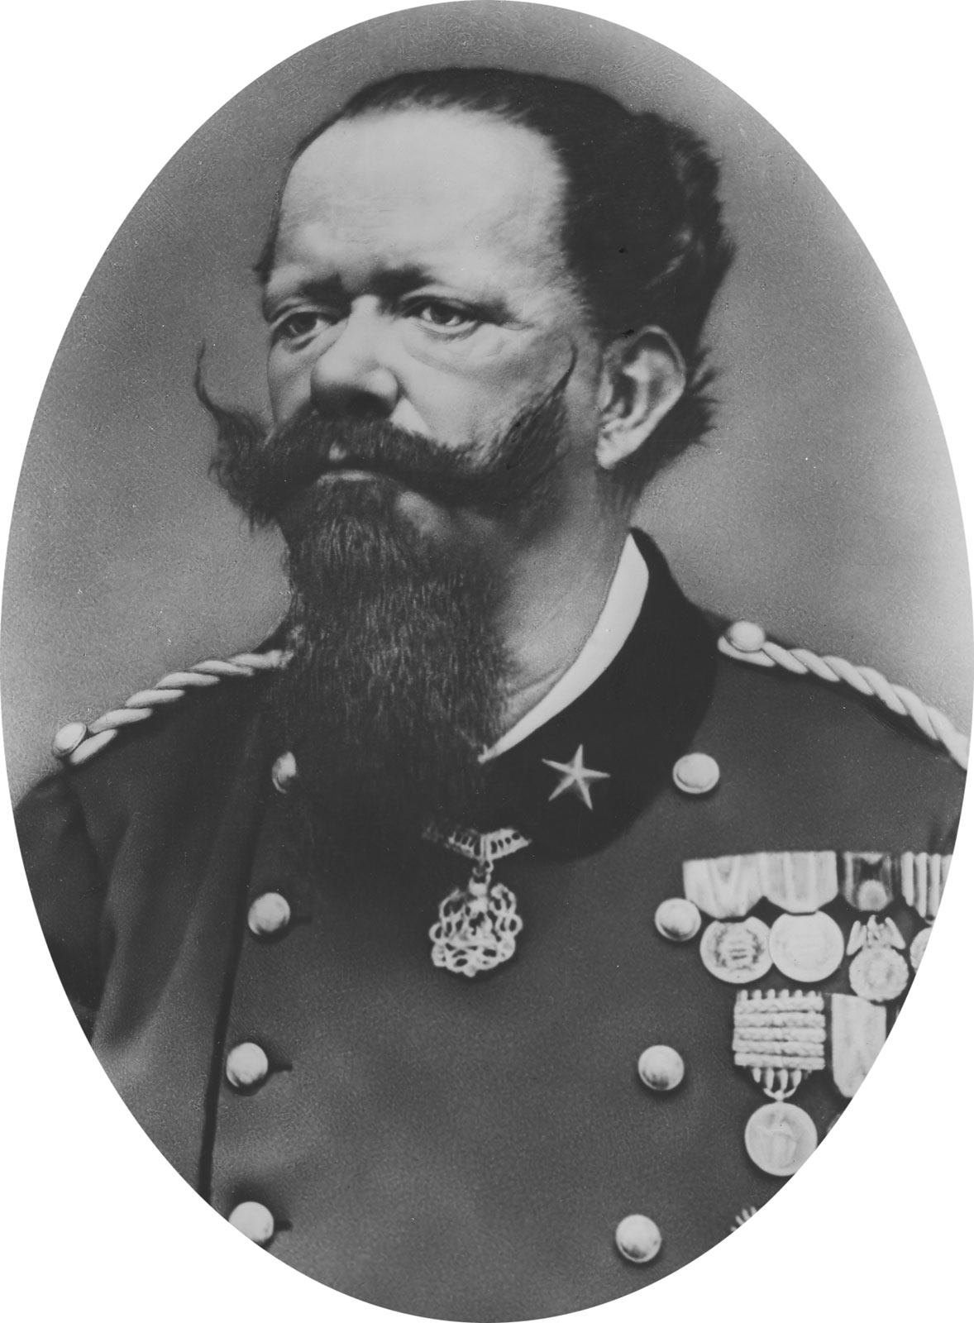
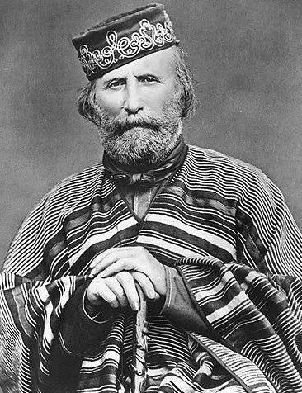

Slide 21
German Unification
German unification was primarily orchestrated by the Hohenzollern family (Dukes of Prussia)
Kleindeutsch plan": The idea for a unified Germany without Austria was seen as the most practicable means of unification among various German states, particularly Prussia.
Otto von Bismarck (1810-1898) led the drive for a Prussian-based Hohenzollern Germany.
Junker background; obsessed with power
"Gap theory" gained Bismarck's favor with the king.
Since the king had granted the constitution, Bismarck insisted he ignore liberals (middle class) in the legislature and follow his own judgment.
“The great questions of the day will not be decided by speeches and resolutions—that was the blunder of 1848 and 1849—but by blood and iron.”

Slide 22
Between 1863 and 1866 Germany fought two wars with Denmark and Austria in order to gain territory
Much of Germany was unified after the1866 defeat of Austria
In 1867, the North German Confederation was established by Bismarck with King William I as president.
It included all the German states except Baden, Wurttemberg, Bavaria, and Saxony.
The parliament (Reichstag) consisted of two houses that shared power equally.
The upper house (bundesrat) included representatives from each state.
The lower house (bundestag) had representatives elected by universal male suffrage

Slide 24
Franco-Prussian War (1870-1871)
Bismarck sought to provoke a war with France in order to further unify Germany and annex Alsace and Lorraine.
Thus, Bismarck boasted that a French diplomat had been kicked out of German
An infuriated France declared war against Germany.
Bismarck used the war with France to bring the four remaining southern German states into the North German Confederation
Paris fell to the Germans in January, 1871: Napoleon III was captured.
Treaty of Frankfurt (May 1871): Alsace and Lorraine were ceded to Germany.
The German Empire was proclaimed on January 18, 1871 (Germany was now the most powerful nation in Europe).

Slide 25
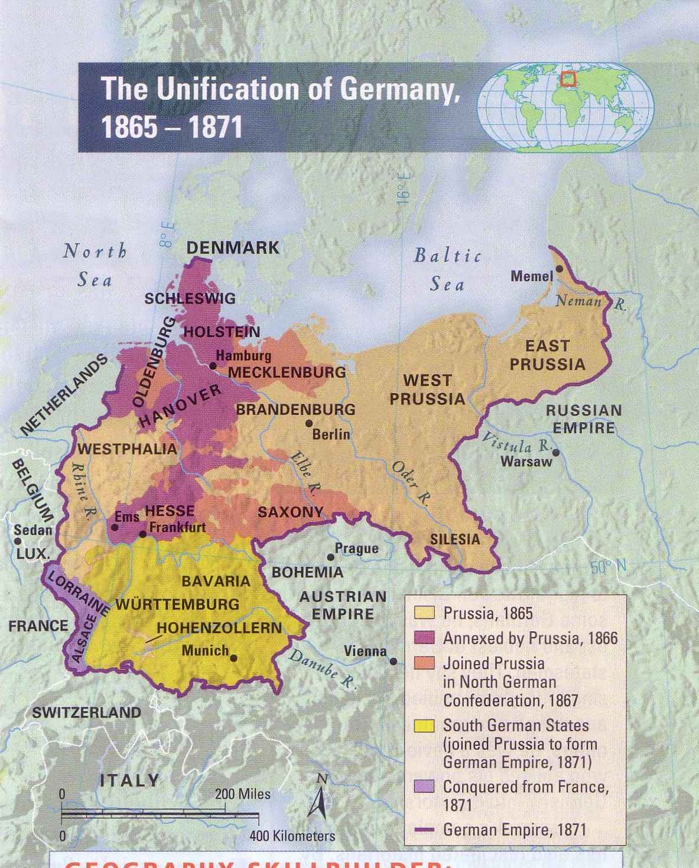

Slide 26
The Austro-Hungarian Empire
Austria’s defeat by Germany in 1866 weakened its grip on power and forced it to make a compromise and establish the so-called dual monarchy.
Ausgleich (or Compromise), 1867
Officially created the Austro-Hungarian Empire
Hungarians now had their own assembly, cabinet, and administrative system, and would support and participate with Austria in the Imperial army and in the Imperial gov’t.
Results
Austria assimilated the Hungarians (Magyars) and nullified them as a primary opposition group.
It also led to more efficient gov’t.

