Slide 1
The Age of Exploration
Spanish and Portuguese

Slide 2
reasons For Exploration
The fall of Constantinople in 1453
led to a search for new trade routes by the Europeans.
Developments in technology helped make exploration possible.
Caravel- new type of ship. Sturdier and faster (more sails)
Astrolabe- could calculate latitude made sailing easier both day and night

Slide 3
Religion-
Europeans wanted to spread Christianity to parts of the globe
Trade:
Europeans were looking for places to gain wealth
Spices, gold, silver, slaves, fine cloth, porcelain
Three G’s
God, Gold, Glory

Slide 4
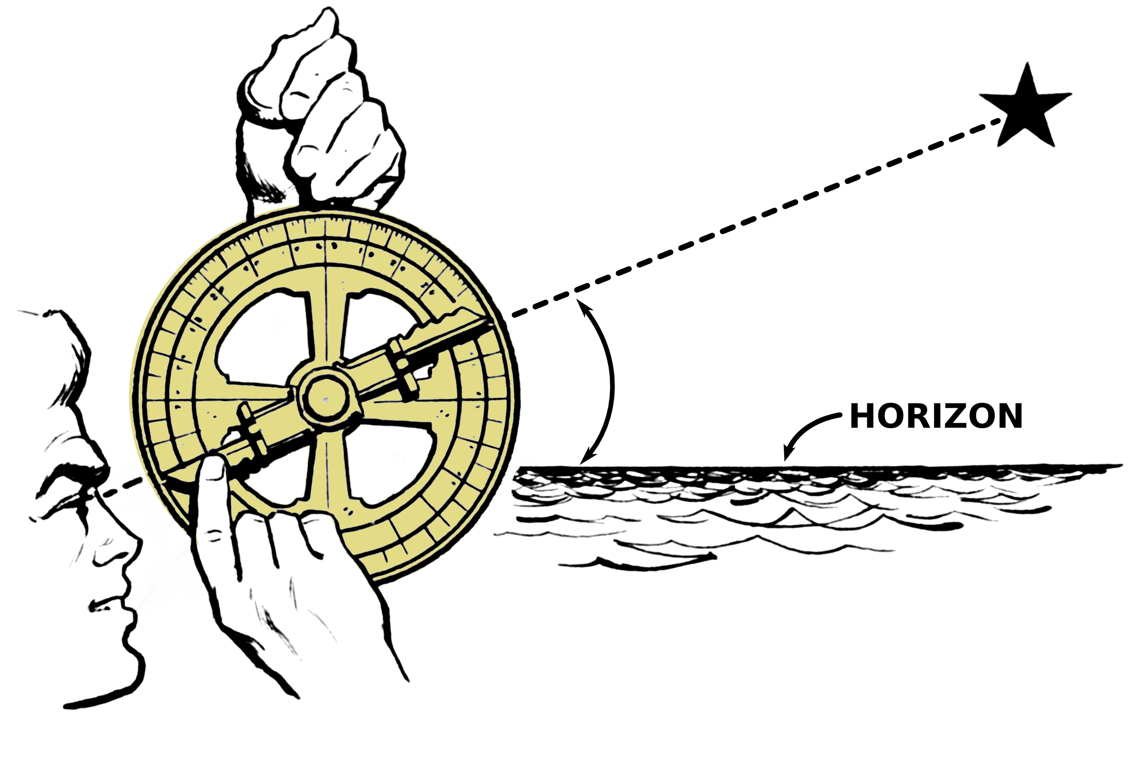
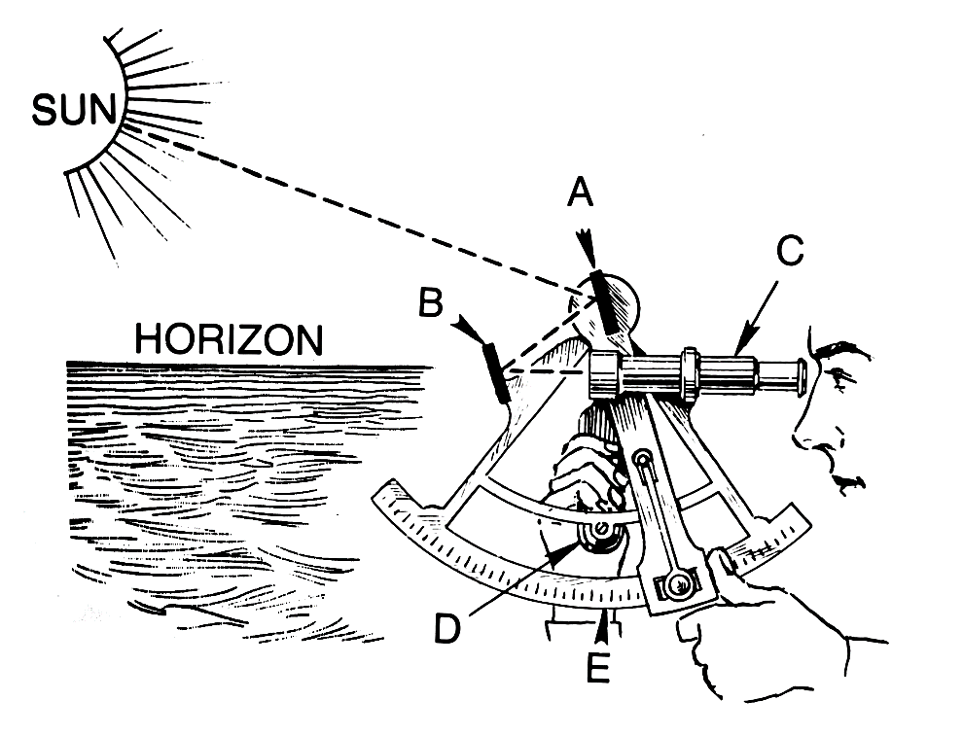
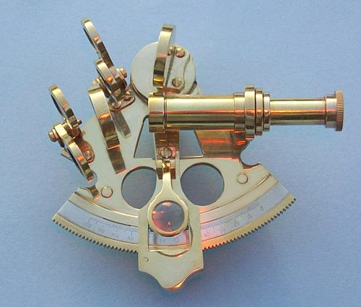
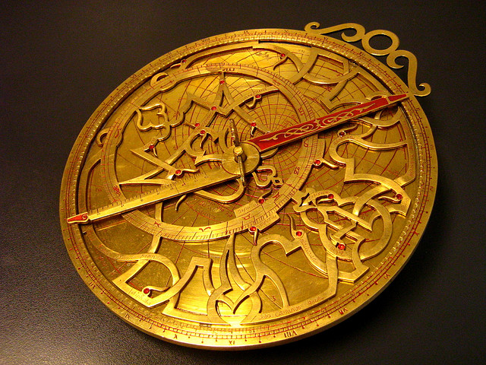

Slide 5
Three Stages of Exploration/ Conquest
First stage, 1492-1570
Foundations
Second Stage, 1570-1700
New society, institutions take shape
consolidation
Third stage, 1700s
Reform & reorganization Spanish America & Portuguese Brazil
Discontent & revolts

Slide 6
Portuguese Lead the Way
Late 1300s- Europeans had reached the Canary Islands off the west coast of Africa
Prince Henry (1394-1460) “Henry the Navigator”
Founded a sailing school to teach others how to sail
Led raids along the North African and West African coast
By 1434 Portuguese had sailed around the cape.
1444- dispatched 6 caravels to the east coast of Africa to bring slaves back to Europe

Slide 7
1487- Bartholomew Dias rounded the Cape of Good Hope at Africa’s Southern tip
1497- Vasco da Gama reached India and found spices such as pepper, cinnamon, rare silks, and precious gems.
gave the Portuguese a direct sea route to India

Slide 8
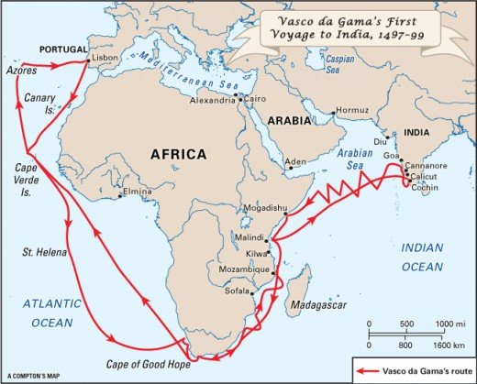
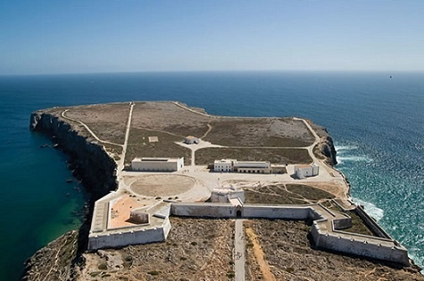
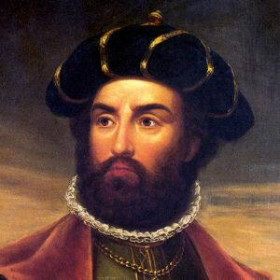

Slide 9
Spanish Join the Race
Isabella and Ferdinand spur on Spanish exploration and conquest
1492 Spanish monarchy funds Columbus’s voyages.
Christopher Columbus:
Sails from Granada in August of 1492 and arrives in the Bahamas in October of the same year.
The Spanish had “discovered” the Americas
He makes 4 voyages in total

Slide 10
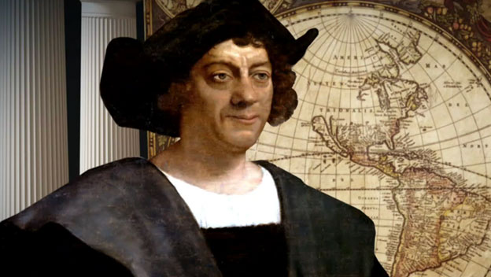
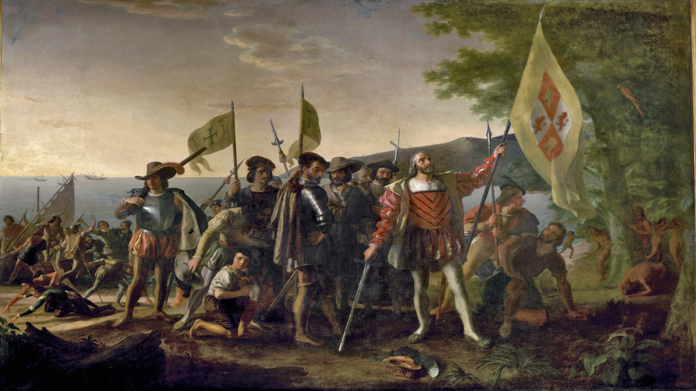

Slide 11
Treaty of Tordesillas (1494)
Spanish and Portugal agree to divide the world amongst themselves.
Negotiated by the Pope
Spanish get the lands west of the demarcation line and Portugal the lands to the east

Slide 12
Important Explorers
1510 – 13 Vasco de Gama, Panama and the Pacific Ocean
1511- Juan Ponce de Leon reaches Florida searching for the fountain of youth
1519- Ferdinand Magellan, sailed (circumnavigated) around the world. He dies on the voyage.
1524- Giovanni da Verrazzano, New York Harbor
1540- Francisco de Coronado, Southwestern U.S.
1540- Hernando de Soto explores the Southeastern U.S. He dies on the journey.

