Slide 1
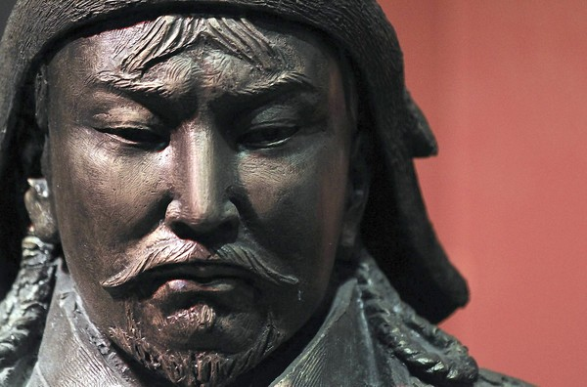
The Mongols
Notes:
To change the image on this slide, select the picture and delete it. Then click the Pictures icon in the placeholder to insert your own image.

Slide 2
Introduction
The Mongols were a pastoral nomadic people
From central Asia
Organized around families, clans, and/or tribes
Lived in small villages with kinfolk
Moved based on seasonal changes
Took their homes with them

Slide 3
Mongol Women
Pastoralists offered women a higher status in society
Fewer restrictions
Greater role in public life
Involved in productive labor
Mongol women:
Could initiate divorce
Could remarry if widowed
Served as political advisors
active in the military

Slide 4
Military Interactions
Nomadic states had military advantages
Horseback riding and hunting skills
Entire male population and many females trained in these skills
Mongols developed the stirrup to help a rider stay on the horse
Used their militaries to extract wealth from larger civilizations through raiding, trading, and extortion

Slide 5
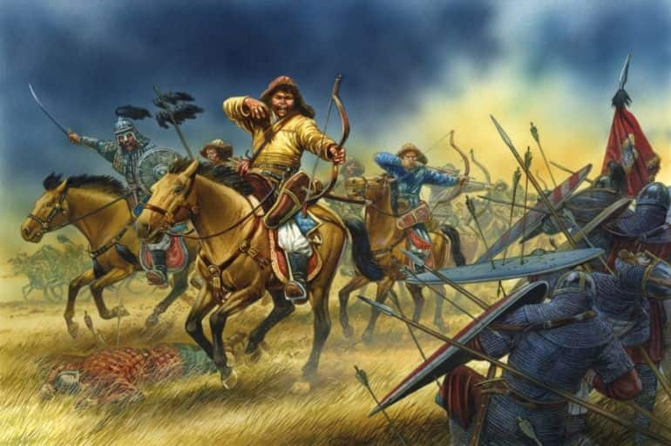
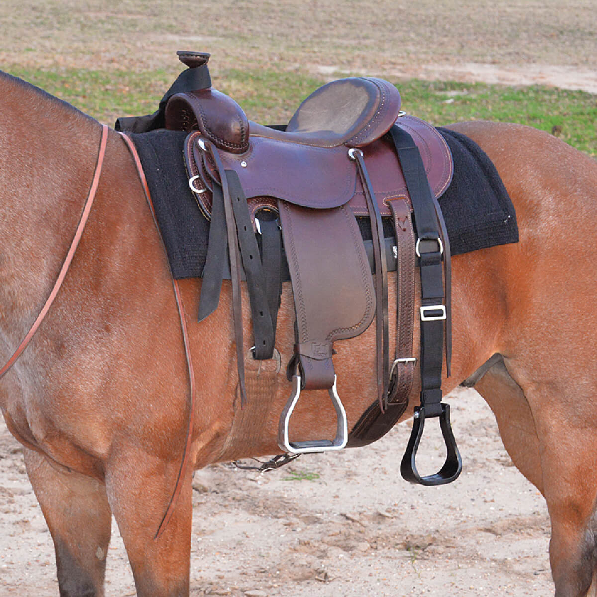

Slide 6
The Mongol Empire
Largest land-based empire in world history
Stretched from the Pacific coast of Asia to Eastern Europe
Brought the major civilizations of Eurasia (Europe, China, and the Islamic world) into more direct contact
One major contribution = facilitated worldwide networks of exchange and communication
No real cultural impact
Did not spread any major religion
Did not spread their language or culture

Slide 7
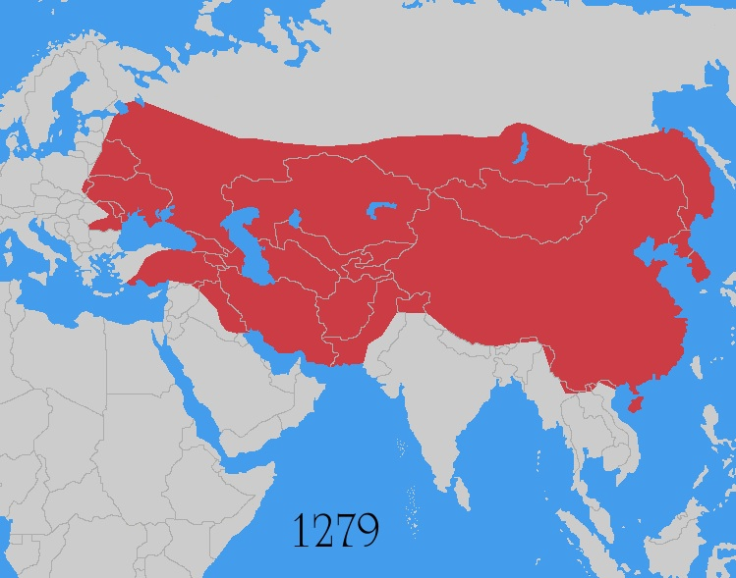

Slide 8
Genghis
United and led the Mongols
Used shifting tribal alliances and betrayals
military victories
Used his reputation as a leader generous to friends and ruthless to enemies
Incorporated warriors from defeated tribes into his own forces
In 1206 the kurlitai recognized Genghis as the Khan
Means “universal” or “supreme” ruler

Slide 9
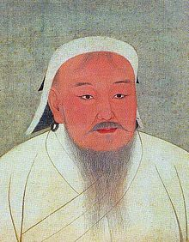

Slide 10
Mongol Expansion
Two major reasons for expansion
The newly united Mongols needed a common task or else they would fragment and fall apart
needed external resources with which to reward followers
Conquests continued for about 50 years under Genghis Khan
China was #1 goal
1227- Genghis dies and his empire is split into 4 Khanates ruled by his 3 sons and grandson

Slide 11
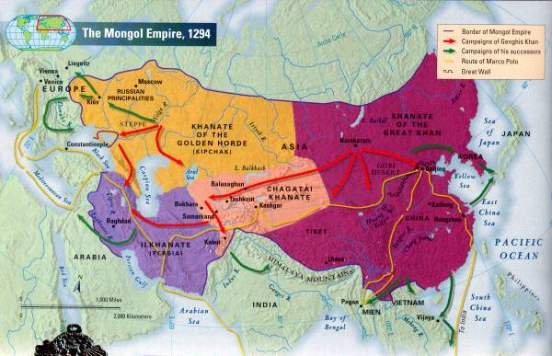

Slide 12
Mongols and Russia
Golden Horde – khanate that controlled Russia
Invaded most of Russia
Tartars- Russia name for the Mongols
Major cities destroyed
Saint Sophia Cathedral spared because the Mongols were tolerant of religions

Slide 13
Mongols in China
The Mongols conquered the Song Dynasty (first defeated the Jin Kingdom)
The Khanate of the Great Khan
Led by Kublai Khan
Established the Yuan Dynasty in China

Slide 14
Marco Polo
Merchant from Venice, Italy
Served as an administrator to Kublai Khan for 17 years
Kept a diary of everything he encountered and experienced
Primary way in which Europeans learned about the east

Slide 15
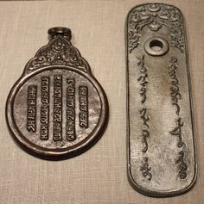
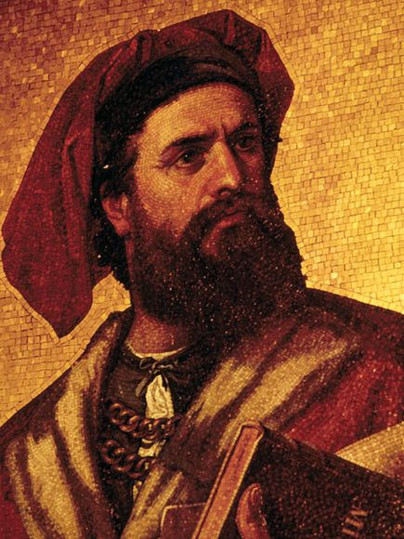
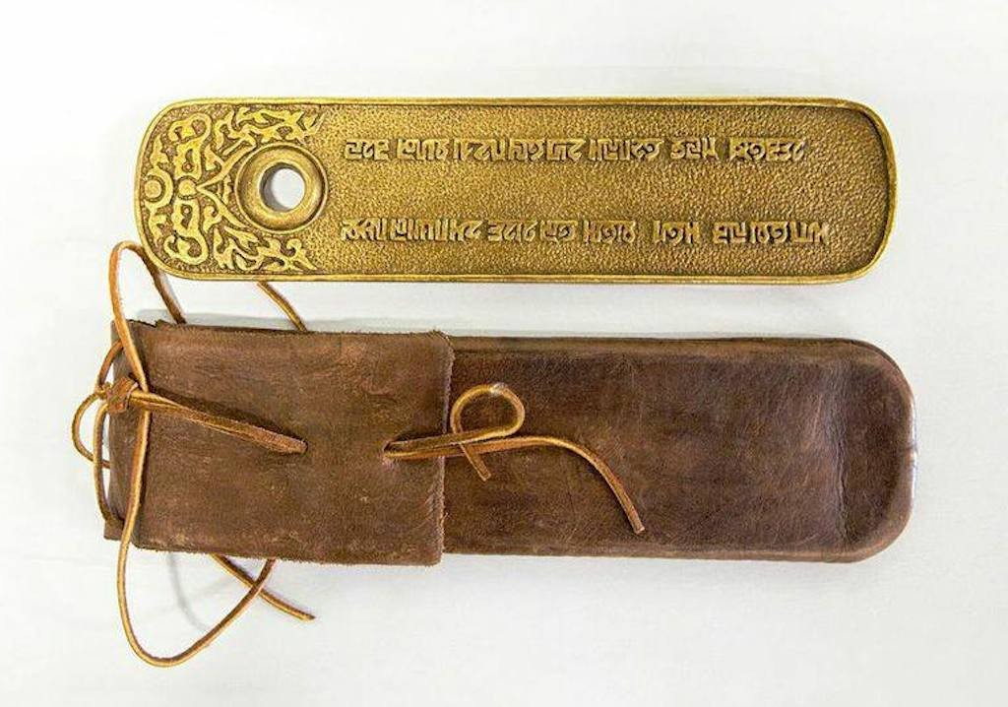

Slide 16
Legacy
Total religious toleration → as long as religion wasn’t the cause of political opposition
Major religions throughout the Mongol Empire = Buddhism, Christianity, Islam, and Daoism
The Mongols also helped spread the Plague (Black Death) on their conquest westward.

