Slide 1
The Islamic Empires the Safavid Empire

Slide 3
The Shi’a Challenge of the Safavids
The Safavid dynasty was established in the 14th century.
Sunni Ottomans and Shi’a Safavids rivals
Sufi preachers
Sail al-Din (leader) led a campaign to purify and reform Islam
Red Heads (followers) grew large in numbers
Isma’l becomes shah in 1501

Slide 4
1514 Ottomans defeat Safavids in Chaldiran
put an end to Isma’il’s westward expansion
Shi’a Muslims become mostly concentrated in Persia

Slide 5
Politics and War Under the Safavid Shahs
Tahmasp I becomes shah (1524-1576)
Attempts to restore the dynasty’s power
Foils Turkic chiefs to assume power
Abbas I (1588-1629)
“Abbas the Great”15-24-15
Dynasty reached the height of its strength and prosperity
Persians become bureaucrats
Used captured Russians as “slave” regiments
Moved the capital to Isfahan

Slide 6
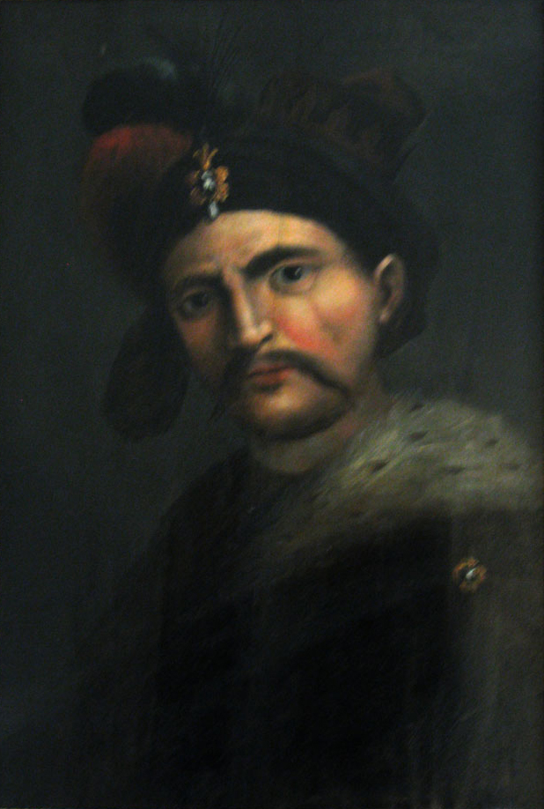

Slide 7
State & Religion
Adopt Persian language and customs after Chaldiran
Shahs claim to descend from one of the Shi’a imams (successor of Ali)
Mullahs
Local mosque officials and prayer leaders
Teachings/prayer were planned and directed by state religious officials
Sunni Muslims, Jews, Christians, Zoroastrians, and followers of Sufi preachers pressured to convert

Slide 8
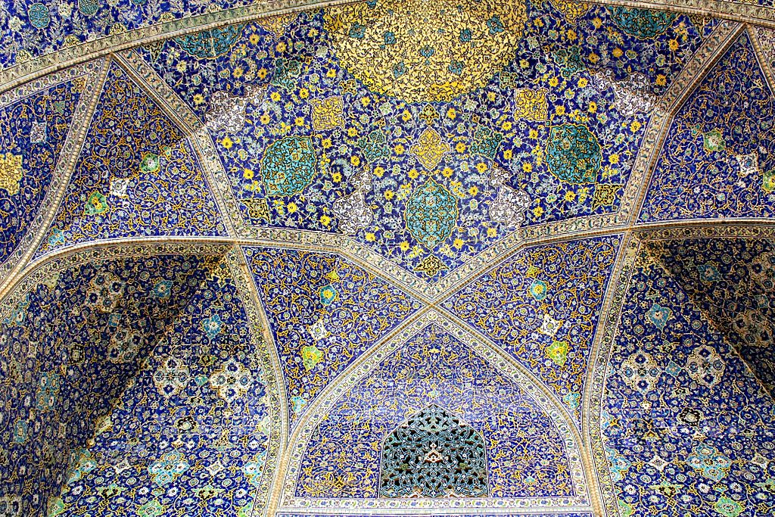
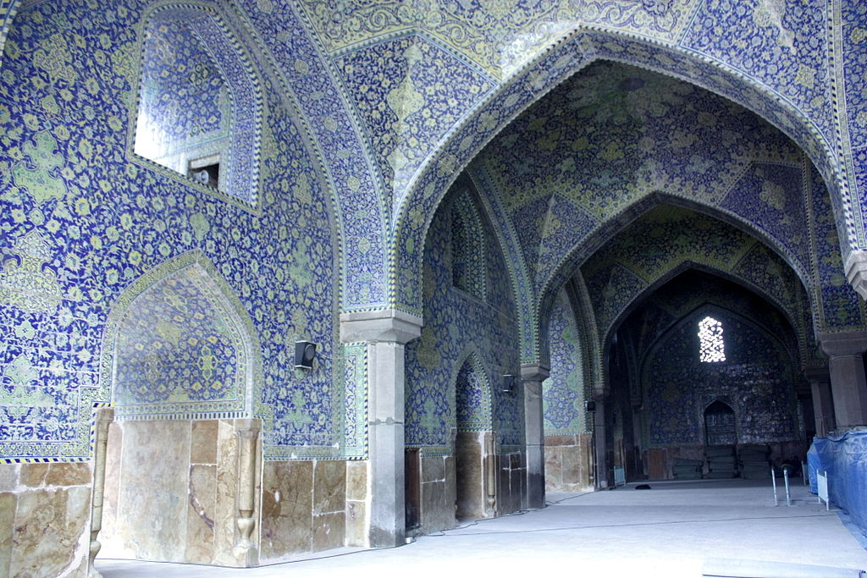

Slide 9
The Demise of the Safavid Empire
Rapid decline after Abbas I died
Grandson becomes shah
Manipulated by state officials
Factional disputes and rebellions cause internal weakness
Invasions by nomadic raiders, Ottoman & Mughal armies
Afghani tribes besiege Isfahan in 1722 and the Safavid power ends
Nadir Khan Afshar restores Safavid dynasty in 1736
Short lived dynasty
Less territory

