Slide 1
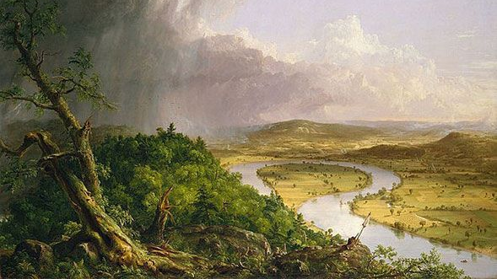
Romanticism

Slide 2
Origins
Began as a movement against the developments of the 18th and early 19th centuries
These include:
The enlightenment
Industrial Revolution
Urbanization
Progress
The movement included art, literature, and music

Slide 3
Values of the Romantics
Nature
Childhood
Emotion
Religion
Romance (Love)
Nostalgia (particularly the Middle Ages)

Slide 4
Enlightenment v. Romanticism
Enlightenment
Reason
Human Nature
Man Over Nature
Forward Thinking
Anti Middle Ages
Middle Class
Romanticism
Passion/ Emotion
Nature
Nature Over Man
Backward Looking
Pro Middle Ages
Aristocratic

Slide 5
The Critique of Progress
Many romantics lamented the depopulation of the country sides as more people moved to cities or urban elites took from those in the countryside
Ex. Oliver Goldsmith
Others had criticism for the progress and the excesses of science.
Ex. Mary Shelley and Frankenstine

Slide 6
Landscapes and the Glorification of Nature
Many romantic artists enjoyed pairing landscapes
Often many humans take a back seat in romantic paintings

Slide 7
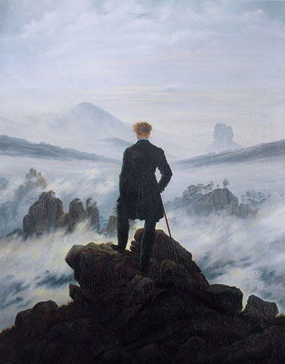
Wanderer Above the Sea of Fog (c. 1818) By: Casper David Friedrich

Slide 8
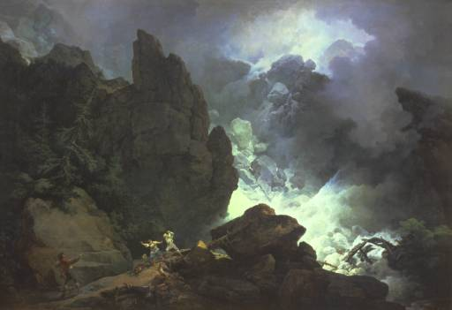
An Avalanche in the Alps (1803)
By: Philip James de Loutherourg

Slide 9
Sunset After a Storm On the Coast of Sicily (1853) By: Andreas Achenbach

Slide 10
New Technology
Another view some Romantics took was that the new technology of the Industrial revolution was dehumanizing.

Slide 11
Rain, Steam, Speed (1844) B: Joseph Mallord William Turner

Slide 12
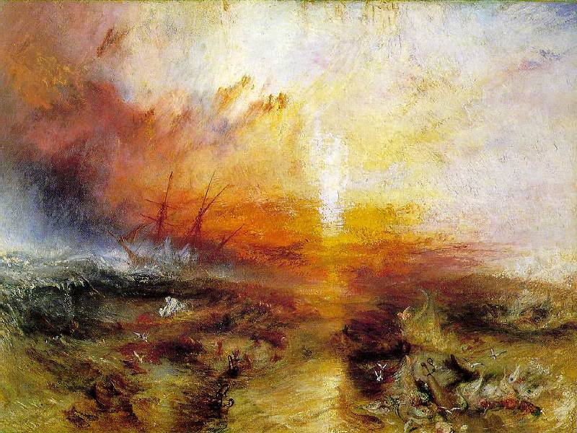
The Slave Ship (1842) By: Turner

Slide 13
Country Life
Many Romantics idealized the countryside and the life of those that lived there.

Slide 14
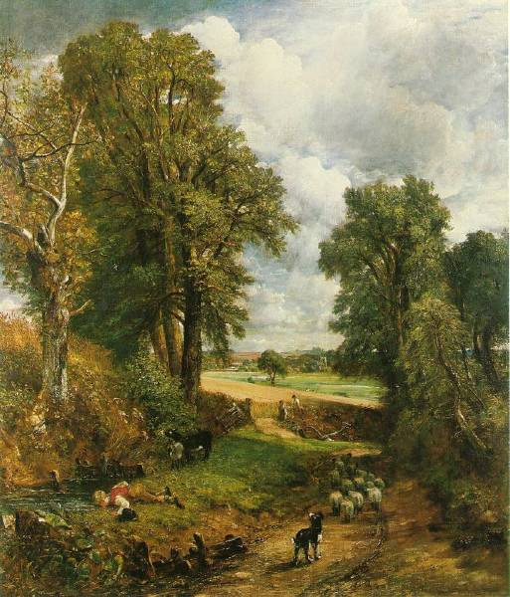
The Corn Field (1826) By: John Constable

Slide 15
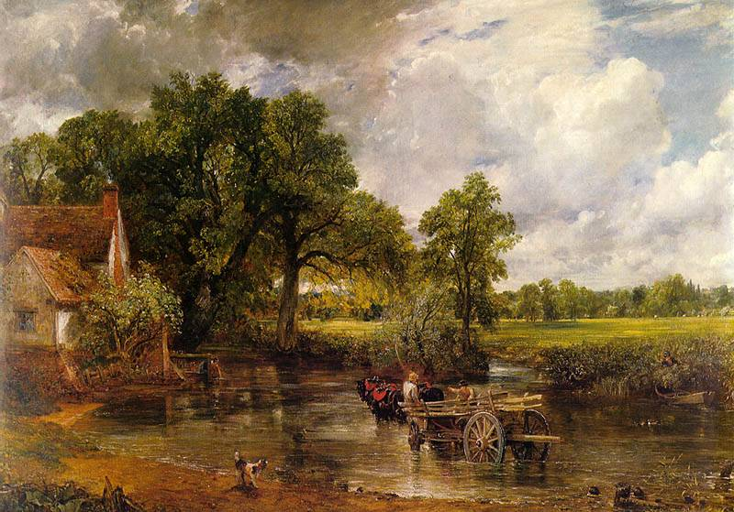
The Hay Wain (1821) By: John Constable

Slide 16
Romanticizing the Gothic/ Middle Ages
During the Romantic period there was a revival of gothic and Romanesque architecture
Medieval ruins became a favorite scene and subject

Slide 17
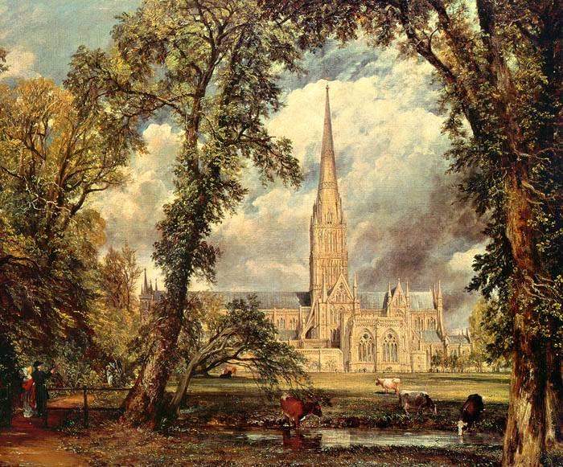
Salisbury Cathedral from the Bishops Ground (1825) By: John Constable

Slide 18
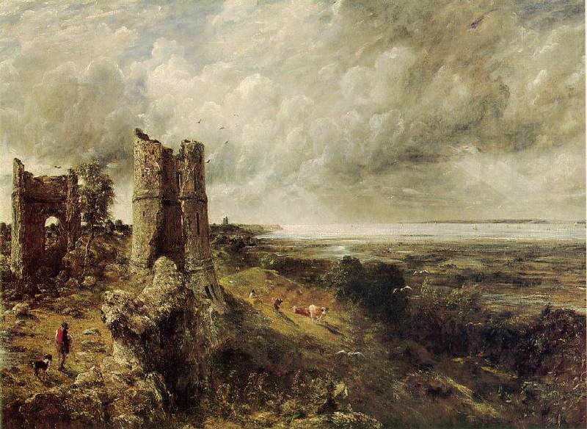
Hadleight Castle (1829) By: John Constable

Slide 19
Nationalism
Many Romantics used their art of literature to comment on political movements; particularly the revolutions of the 1830s and 1848.

Slide 20
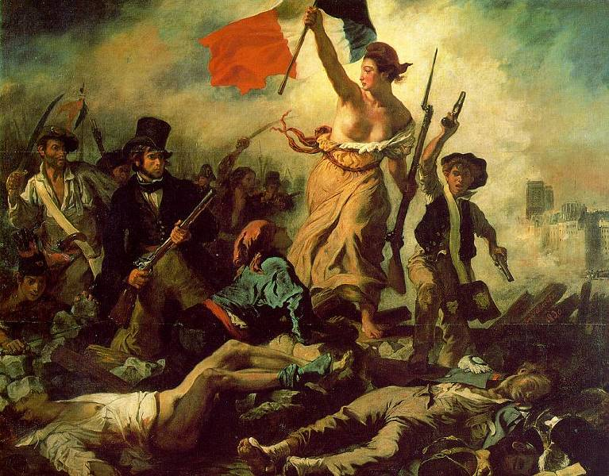
Liberty Leading the People (1830) By: Eugene Delacroix

Slide 21
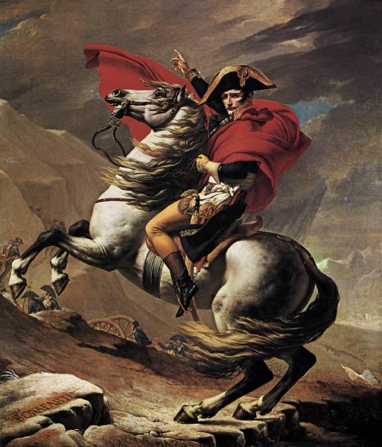
Napoleon at the St. Bernard Pass (1803) By: Jacques-Louis David

Slide 22
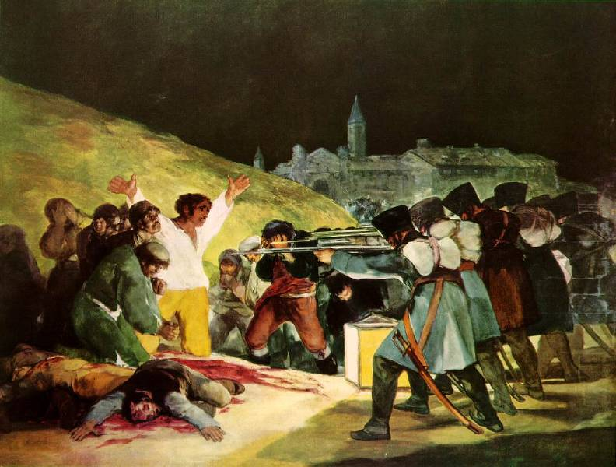
The Shooting of May 3, 1808 (1815) By: Francisco Goya

