Slide 1
Rise of Russia

Slide 2
Introduction
Russian rulers (tsars) used genealogy to claim their power to rule
They were descendants of Rurik (founder of Russia)
Based empire on Rome
Considered themselves the “Third Rome”
Ruler- leader of the church and divine mission

Slide 3
Expansionist Politics Under the Tsars
14th century Duchy of Moscow expelled Mongol (tartar) rule
Ivan III aka Ivan the Great
Organized strong army
Russia becomes an independent state
Territorial expansion
Orthodox Christianity

Slide 5
The Need for Revival
Russia had become purely agricultural under Mongol rule
Cultural & economic decline occur
Literacy decreases
Russia resumed earlier patterns of Russian life after independence
Ivan the Great
Restores traditional centralized rule
Asserts control of Orthodox churches
Calls Russia “Third Rome”
Tsar comes from Caesar

Slide 6
Ivan IV
Continues Russian expansion
Emphasized tsarist autocracy by killing boyars (nobles)
Becomes known as Ivan the Terrible

Slide 8
Patterns of Expansion
Expansion into central Asia
Into Siberia by 1500
Driven by desire to push back Mongols
Cossacks (peasants) recruited to settle new lands
Land grants/estates given to nobles & bureaucrats for loyalty
Slaves used
Trade with Asia increased
Islam tolerated

Slide 9
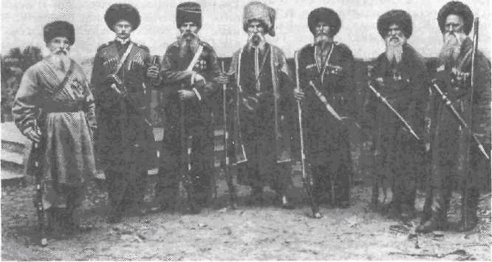
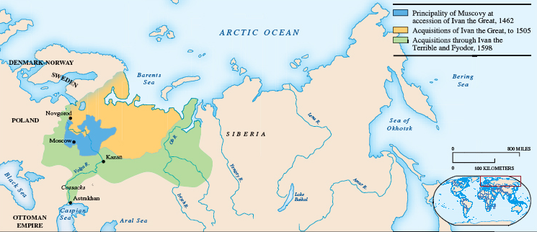

Slide 10
Western Contact and Romanov Policy
Contact with W. Europe occurred in order to improve Russia’s commercial & cultural disadvantages due to Mongol rule
Ivan III
Sent diplomats to leading Western States
Ivan IV
Begin trading with the British
Traded furs & raw materials for manufactured goods

Slide 11
Tsars import Italian artists & architects
Build Kremlin in Moscow
Time of Troubles
Ivan IV dies without an heir
Sweden & Poland attack
Boyars attempt to take power
1613 boyars choose Michael Romanov as the new Tsar

Slide 12
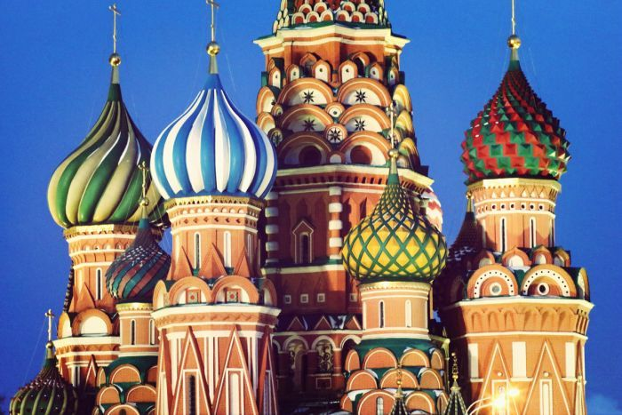
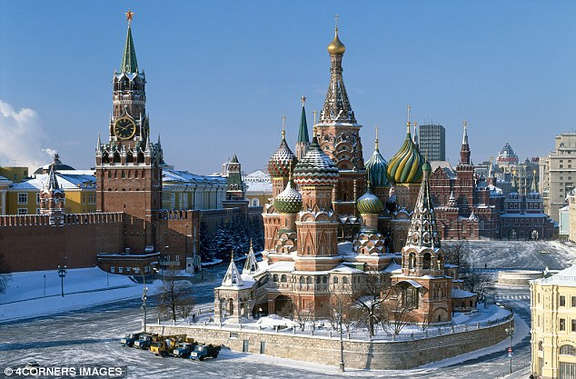
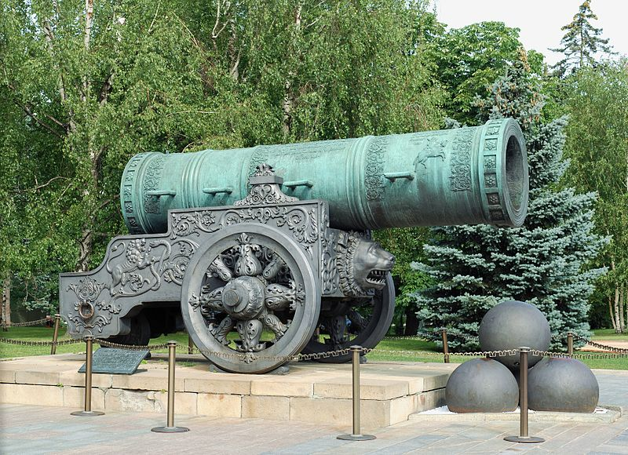
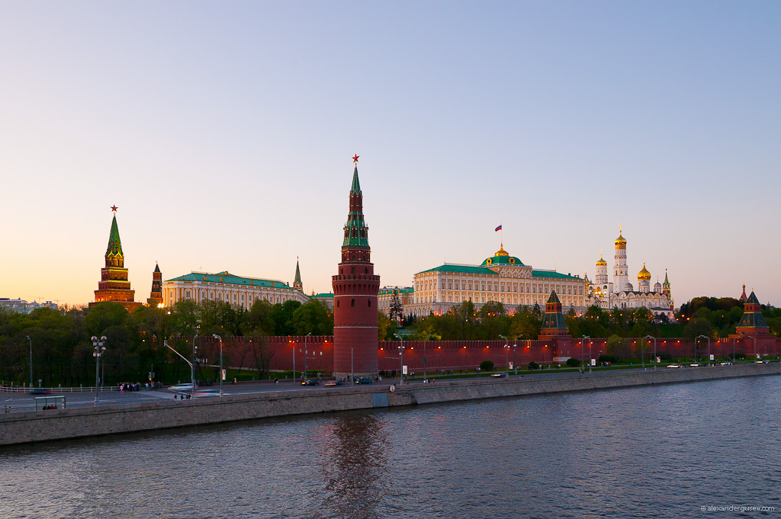

Slide 13
Romanov Dynasty rules until Russian Revolution in 1917
Michael Romanov
Restores order
Expels invaders
Resumes expansion
Ukraine
Boundaries extend to Ottoman Empire
Alexis Romanov
Abolish boyar assemblies
Gained power over church
Exile “Old Believers” to Siberia
Maintain their religion
Expand colonization

