Slide 1
Rise of Global Markets and Britain's Ascendency
18th Century

Slide 2
Mercantilism and the Atlantic Trading System
European maritime expansion in the 18th century
World trade became fundamental to the European economy.
Sugar became the most important commodity produced in the Atlantic trade; tobacco, cotton, and indigo were also important.
The slave trade was enormous.
Spain and Portugal revitalized their empires and grew economically from renewed development.
The Netherlands, Great Britain, and France benefited the most.
By far, England had the largest number of emigrants to the New World at this time

Slide 3
Characteristics of Mercantilism
Main goal: economic self-sufficiency
A country or empire sought to create a favorable balance of trade by exporting more than it imported.
Tariffs (customs duties) were placed on imports
Bullionism: governments sought to build up large reserves of gold and silver and prevent the export of these precious metals out of their countries.
Colonies provide raw materials (and markets) for the mother country.
States granted monopolies to large companies
States encouraged development of domestic industries so that a country would not have to buy a finished product from a rival country.

Slide 4
Great Britain
Became the world’s leading maritime power in the 18th century
The Bank of England (1694) provided an important source of capital for economic development
The Act of Union (1707) unified England and Scotland; the Scots sought the benefits of trade within the English empire
British mercantilism differed from France in that gov’t economic regulations often served the private interest of individuals and groups as well as the public needs of the state.
In contrast, authoritarian states like France sought an economic system that primarily benefited the state rather than businessmen and workers
For example, the intendant system was extende throughout the French empire.

Slide 5
Navigation Acts
Navigation Acts were passed by Parliament to increase military power and private wealth.
The first act was passed in 1651 seeking to reduce Dutch domination of the Atlantic trade.
It required most goods imported from Europe into Britain to be carried on British-owned ships with British crews or on ships of the country producing that specific good.
It gave British merchants and ship owners a virtual monopoly on trade with the colonies.

Slide 6
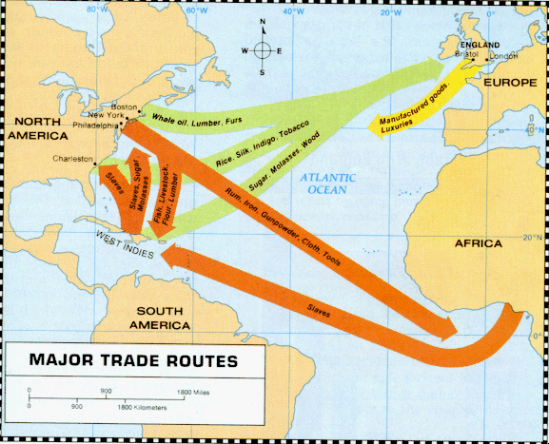
Triangular Trade
It revolved around the West Indies (Caribbean) and included North America and Africa.

Slide 7
The Dutch Republic
During the first half of the 17th century the Netherlands was the world’s dominant maritime power: “Golden Age of the Netherlands”
The middle class (burghers) dominated politics and the economy
The gov’t remained decentralized and didn’t impede the economy
A large degree of religious toleration enabled foreign merchants to live there without persecution.

Slide 8
The Anglo Dutch Wars
Between 1652 and 1674 three wars damaged Dutch shipping and commerce
New Amsterdam was seized by England in 1664 and renamed “New York.
By late-17th century, the Dutch were falling behind the England in shipping, trade, and colonies.
However, the English and Dutch became allies to stop the expansion of Louis XIV in the late-17th and early-18th centuries
Netherlands shifted its attention to banking, rather than trade, and managed to survive intact.
Creation of the central bank of Amsterdam and the Amsterdam markets

Slide 9
The Slave Trade
The dramatic growth in the Atlantic trade was due in large part to the need for labor in the New World colonies.
About 12 million Africans were transported to the New World in the 17th and 18th centuries.
Half of the slave trade occurred on British ships; 25% French
British and French governments gave chartered companies monopolies over the slave trade in the 17th and early 18th century
Forts (“factories”) were set up on the West African coast to oversee and protect the slave trade.
Independent slave traders broke the slave trade monopoly by the 1730s.

Slide 10
Most slaves were actually captured by rival African tribes who traded slaves for European goods such as cloth, alcohol and weapons
Many slaves captured in the African interior died on forced marches to the West African coast.
Between 1/5 and 1/3 of slaves died en route to the New World while on slave ships (the “Middle Passage”).
Most slaves were taken to Brazil or the West Indies, usually to work sugar plantations.
As many as 400,000 ended up in British North America in colonies such as Virginia, Maryland and South Carolina.
The slave trade dwindled significantly by the 1780s
Most of the subsequent increase in the New World slave population came from natural population growth.

Slide 11
Colonial Wars
Britain and France were the two main adversaries in the colonial wars for empire.
Between 1689 and 1783 both countries engaged in a series of wars over the issue of maritime trade and colonial expansion.
France had the largest army on land and was working to build up its naval forces.
France sought to support Spain.

Slide 12
War of Spanish Succession (1701-1713)
The prospect of the Bourbons (Louis XIV and his grandson) controlling both France and Spain (and their empires) became a major threat to Britain in North America
This would upset the balance of power in Europe.
Britain’s North American colonies would be surrounded by New France in the North and Spanish territory in Florida and in the West.
Treaty of Utrecht settled the war
France lost Newfoundland, Nova Scotia and the Hudson Bay territory to Great Britain.
Spain lost the asiento to Britain: the West African slave trade with the New World.
Spain agreed to allow one British ship of merchandise per year through Panama.

Slide 13
War of Jenkins’ Ear (began in 1739)
It started over the issue of Spain’s allegation of British abuse regarding the Treaty of Utrecht’s provision that allowed Britain to send one ship of merchandise to Central America per year.
Spanish officials boarded a British ship suspected of smuggling goods into Latin America and cut off the ear of Captain Jenkins, a British officer.
He kept his ear in a jar of brandy and presented it to Parliament 7 years later
In response, King George II went to war with Spain.
The conflict expanded into the War of Austrian Succession in 1740.

Slide 14
War of Austrian Succession (1740-1748)
It involved battles between England and France in North America and India.
Spain fought effectively in keeping its empire intact.
The Treaty of Aix-la-Chapelle (1748) essentially kept the status quo in the colonial empires.

Slide 15
Seven Years War (1756-1763)
Biggest world war of the 18th century
It began in the disputed Ohio Valley of North America when a young American officer, George Washington, engaged a French force protecting Ft. Duquesne (modern-day Pittsburgh) in 1754.
French forces (and their Amerindian allies) fought British and American colonial forces for control of North America.
This war became part of the larger Seven Years’ War in Europe.

Slide 16
Outcomes of the Seven years War
Britain’s navy defeated France’s navy in various engagements on the high seas.
France planned to invade Great Britain but its devastating naval losses ended such an attempt
France’s trade dropped to 1/16 of its prewar level.
France’s sugar trade with its West Indian colonies was choked off.
Britain took control of French posts in India.
Treaty of Pairs:
Most important peace treaty since Westphalia in 1648.
France was removed from North America.
France accepted British domination of India.
Spain ceded Florida to Britain in return for Cuba and the Philippines.
Britain becomes the world most dominate colonial power

Slide 17
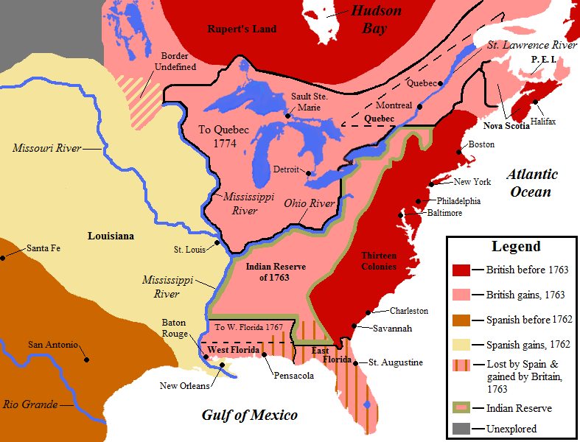
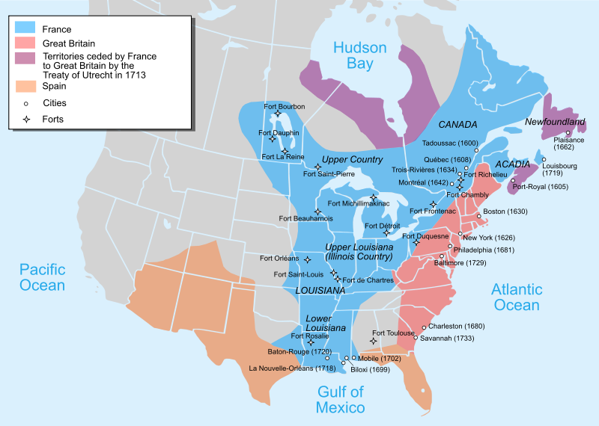

Slide 18
The American Revolution (1775-1783)
In hopes of weakening Britain’s world empire, France gave significant financial and military support to the United States in its successful war for independence.
The 13 American colonies had been Britain’s most valuable colonial possessions as both a source for raw materials and a large market for British goods.
By 1775, about 2.5 million people lived in the colonies (over 1.6 million from England alone).
By 1783 the American colonist (with aid from France) defeated Britain and settled the war at the Treaty of Versailles (1783)

Slide 19
European Rivals in Asia
By the second half of the 18th century European claims in Asia had increased and changed hands
The Portuguese, Dutch, French, Spanish, and British all had colonial claims in Asia
Portuguese claims in India
French in India (lost to Britain during the Seven Years War)
Spain in the Philippines
Dutch in Indonesia
Britain in India
The British East India Company and the Dutch East India Company were the greatest rivals in the spice trade. (The VOC dominated)

