Slide 1
Rise and Decline of the Abbasid

Slide 2
Background on Islam
Founded in 610 by Muhammad
Muhammad was a member of the Bedouin clan called the Umayyad
Received the revelations from the angel Gabriel
Considered by Muslims to the be the last prophet
622- Hijra
Muhammad and his followers flee from Mecca to Medina
Eventually he wins over his clan
Muslims begin to spread the religion via trade and conquest to North Africa, South Asia, and Europe
The Islamic world was ruled by a Caliph (political and religious leader)
Eventually the Umayyad were overthrown by a rival clan, the Abbasid

Slide 3
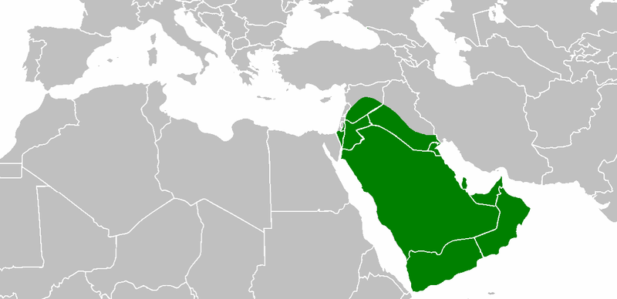
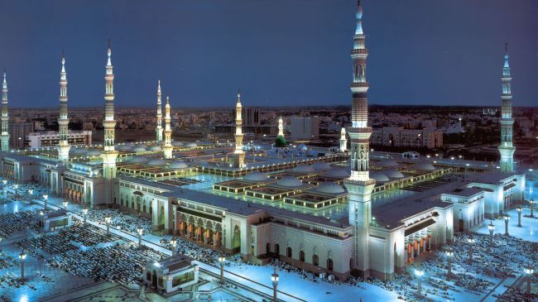
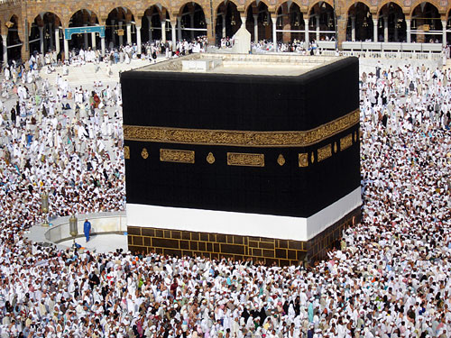
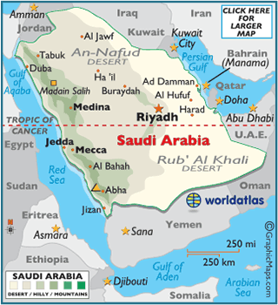
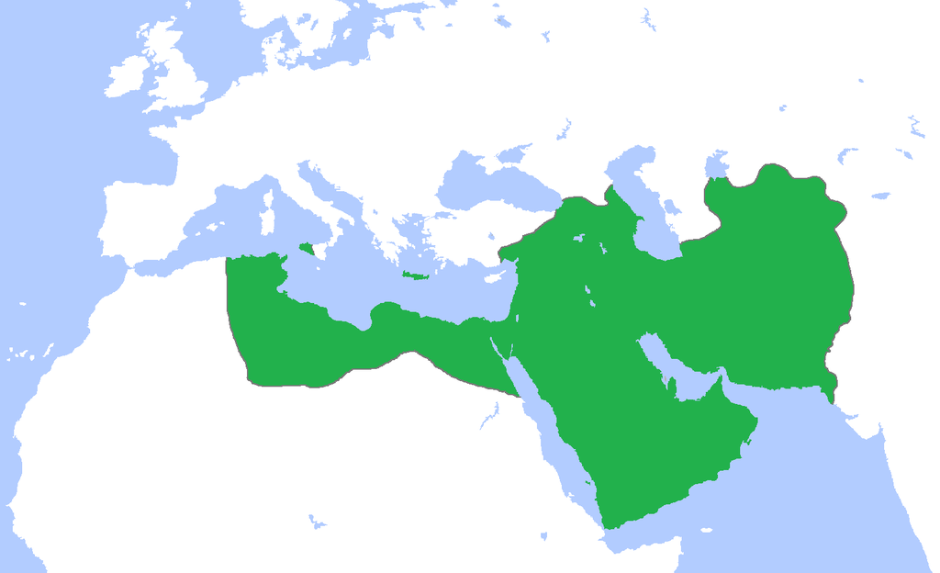
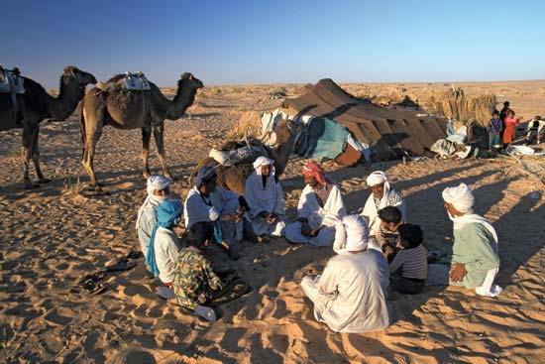
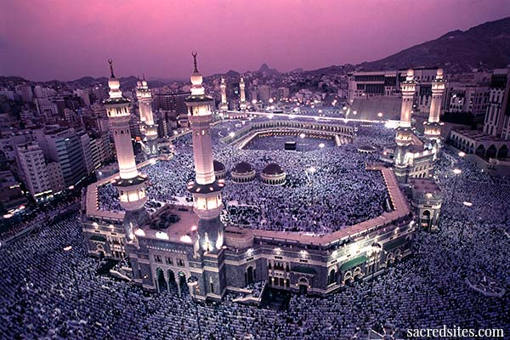
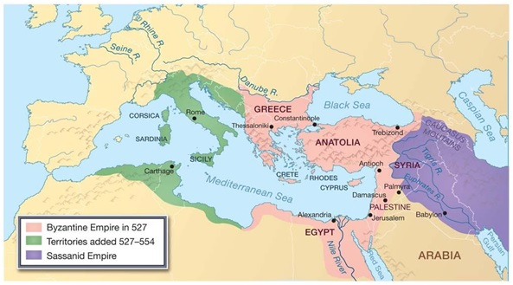

Slide 4
Early Abbasid Era
Islam became a universal religion
Sunni rule
Suppressed Shiites who were seen as heretics
Baghdad
Capital of the Abbasid dynasty
Bureaucratization of Islamic Empire
Islamic Conversion & Mawali acceptance
Integration of Arab & Non-Arab converts
Most converted willingly

Slide 5
Commercial Boom, Agrarian Expansion, and Social Standings
Dhows – sailing vessels
Traded with Christians and Jews
Urbanization
Government & private workshops
Ayan – landowning elite
Artisans were poorly paid
Slaves did labor and unskilled work

Slide 6
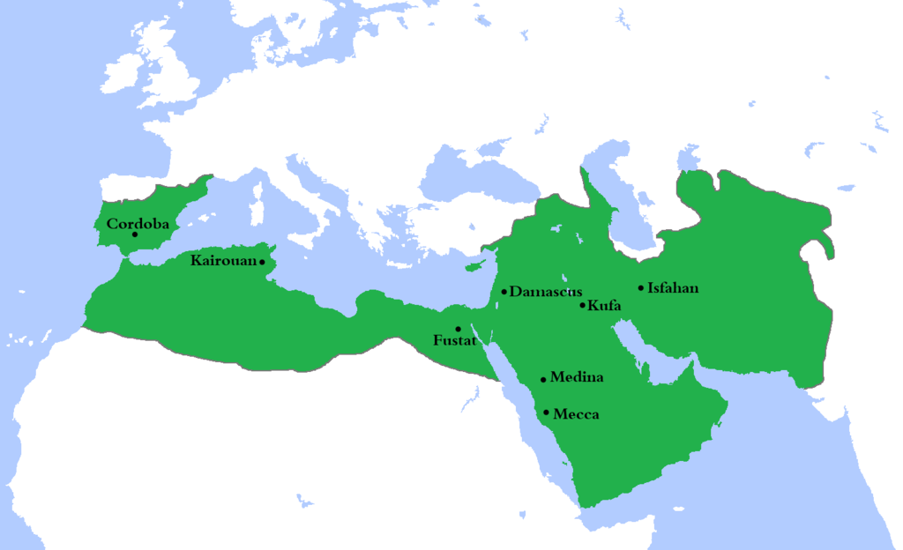

Slide 7
Late Abbasid Era
Empire weakened 9-13th Centuries due to peasant revolts
Third Abbasid caliph was al-Mahdi
Couldn’t reconcile with Shiites
Succession was not secure
Eldest son was poisoned after succession
Harun al-Rashid ascended the throne
One of the most famous and enduring Abbasid caliphs
Ruled during a time of flourishing arts, and scientific discoveries

Slide 8
Imperial Extravagance & Succession Disputes
A. Charlemagne & Harun al-Rashid shared a taste for extravagance
The Thousand and One Nights
Persian advisors influenced Harun’s reign and caliphs there after – caliphs became “pawns”
Civil war broke out after Harun’s death over the issue of succession

Slide 10
B. Al-Ma’mun won struggle for succession
Sons took power after he died
Recruited body guards of 4000 slaves – eventually became an army of 70,000+
Mostly Turkish speaking nomads from central Asia
C. Slave mercenaries murdered the caliph and took power of the throne
Four more caliphs murdered over next decade
Mercenaries major force in riots and social unrest

Slide 11
Imperial Breakdown & Agrarian Disorder
Constant civil unrest
Revenues dwindled
Caliphs built lavishly
Tax burden on peasants increases
Agriculture suffers due to abandonment of villages, irrigation collapse, & flooding

Slide 12
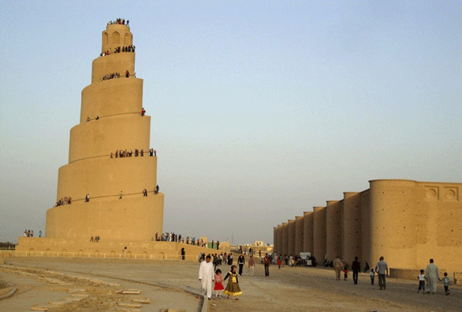
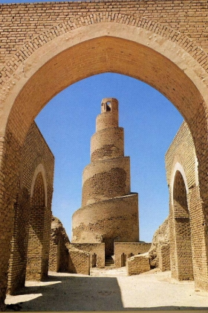
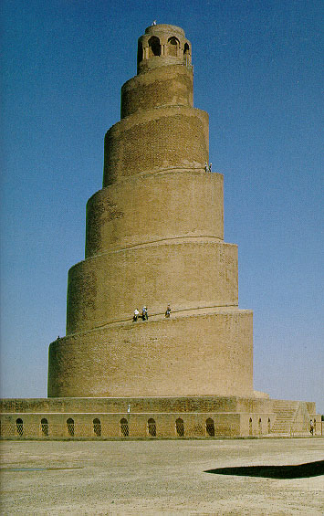

Slide 13
The Declining Position of Women in Family & Society
Secluded
Must wear veil
Polygamy
Slave concubines
Not confined
Didn’t have to wear veils
Eunuchs
Poor women could work, rich women could not
Marriage started at age 9

Slide 14
Nomadic Incursions & the Eclipse of Caliphal Power
Loss of territory
Buyids of Persia invaded Abbasid Empire and take control of Baghdad
Sultans took over & controlled the caliphate
Buyids defeated by Seljuk Turks in 1055
Rid any Shiite influence
Defeated Byzantines in Egypt

Slide 15
Invasions and Impact of Christian Crusades
Knights from Western Europe wanted to capture Islamic territory that was part of biblical holy land 8 Crusades lasted for two centuries
Called for by Pope Urban II in 1099
Christians take Jerusalem in 1099
Influence of Christians by Muslims due to contact esp. the elite & pop culture
Knowledge of weapons, science, medicine, math, return to Europe
1258- Baghdad falls to the Mongols. End of the Abbasid Caliphate

Slide 16
