Slide 1
Reaction to Luther and the Spread of the Reformation

Slide 2
Political Battle Over Lutheranism in Germany
Many HRE states in the north switched to Lutheranism.
Many German princes were politically motivated: they could now escape the authority of the Catholic Church and confiscate church lands for the state’s benefit.
The southern part of Germany largely remained Catholic.
Denmark and Sweden became Lutheran states as well.
Lutheranism did not spread much beyond northern Germany and Scandinavia.
This was unlike Calvinism that spread throughout western Europe and parts of the New World.

Slide 3
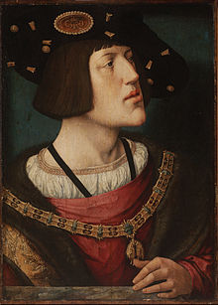
Charles V and His Reaction
He sought to stop the spread of Protestantism and preserve the hegemony of Catholicism.
In this sense, Charles was similar to a medieval emperor in that he was trying to maintain religious unity in Europe.
He was now allied with the pope in trying to stamp out heresy.

Slide 4
Charles was preoccupied with the Turkish threat in Hungary and his dynastic struggle with Francis I of France.
Between 1521 and 1530 Charles was away from the HRE; much of the time he spent in Italy.
Thus, Charles could not focus his military solely on Germany at a time that Protestantism was spreading vigorously.

Slide 5
German Peasant Revolts (1524-1525)
German peasants demanded an end of serfdom and tithes, and other practices of feudalism that oppressed the peasantry (e.g. hunting rights).
Many were inspired by Lutheranism
Luther took a conservative view of the revolts
He believed that people should bey their political authorities
He abhorred the violence of the revolts
He admonished the German princes to put down the revolt
As many as 100,00 peasants died during the uprisings

Slide 6
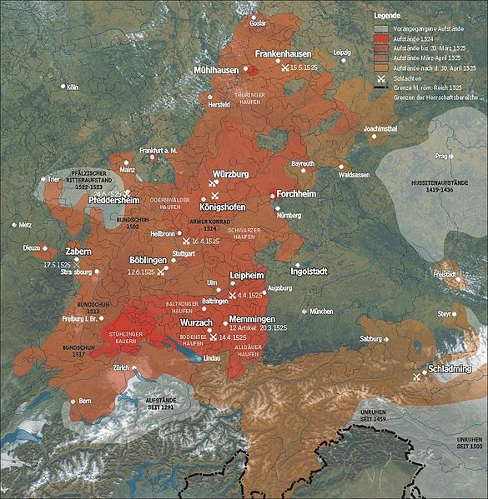

Slide 7
League of Schmalkalden
Formed by Protestant (Lutheran) princes to defend themselves against Charles V
Francis I (France) allied with the league (although France was Catholic) to keep the HRE divided
Charles V defeated the league in 1547 but all hope of restoring all of the HRE to Catholicism was gone
The league played a long term role in political fragmentation within Germany

Slide 8
Peace of Augsburg 1555
Temporarily ends the struggle in the HRE over Protestantism
Provisions
Princes in Germany could choose either Protestantism or Catholicism.
Protestants living in Catholic states were allowed to move to Protestant states. The same was true of Catholics living in Protestant states.
It resulted in permanent religious division of Germany.
It essentially reaffirmed the independence of many German states.

Slide 9
Spread of Protestantism: Anabaptist
Formed in Zurich in 1525
Characteristics:
Voluntary association of believers with no connection or allegiance to any state
They rejected secular agreements, refused to take civil oaths, pay taxes, hold public office, or serve in the military.
They opposed childhood baptism as only adults, they believed, could make the decision to commit to Christ.
They rejected the Trinity (Father, Son, and Holy Spirit).

Slide 10
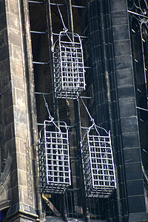
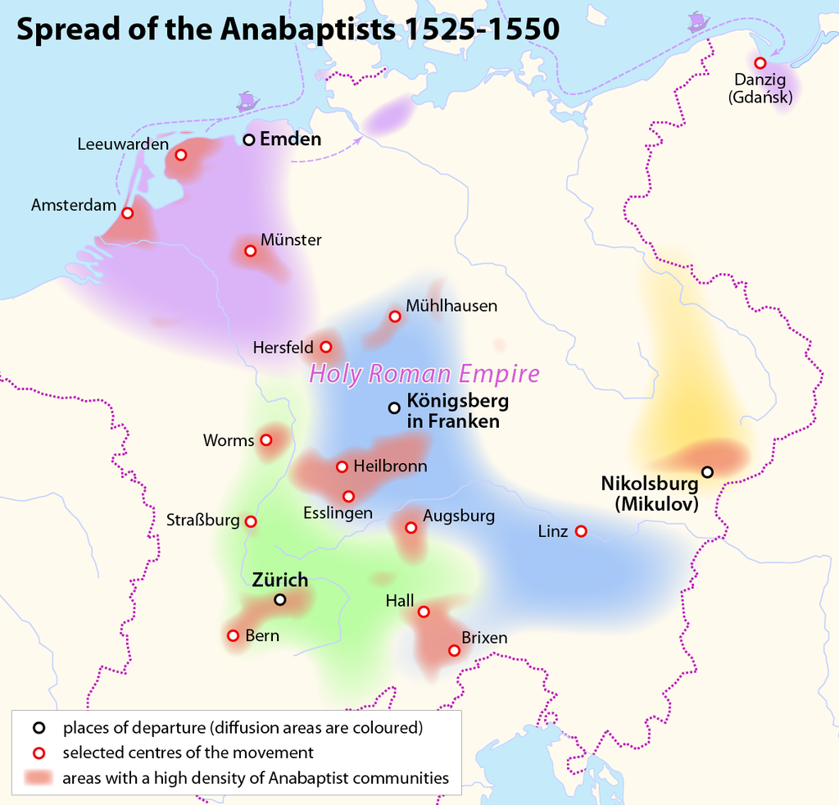

Slide 11
In 1532 a radical group of Anabaptist took control of the city of Munster (NW Germany)
They were led by John of Lyden
Instituted polygamy
Women served as leaders of the movement
All books other than the Bible were burned in the city
They killed Lutherans and Catholics
A combined force of Catholics and Protestants retook the city and executed the leaders
Legacy: influenced others such as the Mennonites, Quakers, and Unitarians

Slide 12
Ulrich Zwingli (1484-1531)
Swiss Reformation
He was a student of humanism who preached from Erasmus’ edition of the New Greek Testament.
He adopted Lutheranism and established what amounted to a theocracy in Zurich.
In contrast to Luther, he saw the Eucharist as only symbolic, and that Luther’s view of the Real Presence was too Catholic in its foundation.
1st major conflict over doctrine among Protestants
Colloquy of Marburg (1529): Zwingli officially split with Luther over the issue of the Eucharist.

Slide 13
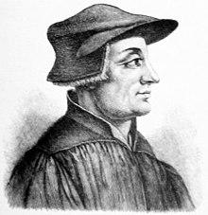

Slide 14
John Calvin and Calvinism
Key Doctrines
Pre-destination: states ones life is already predetermined God
God reveals if one has been chosen for salvation through a conversion experience.
The “elect” are church members who have had their conversion experience and should become model Christians: “visible saints”
Most militant of all of the Protestant sects
A Frenchman who was influenced by humanism, especially Erasmus, and by Luther.
He was exiled to Switzerland due to his religious reform ideas.
Established a theocracy in Geneva
Institutes of the Christian Religion, 1536
Calvin’s foundational work for Calvinism

Slide 15
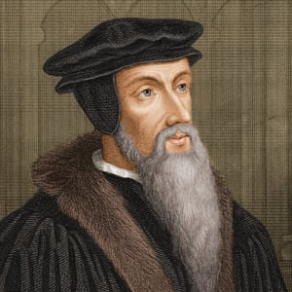

Slide 16
Catholic (Counter) Reformation
Jesuits- Order of monks founded by Ignatius Loyola in 1540
Three goals:
reform the church through education
spread the Gospel to pagan peoples
fight Protestantism
Successful in stemming the tide of Protestantism.
Pope Paul II- Sought to reform the church from within by using existing doctrine
Council of Trent:
Equal validity of Scriptures, Church traditions, and writings of Church fathers
Salvation through both “good works” and faith
All seven sacraments were valid; transubstantiation was reaffirmed
Monasticism, celibacy of the clergy, and purgatory were reaffirmed
It approved the Index of Forbidden Books

Slide 17
