Slide 1
Qing Dynasty 1644-1912
China’s Last Dynasty

Slide 2
Qing Politics
Manchus (ethnicity from Manchuria) rule- not Han Chinese (main Chinese ethnicity)
Manchus make up only 2% of population.
Chinese were forbidden to hold high national offices.
Continued Confucian civil service system.
The Neo-Confucian - obedience of subject to ruler continued
Manchu Qing expansion
Outer Mongolia and into central Asia
Taiwan
Tibet.

Slide 4
Economy
Built public buildings, public irrigation, walls, bridges and other infrastructure.
Light on taxes
international trade grew
Japan and Europe
Exported porcelain, Silk, and spices through maritime trade and Silk Road

Slide 5
Religion
Catholic and Protestant missionaries built churches and schools
Remember it was the Jesuits that successfully introduced Christianity to China
Christianity outlawed in 1840s
Viewed as counter to Chinese values (Confucianism)
The outlawing of Christianity will caused problems in China

Slide 6
Society
Han Chinese discriminated against
Wear hair braided in the back known as a queue
forbid women to bind their feet
repealed because could not enforce it
Intermarriage between the Manchus and Han Chinese was forbidden.
system of dual appointments was used
the Chinese were required to do the substantive work while the Manchus received high ranking positions

Slide 7
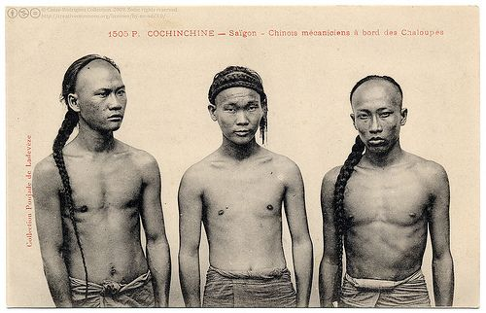

Slide 8
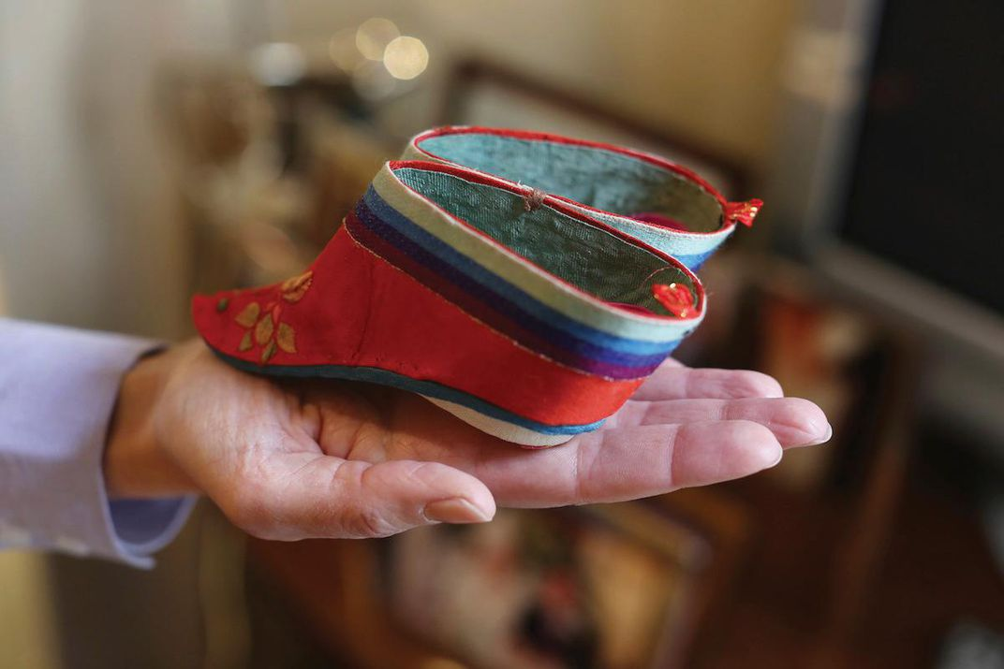
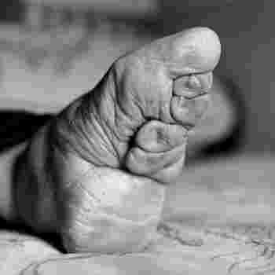

Slide 9
Taiping Rebellion - 1840s
Chinese group, “brother of Jesus”, recruits one million rebels and nearly takes out government, in response to the outlawing of Christianity, before being killed
The group mixed elements of Christianity and traditional Chinese religion
believed in communal property, and the equality of men and women
20-30 million individuals died as a result of the rebellion
This is as many peopled that died in all of WWI
The Taiping Rebellion was the first of several events that will lead to the collapse of the Qing dynasty and the entire dynastic cycle in China

Slide 10
The Opium Wars
1773- Britain brought Indian opium to China to sell
1839- the opium trade was abolished within China due to its erosion of Chinese society
1839-1860 Opium Wars took place as Britain forced China to reopen the trade
China loses and is humiliated
Treaty of Nanjing (1st of unequal treaties)
Britain claims Hong Kong
1844 – Chinese forced to allow Christian missionaries in again
Britain wins HUGE trading rights

Slide 12
Boxer Rebellion- 1900
Chinese traditionalists known as the Society for the Righteous and Harmonies Fists attack Europeans in cities and are defeated
They were called boxers by the Europeans because they shadow boxed
Qing Dynasty was split between those that wanted to intervene and those that did not
Ultimately the government did nothing to stop the attacks on westerners
In response an international force of 8 nations with 20,000 men defeat the imperial army
The coalition consisted of Britain, German Empire, France, Italy, Austria-Hungary, Russia, United States, and Japan
Japan is involved because it sees an opportunity to weaken a rival in China
The rebellion is put down and the Chinese are forced to pay reparations to the victors
This is the last major event that will cause the collapse of the Qing dynasty

Slide 13
Collapse of the Qing
Wasted money, lived luxuriously, cut military, lost respect of Chinese
Empress Cixi is the last true ruler of China
Puyi becomes the last Emperor of imperial China in December of 1908 (chosen by Cixi)
He became emperor at the age of 2.
Xinhai Revolution of 1911 (Chinese Revolution)-
Qing Dynasty Collapsed without a clear path for a future ruler
Puyi is forced to abdicate in February of 1912
Republic of China is established
End of the Chinese Dynastic System

Slide 14
