Slide 1
Prehistory and the Neolithic Revolution
Period 1

Slide 2
Searching for Human Origins
There are three main groups of scientists that search for and study the origins of humans.
Archeologist: study artifacts left by prehistoric peoples.
Anthropologists: study prehistoric culture.
Paleoanthropologists: Theses scientists search for bones in attempt to understand how humans developed and even what early humans ate.

Slide 3
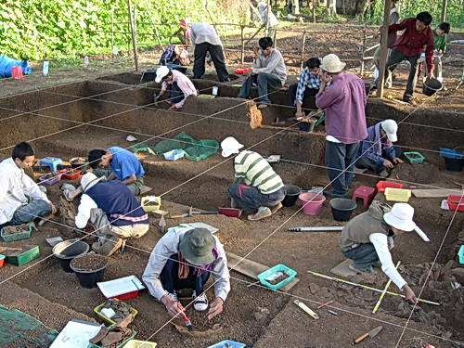
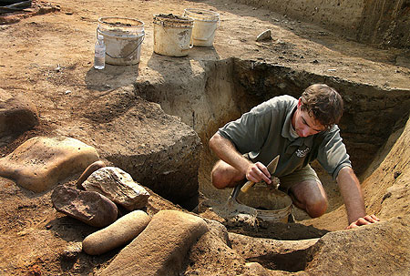
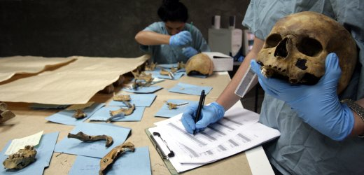

Slide 4
Evidence of Early Hominids
The greatest breakthroughs in understanding early hominids occurred in the late 20th century.
Mary Leakey- (1970s) led an archeological team in search of hominids in Tanzania in East Africa.
Her team discovered foot prints belonging to a hominid called an australopithecine.
Donald Johanson- (1974) discovered the most complete skeleton of the same hominid in Ethiopia.
They named the skeleton “Lucy”. She was dated to have lived 3.5 million years ago.

Slide 5
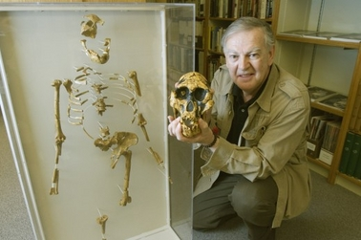
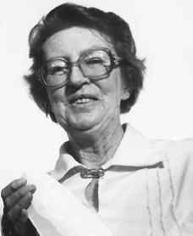
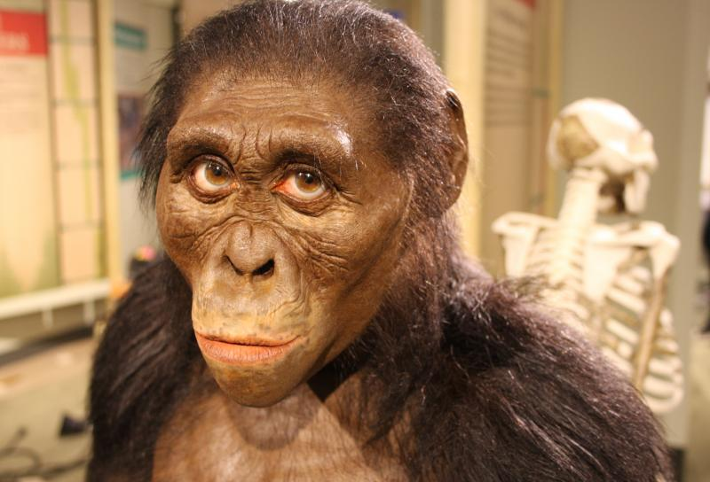
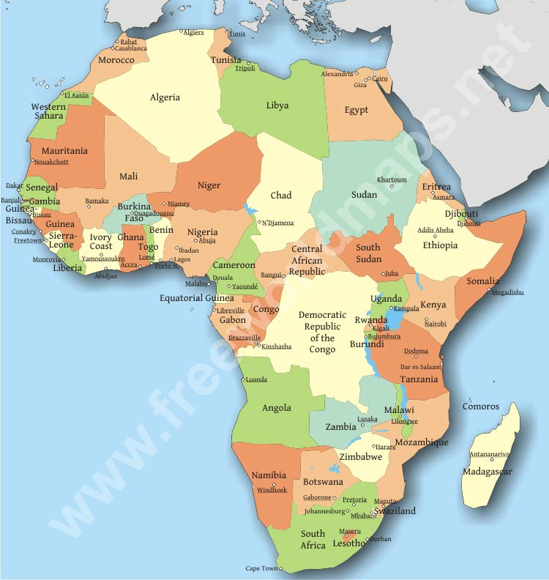
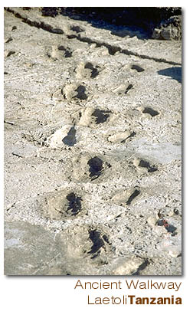

Slide 6
Beginning of Modern Humans
Homo erectus developed into modern man, Homo sapiens.
Neanderthals- discovered in 1856 in Germany . Believed to of developed funeral rituals.
Cro-Magnon- emerged around 40,000 years ago. Identical to modern humans. Were skilled hunters.
All of these groups, including Homo sapiens (modern man), spread around the world, beginning in Africa, over millions of years.

Slide 7
Modern Humans
Homo sapiens arrive by 10,000 B.C.E.
- larger brain
- tools, weapons
- stand erect

Slide 8
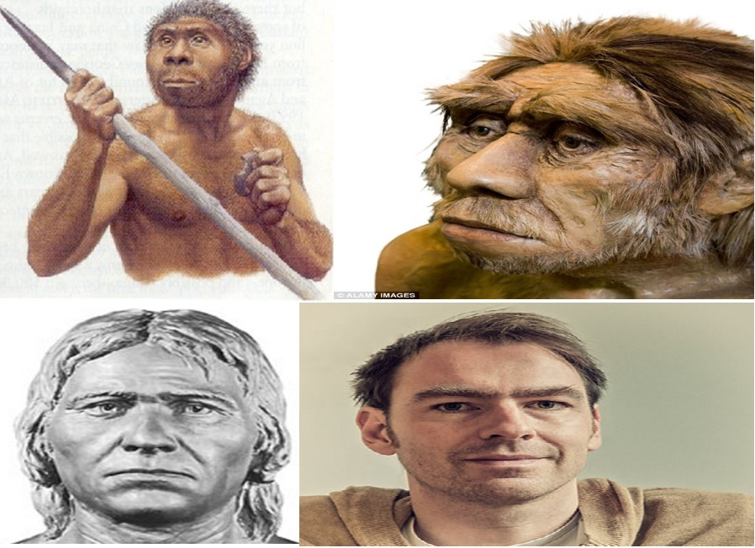
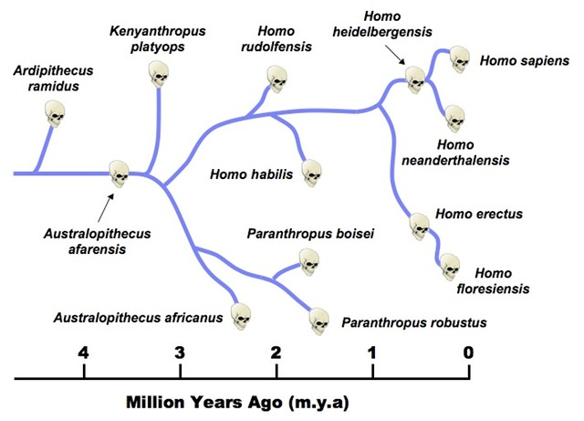
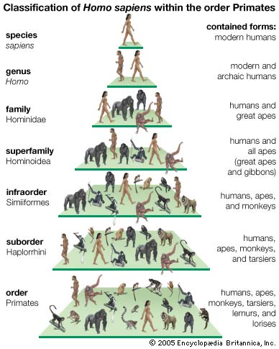
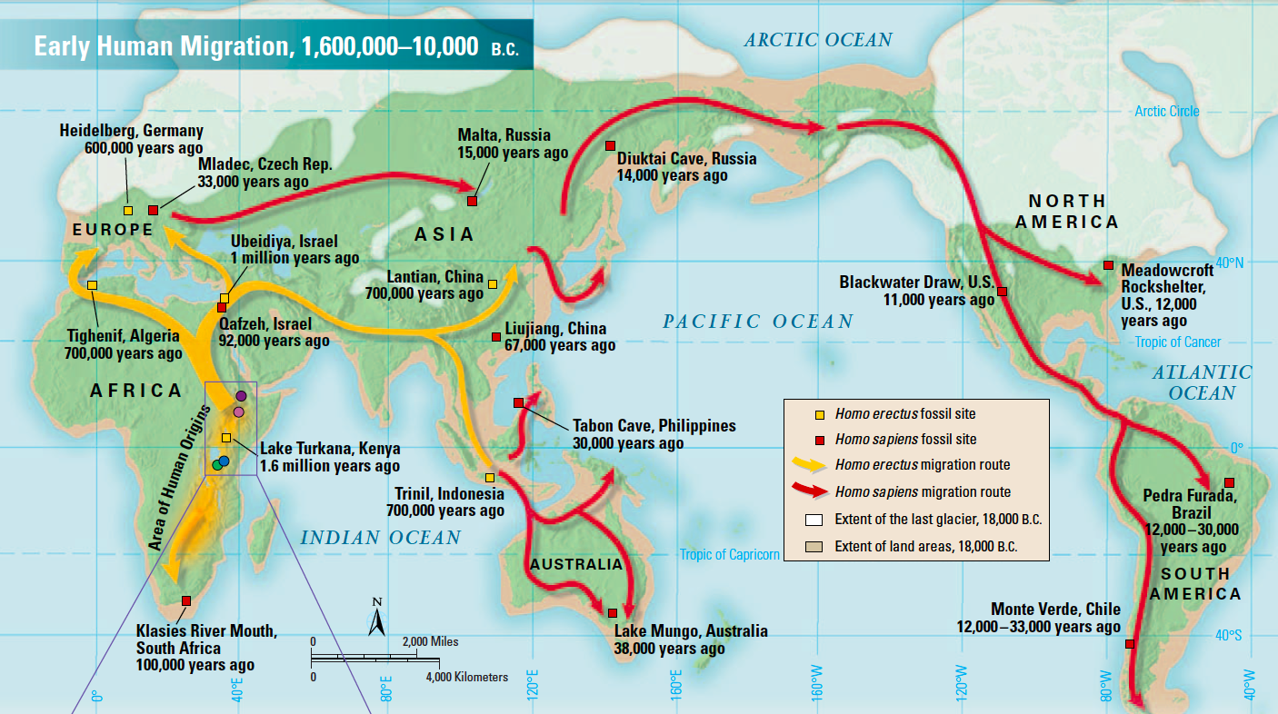

Slide 9
Stone Age
Scientists call the period in which early humans began to create tools, use fire, and develop early language as the Stone Age. This period is split in to two smaller time periods:
Paleolithic Age: “Old stone age”. Lasted from 2.5 million to 8000 B.C.
Speech emerges
Modern humans appear 240,000 years ago.
Neolithic Age: “New stone age”. Lasted from 8000- 3000 B.C. (Lithic- means rock)
This age is known for pottery, agriculture, and domestication of animals.

Slide 10
Advances in Technology
For tens of thousands of years people of the Old Stone Age were nomads.
People that move from place to place in search of food sources.
These groups were hunter gathers.
In order to hunt they had to create specialized tools such as spears, hooks, knives, and harpoons. They made these out stone, bone, and wood.
We know some of what they hunted by the cave paintings they created.
All of these had appeared by 12,000 BCE

Slide 11
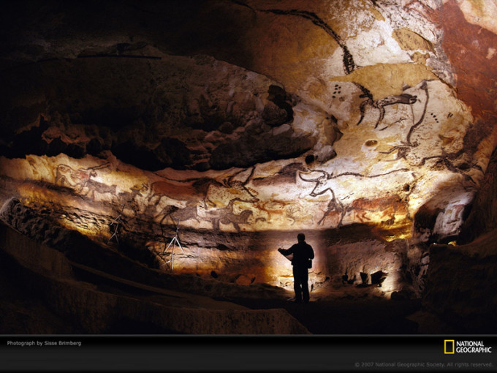
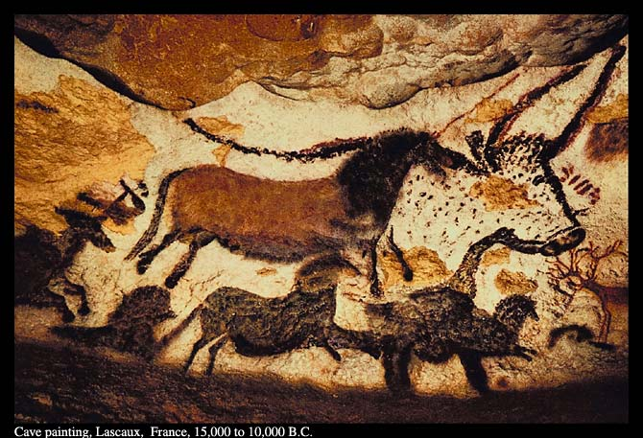
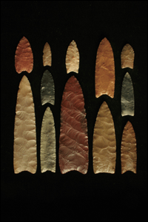
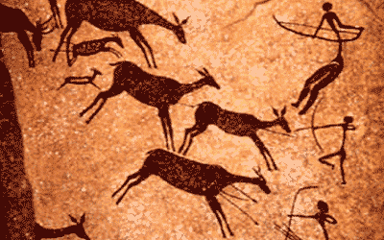
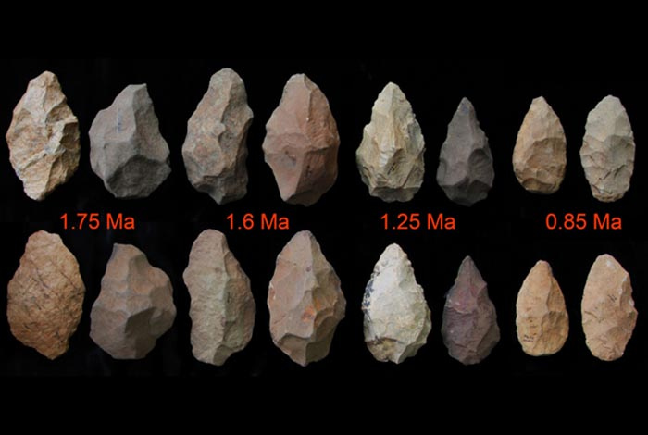
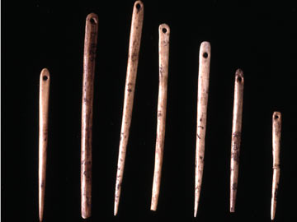

Slide 12
What do you think?
Are there other ways to determine what early humans hunted other than by studying the cave paintings?

Slide 13
Beginning of Agriculture: Neolithic Revolution
Neolithic Revolution: the period that is saw the rise of agriculture
Sedentary agriculture – originated in Middle East
Many of the early crops grown were grains such as wheat, barley, and oats.
By growing crops humans had a more reliable source of food.
Led to the development small settlements
Humans also began to domesticate animals such as horses, sheep, goats, pigs, and dogs.
Provided food, hides, and wool

Slide 14
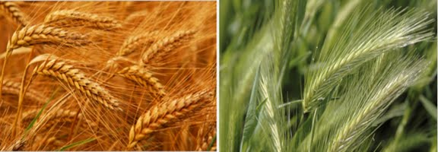

Slide 15
Spread of the Neolithic Revolution
Within a few thousand years farming techniques had spread to other parts of the world including Africa, China, Mexico and Central America, and Peru.
Hunter-Gathers still persists
Pastoralism emerges
Sub-Saharan Africa
root and tree crops
Northern China
Millet
Southeast Asia, to China, India, islands
Rice
Mesoamerica, Peru
Maize, manioc, & sweet potatoes

Slide 16
Bronze Age: 4,000-1,500 BCE
Bronze used to make tools and weapons
Rise of specialization of work: ex. Woodworking
Development of more complex settlements such as towns

Slide 17
