Slide 1
Politics and Society in the German Empire and the 3rd French Republic
1871-1918
Notes:
Are your classroom colors different than what you see in this template? That’s OK! Click on Design -> Variants (the down arrow) -> Pick the color scheme that works for you!
Feel free to change any “You will…” and “I will…” statements to ensure they align with your classroom procedures and rules!

Slide 2
The German Empire (1871-1918)
Government Structure:
Consisted of a federal union of Prussia and 24 smaller states
Kaiser Wilhelm I (r. 1871-1888) had the ultimate power in Germany
Otto von Bismarck (1810-1898) served as the chancellor and was the mastermind behind the government
Bicameral Legislature

Slide 3
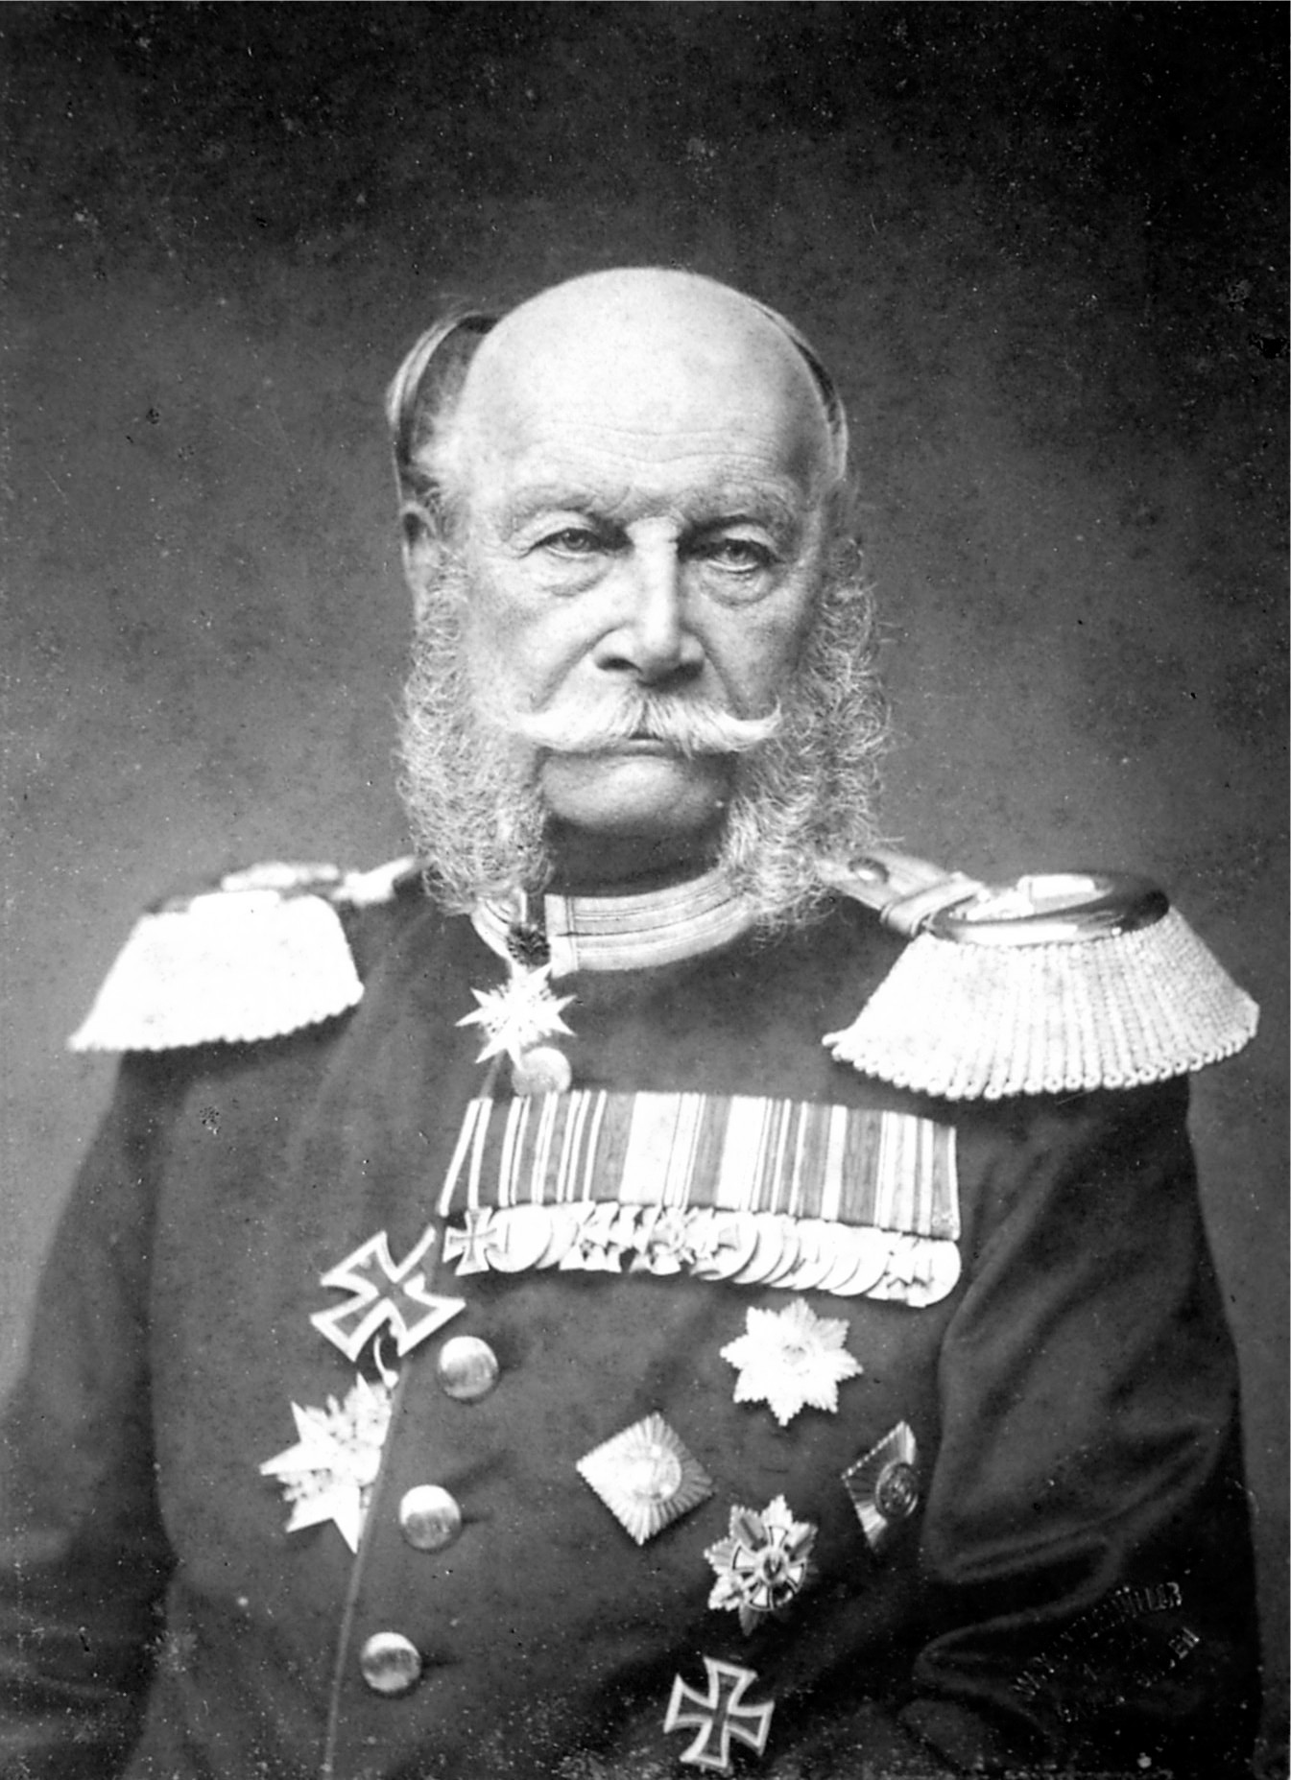
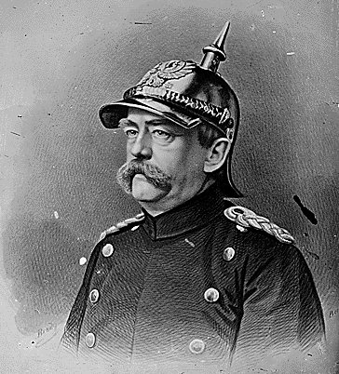

Slide 4
The German Political System
Multi-party
Conservatives represented the Junkers of Prussia
Central Party (Catholic Party) approved Bismarck's policy of centralization and promoted the political concept of Particularism which advocated regional priorities.
The Democratic Socialist Party (SPD) was Marxist and advocated sweeping social change
The German middle class was largely left out of the Germans political system
Many feared the influence of the SPD
Gave more support to the imperial authority and noble influence
Bismarck saw the Catholic Center Party and the SPD as major threats to imperial power and he set about to destroy them, albeit unsuccessfully

Slide 5
Germany under Bismarck
Between 1817 and 1890 Bismarck established an integrated political and economic structure for Germany (while dominating European diplomacy)
Unified the monetary system
Established an Imperial Bank while strengthening existing banks
Developed universal German civil and criminal codes
Established compulsory military service
Kulturkampf (“struggle for civilization”)
Bismarck sought to limit the influence of Catholic Party in light of Pope Pius IX’s declaration in 1870 of papal infallibility
Most of the German stated in north were protestant
The Catholic Party was particularly strong in the south

Slide 6
Social Democratic Party (SPD)
Advocated sweeping social legislation
South universal suffrage and genuine democracy
Sought demilitarization of German gov’t
Bismarck was unsuccessful in limiting its growth
Bismarck instituted a set of weeping reforms in order to minimize the threat from the left (socialists)
Modern Social security laws established (Germany was 1st)
Despite better standard of living, workers did not leave the SPD
Wilhelm II is at odds with Bismarck and forced him to resign

Slide 7
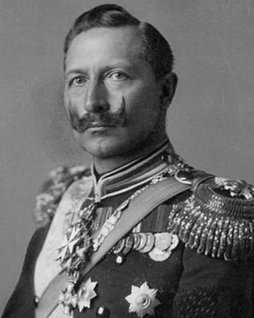

Slide 8
Paris Commune
The Paris Commune (1870-1871)
In 1870, Napoleon III’s Second Empire collapsed when it was defeated by Prussia in the Franco-Prussian War.
New assembly was created (lead by Adolphe Thiers)
Radical communist government lay sieged to Paris (Paris Commune)
From March to May 1871, the Paris Commune fought a bloody struggle with the troops of the National Assembly
Theirs’ defeat of Paris Commune and other firm measures led France on road to recovery

Slide 9
The Third French Republic
Established in 1875
Largely dominated by the bourgeoisie
Constitution
Chamber of Deputies had most power (elected by universal suffrage)
The president was weak
The Senate was indirectly elected
Leon Gambetta led the republicans during the early years of the Republic
Established parliamentary supremacy
Reforms
Trade unions fully legalized (had been suppressed by Napoleon III)
Secular education was reformed: taxes supported public schools

Slide 10
Threats to the Republic
Boulanger Crisis (1887-1889)
Plotted a coup to overthrow the Republic with the support of the military
He was going to be put on trial but fled to Belgium where he committed suicide
Panama Scandal (1892)
Ferdinand de Lesseps failed to build a canal across Panama
Cost French taxpayers millions
The Public perceived the government to be corrupt
Dreyfus Affair (1894)- was the most serious threat to the Republic
Military falsely accused Captain Alfred Dreyfus, a Jew, of supplying secrets to the Germans
Monarchist used this to discredit the Republic
Dreyfus was acquitted but the case led to an alliance between moderate republicans and socialists

Slide 11
