Slide 1
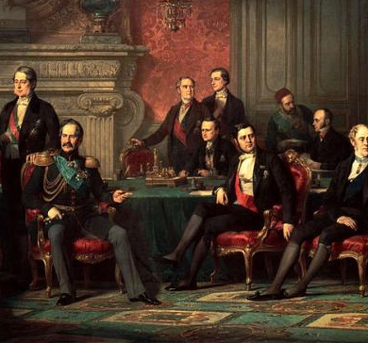
Political Developments of the Early 1800s
Concert of Europe to Revolutions of 1848

Slide 3
Concert of Europe
Lasted from Congress of Vienna in 1815 until the Crimean War of the 1850s
Series of arrangements to enforce the status quo as defined by the Vienna settlement
1. Highly conservative in nature
2. Essentially a crusade against liberalism & nationalism
Two major provisions: Quadruple Alliance and the Congress System.

Slide 4
Quadruple Alliance
Russia, Prussia, Austria and England
Provided for concerted action against any threat to peace or balance of power.
France was usually seen as the possible violator of the Vienna settlement.
Alliance agreed that no Bonaparte should ever again govern France.
Austria used the alliance to defend the status quo as established at Vienna against any change or threat to the system.
Liberalism and nationalism were seen as threats to the existing order.

Slide 5
Congress System
European international relations controlled by series of meetings held by great powers to monitor and defend status quo
Principle of collective security required unanimity among members of the Quadruple Alliance
Worked effectively until the early 1820s
1822, Britain withdrew from the Congress effectively killing the Congress system.
Britain disagreed with the Congress’s squashing of a revolt in Spain

Slide 6
Holy Alliance
proposed by Alexander I in 1815
Included Russia, Prussia and Austria
First attempt to stop the growth of liberalism
Proposed for all monarchs to sign a statement agreeing to uphold Christian principles of charity and peace
Plan proved to be overly ideological and impractical and few took it seriously (especially Britain)
Liberals saw it as a sort of unholy alliance of monarchies against liberty and progress.

Slide 8
Conservatism and Repression
Conservatism was a reaction to liberalism and a popular alternative for those frightened by the violence, terror and social disorder of the French Revolution.
Embodied most by Klemens von Metternich of Austria
Supported by traditional ruling classes (e.g. nobles) & peasants who still formed majority of the population
Bourgeoisie constituted the biggest threat to the conservative status quo
Believed in order, society and the state; faith and tradition
Edmund Burke: (1729-1797): Reflections on the Revolution in France
One of the great intellectual defenses of European conservatism.
Defended inherited privileges, especially those of English monarchy and aristocracy.
Advised England to go slow in adapting its own liberties.

Slide 9
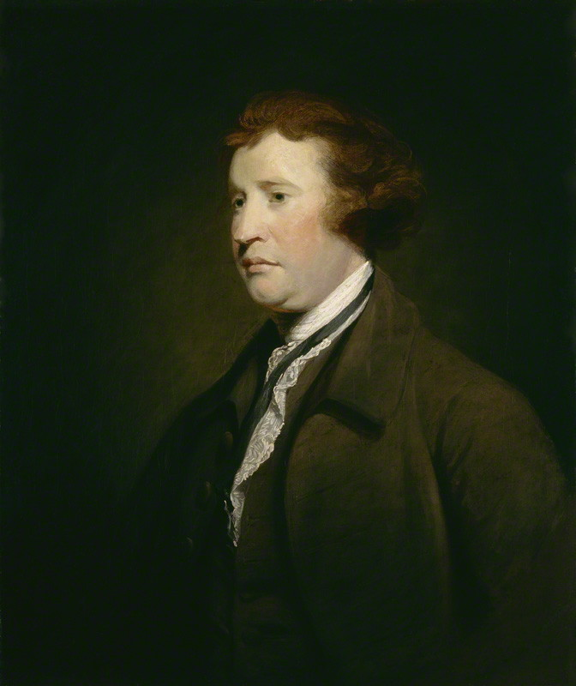

Slide 10
Metternich was particularly concerned about the multi-ethnic character of the Hapsburg empire
Nationalism in particular threatened to tear the empire apart.
Repression by conservatives resulted in the period between 1815 and 1849.
Austria and the German Confederation
Multi-ethnic composition of Hapsburg Empire meant liberalism and nationalism were potentially more dangerous than in other countries.
Liberalism and nationalism were often centered in universities in first half of the 19th century
Karlsbad Diet (1819) called by Metternich
Karlsbad Decrees cracked down on liberalism in universities and drove liberalism and nationalism underground.

Slide 11
Prussia
Prussian gov’t and its traditional ruling classes (Junkers) followed Metternich’s lead in repressing liberal and nationalist movements.
Britain
The conservative Tories (who had defeated Napoleon) controlled the government.
Corn Laws of 1815: halted importation of cheaper foreign grains.
Habeas corpus repealed for first time in English history
“Peterloo Massacre” of 1819
Pro-liberal crowd listening to anti-Corn law rhetoric were attacked by police.
The press was brought under more firm control and mass meetings were abolished.

Slide 12
Russia:
Czar Alexander I (1801-1825) initially favored Enlightened despotism but after 1815 grew increasingly reactionary but his death lead to a power vacuum
Nicholas I became the tsar
Decembrist Uprising (1825)
Decembrists (junior military officers): upper-class opponents of the autocratic Russian system of gov’t
Supported popular grievances among Russian society.
First upper-class revolt against Russia’s autocratic system of government
Nicholas became Europe’s most reactionary monarch
Resulted in severe alienation of Russian intellectuals

Slide 14
France
France began this period as the most liberal large state in continental Europe
Charter of 1814 established a constitutional monarchy under King Louis XVIII
“White Terror”: In 1815, thousands of former revolutionaries murdered by royalist mobs
Elections in 1816 restored moderate royalists to power

Slide 16
Liberalism
Characteristics
First major theory in Western thought that saw the individual as a self-sufficient being, whose freedom and well-being were the sole reasons for the existence of society.
Classical Liberalism
Reformist and political rather than revolutionary in character
Individuals entitled to seek their freedom in the face of tyranny.
Humans have certain “natural rights” and governments should protect them (Locke).
Rights are best guaranteed by a written constitution, with careful definition of the power of gov’t
Republican (representative) form of gov’t
Utilitarianism: founded by Jeremy Bentham
Utility of any proposed law or institution was based on “the greatest happiness of the greatest number.”
Bentham was a major proponent of Poor Laws.

Slide 17
Impact of Liberalism
Influenced revolutions in France in 1830 and 1848
Liberalism became embodied in over ten constitutions secured between 1815 and 1848 in the states of the German Confederation.
Influenced reform measures in Britain from the 1830s into 20th century.
Inspired German student organizations and impacted Prussian (and later German) life in the late 19th century.
Resulted in some mild reforms in Russia in the early 20th century.

