Slide 1
The Islamic Empires: the Ottoman Empire

Slide 2
Introduction
Three major Islamic Empires
Ottoman
Safavid
Mughal

Slide 3
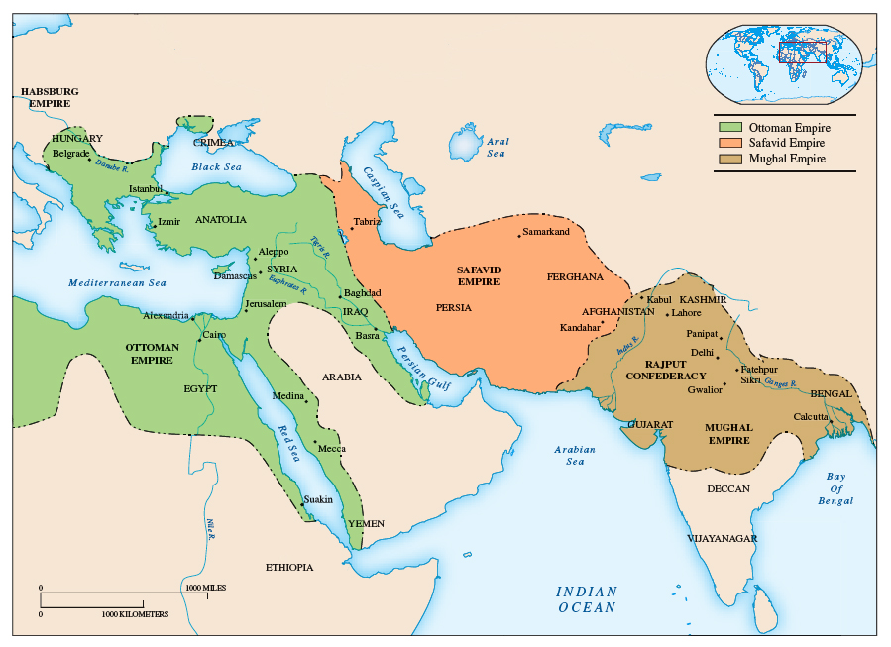

Slide 4
The Ottomans
Founded by Osman
13th-20th centuries
Eastern Mediterranean
Based in Anatolia
1453 Mehmed II takes Constantinople
Empire spread through the Balkans into Hungary
Large naval power
Biggest rival was the Austrian Habsburg dynasty
Major force in European politics until 19th century

Slide 6
A State Geared to Warfare
Economy based on military and expansion
Warriors become nobility
Janissary infantry
Most Janissaries forced into service - slaves
Most Christians
Become politically influential

Slide 8
The Sultans & Their Court
Sultans = absolute monarchs
Used factions (warrior elites) against each other to maintain power
Commerce controlled by the dhimmi
Bureaucratic administration carried out by grand vizier
Prime Minister to the Sultan
No clear rules of succession = hostility among rival heirs

Slide 9
Constantinople Restored & Ottoman Culture
Culture varied
Influenced by Africa, Europe, & Asia
Constantinople becomes Ottoman capital
restored to its ancient glory
Aqueducts built, markets reopened, & defenses repaired
Saint Sophia converted into a mosque
Suleymaniye mosque built by Suleiman the Magnificent, 16th Century

Slide 10
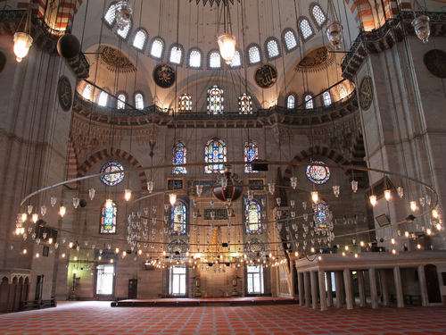
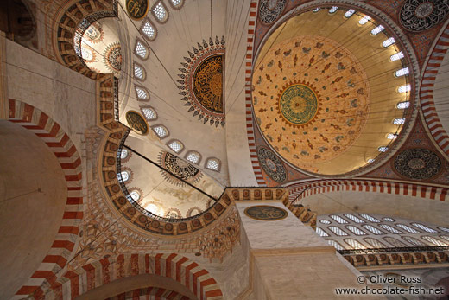
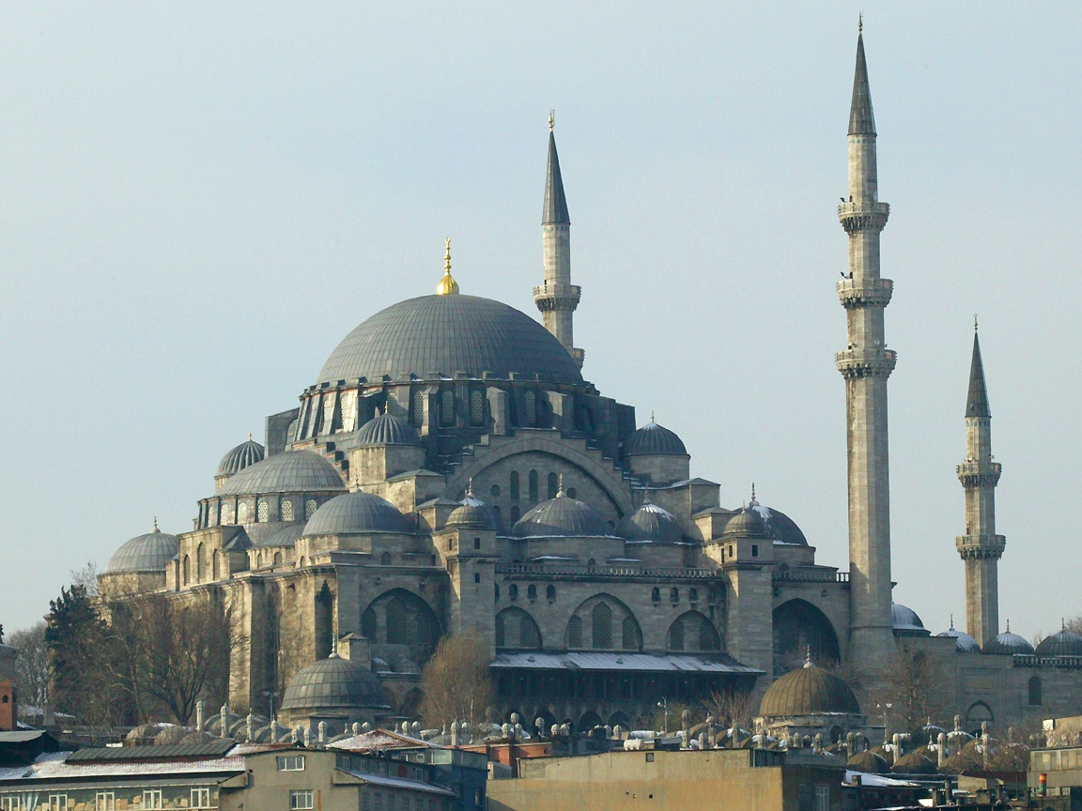
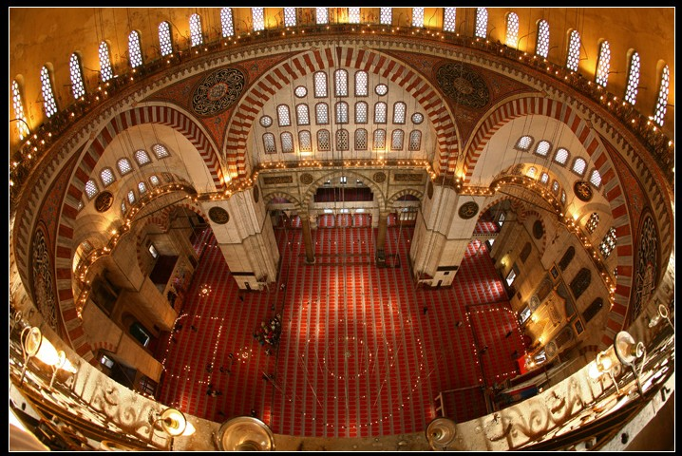

Slide 11
Constantinople is the commercial center
Government regulates trade & crafts
Artisan guilds
Early Ottomans used Persian & Arabic for language in law and religion, but Turkish becomes prevalent in 17th century

Slide 12
Problems and Ottoman Decline
Dynasty endured for over 600 years
Empire too big
Infrastructure insufficient
As conquest declines, lands lost to Christian & rival Muslim kingdoms
Problems in imperial administration
Succession issues continue
Sultans less dynamic

Slide 14
Military Reverses and the Ottoman retreat
Ottomans fall behind European rivals in scientific, technological, & commercial transformations
Janissaries block military change and technology
Navy defeated in Battle of Lepanto by Spanish & Venetian fleets
Lose control of eastern Mediterranean
Portuguese beat Muslim navies in Indian Ocean
Inflation occurs due to New World bullion & loss of trade

