Slide 1
Rise of Islam and the First Islamic Empires

Slide 2
The Life of Muhammad and the genesis of Islam
Mesopotamia, Byzantine & Sasanian empires established monotheistic religions​
Christianity & Judaism​
Muhammad influenced the worship of a single, almighty god​
Orphaned​
Resided in Mecca as a trader
Married the widow Khadijah

Slide 3
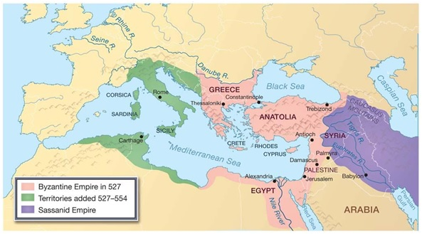

Slide 4
The life of Muhammad and the Genesis of Islam
Muhammad revelations from Allah via the angel Gabriel in 610 CE​
Revelations written in Arabic & collected in the Qur’an​ (Koran)
Basis for Islam

Slide 5
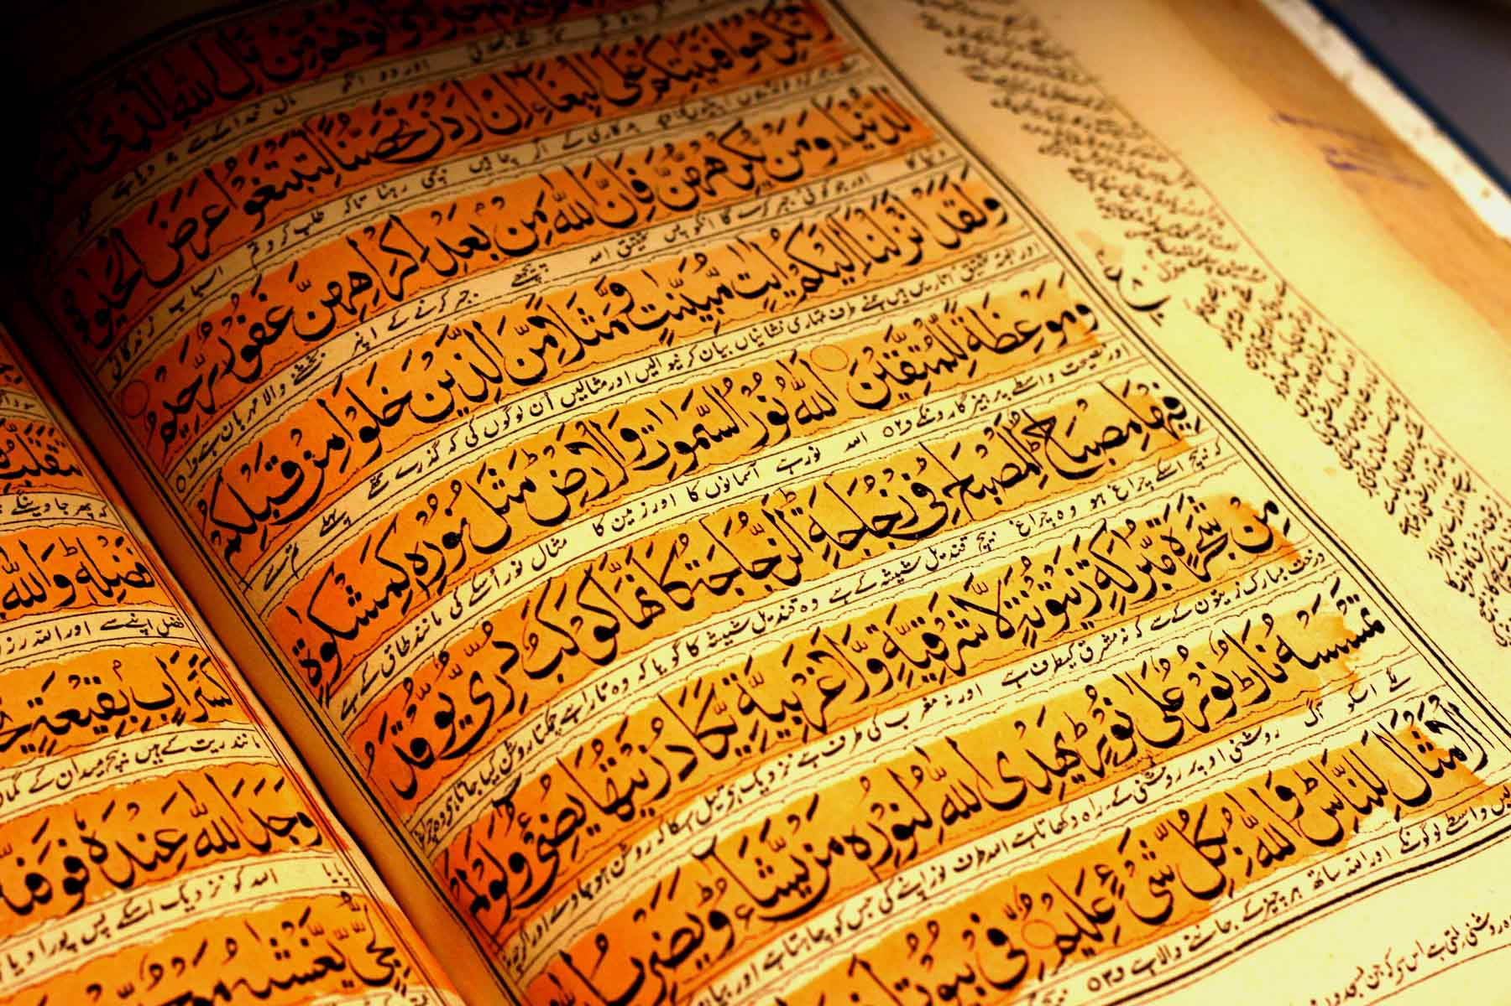

Slide 6
The life of Muhammad and the Genesis of Islam
Muhammad seen as a threat by Umayyads ​
Plotted to murder him​
Threatened gods of Ka’ba
Hijra – Muhammad’s flight to Medina marking the first year of the Islamic calendar​
Quraysh launched a series of attacks on Muhammad and his followers in Medina​
Proclaimed Allah as the one true god by smashing idols on the Ka’ba​

Slide 7
Reasons for Islam in the Arab World
Islam provided ethics​
Zakat – tax for charity​
Muhammad’s teachings & revelations in the Qur’an regulated all aspects of Muslim life​
Provided a last Judgment
Offered monotheism equal to Christianity & Judaism​
Distinctively Arab in origin​
Umma (Islamic community) offered political unity for tribal boundaries​
Bedouins unite and conquered Middle East​

Slide 8
Universal elements of Islam
Monotheism​
Ethics​
Legal codes​
Sense of community​
Egalitarianism​

Slide 9
Arab empire of the Umayyad's
There was a leadership crisis after Muhammad’s death (633 CE)
Abu Bakr
Succeeded Muhammad as the 1st Caliph (political and religious leader of Islam)
Ridda Wars
defeat of rival prophets
Restores unity of Islam

Slide 10
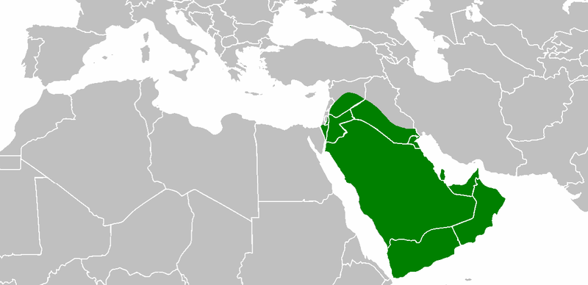

Slide 11
Succession and the Sunni – Shiite split
Uthman - 3rd caliph
unpopular because he was chosen by the Umayyad
Murdered by disobedient warriors
Ali proclaimed caliph causing a split within Islam
Ali- Muhammads son in law
Rejected by Umayyads as caliph
Loses support because he tries to mediate with Umayyads
Assassinated, 661
Sunni’s believe that the caliph should be elected by the umma. Shiites (Shi’a Muslims) believe that the caliph should be the direct descendent of Muhammad.

Slide 12
Reasons for Arab conquest
Motives for Arab Conquests​
Booty – loot/goods​ (treasure)
Conversions​
Jihads – holy war to forcibly spread the Muslim faith
Spread for two reasons
Trade and Invasion

Slide 13
Spread and Decline
Spread conquests into
Central Asia
Islam rivaled with Buddhism
Northwest India
North Africa
Expansion into northern Europe blocked by Charles Martel and the Franks
Battle of Tours in 732
Center of Islam shifts from Mecca to Damascus

Slide 14
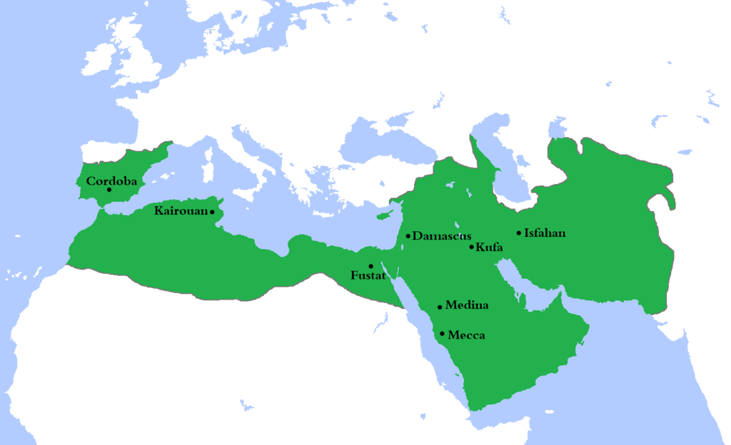
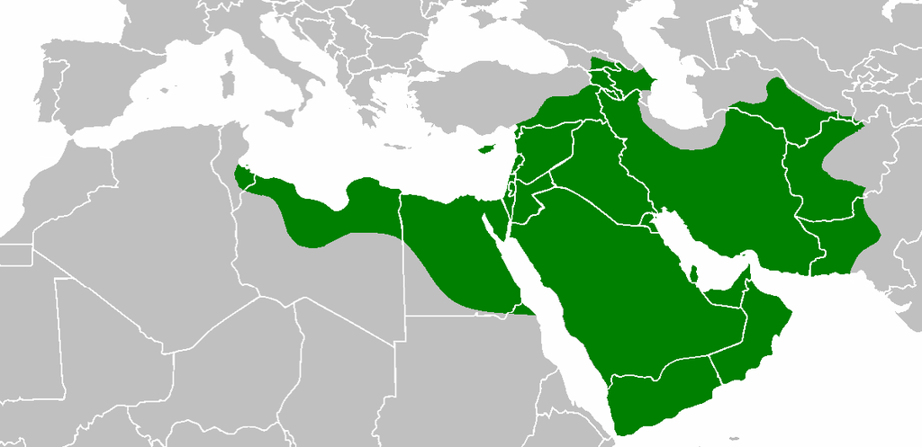

Slide 15
Spread and Decline
Weakening of the Umayyad
Alienation of Muslim faith led to revolts
The Abbasid Revolt in Merv
Supported by Shiites & Malwai (non-Arab converts)
Defeated Umayyads

Slide 16
The Early Abbasid Era
Islam became a universal religion
Sunni rule​ (dominate sect)
Suppressed Shiites​
Seen as heretics​
Baghdad​ becomes the capital
Bureaucratization of Islamic Empire

Slide 17
The Early Abbasid Era
Islamic Conversion & Mawali acceptance
Integration of Arab & Non-Arab converts
Most converted willingly

Slide 18
Commercial Boom, Agrarian Expansion, and Social Standings
Dhows – sailing vessels​
Trade with Christians and Jews​
Urbanization​ increased
Government & private workshops​
Artisans poorly paid​
Slaves did labor and unskilled work​
Ayan – landowning elite

