Slide 1
New Monarchies
Notes:
To change the image on this slide, select the picture and delete it. Then click the Pictures icon in the placeholder to insert your own image.

Slide 2
New Monarchs (c. 1460-1550)
Consolidated power and created the foundation for Europe’s first modern nation-states in France, England, and Spain
This evolution had begun in the Middle Ages.
New Monarchs on the continent began to make use of Roman Law and declared themselves “sovereign” while incorporating the will and welfare of their people into the person of the monarch.

Slide 3
They increasingly had authority to make their secular systems of laws.
Meanwhile, monarchies had grown weaker in eastern Europe during the Middle Ages.
New Monarchies never achieved absolute power; absolutism did not emerge effectively until the 17th century
New Monarchies also were not nation-states (in the modern sense) since populations did not necessarily feel that they belonged to a “nation.”
Identity tended to be much more local or regional.
The modern notion of nationalism did not emerge until the late-18th and early-19th centuries.

Slide 4
Characteristics of New Monarchs
1. Reduced the power of the nobility through;
taxation
confiscation of lands (from uncooperative nobles), and the
hiring of mercenary armies
the creation of standing armies
2. The military revolution increased monarchical power.
Gunpowder (rise of modern weaponry) made armies, castles, and mounted knights vulnerable
Monarchs built fortification
Armies cost too much for nobles to have their own
Many nobles did receive favors in exchange for support

Slide 5
4. Monarchs reduced the political power of the clergy
The medieval notion of church over state was no longer believed
Many monarchs gained the right to determine the religion of their subjects
5. New and more efficient bureaucracies were created
Allows monarchs to centralize control of their realm
6. Increased the political influence of the bourgeoisie (at the expense of the nobility) particularly in France
7. Increased national debts by taking out loans with merchant-bankers

Slide 6
Opposition to Monarchical Power
Nobles resented the decline of their political influence.
The clergy saw the pope as their leader, not the monarch.
Independent towns resisted more centralized monarchical control.

Slide 7
France
France’s political and economic recovery began after the Hundred Years’ War (1337-1453).
England was expelled from France.
The defeat of the duchy of Burgundy in 1477 removed the threat of a new state in eastern France.
Rise of the Valois line of monarchs
Louis XI (1461-1483) “Spider King”
Created large royal army
Dealt ruthlessly with nobles
Increased taxes
Exerted power over the clergy
Encouraged economic growth

Slide 9
Francis I (1515-1547)
Condordat of Bologna (1516): The king of France now had power to appoint bishops to the Gallican (French) Church.
This represented a major blow to papal influence in France.
Yet, French control over these appointments was one reason France did not become Protestant during the Reformation.
taille: Francis instituted a direct head tax on all land and property.
This enabled the French gov’t to expand its budget on such things as a larger army.

Slide 11
England
War of the Roses (1455-1477)
Two noble families, the House of York and the House of Lancaster, fought a civil war to gain the crown.
Yorkists were victorious and gave rise to the Tudor dynasty (which would rule England until 1603).
Henry VII (r. 1489-1509):
He reduced the influence of the nobility, in part, through the Star Chamber (secret court/trials).
Nobles were tried without a jury, could not confront witnesses, and were often tortured.
Nobles were not allowed to have private armies with their own insignias.

Slide 12
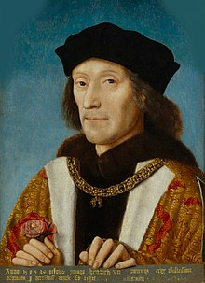

Slide 13
The English parliament continued to gain power in its struggle with the crown.
• Standard governmental procedures of law and taxation were developed.
• Tudors did not have the power over taxation like the Valois’ in France.
Henry VIII (r. 1509-1547)
He broke away from the Catholic church in 1534 and established the Church of England with the king as its head.
He oversaw the expansion of the royal bureaucracy and became the most powerful king in English history up to that time.

Slide 15
Spain
Ferdinand of Aragon (r. 1478-1516) and Isabella of Castile (r. 1474-1504) eventually unified Spain.
Reconquista (achieved in 1492)
Its goal was to remove the last of the Moors and Jews and Christianize Spain.
The last Muslim stronghold of Granada surrendered in 1492
The loss of Jews and Moors resulted in a significant decline in the Spanish middle-class.
A minimum of 165,000 Jews were expelled, about 50,000 were baptized, and 20,000 died when emigrating.
Many Jews fled to Turkey, North Africa, and northern Europe (e.g. Holland, England, Scandinavia, Italy, and France).

Slide 16
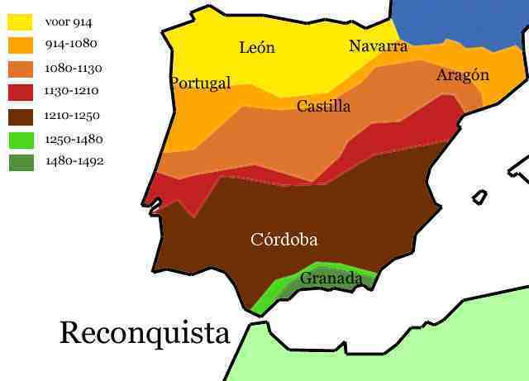

Slide 17
Spanish Inquisition
Conceived by Isabella
The monarchy enforced the authority of the national (Catholic) church.
Tomás de Torquemada, a Dominican monk, oversaw the Inquisition.
The Inquisition targeted conversos (Jews who had converted to Christianity but were now suspected of backsliding to Judaism.)
• Thus began a wave of anti-Semitism in certain parts of Europe.
• In Portugal, 4,000 Jews who refused to leave were massacred in 1506.
• Germany began systematically persecuting Jews in 1509.
By 1500 Cardinal Ximenes succeeded in getting rid of the abuses and opposition to reform in the Church
Thus, Spain, like France, did not turn Protestant during the Reformation.

Slide 18
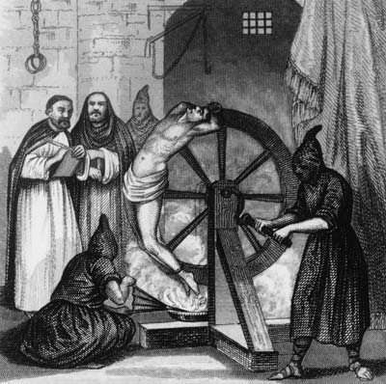

Slide 19
Holy Roman Empire (Hapsburg Empire)
Each state/ principality had its own foreign policy and wars sometimes occurred between states
The center of Hapsburg power was in Austria and other hereditary states nearby.
The HRE was NOT a “New Monarchy”
Emperor did not have centralized control
Could not levy taxes
Never controlled all of the German states, duchies, and principalities

Slide 20
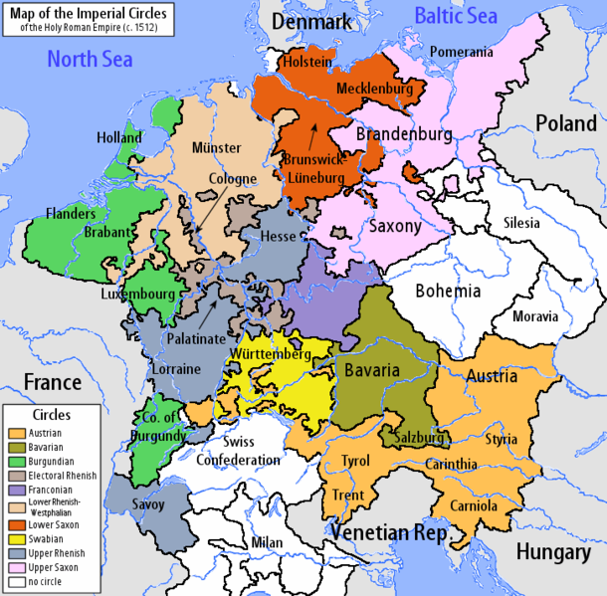

Slide 21
Maximilian I (1493-1519): He gained territory in eastern France via his marriage to Mary of Burgundy.
This sparked a fierce dynastic struggle between the French Valois dynasty and the Hapsburgs that would last until 1559.
Charles V (r. 1519-1556): most powerful ruler in 16th-century Europe
As Holy Roman Emperor, he controlled the Austrian Hapsburg lands while he ruled the Spanish Empire at the height of its power.

Slide 22
