Slide 1
Nationalism and Unification
Germany, Italy, and Austria-Hungary in the 1800s

Slide 2
Reasons for Nationalism and Unification
In the 1830s and in 1848 there had been a series of revolutions that occurred around Europe.
These revolutions had liberal aims that sought to change the long standing conservative policies adopted by many European Government following the defeat of Napoleon in 1815.
The revolutions of the 1830s and 1848 largely failed; however, their ideas would ultimately give rise to nationalistic and unification movements across central and southern Europe.
Nations also began to believe that they could benefit more from acting better independently from each other rather than collectively.
This is what know as nationalism
The Industrial Revolution and eventually imperialism fed into this idea

Slide 3
Italian Unification
After collapse of the Revolutions of 1848-49, the unification movement in Italy shifted to Sardinia-Piedmont region under King Victor Emmanuel, Count Cavour and Garibaldi.
Count Camillo Benso di Cavour (1810-1861) of Sardinia-Piedmont led the struggle for Italian unification.
He served as King Victor Emmanuel’s prime minister between 1852 and 1861.
He guided Sardinia-Piedmont into a liberal and economically viable state.
Molded after the French constitution of 1830
Cavour sought unity for the northern and central areas of Italy.
Obtained through war with Austria and negotiations with Napoleon III

Slide 4
Giuseppe Garibaldi (1807-1882) liberated southern Italy and Sicily.
In May 1860, Garibaldi and his thousand Red Shirts landed in Sicily and extended the nationalist activity to southern Italy.
By September, Garibaldi took control of Naples and the Kingdom of the Two Sicilies.
Although Cavour distrusted Garibaldi, Victor Emmanuel II encouraged Garibaldi’s exploits in the south of Italy.
Garibaldi thus allowed his conquests to be absorbed into Sardinia-Piedmont
In February 1861, Victor Emmanuel was declared King of Italy and presided over an Italian Parliament which represented all of Italy except for Rome and Venice
Venice was added in 1866 and Rome in 1871 (Remember the Pope still ad strong influence over Rome

Slide 5
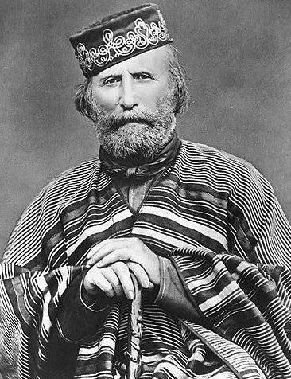
Camillo Cavour
Giuseppe Garibaldi

Slide 6
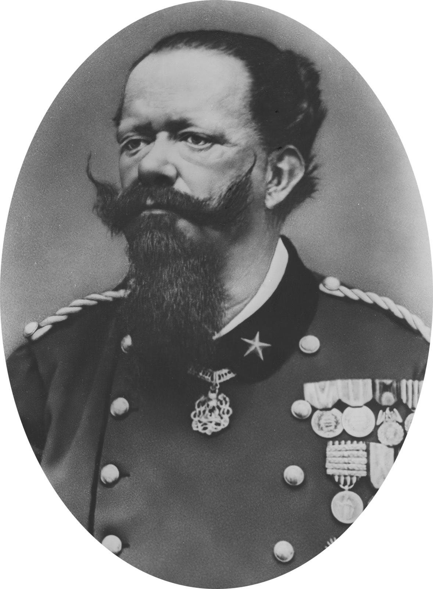
King Victor Emanuel II
First king of a unified Italian State

Slide 7
German Unification
German unification was primarily orchestrated by the Hohenzollern family (Dukes of Prussia)
“Kleindeutsch plan": The idea for a unified Germany without Austria was seen as the most practicable means of unification among various German states, particularly Prussia.
Otto von Bismarck (1810-1898) led the drive for a Prussian-based Hohenzollern Germany.
Junker (noble) background; obsessed with power
"Gap theory" gained Bismarck's favor with the king.
The idea that when Parliament and the Monarch cannot agree then the Monarch has the right to do as it sees fit.
Since the king had granted the constitution, Bismarck insisted he ignore liberals (middle class) in the legislature and follow his own judgment.
“The great questions of the day will not be decided by speeches and resolutions—that was the blunder of 1848 and 1849—but by blood and iron.”

Slide 8
Between 1863 and 1866 Germany fought two wars with Denmark and Austria in order to gain territory
Much of Germany was unified after the1866 defeat of Austria
In 1867, the North German Confederation was established by Bismarck with Kaiser (emperor) Wilhelm I as president.
It included all the German states except Baden, Wurttemberg, Bavaria, and Saxony.
The parliament (Reichstag) consisted of two houses that shared power equally.
The upper house (bundesrat) included representatives from each state.
The lower house (bundestag) had representatives elected by universal male suffrage

Slide 9
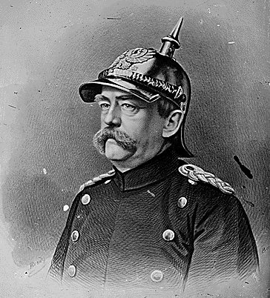
Otto von Bismarck
Kaiser Wilhelm I

Slide 10
Franco-Prussian War (1870-1871)
Bismarck sought to provoke a war with France in order to further unify Germany and annex Alsace and Lorraine. (two boarder regions)
Thus, Bismarck boasted that a French diplomat had been kicked out of Germany
An infuriated France declared war against Germany.
Bismarck used the war with France to bring the four remaining southern German states into the North German Confederation
Paris fell to the Germans in January, 1871: Napoleon III was captured.
Treaty of Frankfurt (May 1871): Alsace and Lorraine were ceded to Germany.
The German Empire was proclaimed on January 18, 1871 (Germany was now the most powerful nation in Europe).
This begins a long lasting animosity between the French and Germans

Slide 11
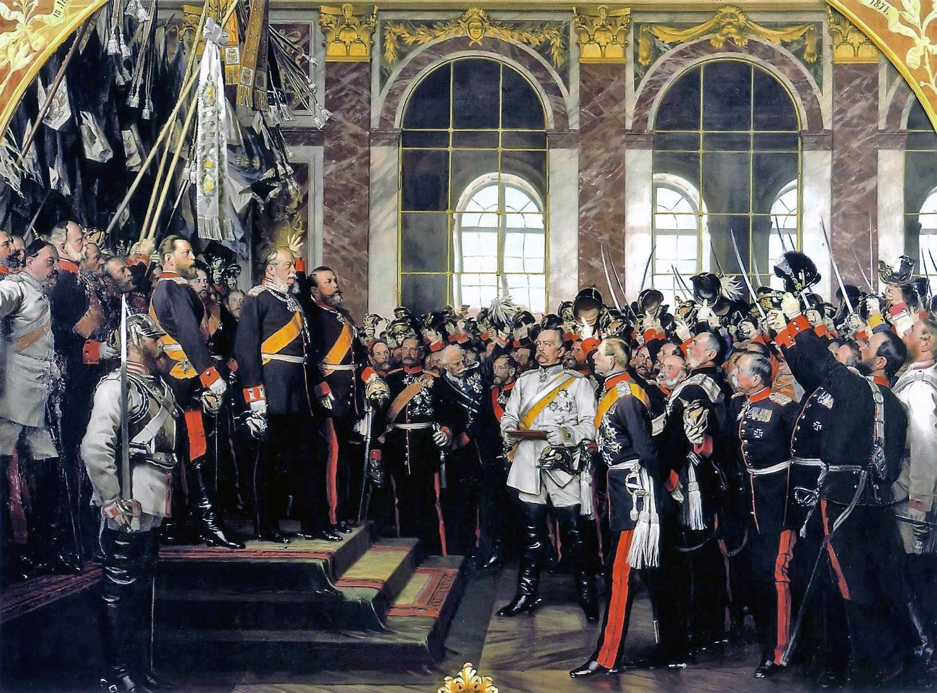
The third version of the proclamation of Prussian king Wilhelm I as German Emperor at Versailles, by Anton von Werner. Wilhelm I is on the risers center and Otto von Bismarck is below in white.

Slide 12
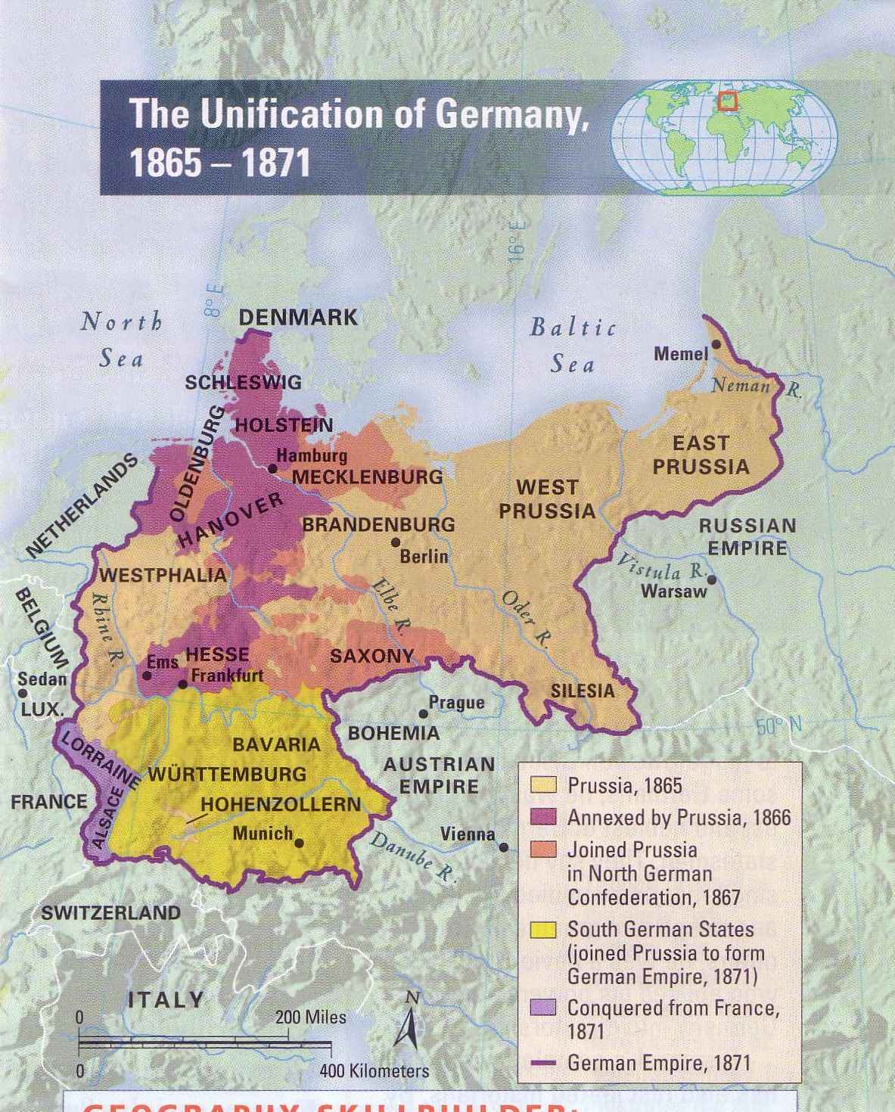

Slide 13
The Austro-Hungarian Empire
Austria’s defeat by Germany in 1866 weakened its grip on power and forced it to make a compromise and establish the so-called dual monarchy.
Ausgleich (or Compromise), 1867
Officially created the Austro-Hungarian Empire
Hungarians now had their own assembly, cabinet, and administrative system, and would support and participate with Austria in the Imperial army and in the Imperial gov’t.
Results
Austria assimilated the Hungarians (Magyars) and nullified them as a primary opposition group.
It also led to more efficient gov’t.
Along with the German Empire the Austro-Hungarian Empire created a large power block in central Europe. This would have dire consequences in 1914.

