Slide 1
Nationalism and Imperialism

Slide 2
The Periphery of Western Europe
Nationalism: the belief that nations will benefit by acting independently rather than collectively
Two faces of nationalism
Positive: Empowers masses of nation
Negative: Leads to conflicts such as World War I
Nationalism led to wars of unification and willingness to control affairs of others to benefit the “nation”

Slide 3
Italy and Germany
Neither unified before 1870
Culturally similar but politically separate
small states before 1870
Regional leaders sought unification to obtain national power
Italy had common language and borders, Germany not as well situated

Slide 4
Italy
Giuseppe Mazzini provide vision for Italy
Formed Young Italy in 1831
Camillo Cavour provided political power and alliances from Piedmont
Garibaldi added Kingdom of the Two Sicilies
Victor Emmanuel II leads unified Italy
Germany
Otto von Bismarck of Prussia unified Germany
Unification achieved by wars (“Blood & Iron”)
Defeated Austria (1866) and France (1871)
Southern German states voted to join

Slide 5
Quest for Empire: Western Europe
“Dual Revolutions"- political and industrial
Leads to a belief in superiority
Often carried racial overtones (Social Darwinism)
By 1914: 85% of earth’s surface controlled by Europe or nations of European ancestry

Slide 6
Great Britain
Greatest imperial power in the 1800s
Empire stretched from the Americas to Africa to Asia
India was the crown jewel
British taxes took money out of Indian economy for British home treasury
British tariffs harsh on Indian textiles
Trade rivals for Britain by early 1800s

Slide 8
British India 1858-1914
British defeat French for control of India, 1763
British East India Company administers the colony
(Joint-Stock Company)
Increased tax & manipulated tariffs
Indian economy structured for British benefit
1857- Sepoy Rebellion
Indian soldiers rebel
ends East India Company control (British crown takes direct control of India)

Slide 10
China 1800-1914
Manchus colonized
Internal problems from 1800
Population growth but no government response
Opium supplied by West to pay for goods
The Opium Wars- wars fought over the British importation of Opium from India to China
1839-42 war gains extraterritoriality for Britain (Hong Kong)
Refusal to grant diplomatic recognition leads to second war, 1856-60
Japan defeats China in 1894-5 war over Korea

Slide 11
The Boxer Rebellion, 1898-1900
Boxers were nationalists seeking to drive Europeans out of China
The western nations and Japan form a coalition (8 nations) army to put down the rebellion
Western victory results in more concessions from China to the West
Qing dynasty collapsed in 1911

Slide 12
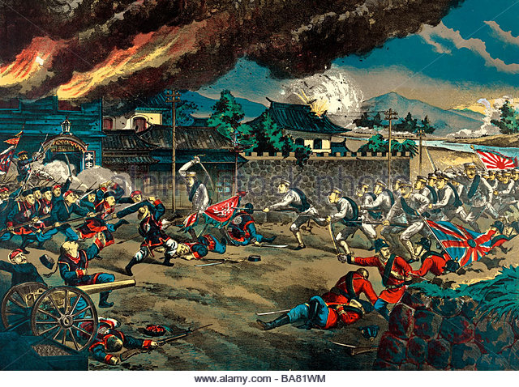

Slide 13
Scramble for Africa
1884-85 Berlin Conference
Europeans divide Africa amongst themselves
African resistance to European claims met with force

Slide 14
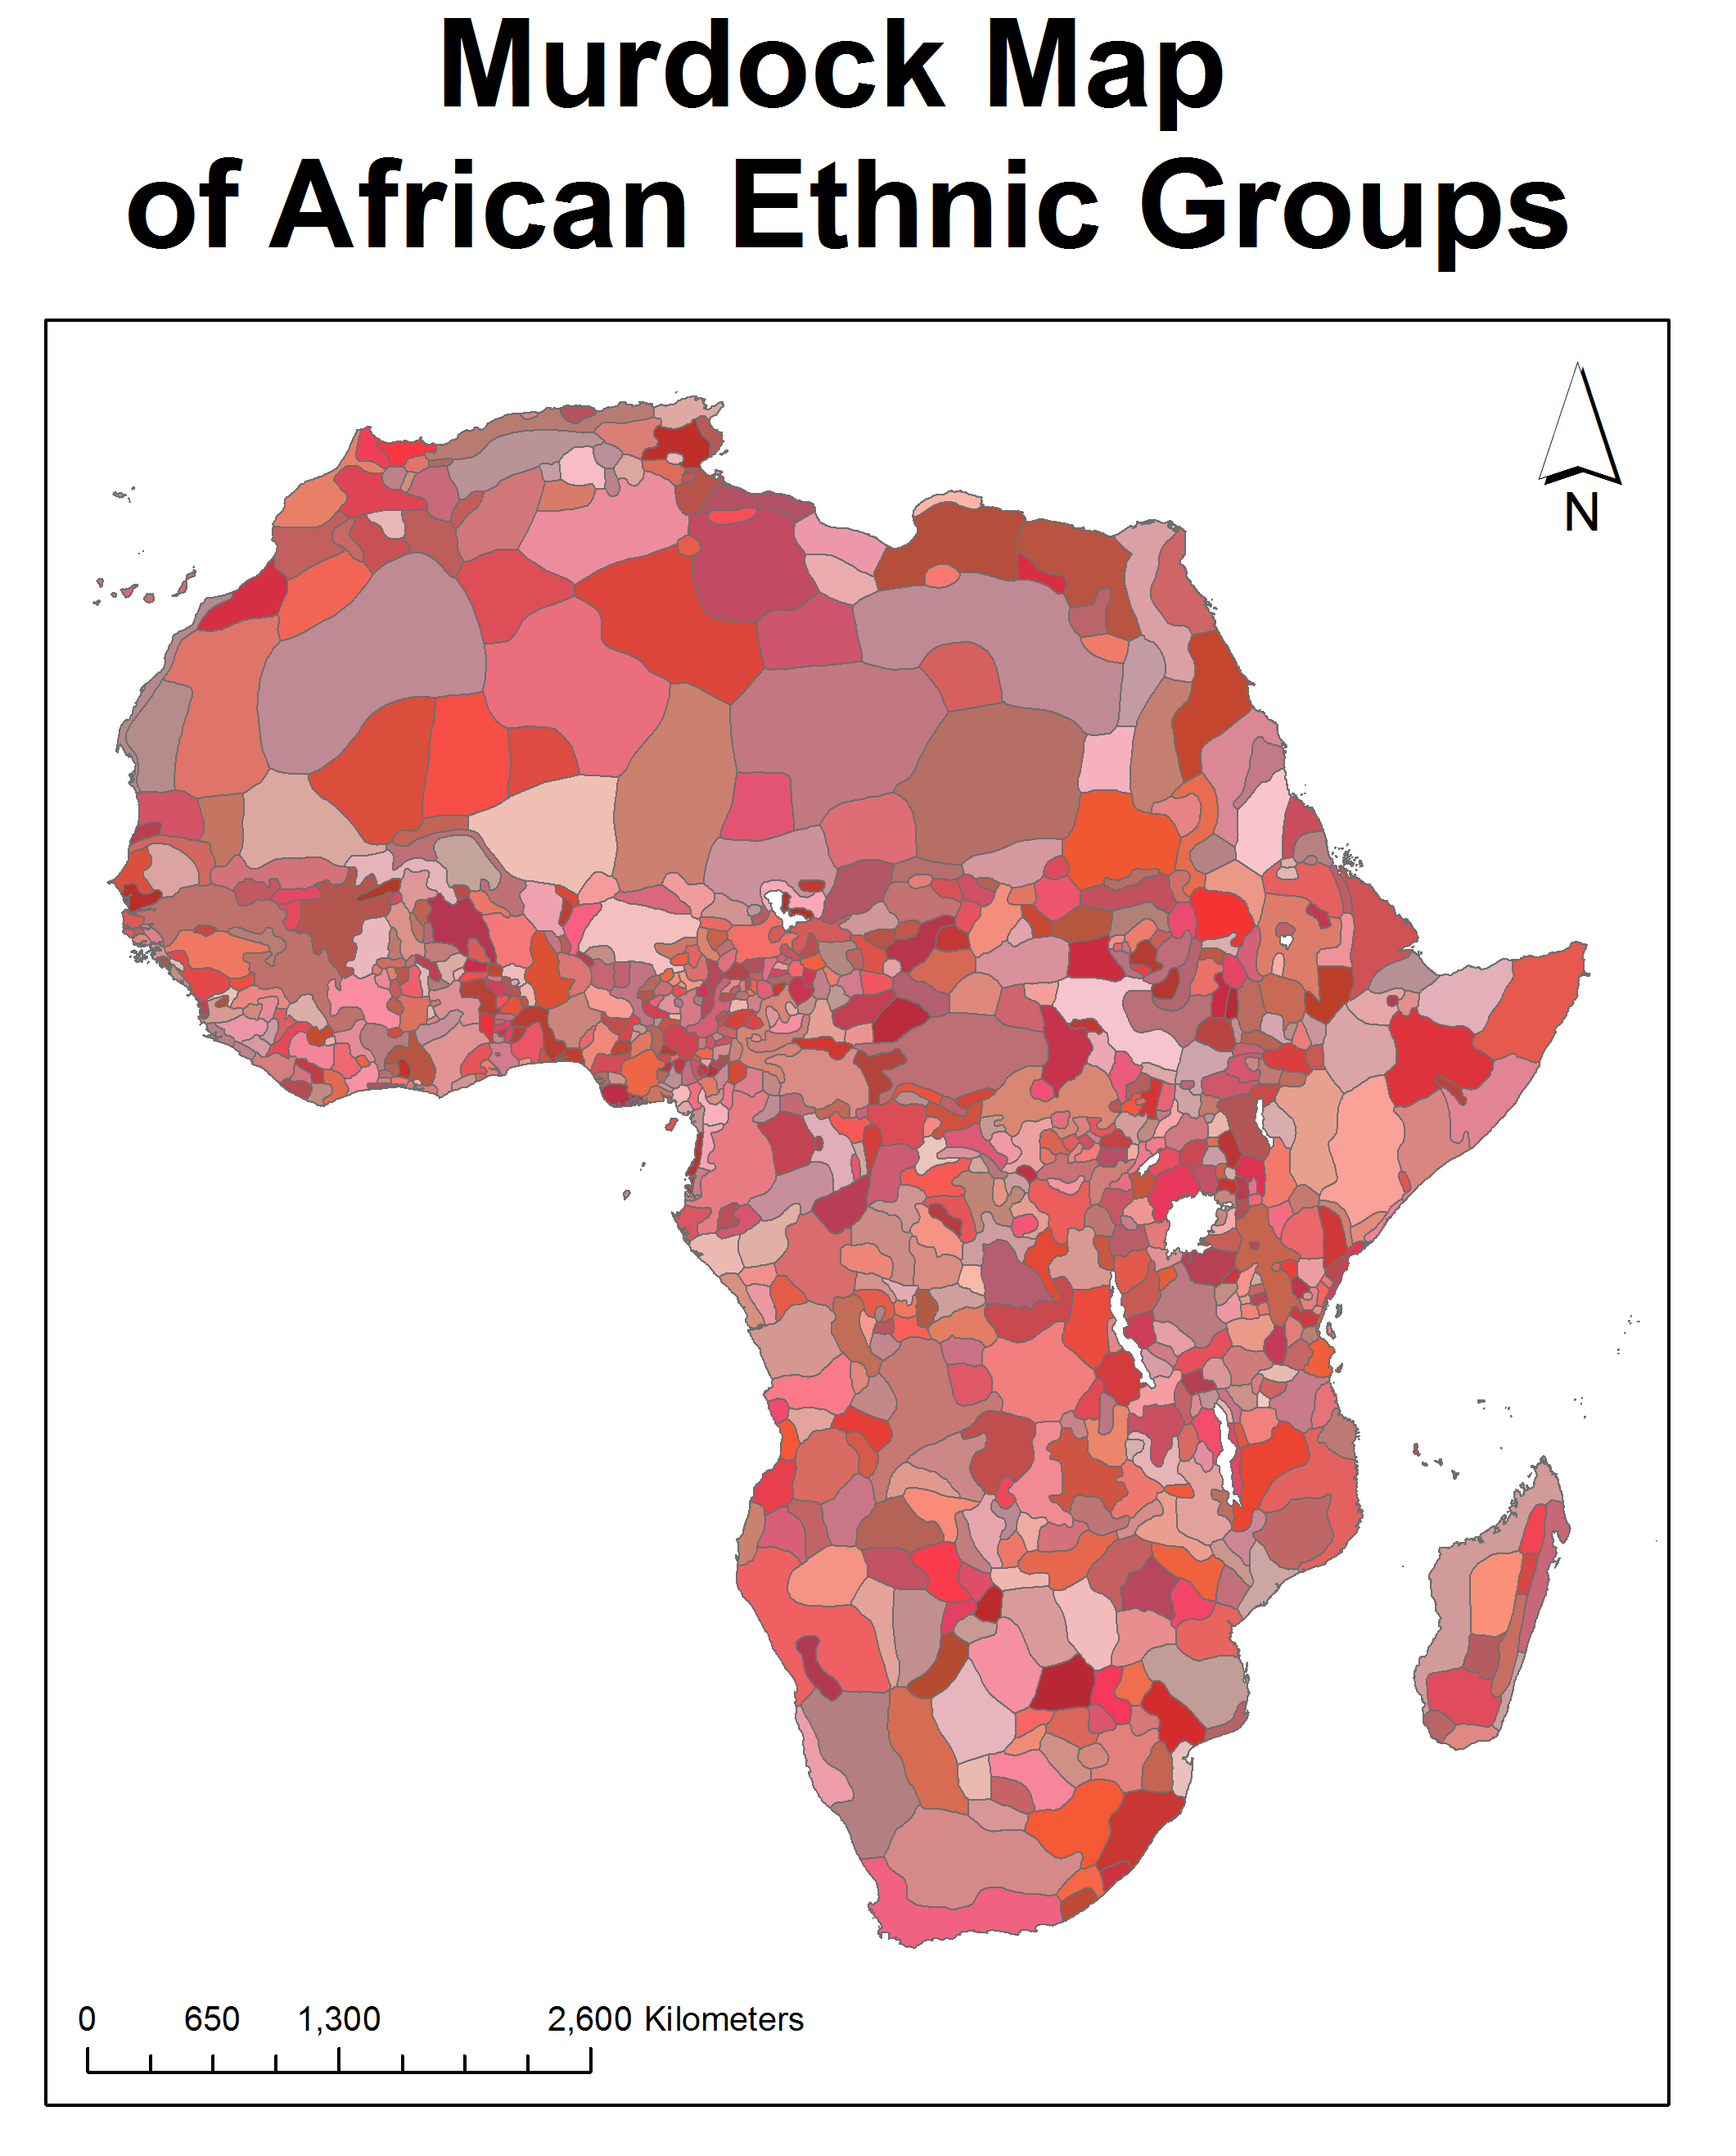

Slide 15
Impact of Imperialism and Challenges
Benefits- Jobs, Raw materials, Wealth
accompanied by resentment at discrimination
Colonials initially sought restoration of idealized, independent past
Later movements sought freedom within setting of modern institutions
Young Turks
African National Congress (South Africa)

