Slide 1
Nationalism and Decolonization
Since 1945

Slide 2
Nationalism and Decolonization
WWII ends in 1945
Victory in Europe (VE Day)- May
Victory in Japan (VJ Day)- August
Total war drained the resources of the European powers
Atlantic Charter of 1941
US & Great Britain
Recognized the right of all people to choose the form of government under which they lived
FDR & Soviets condemned colonization

Slide 3
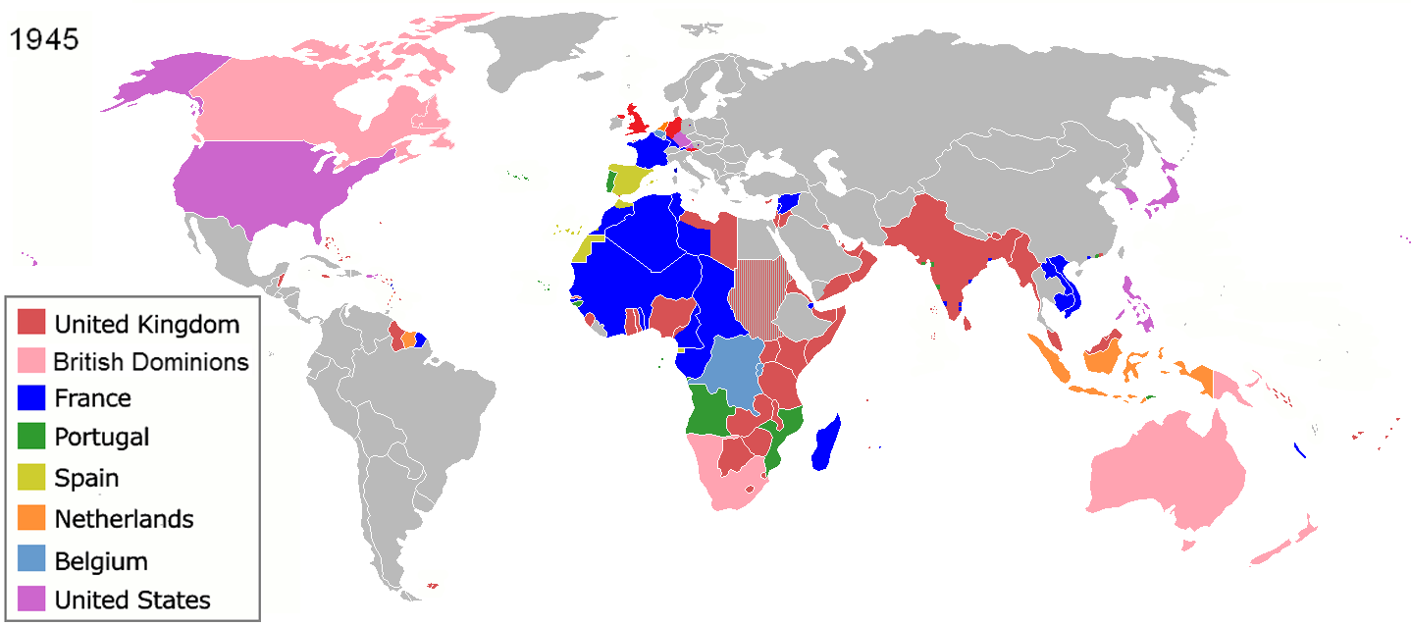
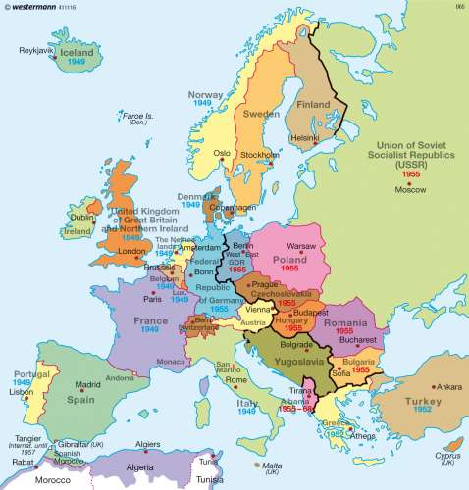
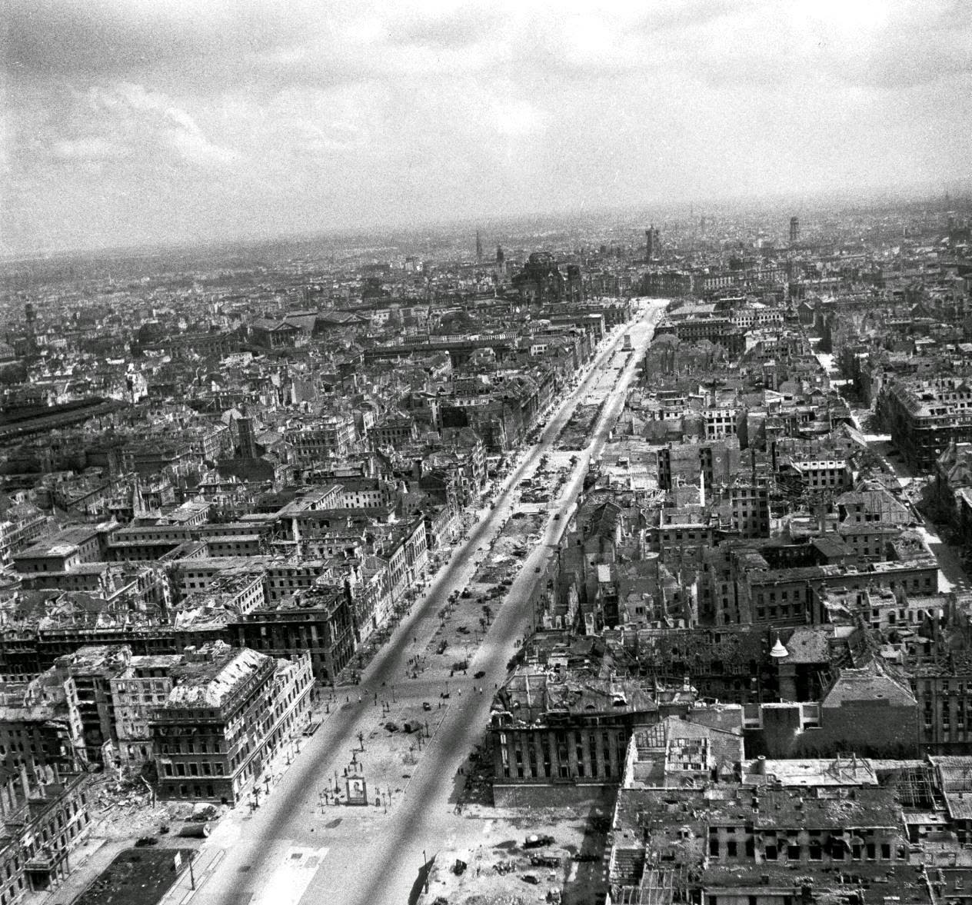
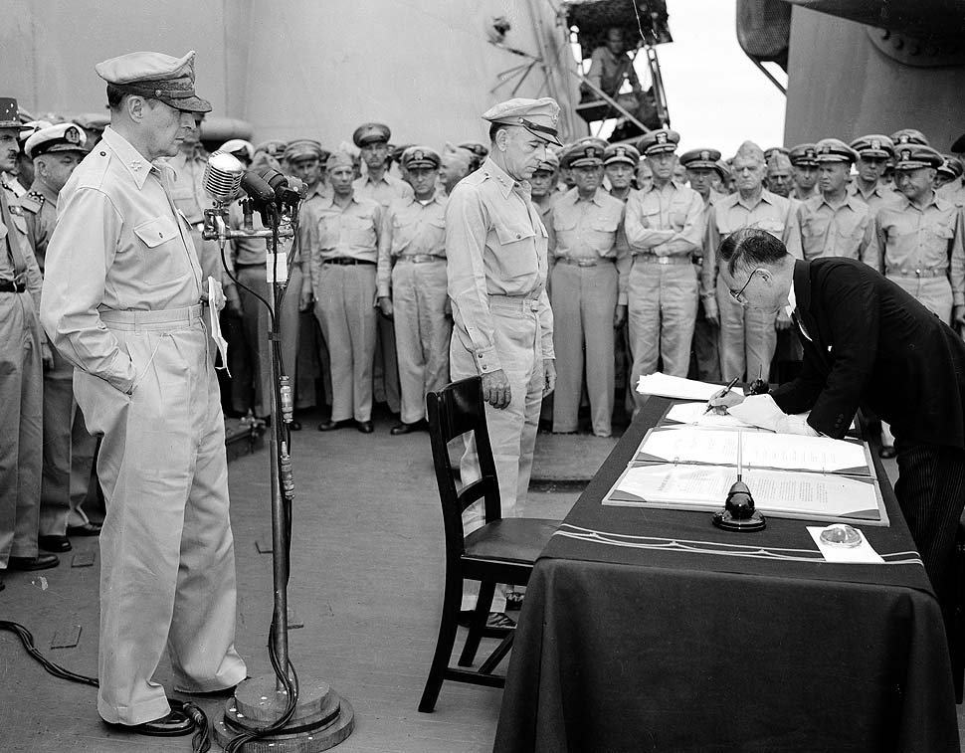
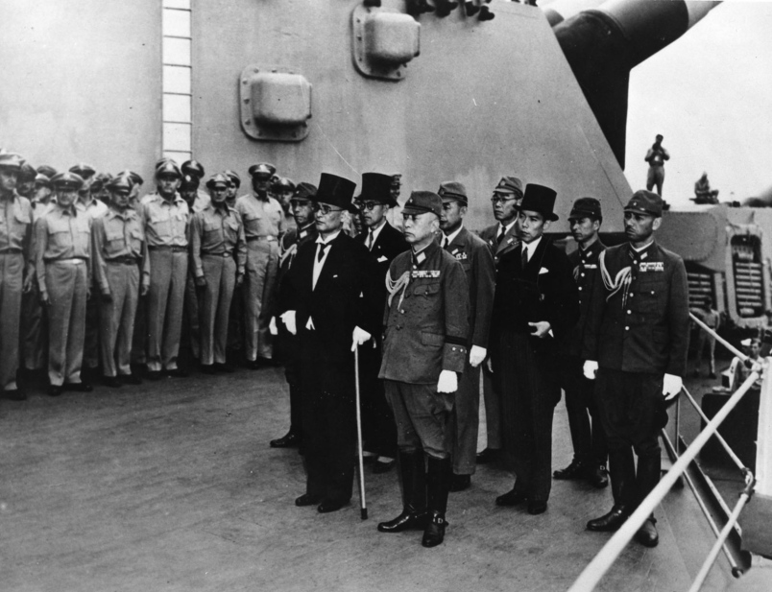
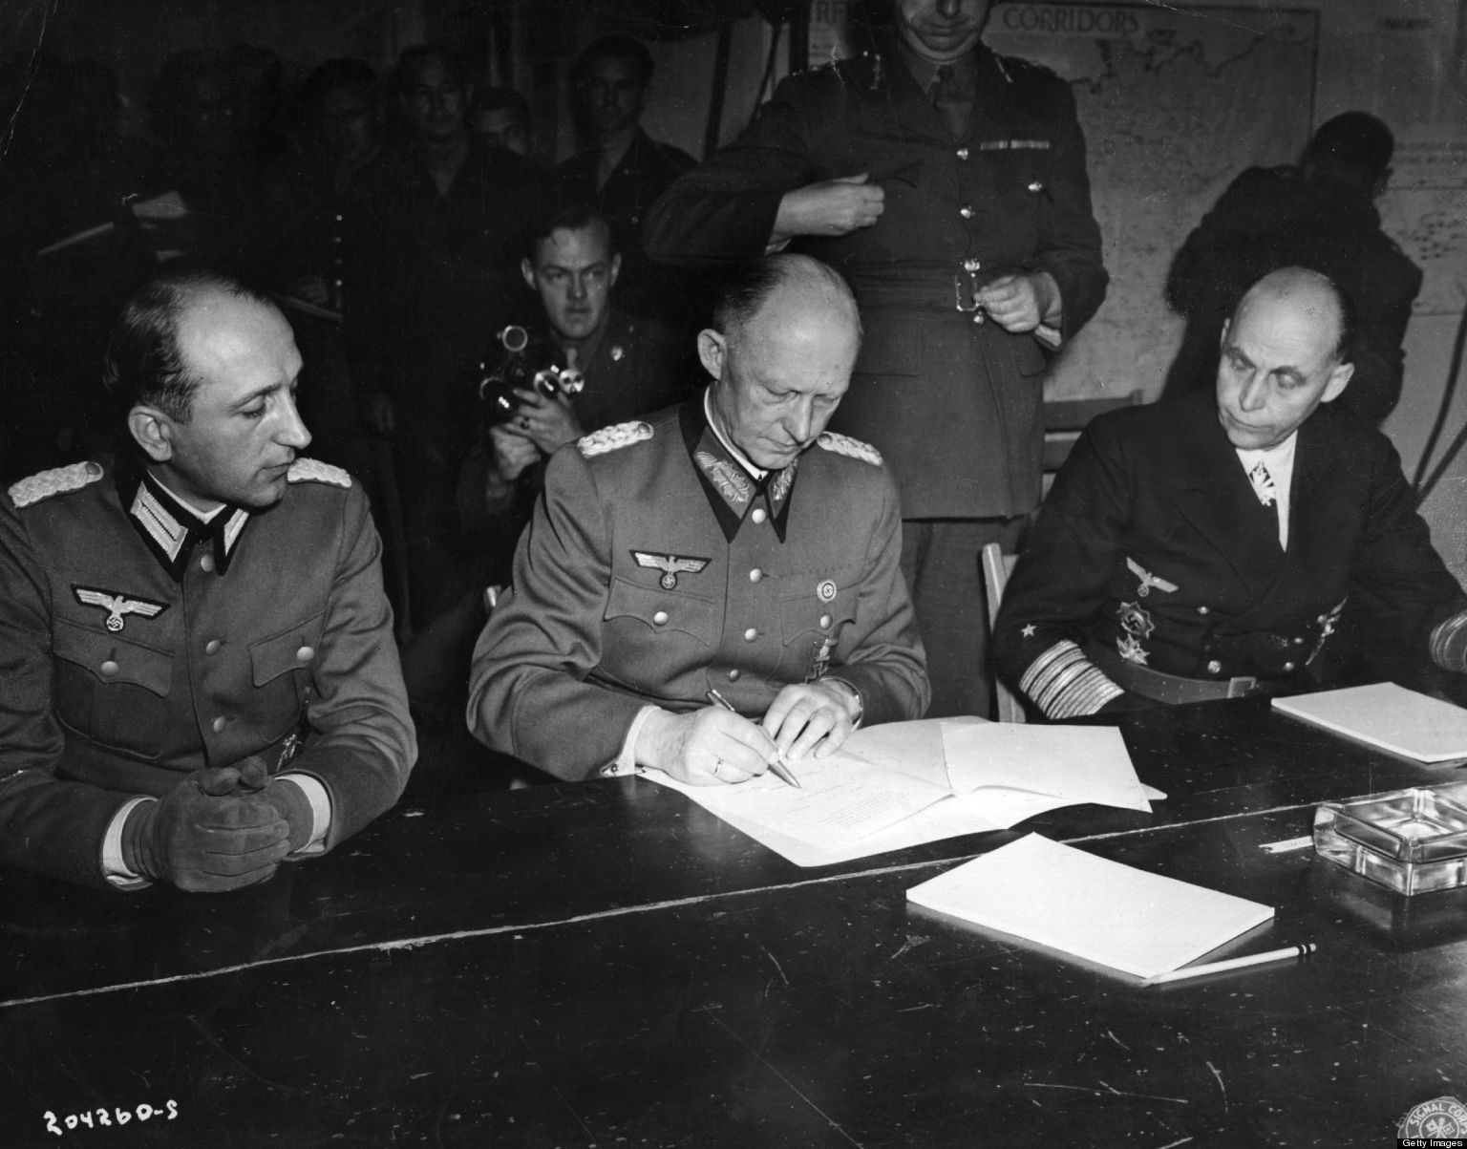
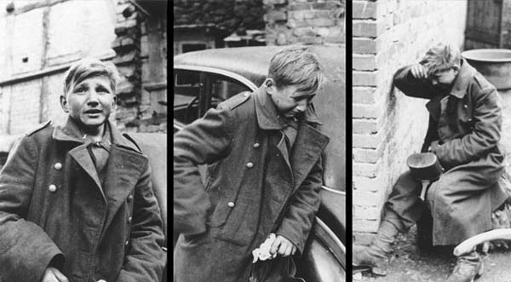

Slide 4
Independence in the South and SE Asia
Indian National Congress
Offered support to the Allies in exchange for independence
Rejected
Quiet Indian Movement
Mass civil disobedience movement to end British rule in India
British responded with mass arrests & repression
Gandhi, Nehru, and other Congress politicians were imprisoned
Independence is granted August 15, 1947
Split into India and Pakistan

Slide 5
Muslim League
Led by Muhammad Ali Jinnah
Rallied British support in WWII in exchange for a separate Muslim nation on the Indian sub-continent
Pakistan
Issues in India
Hindu-Muslim & Hindu-Sikh communal rioting turned into bloodbaths
Gandhi shot & killed
Burma (Myanmar) & Sri Lanka (Ceylon) gain independence
Philippines (1946 from the US) & Indonesia (1949 from the Netherlands) gain independence in SE Asia

Slide 6
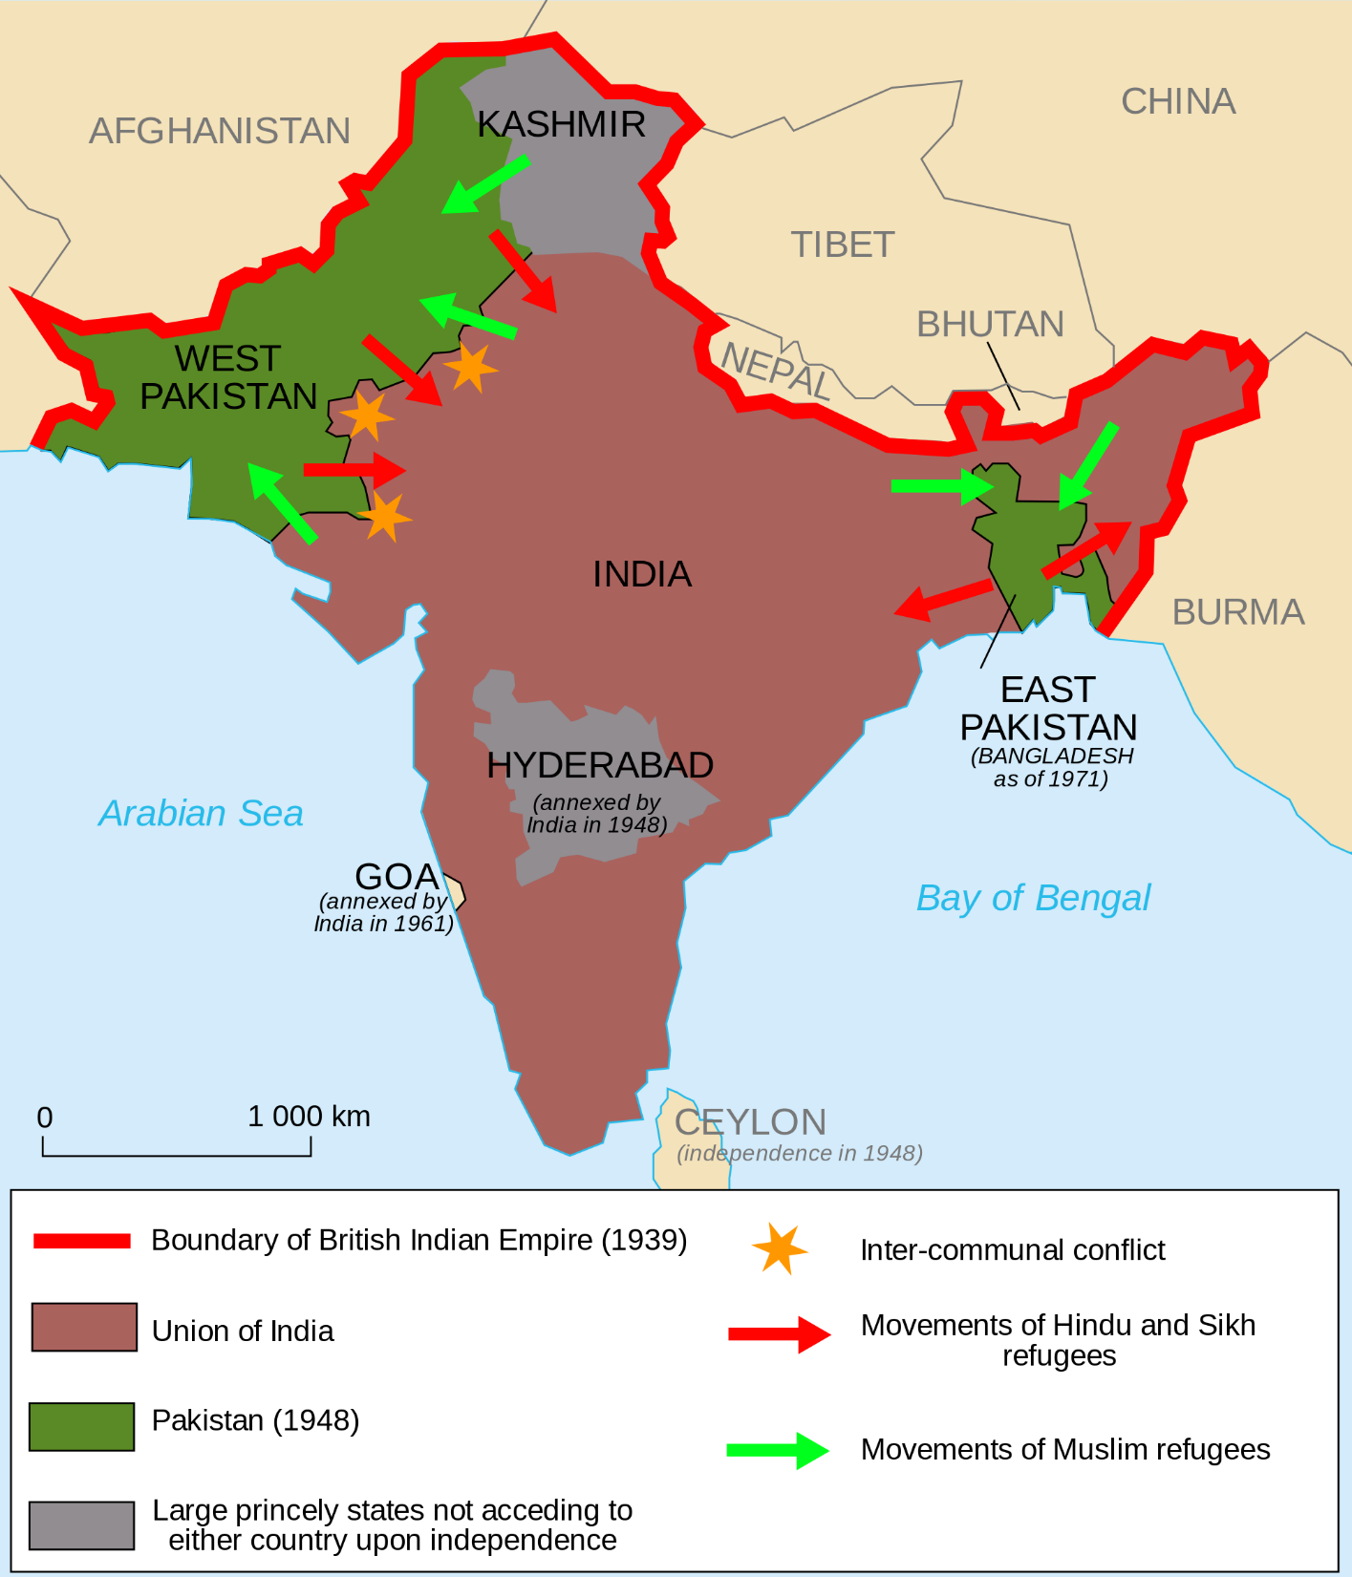
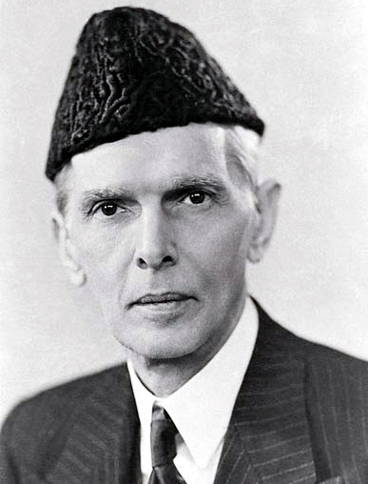

Slide 7
The Liberation of Non-settler Africa
Africa was impacted by WWII
Two main paths to decolonization in the postwar era
Radical
Kwame Nkrumah (Ghana)
Convention Peoples Party (CPP)
Organized strikes, boycotts, rallies, etc…
Ghana gains independence from the British in 1957

Slide 8
Peaceful
France
Negotiations for independence led by
Leopold Sedar Senghor (Senegal)
Felix Houphouet-Boigny (Ivory Coast)
Retained European economic and cultural ties
Belgium
Retreat (leave) from the Congo
Portugal
Retains colonies until the mid 1970s.
Once independent many of the form colonies will see bloody civil wars.

Slide 9
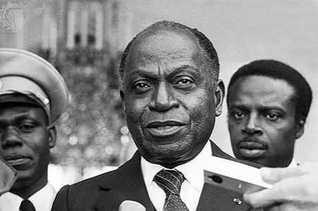
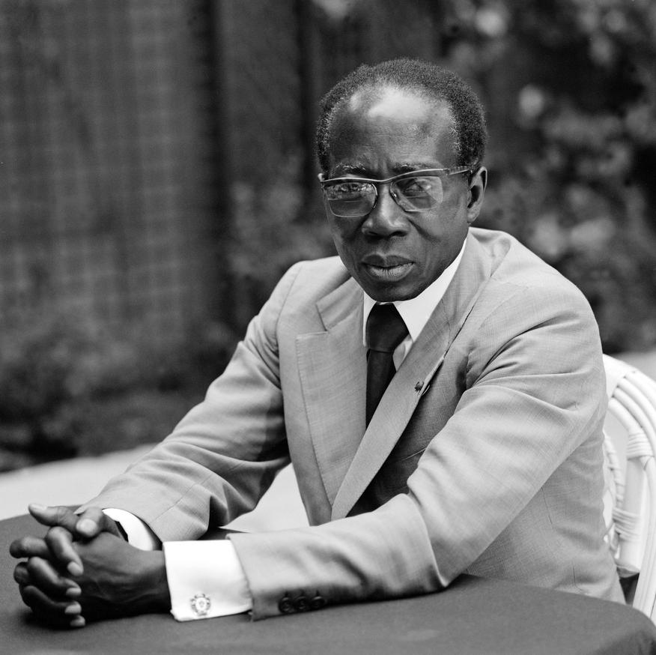

Slide 10
Repression and Guerrilla War: The Struggle for the Settler Colonies
Kenya (British)
Jomo Kenyatta
Promoted peaceful independence
Lead Kenya African Party (KAU)
Land Freedom Army
Radical
Used terror and guerilla warfare
Arrest Kenyatta
Gain independence in 1963
Kenyatta becomes president

Slide 12
Algeria (French)
Civil War
National Liberation Front (FLN)
Led by Arabs & Berbers
Violent
Secret Army Organization (OAS)
Algerian settlers
Favored France
Against Arabs & Berbers
Wins independence in 1962
FLN wins a political victory

Slide 13
Persistence of White Supremacy in South Africa
Angola & Mozambique
Revolution
Independence 1975
Southern Rhodesia (Zimbabwe)
Independence by 1980
South Africa
Only white minority to maintain its position of supremacy
Afrikaners (descendent of Dutch settlers)
White supremacist attitude
In control after Boer War (1899-1902)
Afrikaner National Party
Apartheid
A system of racial segregation.

Slide 14
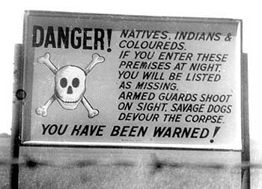
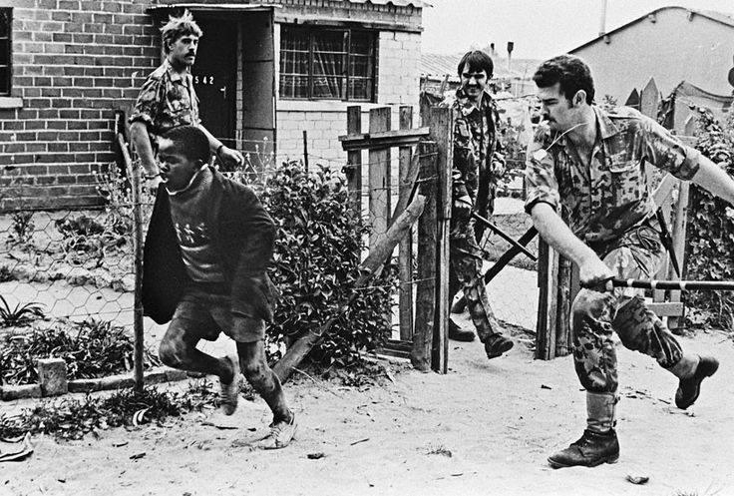
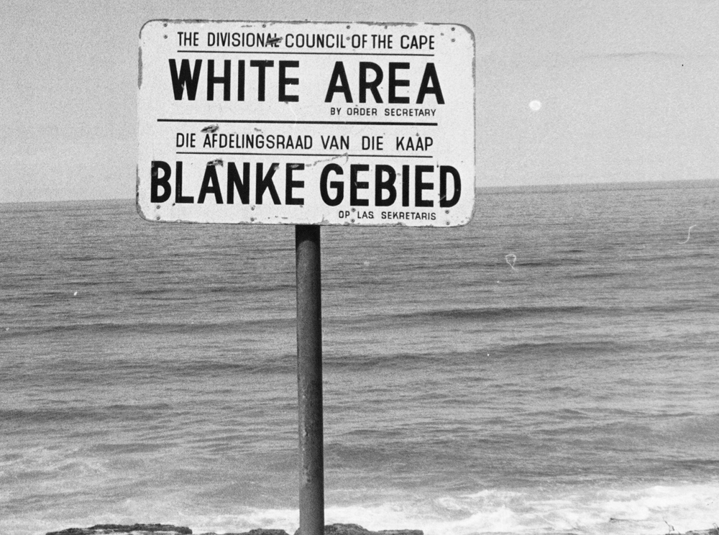

Slide 15
Conflicting Nationalisms: Arabs, Israelis, and the Palestine Question
Most Arab nations are independent by the 1960’s
Most governments not strong until the 70’s
Palestine
Zionist (the belief in a Jewish nation) movement gained sympathy due to the Holocaust
Muslim Revolt (1936-1939)
British placed restrictions on the entry of Jews due to Arab resistance

Slide 16
The UN partitions Palestine into Arab and Jewish countries
The two sides engage in warfare
Zionists have better arms and defend themselves and expanded into Arab territory.
The hostilities still remain today
Palestinian Liberation Organization-PLO- fights for Palestinian independence
Arab nations often go to war with Israel
Six Days War (1967), Yom Kippur War (1973)

