Slide 1
Ming Dynasty and Qing Dynasty

Slide 2
Founding of the Ming
Ming dynasty founded by Zhu Yuanzhang
Unique because he was born a peasant
Expels Mongols
Forces Mongols north of the Great Wall
Takes name Hongwu becomes the emperor in 1368

Slide 3
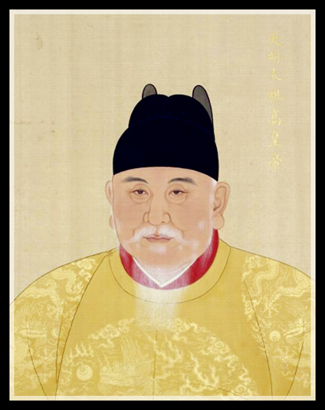
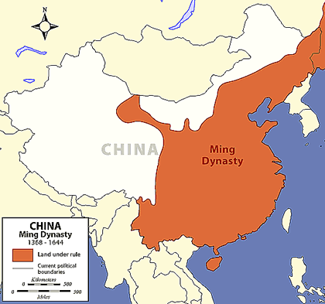

Slide 4
Restoration of the Old System
Under the Ming Dynasty and Hongwu the traditional scholarly gentry is restored to power.
The Chinese Confucian schools and examination system were restored as well.

Slide 5
Reforms
The power of the Emperor restored (not in the hands of nobles)
Honesty, loyalty, & discipline was expected from officials
Emperor’s wives were only allowed to come from modest families
off set power plays from high ranking families
Limited number of eunuchs to powerful positions
Built the Forbidden City

Slide 6
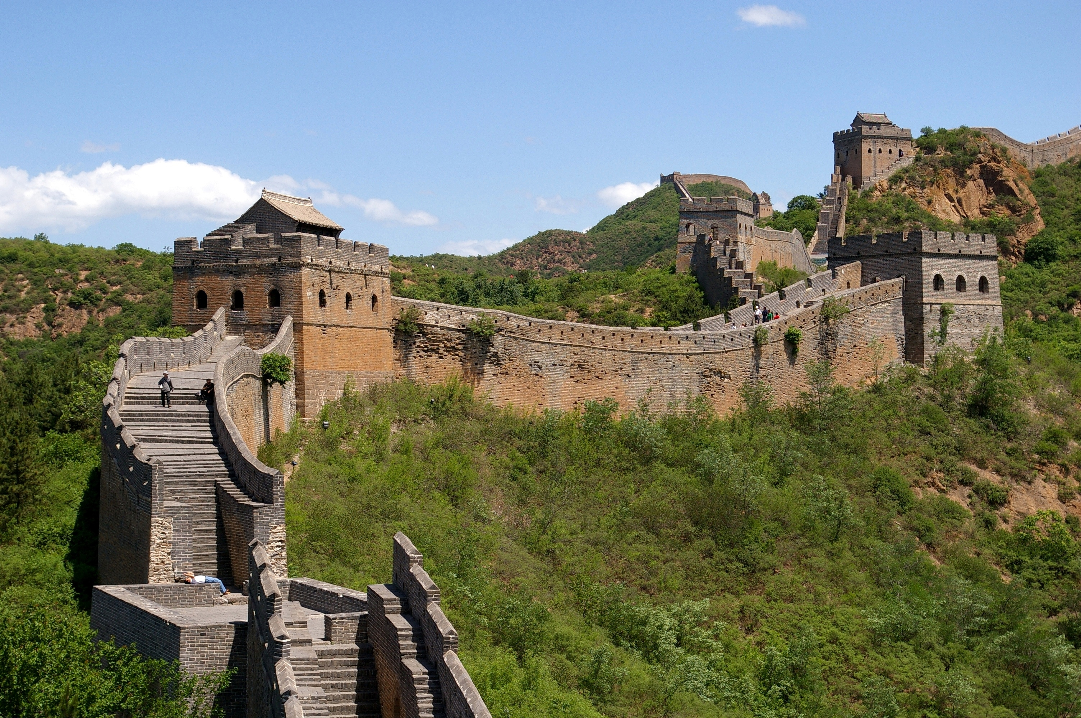
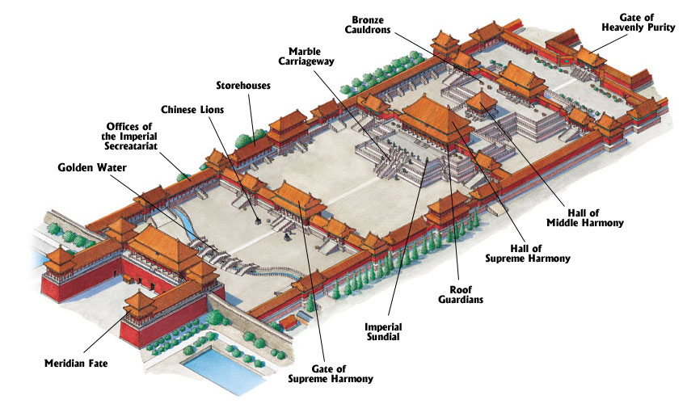
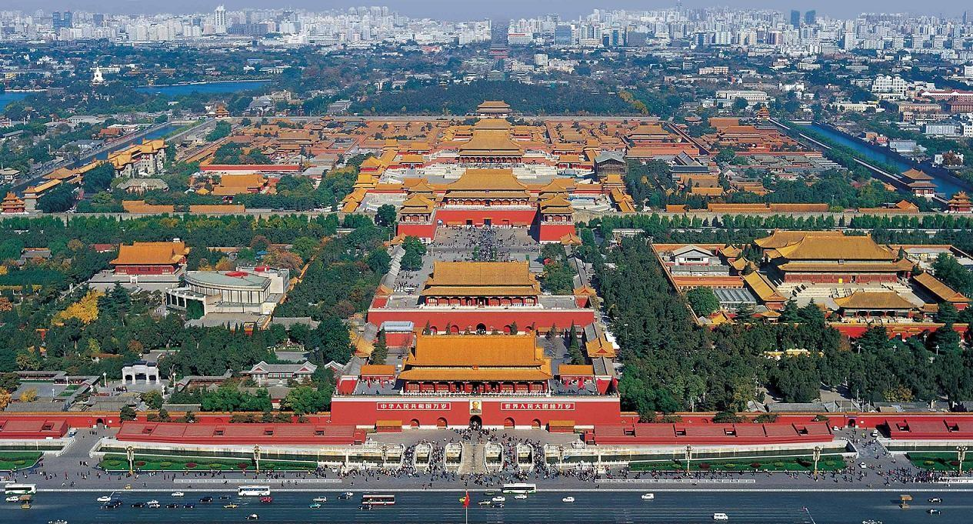
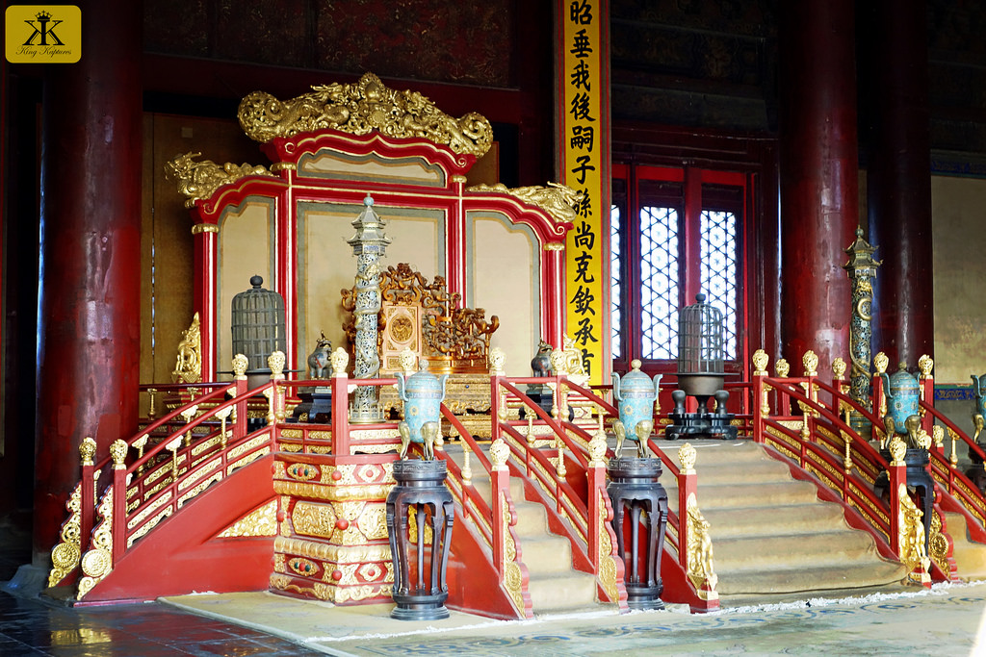

Slide 7
An Age of Growth
Importation of American crops = population growth
Population grew from 80-90 million to 300 million from 14th -17th centuries
Chinese manufactured goods in high demand
Ceramics, textiles, etc..
Macao & Canton only places Europeans were officially allowed

Slide 8
The Zheng He Expeditions
1405-1423
7 major overseas expeditions including:
Persia
Indian Coast
African Coast
Initial fleet contained 62 ships
Columbus only had 3 in 1492
Da Gama only had 4 in 1498
Chinese had the capacity to expand on a global scale at least a century before the Europeans
Expeditions end due to lack of funding and internal problems

Slide 9
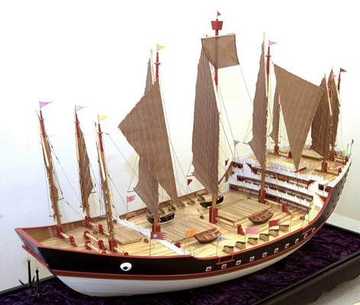
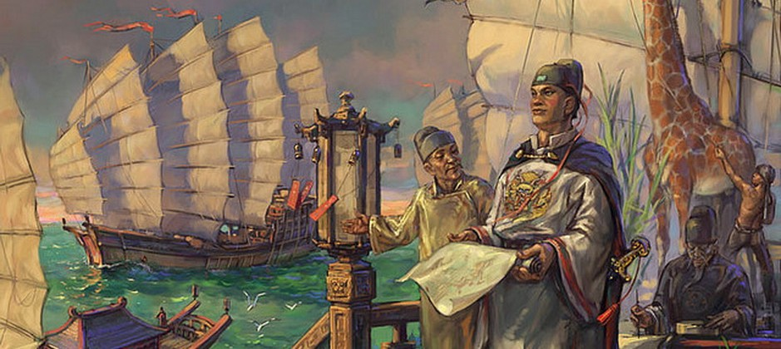

Slide 10
Arrival of the Europeans
The first European groups to arrive in China were merchants as well as Franciscans and Dominicans
The dominate group were the Jesuits
They try to recruit the elites by adopting Chinese customs and clothing.

Slide 11
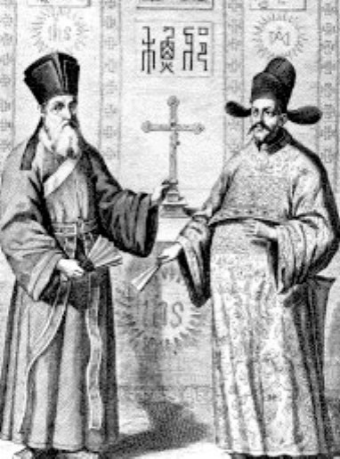

Slide 12
Ming Decline and Collapse
Later rulers incompetent
Public works projects fall into disrepair
Floods, droughts, & famine rage lands
Internal disorder leads to invasions
Last Ming emperor, Chongzhen, kills himself to avoid capture and the dynasty is overthrown in 1644

Slide 13
Qing Dynasty

Slide 14
Qing Politics
Manchus rule - not Han Chinese
2 % of the pop. = Manchu
Chinese were forbidden to hold high national offices.
Continued Confucian civil service system.
The Neo-Confucian - obedience of subject to ruler continued
Manchu Qing expansion
Outer Mongolia and into central Asia
Taiwan
Tibet.

Slide 15
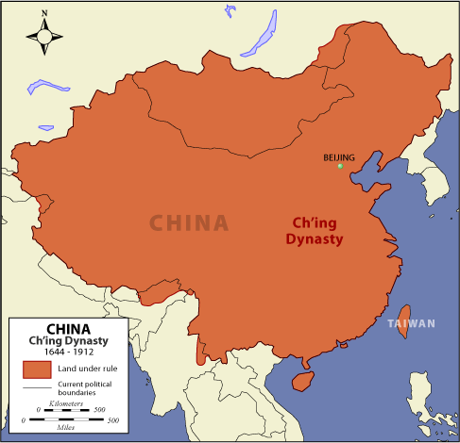

Slide 16
Economy
Built public buildings, public irrigation, walls, bridges and other infrastructure.
Light taxes
international trade grew
Japan and Europe
Exported porcelain, Silk, and spices through maritime trade and Silk Road

Slide 17
Society
Han Chinese discriminated against
Wear hair braided in the back
forbid women to bind their feet
repealed because couldn’t enforce it
Intermarriage between the two groups was forbidden.
system of dual appointments was used
the Chinese were required to do the substantive work and the Manchu to ensure loyalty

Slide 18
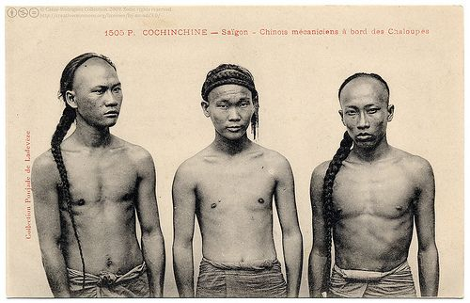

Slide 19
