Slide 1
Ming Dynasty
1368-1644

Slide 2
Founding of the Ming
Ming dynasty founded by Zhu Yuanzhang
Originally a peasant
Expels Mongols as leader of the rebel group called the Red Turbans
Takes name Hongwu become emperor in 1368
Force Mongols north of the Great Wall

Slide 3
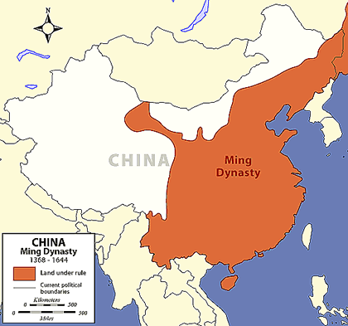

Slide 4
Another Scholarly-Gentry Revival
Hongwu, like the Han, restores scholarly gentry to high offices
Imperial schools and examination system restored

Slide 5
Reforms
transferred powers of the chief minister to the emperor
Honesty, loyalty, & discipline was expected from officials
Bureaucrats guilty of corruption or incompetence were publically beaten
Emperor’s wives were only allowed to come from modest families
off set power plays from high ranking families
Limited number of eunuchs to powerful positions

Slide 6
A Return to Scholarly-Gentry Social Dominance
promoted public works and aimed to improve lives of the common people
Gentry households grew in power as landlord families buy up peasants land
Women were confined & bearing male children was stressed
Youth subordinate to elders

Slide 7
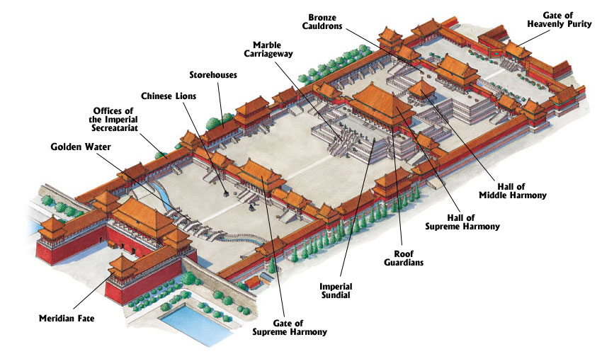
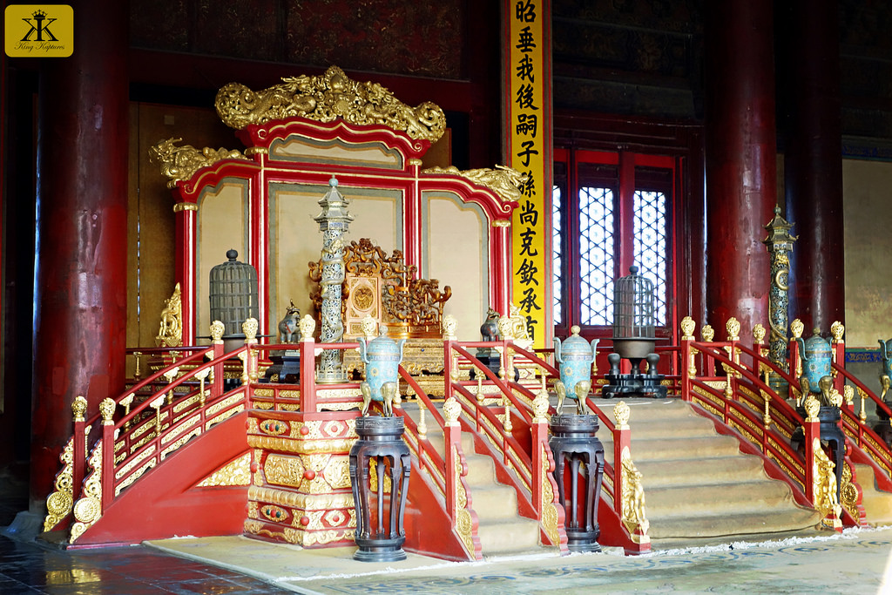
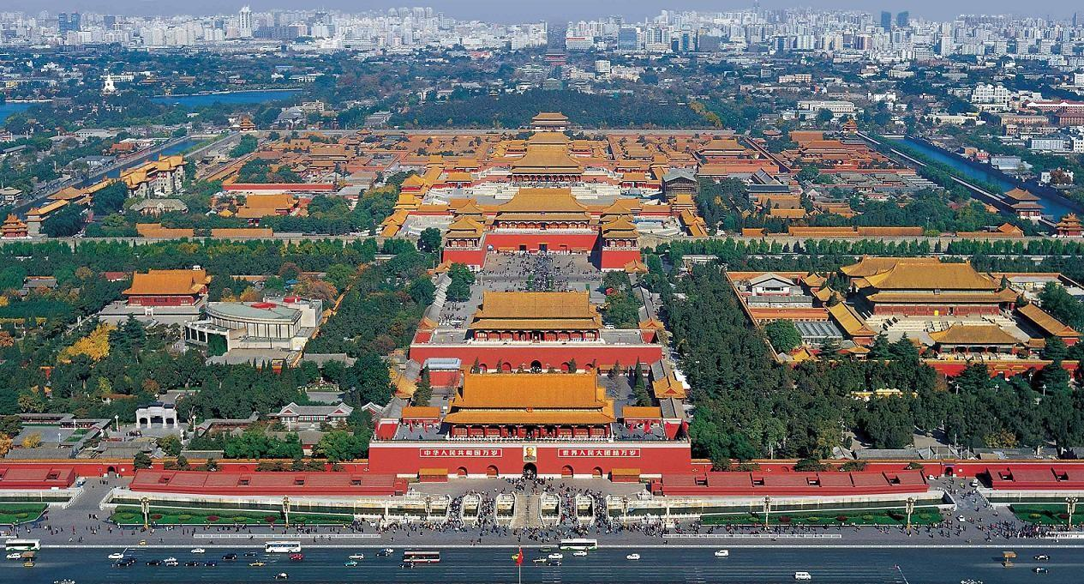

Slide 8
An Age of Growth
Importation of American crops = population growth
Population grew from 80-90 million to 300 million from 14th -17th centuries
Chinese manufactured goods in high demand
Ceramics, textiles, etc..
Macao & Canton only places Europeans were officially allowed
Ming prosperity was reflected in the fine arts
Innovations in literature
Woodblock printing
Many high class individuals continued the practice of foot binding.

Slide 9
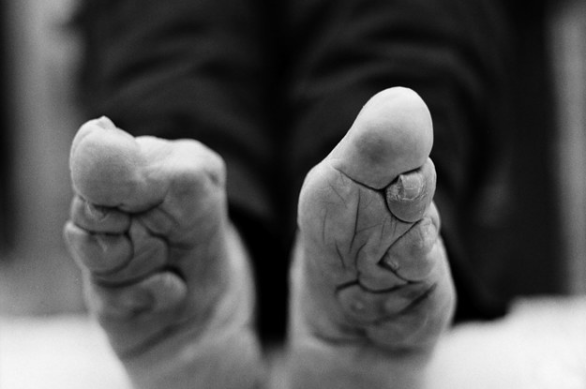
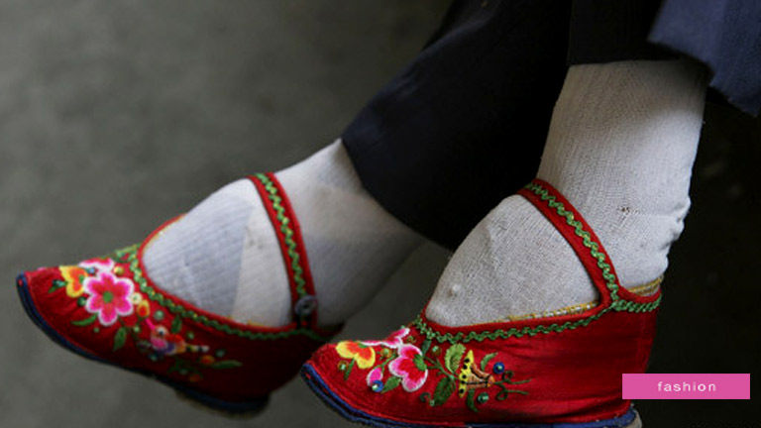
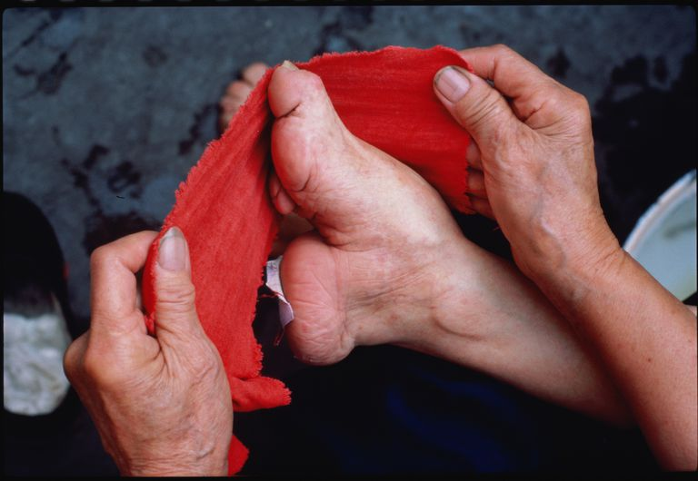

Slide 10
An Age of Expansion: The Zheng He Expeditions
1405-1423
7 major overseas expeditions including:
Persia
Indian Coast
African Coast
Initial fleet contained 62 ships
Columbus only had 3 in 1492
Da Gama only had 4 in 1498
Chinese had the capacity to expand on a global scale at least a century before the Europeans

Slide 11
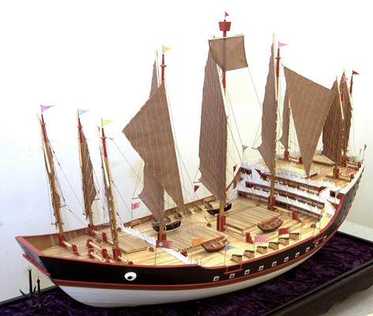
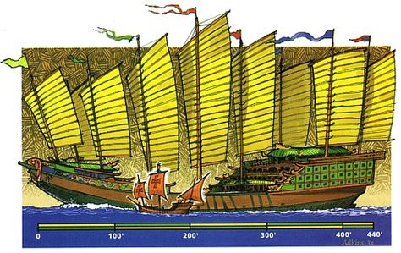

Slide 12
Chinese Retreat and the Arrival of the Europeans
Overseas trade limited in 1390
Ming China moves toward isolationism
Europeans probe the globe
Drawn to the Middle Kingdom
Franciscans and Dominican missionaries try to convert commoners
Jesuits try and convert elites

Slide 14
Ming Decline and the Chinese Predicament
Later rulers incompetent in holding a highly centralized, absolutist structure
Floods, droughts, & famine rage lands
Some sell children into slaver
Imjin War (1592-1598): war between China, Korea, and Japan.
Precipitates the decline of the Ming
Last Ming emperor, Chongzhen, kills himself to avoid capture and the dynasty is overthrown in 1644

Slide 15
Manchu Invasions
In the summer of 1644 the Manchus invaded China and established a new Dynasty called the Qing.
The Manchus were from northeastern China (a regions known as Manchuria)
Took the Manchu 40 years to conquer all of China, Taiwan, parts of Mongolia, and Central Asia

