Slide 1
Classical Mediterranean Societies

Slide 2
Phoenicians (900- 202 BCE)
Located in modern day Lebanon
Around 900 BCE they began to move westward across the Med.
Greeks called them “red men”
Known for creating a red-purple dye from glands of a snail
Major trade networks
Established colonies throughout the Med.
Ex. Carthage
Legacy:
Alphabet: (Phonetic)
Consisted on 22 consonants
No pictorial symbols
Depicted only sounds
Ancestor of the Roman alphabet

Slide 3
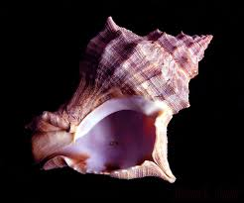

Slide 4
Persia
Empire was founded in the Middle East (Modern day Iran)
Cyrus the Great​
Established the large Persian Empire​
Influenced by earlier Mesopotamian society​
Religion
Zoroastrianism – pre-Islamic monotheistic religion​
Eventually conquered by Alexander the Great of Macedon

Slide 5
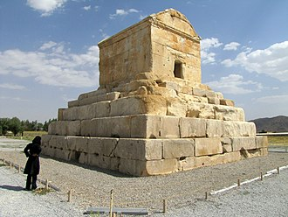

Slide 6
Minoan Civilization (2000 BCE -1500 BCE)
Located on the island of Crete
Ends abruptly due to invasion or natural disaster
Politics:
Ruled by a king (monarchy)
Legendary king Minos is the most famous Minoan king
The civilization was named after him
Economics:
Fishing, agriculture
Extensive trade network through the Med. (pottery found throughout the Med)
Traded with the early Greeks and Egyptians.

Slide 7
Minoan continued
Culture:
Built roads, temples, and lavish palaces
Bronze metallurgy
Writing system called Linear A (not deciphered)
Polytheistic: worshiped the fertility goddess (snake/ fertility goddess may be origin on Medusa)
Society:
Typical Social Hierarchy of ruler, nobles, rich, traders, peasants, women and slaves
Women regarded as important; given more freedom than many other early civilizations

Slide 8
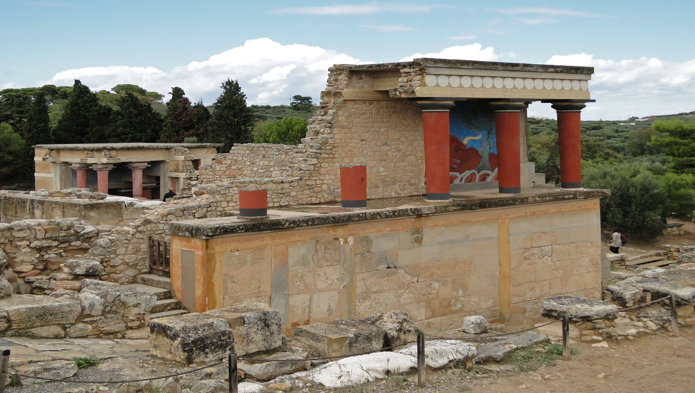
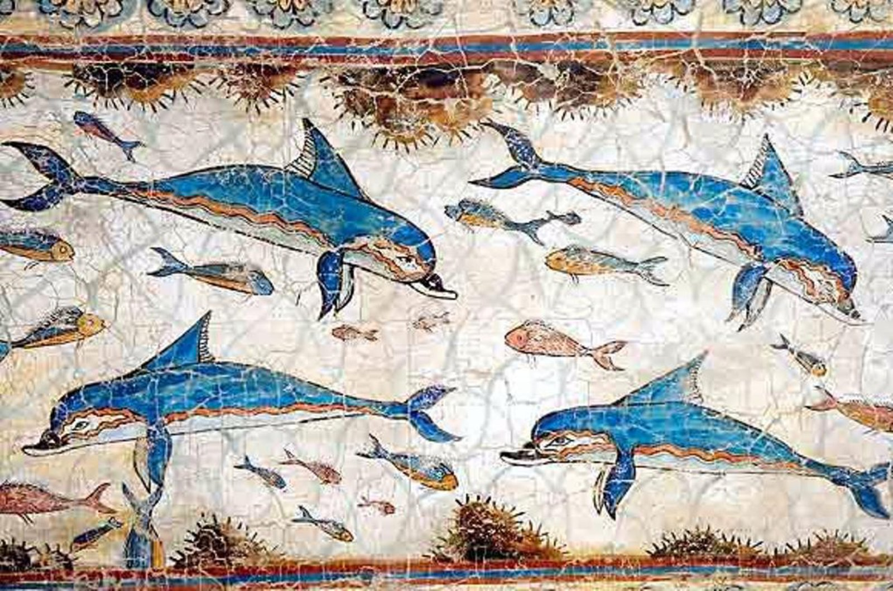
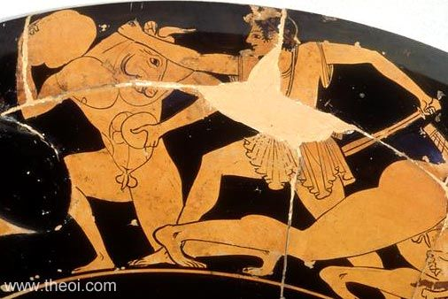
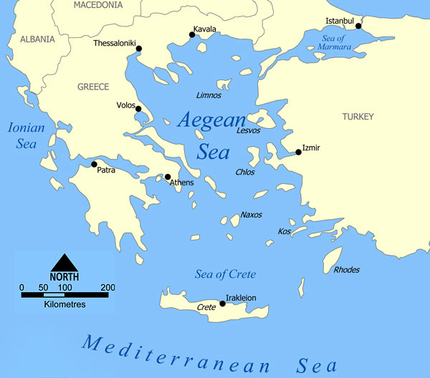
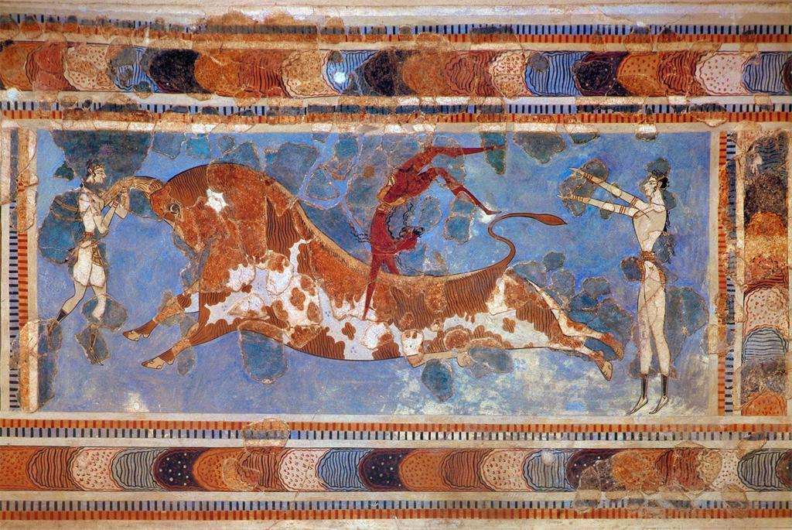
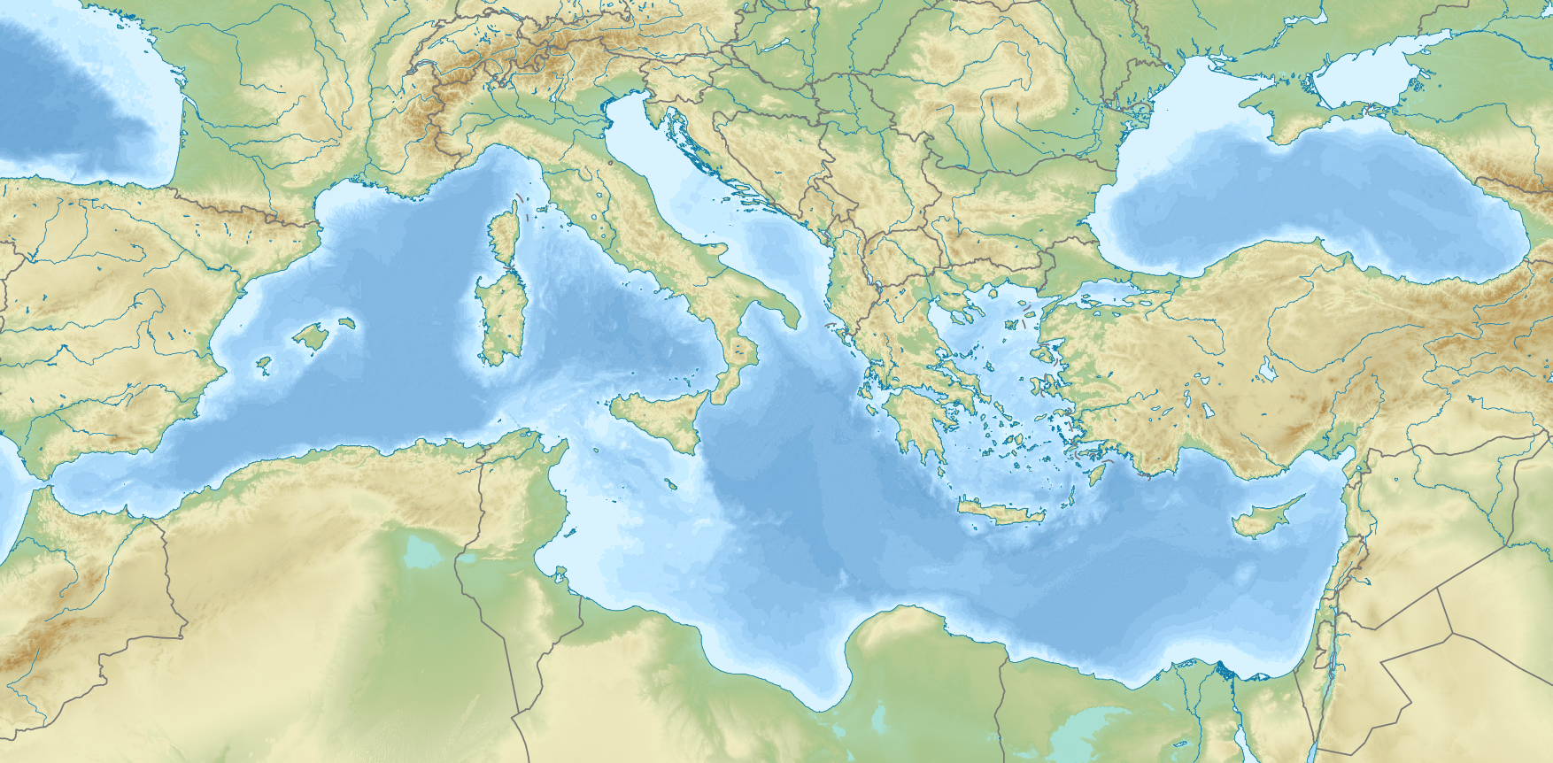

Slide 9
Mycenaeans
Earliest civilization based on mainland Greece
Politics -
Warlike
absolutist kings over various city states
conquered Minoans.
Colonized along Persian coast
Economy – sailors, farmers, merchants
Religion – polytheist, Greek mythology
Social -
Women had fewer rights than the Minoan Civilization.
Culture and legacy -
Homer’s poet who told the stories of the Odyssey and Iliad,
Trojan War and the Trojan Horse
great metal workers
Introduced the arch to Europe

Slide 10
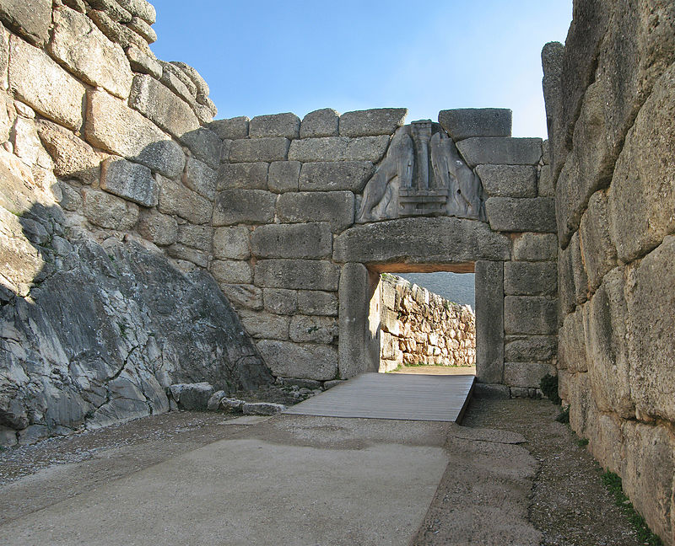
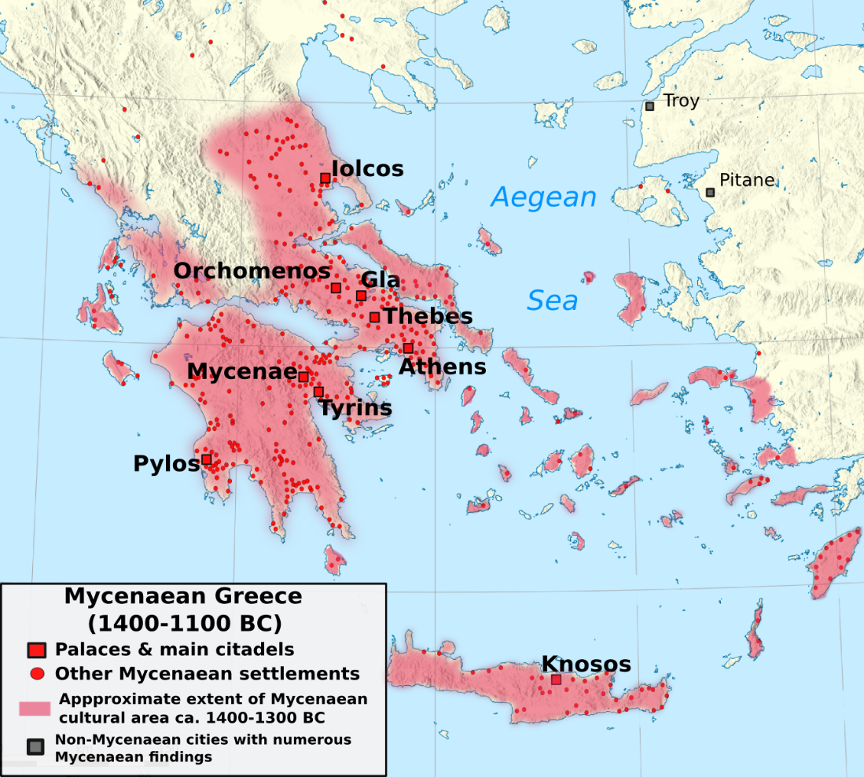

Slide 11
Greece
Around 800 BCE the polis (city-state) begin to form
Allowed people to diversify in occupations
The towns become walled cities
Each city-state had a guardian deity
Ex. Athena= Athens
They communicated with gods through oracles
Oracle of Delphi
730 BCE many city-states adopted the Phoenician alphabet and added vowels.

Slide 12
Sparta vs Athens
Sparta
Ruled by a military aristocracy
Granted rights to the citizens
Social Hierarchy:
Citizen Soldiers
“Dwellers around”- decedents of first conquered peoples.
Helots- slaves, lowest group
Women had more freedom. Ran estates but could not vote
Oligarchy: (rule by a group)
Governed by a group of elders in conjunction with two kings
Athens
Formed a democracy over a 100 years or more
507 BCE- direct democracy established
All men above 20 could join the assembly (governing body)
Women were not citizens and could not become soldiers
Athens was in direct competition with Sparta
Athens was a commercial center

Slide 13
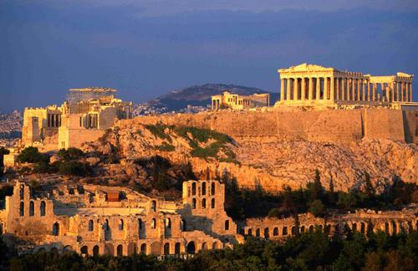
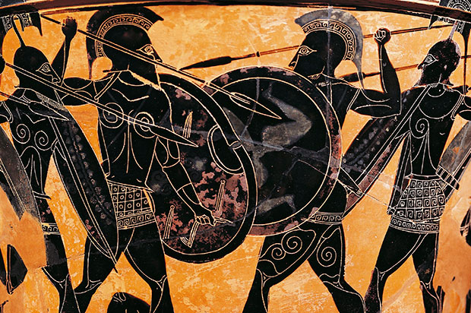
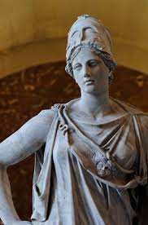

Slide 14
Persian and Peloponnesian Wars
Much of what is known of these wars come from the writings of Herodotus. A Greek historian
Persian Wars:
Greeks vs. Persians
Delian League : an alliance between city-states formed to defeat the Persians.
Falls apart after the war
1st Greek Victory at battle of Marathon (490 BCE)
Thermopylae- Stand of 300 Spartans against thousands of Persians. Persians sack Athens after this
War ends in a victory for the Greeks
Peloponnesian War: 431-404 BCE
Athens vs Sparta (each had city-states as allies)
Sparta defeats Athens in 404 BCE
Outcome:
Both city-states decline during this time
Allows the Macedonians to invade and take over the Greek city states

Slide 15
Greek Philosophers
Socrates (469-399 BCE):
Developed the Socratic Method (persistent questioning)
In 399 BCE found guilty of corrupting the youth of Athens and not believing in the gods
Did not confess and was executed
Plato (429-347 BCE):
Student of Socrates
Founded the Academy
A school for young boys and sometimes girls
Aristotle (384-322 BCE)
Student of Plato
Born in Macedon
Tutored Alexander of Macedon

Slide 16
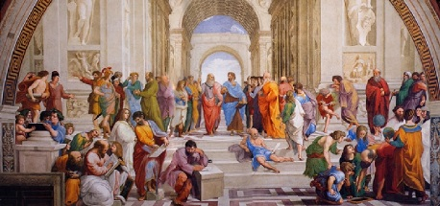
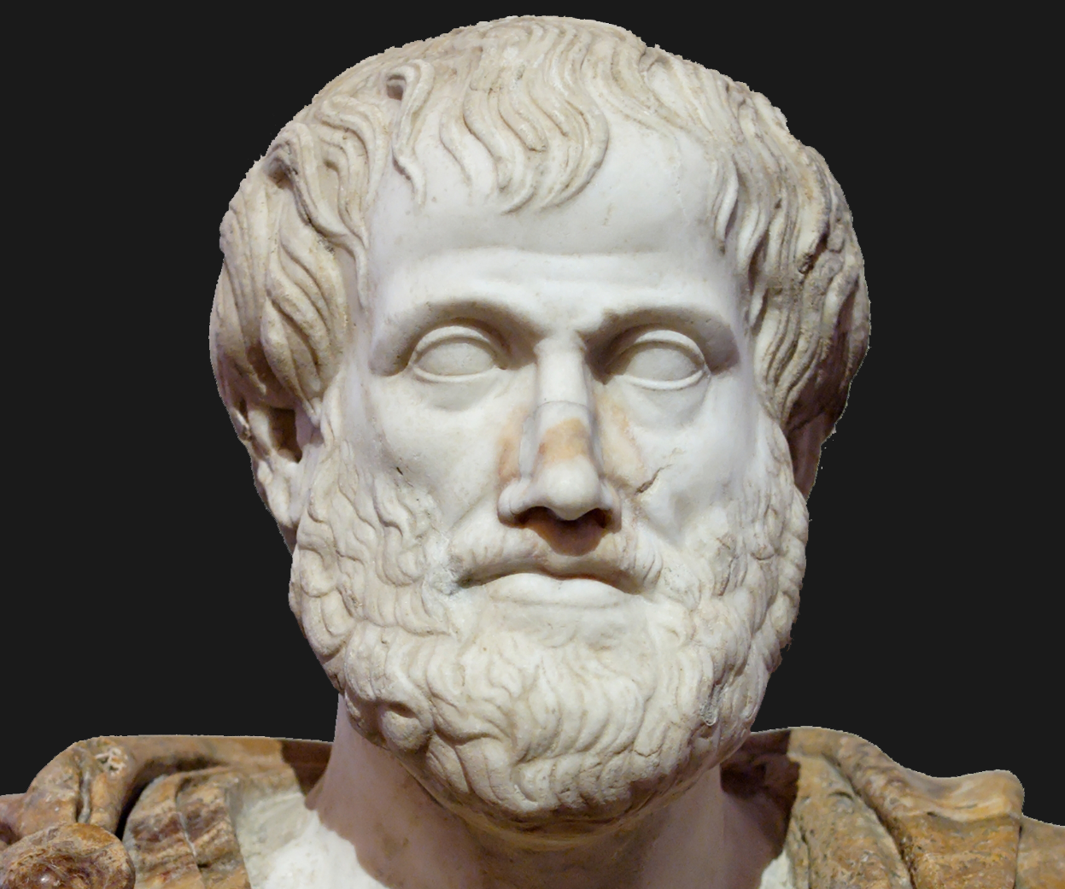
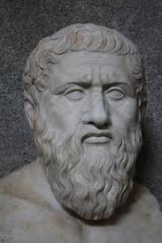
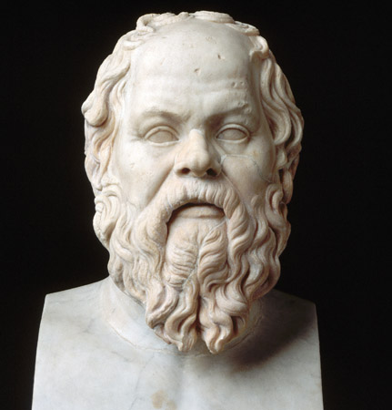

Slide 17
Philip II and Alexander of Macedon
Philip II of Macedon:
developed a massive and well equipped army
After the Peloponnesian War the Macedonian army invaded and united the Greek city-states
Philip II was assassinated in 336 BCE
He was succeeded by his son, Alexander
Alexander the Great:
Reigned for 13 years
Defeated the Persian empire
His empire stretched from Greece to Egypt to northern India
Conquered the area in only 8 years!
Helped spread Greek culture
Adopted many aspects of Persian governance and culture
Died in 323 BCE in Babylon

Slide 18
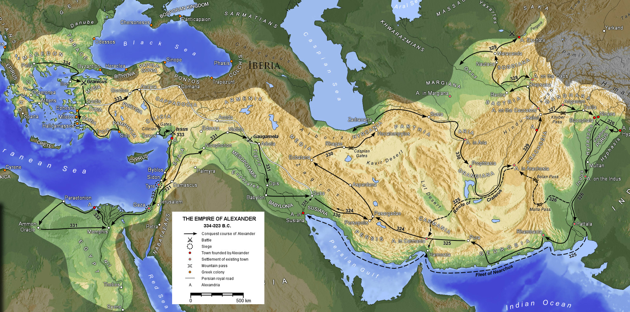
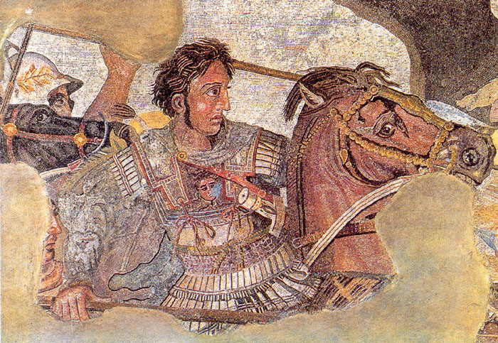

Slide 19
Hellenism
During the time of Alexander the Great Greek culture was spread throughout the known world and mixed with other cultures
In their wake the Greeks established kingdoms run by Alexander's former generals
Ptolemy- Egypt
Antigonas- Greece and Macedon
All other territories to Seleucus
In Egypt the city of Alexandria becomes a center of learning
Library of Alexandria was the largest in the classical world

