Slide 1
Medieval Europe

Slide 2
Introduction
The period began after the collapse of the Western Roman Empire
Also known as the dark ages
The population declined and became more rural
The center of learning shifted to the Middle East and the Islamic world
In Europe only the priests, monks, and some of the noble class could read and write

Slide 3
The Church: Political and Spiritual Power
Popes follow Roman organization
Monasticism
Benedict of Nursia
Benedictine rule- promoted Christian unity
Spiritual functions- Holiness, Network, Pilgrimage centers
Secular functions- Education, Large estates, Shelter travelers
Universities- form in the 13th century

Slide 4
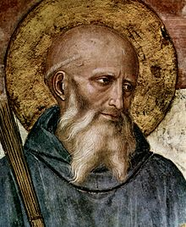

Slide 5
Charles Martel and Charlemagne
Charles Martel and the Franks stopped the spread of the Islam into northern Europe
Battle of Tours in 732
Charles the Great (Charlemagne)
800- crowned emperor
Copied roman centeral administration
After his dearth in 814 his empire frgaments

Slide 6
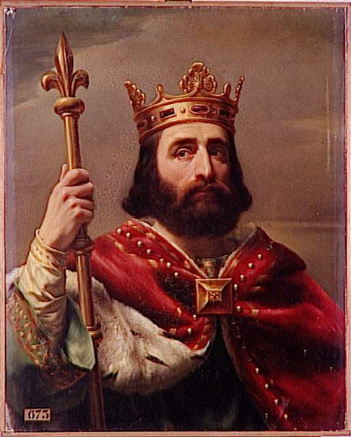
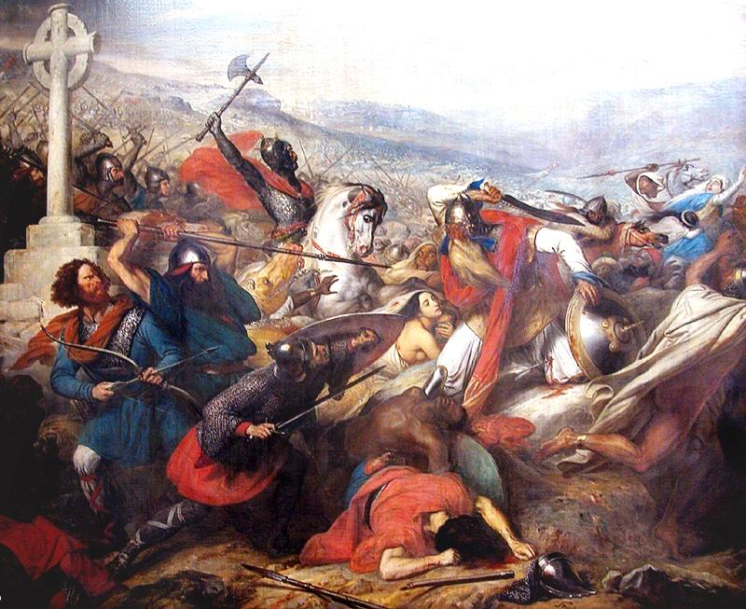
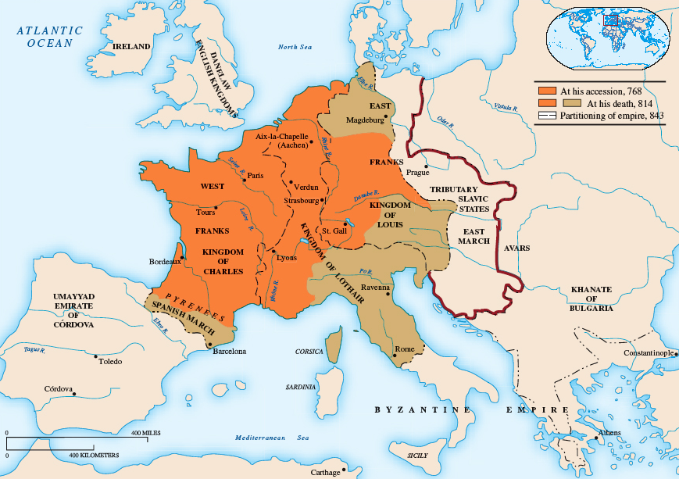
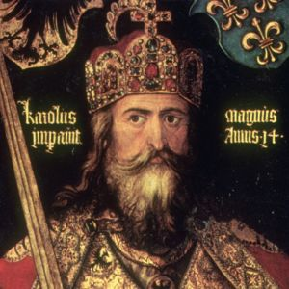

Slide 7
A New Empire Emerges
The Hole Roman Empire
962-1806
Ruled over Germany and most of northern Italy

Slide 8
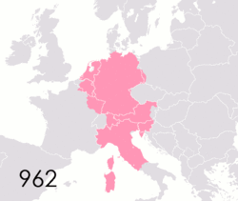

Slide 9
Feudalism emerges
Feudalism emerges as a new political system
Relationships created between lord and vassal
William the Conqueror (from Normandy)
1066- Norman conquest of England
Introduces centralized government to England
Established sheriffs and courts

Slide 10
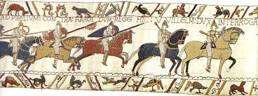
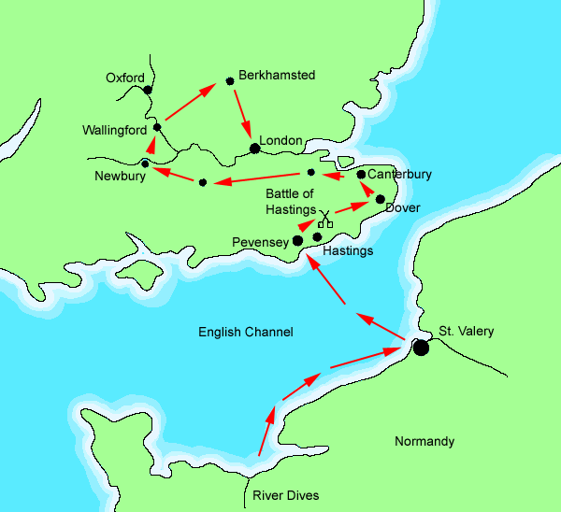
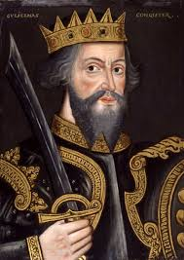

Slide 11
Economic and Urban growth
Agriculture:
Three-field system- a third of the farm land is left unplanted to regain fertility.
Towns grow
Education
Literacy expands
Cathedral schools- form in the 11th century
Universities- form in the 13th century

Slide 12
Limited Government and continued Conflicts
1215, Magna Carta (Great Charter) (England)
King John recognizes supremacy of written law
Representative Bodies
England- 1265: Parliament- two houses : house of lords and house of commons
Monarchs continue to increase in power
Large conflicts
Hundred Years War
England vs France claims to the throne of France

Slide 13
The Crusades
Called for by Pope Urban II, 1095
Initial success
New contact with Islam
Christian knights bring back new technology and ideas

Slide 14
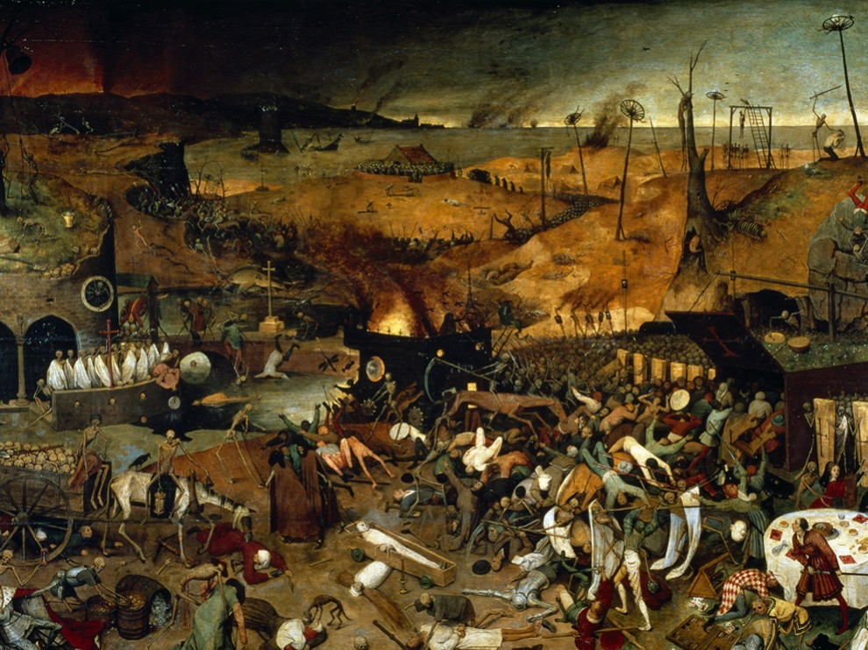

Slide 15
The Plague
Originated in Central Asia
In Europe it arrived in Italy first (southern Europe)
Carried by the Oriental Rat Flea on the back of rats
Has a religious, economic, and social impact on European history
Carried east and west along the Silk Road by traders and Mongol Armies
1340s- disease had struck China, India, and Persia
Many felt that the diseases was a punishment from God
Caused religious fanaticism to increase

Slide 16
3 Types
Pneumonic
Attacked the Lungs
Caused fierce coughing & sneezing fits
Chest pain, Bloody sputum
Septicemic
Rarest and Deadliest
Traveled thru bloodstream
Black spots beneath skin
Victims choked on own blood, Excruciating Pain!
Bubonic
Most Common
Egg-sized swellings (buboes)
Neck, armpits, groin (dark blisters)
Headaches, Weakness, Nausea/Vomiting
Severe Fever and Delirium

Slide 17
Results of the Plague
People persecuted heretics to try to please god.
Jews, Friars, Foreigners, Pilgrims, Beggars, Lepers
Between 75 and 200 million people died in Europe and Asia
Estimated that between 25%-60% of Europe’s total population was killed
The loss of life caused labor shortages throughout Europe
Ends the feudal system
By the 1350s the worst epidemic had run its course

Slide 18
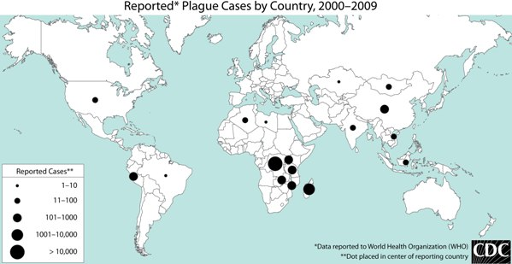
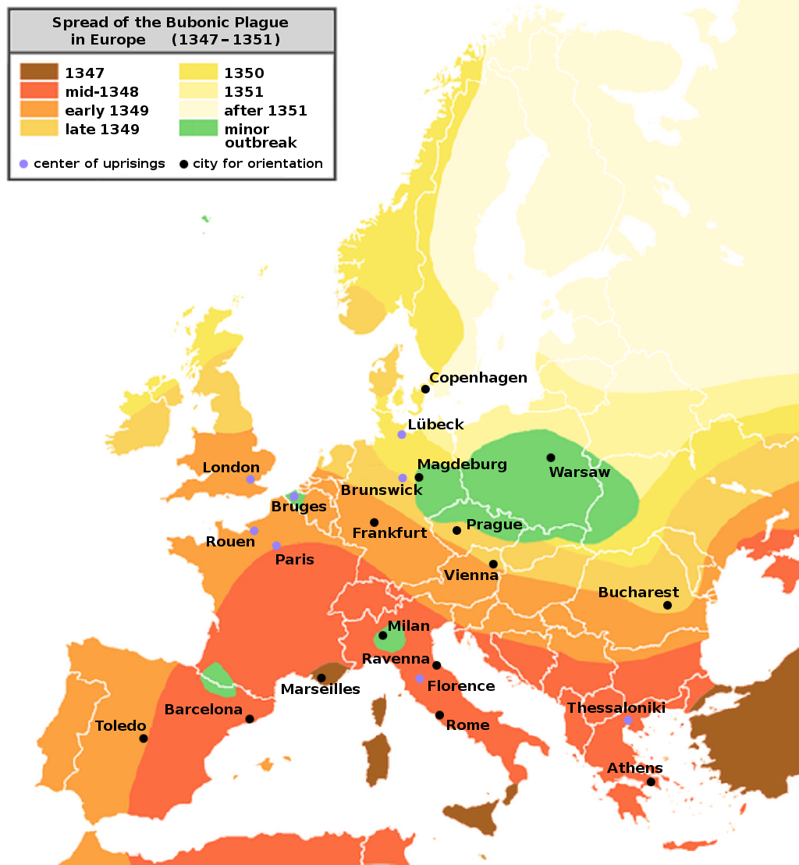
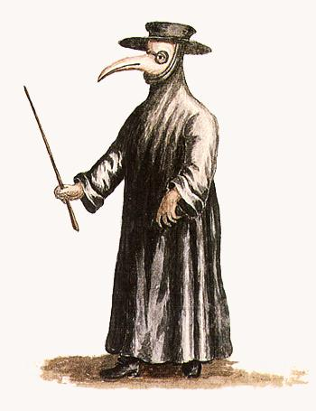

Slide 19
Nursery Rhyme
Ring-a-round the rosie, A pocket full of posies, Ashes! Ashes!
We all fall down
Does this nursery rhyme have a darker meaning than a happy children's song

