Slide 1
Africa in the Middle Ages and Kingdoms of the Grasslands

Slide 2
Introduction
Common Elements in African Societies:
Bantu Migration – some mutual language
Religion
Animistic religion
Belief in evil – produced witchcraft
Cosmology
Spirits & gods

Slide 3
Stateless Societies
Organized around kinship
Lacking concentrated political power & authority
Power exercised by rulers or a council of families
No taxes
Some secret societies
Many thrived

Slide 4
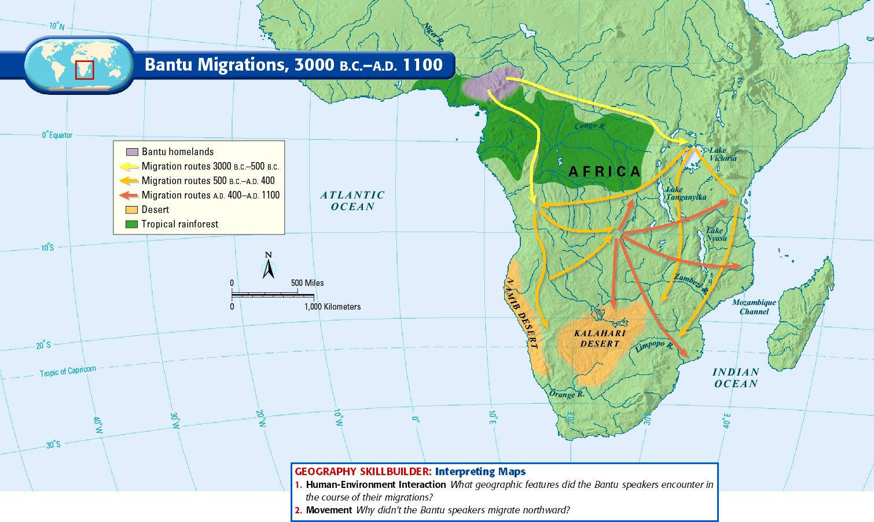

Slide 5
Christian Kingdoms: Nubia & Ethiopia
Christianity first universal religion in Africa
Copts – Egyptian Christians
Allowed to keep faith by Muslims
Spread to Nubia
Axum Christians in Ethiopia
King Lalibela
Built Christian state

Slide 6
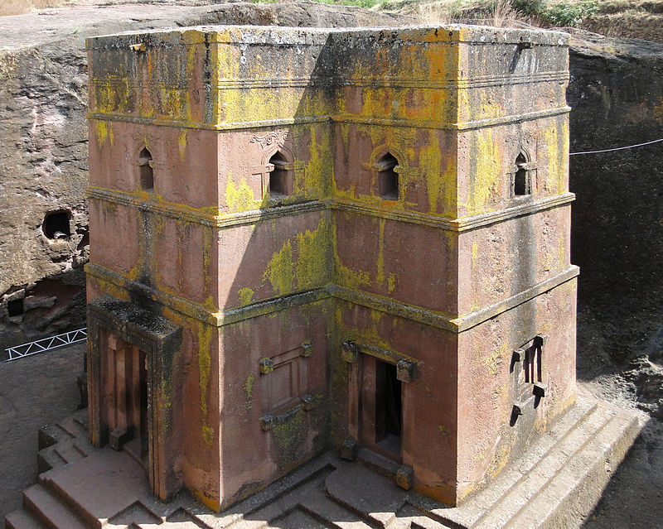
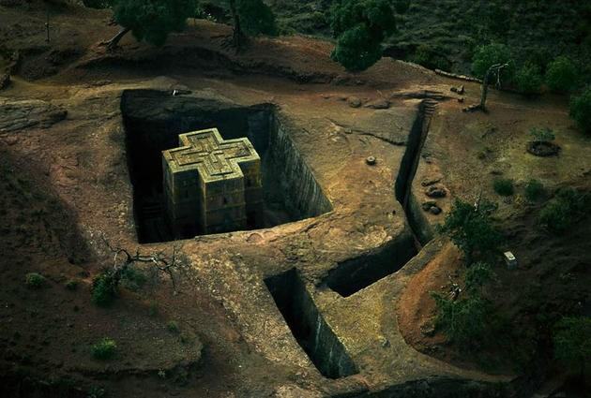
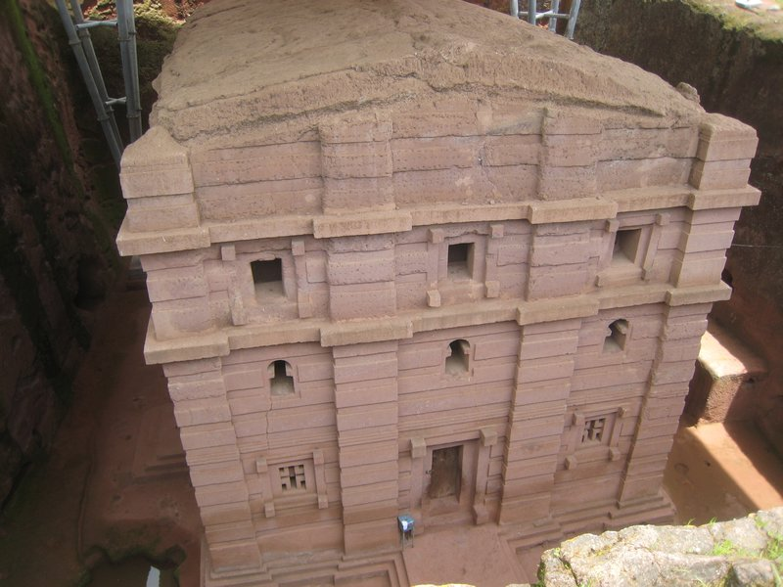
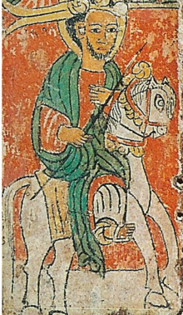
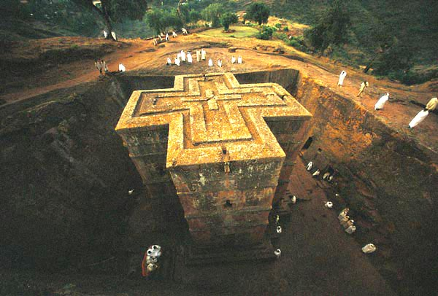

Slide 7
Grassland Kingdoms
Islam spread via travelers & merchants
Three important coasts: Atlantic, Indian, & the savanna on the southern edge of the Sahara
Ghana was powerful
Taxed salt & gold

Slide 9
Sudanic States
Patriarch or council of elders as leaders
Rulers considered sacred
Islam was adopted by rulers, but not most of the population
Islam became a “royal cult”
Islam reinforced indigenous ideas of kinship
Mali & Songhay – important cultures!!!

Slide 10
Empire of Mali and Sundiata & the “Lion Prince”
Malinke people from Ghana
Rulers supported Islam
Agricultural economy
Juula – Malinke merchants
Gold

Slide 11
A. Sundiata – mansa (ruler)
Griots – oral historians
Expanded territory
Divisions of social arrangements
Ibn Battuta – Berber Traveler
B. Mansa Kankan Musa (1312 -1337) 2nd ruler of Mali
Pilgrammage to Mecca
Ishal al-Sahili
Architect from Muslim Spain
Used beaten clay to build

Slide 12
City Dwellers & Villages
Jenne & Timbuktu – two important trading cities and centers of learning
Thrived with expansion on Mali, Songhay
Life centered on agriculture & the villages
Polygamy
The hoe & bow symbol of the common people of Savanna states

Slide 13
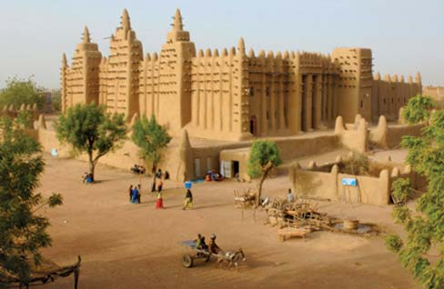
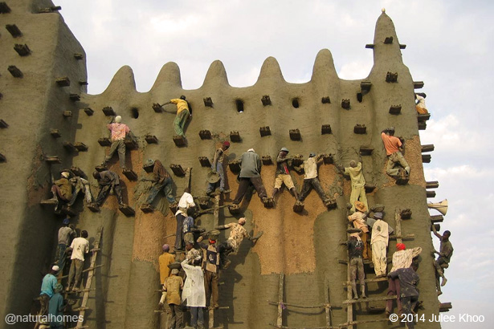

Slide 14
The Songhay Kingdom
Middle Niger Valley
“masters of the soil”
Independent 7th century
Muslim by 11th century
Sunni Ali (1464-1492): 1st king
Expanded territory
Succeeded by Askia
Muhammad the Great
Muslims uneasy with pagan populations, the local interpretation of Islamic law, & the free mixing of men and women

Slide 15
Songhay defeated by Muslims from Morrocco
Hausa states- took control of the region
Kano becomes Muslim center

Slide 17
Political and Social Life in the Sudanic States
Common religion and law (Sharia) provided solidarity
Islam fused with indigenous traditions
Many converts kept old beliefs
Slavery and slave trade between black Africa and the rest of the Islamic world impacted women and children
In theory, Muslims viewed slavery as a process of conversion for pagans
Slaves had many roles in the Islamic world

