Slide 1
Japan’s Reunification and first Challenge

Slide 2
Introduction
Since the mid-15th century Japan was made up of 300 small feudal kingdoms.
By the mid-16th century the Japanese had found leaders to restore unity under the Tokugawa Shogunate
Three military leaders who restored unity:
Nobunaga
Toyotomi Hideyoshi
Tokugawa Ieyasu

Slide 3
Japanese Feudalism
Feudalism in Japan developed independently of European feudalism
Similar:
Divided into Social classes, King/ Emperor at the top, peasants at the bottom
Different:
Shogun had the real power, No reciprocal relationship in Japanese feudal system.

Slide 4
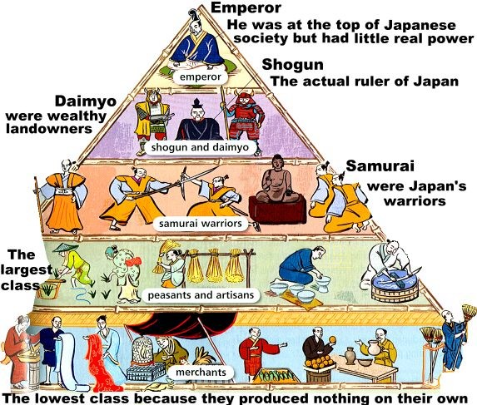

Slide 5
Attempts to Reestablish Control Nobunaga
Nobunaga
Daimyo lord
Used firearms extensively
Deposes last Ashikaga shougun in 1573
Killed in 1582

Slide 6
Toyotomi Hideyoshi
Nobunaga’s general
Rules Japan by 1590
Unsuccessfully invades Korea (Imjin War)
1592 and 1597
Succession struggle after his death in 1598
Wanted his son to succeed him, but his vassals seized power for themselves

Slide 7
Control Reestablished
Tokugawa Ieyasu
Forms Tokugawa Shogunate – appointed Shogun by the emperor
Reorganizes remaining daimyo
Ruled from Edo (Tokyo)
Tokugawa’s victory ends Japan’s civil wars
Tokugawa family rules for 250 years!!!

Slide 8
Dealing with the Europeans
Europeans had been in Japan since 1543
Missionaries & traders
Europeans brought firearms, printing press, clocks, etc…
Nobunaga protects Jesuit missionaries & allows churches to be built
Hideyoshi less tolerant of Jesuits
Christian beliefs = threat to established social order

Slide 9
Japan’s Self-Imposed Isolation
Measures taken to restrict foreign activities in Japan in 1580’s
Christianity persecuted in the 1590’s and banned in 1614 by Tokugawa Ieyasu
Those who refused to renounce faith were imprisoned, tortured, or killed
Ieyasu increases isolation & restricts foreign merchants in 1616
Japanese ships forbidden to sail overseas by 1630

Slide 10
By 1640, only the Dutch (Netherlands) and the Chinese were allowed to visit the island Deshima
By mid 17th century Japan was completely isolated
Neo-Confucian revival replaced by the school of National Learning
Emphasizes Japan’s unique history

Slide 11
Japanese Culture Endures
During the civil war periods and through limited European interactions Japanese culture continued to remain strong.
Shintoism continued to be the dominate religion practiced
Haiku became the favorite style of poetry
Kabuki theaters helped to entertain the people by using elaborate dace and costume
The samurai code of Bushido remained the foundation of the warrior class

