Slide 1
Japan: from Isolation to Equality
1867-1914

Slide 2
The End of the Shogunate
Japan’s 200 year self-imposed isolation under the Tokugawa Shogunate ends 1853
Commodore Mathew Perry of the United States Forced Japan to open up its markets to foreign trade
Regional leaders decide to remove Shogun
stood in way of modernization
Meiji Restoration began as regional revolt
Ended with confiscation of Shogun’s land and restoration of direct rule by the emperor assisted by daimyo in 1868
This is known as the Meiji Restoration
Meiji was the imperial name of the emperor of Japan
He is the great-great grandfather of the current emperor of Japan

Slide 4
Policies of the Meiji Government
Seek knowledge of world with two year tour
Import advisors in industry & agricultural
130 foreigners in government by 1879
Restructure Government
Daimyo give lands to emperor & become governors
War with those who won’t
Create western style army using German model
In just 50 years Japan goes from a feudal society to a modern industrialized nation

Slide 5
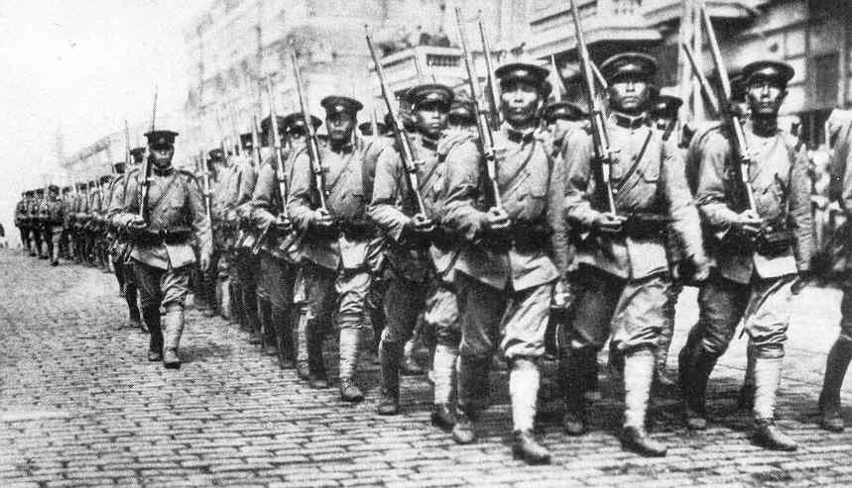
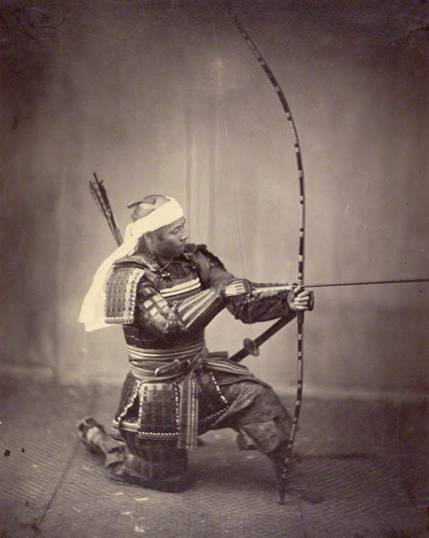

Slide 6
Restructuring the Economy
Revitalized agriculture yields
landlord profit from investment in commerce and industry
Government finances early industrial ventures
Urbanization
Existing cities become regional capitals
New cities combined old businesses and entertainments with new westernized sectors

Slide 7
Cultural and Educational Change
Westernization in fashion, calendar & measurements are adopted
Extensive study of western writings including
Centralized, compulsory education
Ninety percent of boys and girls attend school by 1905

Slide 8
Gender Relations
Restoration of emperor reinforced male control of household
Women & minors barred from political activities
Women will gain vote after World War II
Women have few legal rights after 1898 Civil Codes
Goal of women’s education in Japan was to create “good wives and wise mothers”

Slide 9
War, Colonialism & Equality in the Family of Nations
Seek control of tariffs--done by 1911
Expanded into Korea & Manchuria makes
Japan, not China, the dominant East Asian power
Equality with Europe in 1902 alliance with Britain
Japan is recognized as a world power
Defeat of Russia during the Russo-Japanese War in 1905 underscores possession of “great power” military
Annex Korea, 1910

Slide 10
